Slide 1
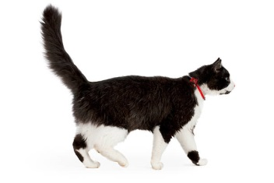
!!!!!!!!!!!!!!!!!!!!!!!!!!!!!!!!!!!!!!!!!!!!!!!!!!!!!!!!!!!!!!!!!!!!!!!!!!!!!!!!!!!!!!!!!!!!!!!!!!!!!!!!!!!!!!!!!!!!! !!!!!!!!!!!!!!!!!!!!!!!!!!!!!!!!!!!!!!!!!!!!!!!!!!!!!!!!!!!!!!!!!!!!!!!!!!!!!!!!!!!!!!!!!!!!!!!!!!!!!!!!!!!!!!!!!!!!!
Catch the Cat!

