Slide 1
Radar Data Processing Assignment
Moshe Ohana
Tools: Python, NumPy, Streamlit, multiprocessing
Goal: Optimize radar data storage, computation, and visualization.

Slide 2
Storage Optimization (Task 3.1)
Goal: Reduce storage size without losing information.
Approach: Analyzed .npz fields
Applied dtype downcasting (float64 → uint8/bool)
Used compressed save (np.savez_compressed)
Results:
Original: 6.87 MB → Optimized: 2.27 MB (~67% reduction)
Explanation: Smaller numeric types and compression drastically reduced file size.

Slide 3
RMS Optimization (Task 3.2)
Goal: Speed up RMS computation.
Baseline: Naive implementation with nested loops.
Optimization: Vectorized operations using NumPy, reduced Python overhead.
Results:
• Baseline: 46.02 ms
• Optimized: 1.08 ms (×42.8 faster)
Key insight: Vectorization significantly improves performance.

Slide 4
Parallelization (Task 3.2 Extension)
Goal: Process many files concurrently using multiprocessing.
Implementation: multiprocessing Pool with 7 workers, chunksize=35.
Results:
• Serial: 88.84s
• Parallel: 27.43s
• Speed-up: 3.24×
Conclusion: Parallel execution fully utilized CPU cores, reducing total runtime by ~70%.

Slide 5
UI Dashboard (Task 3.3)
Goal: Build an interactive visualization dashboard using Streamlit and Plotly.
Features:
• Upload .npz file
• Interactive time-series (zoom/pan)
• Histograms for signal, signal_quality, heart_state
• Subsampling for performance

Slide 6
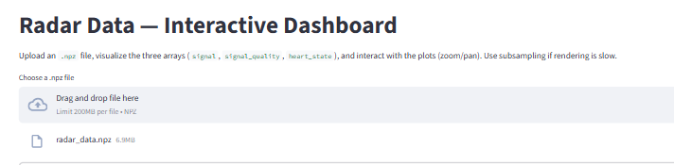

Slide 7
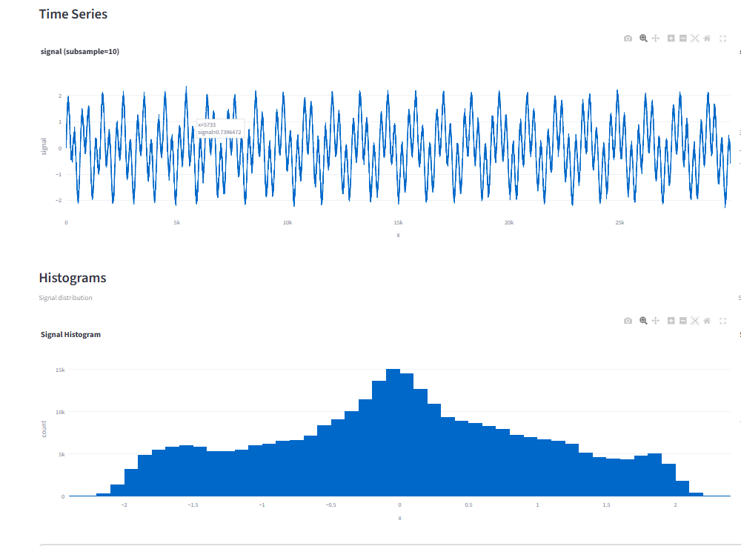

Slide 8
Summary & Reflections
Summary:
• Task 3.1: ~67% storage reduction
• Task 3.2: 43× faster RMS computation
• Task 3.2 Extension: 3.2× speed-up
• Task 3.3: Interactive Streamlit UI
Reflections:
• Learned efficient data handling and multiprocessing.
• Balanced accuracy and performance.
• Created usable visualization tool.

