Slide 1

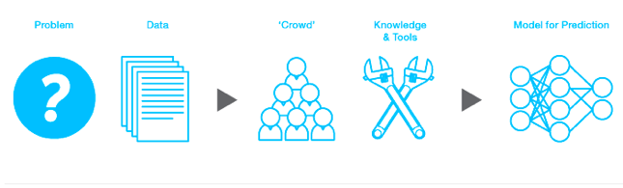
A platform for predictive modeling competitions.
“We're making data science into a sport.”

Slide 2
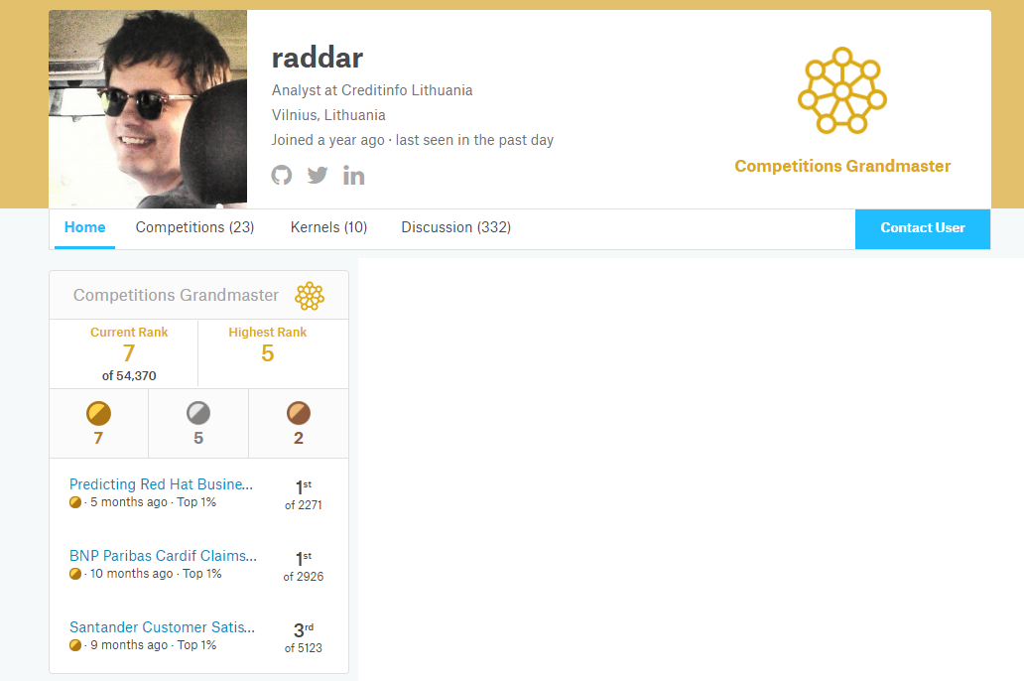
Tips & tricks to win data competitions

Slide 3
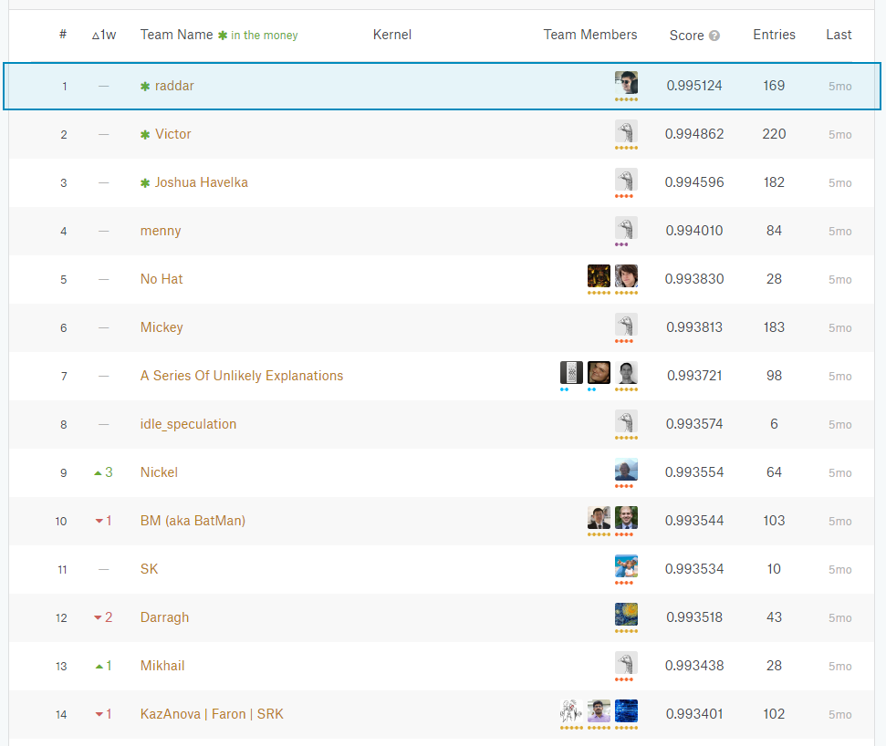
Kaggle –
What’s so fun about it?
Real-time standings - competitive spirit of a game
Cooperate with anyone to learn from each other
Improve or learn new skills from shared scripts in forums
Overall profile rankings on past competition performance – added value to data science profiles
Friendly and helping community
And of course nice prizes for top finishers ☺

Slide 4
How does it all work?
1. Build model using training samples with known labels
2. Make predictions on test samples
TRAINING SET
TEST SET - PUBLIC
TEST SET - PRIVATE
3. Submit model predictions on “unseen” data and get quick response in public leaderboard standings
4. Final standings based on Private test predictions

Slide 5
Cross-validation – the basics
TRAINING SET
TEST SET
1. Make random training set splits
2. Run models on all-but-one subsamples
3.Infer information from CV models
CV1 + CV2 => validate CV3
CV1 + CV3 => validate CV2
CV2 + CV3 => validate CV1
CV1
CV2
CV3

Slide 6
NO GOLDEN RULE WHICH IS BETTER!
#1 better on smaller datasets, simpler code
#2 preferred on larger datasets, faster iterations
#2 > #1 for many top kagglers – but situational
Using CV results
TRAINING SET
TEST SET
#1
CV1
CV2
CV3
mean(p(CV1+CV2),p(CV1+CV3),p(CV2+CV3))
#2
CV1
CV2
CV3
TEST SET

Slide 7
Public leaderboard – don’t be fooled
TIP #1 – DO NOT OVERFIT PUBLIC TEST SET
Random forest example – tuning number of trees with no proper validation
Model | Public test score | Private test score
Number trees 200 | 0.812 | 0.815
Number trees 300 | 0.814 | 0.819
Number trees 400 | 0.816 | 0.820
Number trees 500 | 0.814 | 0.821
Number trees 450 | 0.817 | 0.819
Number trees 430 | 0.818 | 0.816
… many attempts later … | Maximum public LB score | Seems good right? – often NO!
Number trees 437 | 0.820 | 0.814
#500 < #400 => test if #450 is good? => public LB score confirms it! => spurious results
Rule of thumb – the less submissions you make, less likely you have overfitted to LB solution!

Slide 8
Should I even trust public leaderboard?
TRAIN
TRAIN
NO
PUBLIC TEST
MAYBE
PUBLIC TEST
PRIVATE TEST
PRIVATE TEST
Time
Time
TRAIN
PUBLIC TEST
TRAIN
PUBLIC TEST
PRIVATE TEST
PRIVATE TEST
MUST
YES
Time
Time

Slide 9
CV or LB?
TIP #2 – TRUST YOUR CV
Typical question on smaller datasets:
“I’m doing proper cross-validation and see improvements on my CV score,
but public leaderboard is so random and does not correlate at all!”
What to trust
CV?
Public LB score?
Cross-validation AUC behavior
Public LB score behavior
Both seem valid choices ?!
1) is better 90%+ of the time (other 10% due to luck)

Slide 10
CV or LB?
TIP #2 – TRUST YOUR CV
Typical question on smaller datasets:
“I’m doing proper cross-validation and see improvements on my CV score,
but public leaderboard is so random and does not correlate at all!”
What to trust
CV?
Public LB score?
Cross-validation AUC behavior
Public LB score behavior
Top kagglers’ pick most of the time:
3) X*CV + (1-X)*LB
Typically X=0.5 is ok
Both seem valid choices ?!
1) is better 90%+ of the time (other 10% due to luck)

Slide 11
What if I don’t trust my CV?
TIP #2 – TRUST YOUR CV
Solution: repeat CV splitting with different seeds and train even more equivalent models!
CV
#1
#2
#3
#4
#5
#6
#7
#8
#9
#10
CV | CV | CV | CV | CV | CV | CV | CV | … | CV
#1 | #1 | #1 | #1 | #1 | #1 | #1 | #1 | … | #1
#2 | #2 | #2 | #2 | #2 | #2 | #2 | #2 | … | #2
#3 | #3 | #3 | #3 | #3 | #3 | #3 | #3 | … | #3
#4 | #4 | #4 | #4 | #4 | #4 | #4 | #4 | … | #4
#5 | #5 | #5 | #5 | #5 | #5 | #5 | #5 | … | #5
#6 | #6 | #6 | #6 | #6 | #6 | #6 | #6 | … | #6
#7 | #7 | #7 | #7 | #7 | #7 | #7 | #7 | … | #7
#8 | #8 | #8 | #8 | #8 | #8 | #8 | #8 | … | #8
#9 | #9 | #9 | #9 | #9 | #9 | #9 | #9 | … | #9
#10 | #10 | #10 | #10 | #10 | #10 | #10 | #10 | … | #10
Average

Slide 12
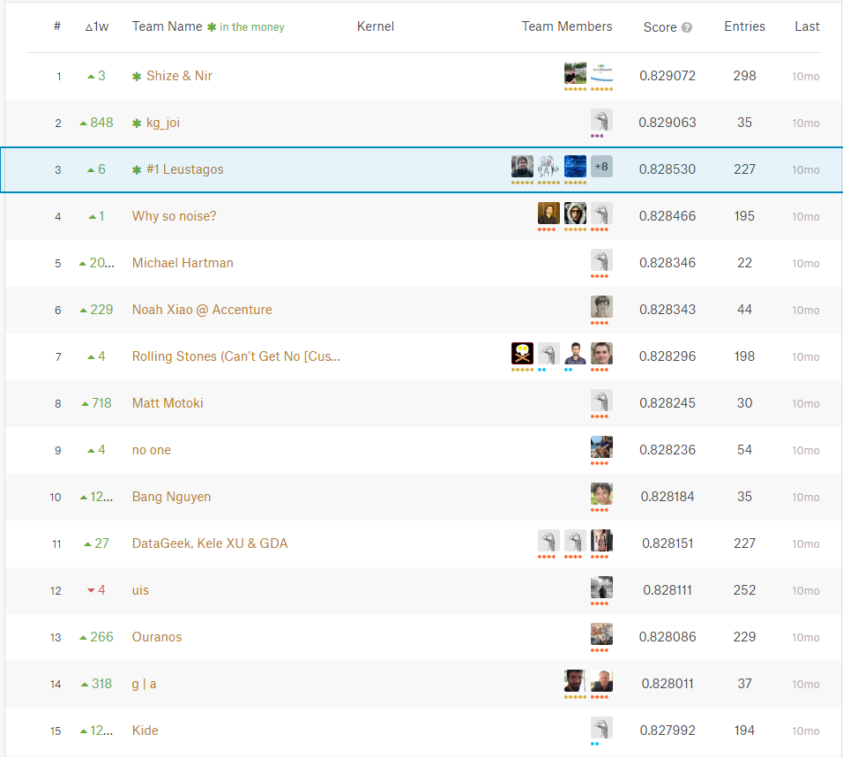
Santander competition:
“small” data – many fast modelling iterations for everyone
Many people over-tuned parameters to fit public leaderboard in order to maximize their standings
CV and public LB scores had scissors like relationship
The ones who trusted CV-based submissions had much lower ranking variation in final standings
Teams who discarded best public LB submissions stayed in top (my team included)
Trusting CV was hard thing to do – we did it repeated 20-times
Trusting CV – ultimate example

Slide 13
Bootstrap aggregating – in short: bagging
TIP #3 – BAGGING IS IMPORTANT
Bagging ~= averaging similar models
Bias-variance tradeoff:
reduced variance penalty of a classifier
Seed1
Seed2
Seed3
Average
Lucky seed phenomena
Model
Same model but with less variance!
A model may suffer from initial parameters of your classifier
(may overestimate or underestimate your potential score)
bias is not very important – competitors suffer from bias too (with similar degree)

Slide 14

Ways to deal with categorical features
One hot encoding – create bag-of-words (bag the size of unique categories) and assign 0/1’s for each representing column. Will fail on new categories.
Label encoding – label each category into space. Will fail for new categories
Features with many categories - rows:categories ratio 20:1 or less
Count encoding – count number of each category and use counter as a value. Iterate counter for each CV fold
Hash encoding – mapping categories to reduced category space and do one hot encoding. Produces good results but may be sub-optimal.
Category embedding – use a function (autoencoder) to map each category to Euclidian space
Likelihood encoding – apply label average (likelihood) for each category
Encode categories appearing 3+ times – reduce training feature space with no loss of info
Dealing with NA’s depend on situation. NA itself is an information unit! Usually separate category is enough.

Slide 15
Likelihood encoding
TIP #4 – AVOID LABEL LEAKAGE TO TRAINING SET
Imagine having categorical feature with 100k different values on 1M dataset –
one hot encoding each category => dimensionality curse for any model
How not to do it!
X1 | Label | X1m
“A1123” | 0 | 0.5
“A1123” | 1 | 0.5
“A1123” | 1 | 0.5
“A1123” | 0 | 0.5
“A1123” | NA | 0.5
Label information of each row was transferred into independent variable X1m – label now has indirect dependence to itself - label leakage introduced!

Slide 16
Likelihood encoding
TIP #4 – AVOID LABEL LEAKAGE TO TRAINING SET
How to do it? Might work but risky
X1 | Label | X1m
“A1123” | 0 | 0.666 + rand(0,sigma)
“A1123” | 1 | 0.333 + rand(0,sigma)
“A1123” | 1 | 0.333 + rand(0,sigma)
“A1123” | 0 | 0.666 + rand(0,sigma)
“A1123” | NA | 0.5
Problem: selecting optimum sigma value is painful and depends on how much you regularize your model
Holdout set might help but not always

Slide 17
Likelihood encoding
TIP #4 – AVOID LABEL LEAKAGE TO TRAINING SET
How to do it? Works well but may underperform
X1 | Label | X1m
“A1123” | 0 | CV out-of-fold prediction
“A1123” | 1 | CV out-of-fold prediction
“A1123” | 1 | CV out-of-fold prediction
“A1123” | 0 | CV out-of-fold prediction
“A1123” | NA | CV predictions average
Nested cross-validation and high number of CV folds for your model is highly recommended
Additional CV calculations are done within each model CV fold. Tricky and prone to errors method.
Problem: some degree of loss of information due to CV scheme
Good option for larger datasets

Slide 18
Categorical features – interactions!
If interactions are natural for a problem - ML only does approximations! => sub-optimal
Always test your method with all explicitly created possible 2-way interactions
Interactions feature selection may be important due to exploding feature space (20 categorical features => 20*19/2 interactions!)
If 2-way interactions help – go even further (3-way, 4-way, …)
Applying previous category transformations may be necessary
Interaction example
X1 | X2 | X1*X2
A | C | AC
B | R | BR
A | R | AR
A | C | AC
B | R | BR
B | R | BR

Slide 19
Numeric features
Feature transformations to consider:
Scaling – min/max, N(0,1), root/power scaling, log scaling, Box-Cox, quantiles
Rounding (too much precision might be noise!)
Interactions {+,-,*,/}
Row counters – #0’s, #NA’s, #negatives
Row stats (if makes sense) – min, max, median, skewness…
Row similarity scoring – cosine similarity
Clustering
…
Sometimes numeric features are categorical or even ordinal by nature - always consider that!
Tree methods are almost invariant to scaling.
Linear models (including NN’s) need careful raw data treatment!

Slide 20
Methods
Regularized GLMs (underperforming but good ensembling material)
XGBoost (top pick for traditional data)
LightGBM (top pick for traditional data)
Keras (NN’s are always good with good pre-processing)
LinearSVM (non-linear is resource hungry and usually not worth it)
Vowpal Wabbit (extremely fast online learning algorithms)
Random forests (used to be popular, underperforming to GBM’s now)
To achieve maximum, each method requires good understanding of how they work and how they should be tuned

Slide 21
Tuning parameters – expert approach (xgboost)
Tuning parameters = experience + intuition + resources at hand
Typical routine:
Set learning rate (eta) parameter 0.1-0.2 (based on dataset size and available resources); all other parameters at default; personal experience: eta does not influence other parameter tuning!
Test maximum tree depth parameter, rule: 6-8-10-12-14; pick best performing on CV
Introduce regularization on leaf splits (alpha/lambda), rule: 2^k; IF it helps on CV, try to tune it as much as possible!
Tune min leaf node size (min_child_weight), rule: 1-0-5-10-20-50; IF it helps on CV, try to tune it as much as possible; IF it does not help, use value 0 (default = 1 is worse most of the times!); If 3-4 works – repeat step 2.
Tune randomness of each iteration (column/row sampling); Usually 0.7/0.7 is best and rarely needs to be tuned
Decrease eta to value which you are comfortable with your hardware; 0.025 is typically a good choice; lower values than 0.01 don’t provide significant score uplift
If training time is reasonable, introduce bagging (num_parallel_trees) – how many models should be averaged in each training iteration; random forests + gradient boosting ☺ recommended value - up to 5.

Slide 22
Tuning parameters – non-expert approach
Naive approach : apply grid search on all parameter space
Zero effort and no supervision
Enormous parameters’ space
Very time consuming
Bayesian optimization methods : trade-off between expert and grid-search approach
Zero effort and no supervision
Grid space reduced on previous iterations’ results (mimic expert decisions)
Time consuming (still)
Golden rule : finding optimal parameter configuration rarely is a good time investment!

Slide 23
Competitive advantage
Get good score in public LB as fast as possible (if you intend to team up with experienced people)
Fail fast & often / agile sprint / fast iterations
Use many different methods and remember to save all your models (both CV and test runs)
Invest into having generic modelling scripts for every method – time saver long-term
Debug, Debug, Debug – nothing worse is finding a silly preprocessing error at the last day of the competition
Write reproducible code - setting seeds before any RNG tasks
Learn to write efficient code (vectorization, parallelization; use C, FORTRAN, etc. based libs)
Learn how to look at the data and do feature engineering
Get access to reasonable hardware (8CPU threads, 32GB RAM minimum); AWS is always an option
TIP #5 – USE SAME CV SPLIT FOR ALL YOUR MODELS!

Slide 24
Competitive advantage – data flow pipeline
Ideally you would want to have a framework which could be applied to any competition;
It should be:
Data friendly (sparse/dense data, missing values, larger than memory)
Problem friendly (classification, regression, clustering, ranking, etc.)
Memory friendly (garbage collection, avoid using swap partition, etc.)
Automated (runs unsupervised from data reading to generating submission files)
Good framework can save hours of repetitive work when going from one competition to another

Slide 25
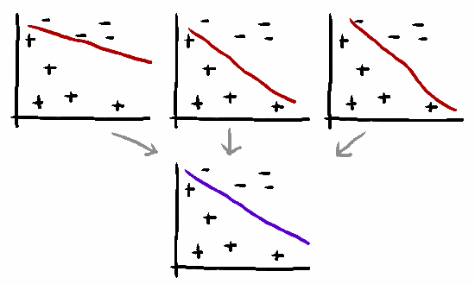
Success formula (personal opinion)
50% - feature engineering
30% - model diversity
10% - luck
10% - proper ensembling:
Voting
Averaging
Bagging
Boosting
Binning
Blending
Stacking
Although 10%, but it is the key what separates top guys from the rest
MODEL | PUBLIC MAE | PRIVATE MAE
Random Forests 500 estimators | 6.156 | 6.546
Extremely Randomized Trees 500 estimators | 6.317 | 6.666
KNN-Classifier with 5 neighbors | 6.828 | 7.460
Logistic Regression | 6.694 | 6.949
Stacking with Extremely Randomized Trees | 4.772 | 4.718
Ensembling added efficiency +30%

Slide 26
Ensembling by voting
Common application – recommendation models
1111111100 = 80% accuracy
0111011101 = 70% accuracy
1000101111 = 60% accuracy
Majority vote
1111111101 = 90% accuracy

Slide 27
Ensembling by averaging
Let’s say we have N classifiers: X1, X2, … , XN
We want to make a single prediction using weighted average:
B1*X1+B2*X2+B3*X3+…+BN*XN
TIP #6 – apply optimization for estimating ensemble weights very common mistake to select weights based on leaderboard feedback –
inefficient & prone to leaderboard overfitting
Solve the problem using CV predictions with optimization algorithms
optim(B1*X1+B2*X2+B3*X3+…+BN*XN) with starting weights Bi=1/N
Critical to control convergence criteria, as default values usually lead to suboptimal solutions!
TIP #7 - apply optim on each fold and average Bi among folds

Slide 28
Ensembling by averaging
TIP #8 – apply transformations before averaging
For ranking-based models apply rank transformation on predicted probabilities
Rank transformation makes average more robust to model prediction probability outliers
TIP #9 – always try geometric mean as an option
Rank transformed ecdf
root(X1*X2*…*XN,N)
Probability ecdf
Sometimes outperforms weighted average, when number of models is not too large

Slide 29
Stacked generalization (stacking)

Slide 30
Structure of stacked models
TIP #10 – stack of non-tuned models often outperforms smaller stack of fine-tuned models
Weaker models often struggle to compensate fine-tuned model’s weaknesses
“More is better” motivates create monster ensembles of sub-optimal models
Model selection for stacker > fine-tuning

Slide 31
Model selection for ensemble
Having more models than necessary in ensemble may hurt.
Lets say we have a library of created models. Usually greedy-forward approach works well:
Start with a few well-performing models’ ensemble
Loop through each other model in a library and add to current ensemble
Determine best performing ensemble configuration
Repeat until metric converged
During each loop iteration it is wise to consider only a subset of library models, which could work as a regularization for model selection.
Repeating procedure few times and bagging results reduces the possibility of overfitting by doing model selection.

Slide 32
Rule of thumb: data first, ML later
Score progress over duration of a competition
Create few simple models first – having a good dataflow pipeline early is very convenient
Data exploration and visualization. Might be boring and frustrating, but pays off well. Excel is underrated in this aspect☺
Think of how to make smart features; avoid using linear combinations, {/,*} is superior
Winners usually find something that most people struggle to see in data. Not many people look at the data at all!
Simple feature engineering
Basic models on raw data
Sophisticated feature engineering
Minor tweaks + ensembling

Slide 33
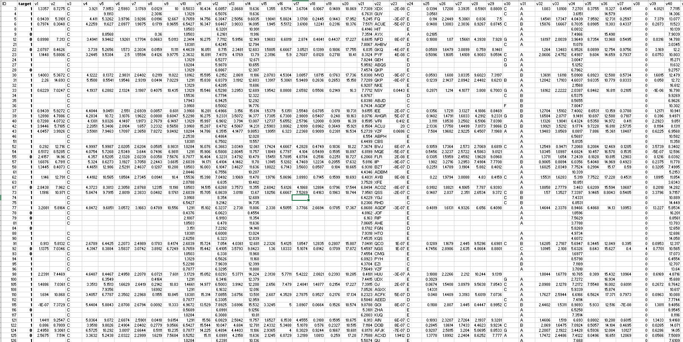
Anonymous data – usually

Slide 34
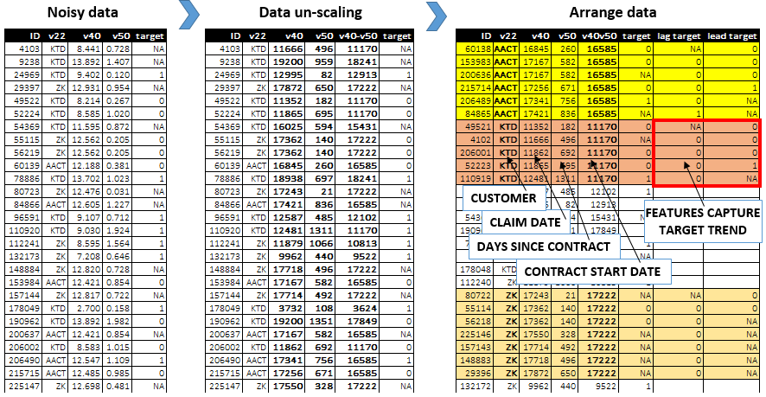
Find something that no one else can find = guaranteed top place finish
BNP Paribas competition:
Medium sized dataset with 100+ anonymous features
numerical features scaled to fit in [0; 20] interval, all looking like noise
Dedicated 3 weeks for data exploration - found something no one else did
Moving from i.i.d. dataset assumption to timetable dataset
Whole new class of time related feature engineering

Slide 35
Feature engineering - summary
Feature engineering is hard and is the most creative part in Kaggle – not many enjoy it
Typical feature transformations:
Multiplication & ratios of numeric features
Log, Box-Cox transformations
PCA, t-SNE outputs
Percentile ranks
Interactions of categorical features (A,B => “AB”), multiple levels of interactions
Lag & lead features (for timetable data)
Target likelihood ratios of categorical features
One-hot encoding/label encoding of categorical features
…
Having strong explicit features in simple models often beat monster ensembles with no feature engineering (personal experience ☺)

Slide 36
Data leakage – competition design
Sometimes competition has its flaws by data design, when you can directly infer some information from training set to test set (leakage); For example:
The order of rows matter as data rows have not been random shuffled
Same subject appears both in train & test set
Time-based data structure with improper data shuffling, etc.
Detecting and exploiting a leakage can give a significant advantage, and many people dedicate significant amount time for that.
As a result, the outcome of a competition not what a sponsor wanted to achieve.

Slide 37
Final remarks
Kaggle is a playground for hyper-optimization and stacking – for business any solution in 10% rankings is sufficient.
Teaming up is important – simple average of i.e. 9th and 10th place finishes can sometimes beat 1st place solution.
No winning solution go straight to production due to their complexity or occasional leakages.
Sponsors benefit more from forum discussions and provided data visualizations.

Slide 38
Useful links
http://mlwave.com/kaggle-ensembling-guide/
http://www.slideshare.net/OwenZhang2/presentations
http://www.slideshare.net/markpeng/general-tips-for-participating-kaggle-competitions
Must read:
https://www.slideshare.net/HJvanVeen/feature-engineering-72376750?trk=v-feed

