Slide 1
Robust Medical Segmentation with Natural UI
Shlomo Shenzis
&
Moshe Samson
Advisor:
Rafael Vivanti

Slide 2
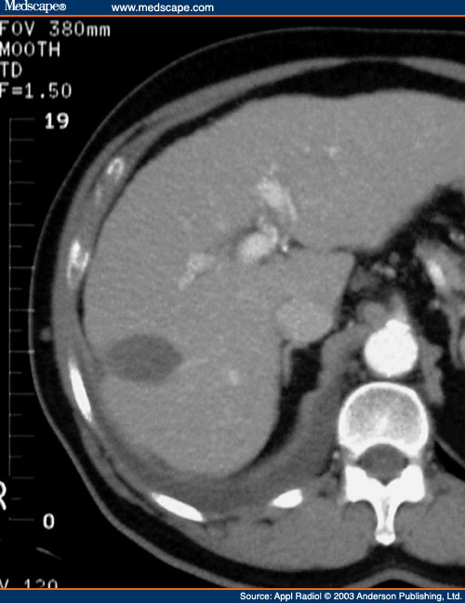
Some Background
Cancer is a group of diseases involving abnormal cell growth with the potential to invade or spread to other parts of the body.
Cancer is a leading cause of death worldwide, accounting for 8.2 million deaths in 2012
A tumor is an abnormal mass of tissue as a result of abnormal growth or division of cells.
A tumor can be cancerous or not.

Slide 3
Some Background
Measuring tumor volume is important for the evaluation of treatment response and can greatly increase chances of healing!
How can that be done?

Slide 4

Segmentation
Identifying a tumor among healthy tissue.
3 possible approaches:
Manual Segmentation
Automatic Segmentation
Semi-Automatic Segmentation.

Slide 5

Segmentation - Problems
Manual Segmentation:
A radiologist goes over the patients CT scan slice-by-slice and marks the infected regions.
Problem: An average CT scan can be as big as 140 slices!
It is a tedious and time consuming work.

Slide 6
Segmentation - Problems
Automatic Segmentation:
An algorithm receives a scan and automatically segments the infected region.
Problem: Tumors have very loose borders, they are latent by the healthy tissue.
As a result, automatic algorithms have low accuracy rate and are prone to errors.

Slide 7
Segmentation - Problems
Semi-automatic Segmentation:
An algorithm receives a scan and an initial user input, then segments the infected region using the input as a clue.
Problem: Although, semi-automatic approach has good accuracy and is more efficient then the manual approach, user input is not intuitive, hence, most radiologists don’t use it.
Moreover, the segmentation still has leaks!

Slide 8

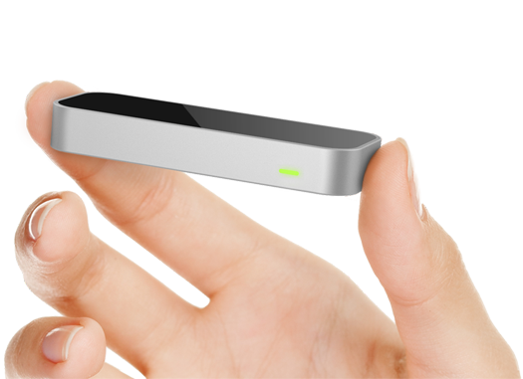
Solutions
Semi-automatic Lesion Removal Tool.
Natural User Interface –NUI

Slide 9
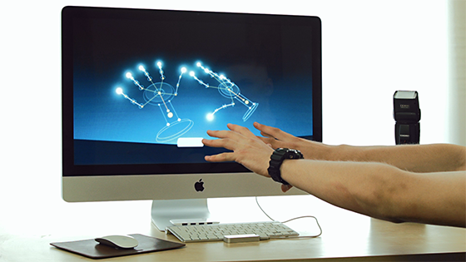
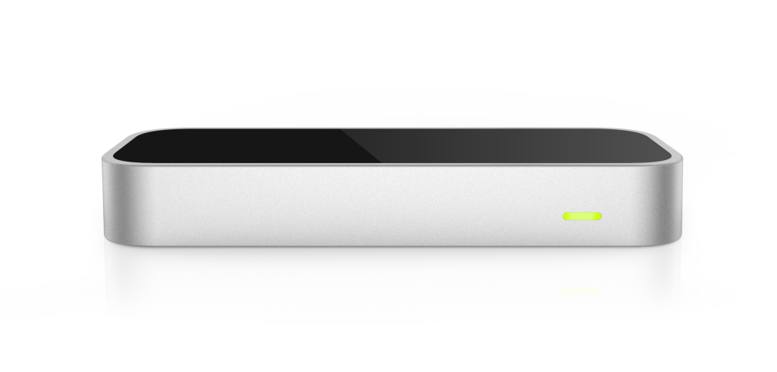
Solutions-NUI
Leap Motion is a computer hardware sensor device that supports hand and finger motions as input, analogous to a mouse, but requiring no hand contact or touching.

Slide 10
Solutions-Lesion Removal
After segmentation of the tumor a 3D mesh is composed.
A user-friendly interface lets the user mark ‘good’ and ‘bad’ regions of the resulting mesh
The special tool will then reevaluate the results and remove the leaks based on the given marks.

Slide 11

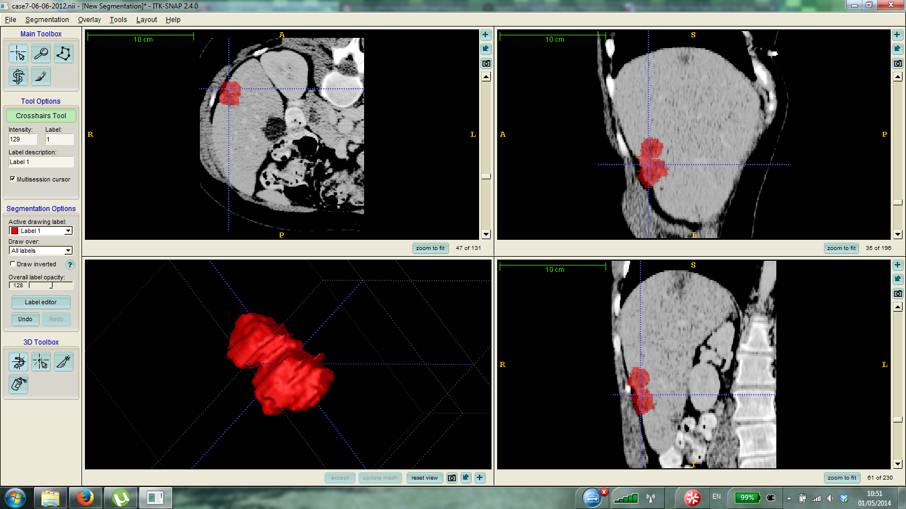

Solution - Overall
An initial 3D input is given using the pointing finger as a scroll
The algorithm segments the tumor and creates a 3D mesh

Slide 12
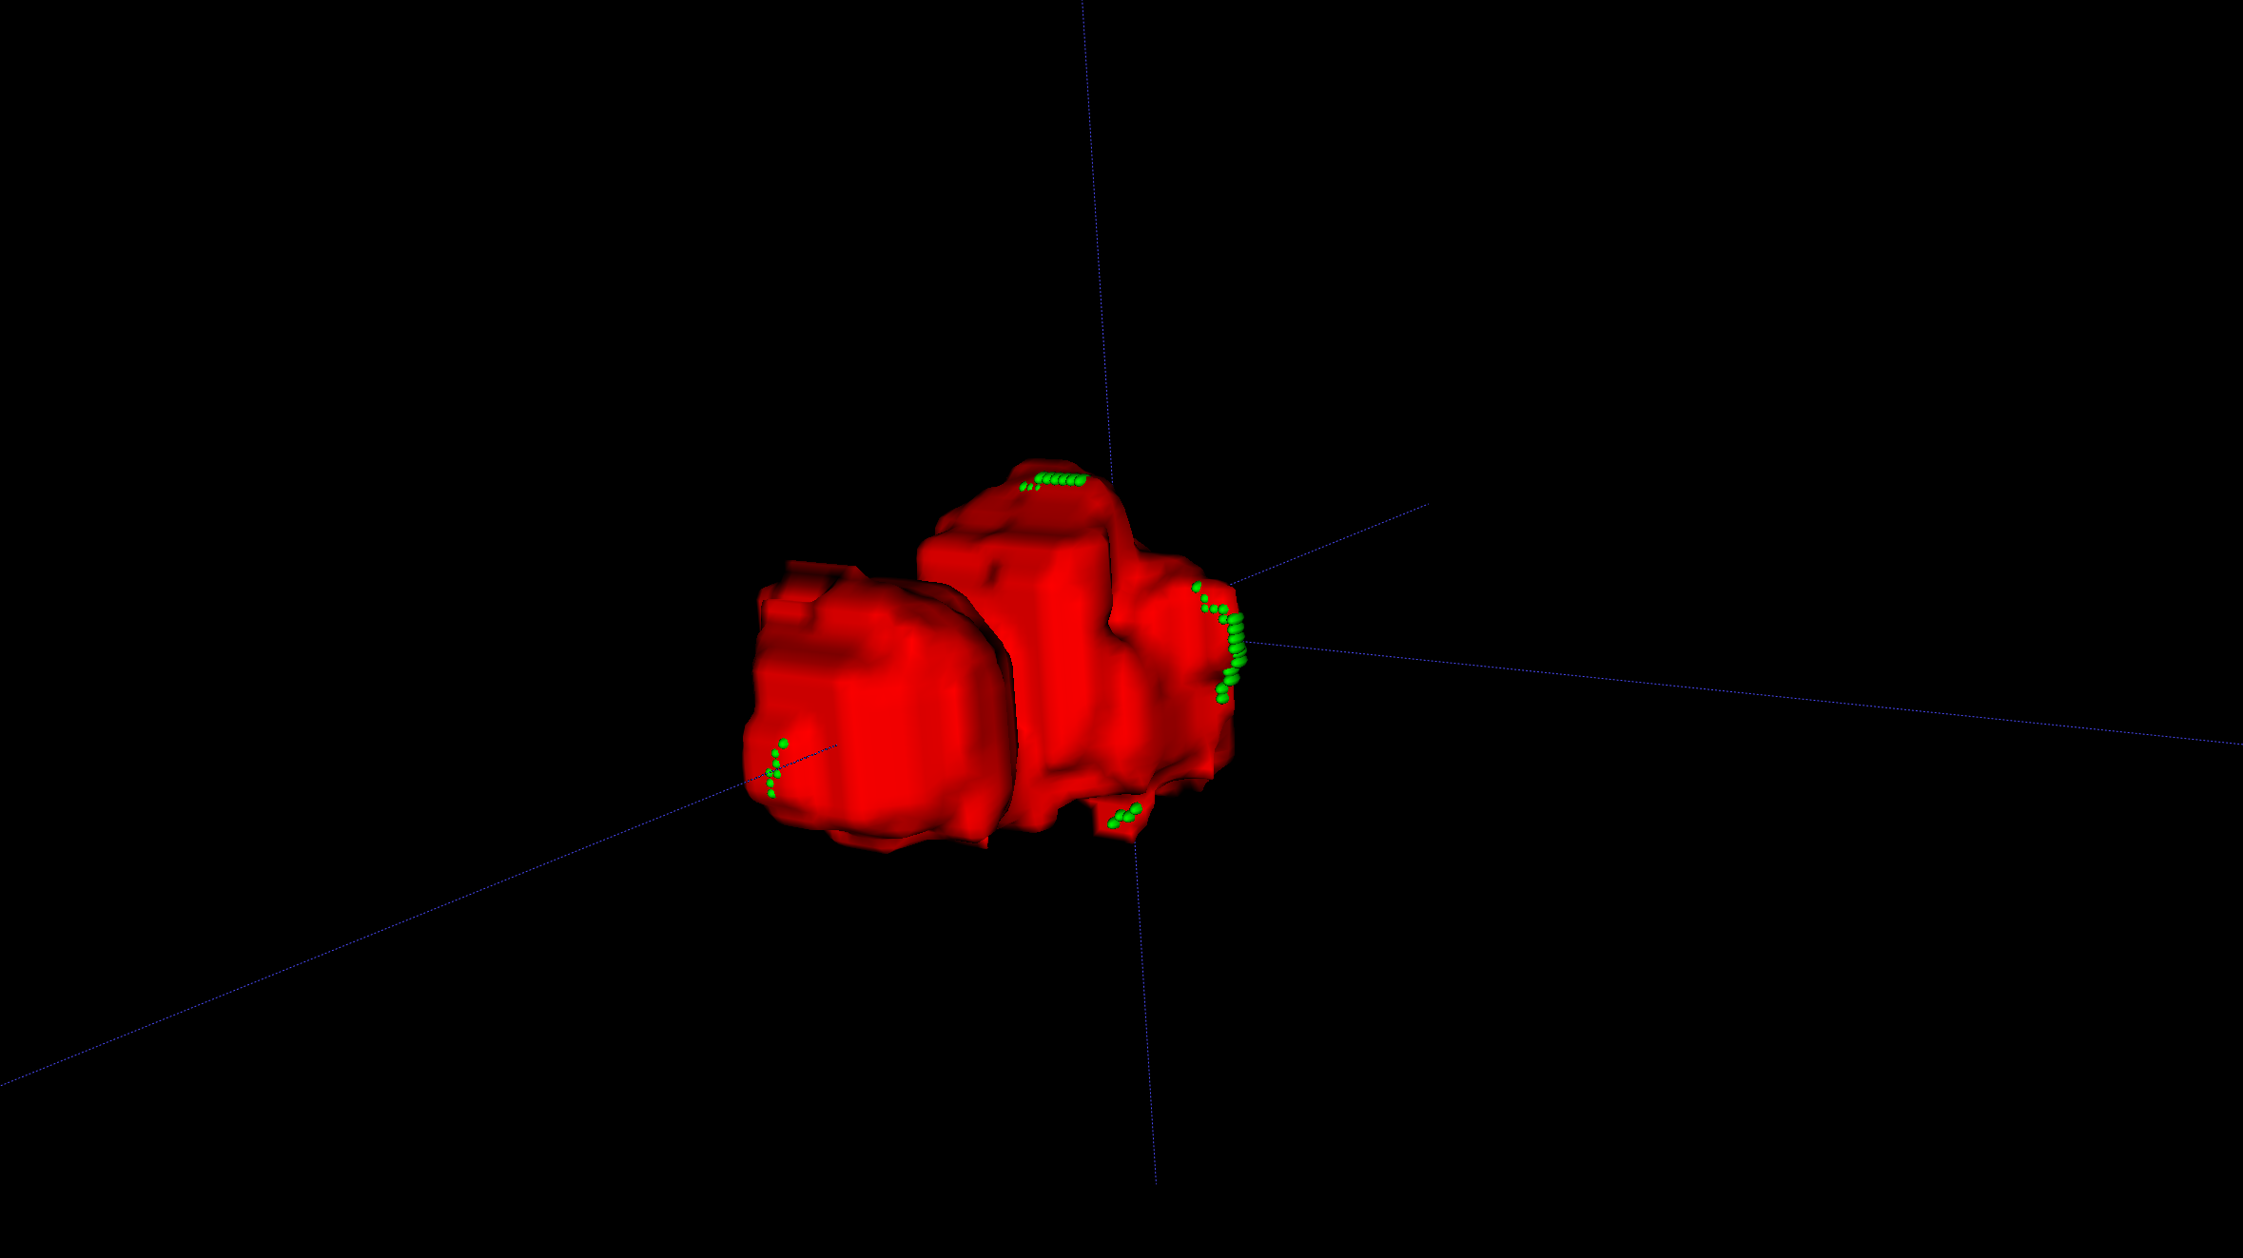
Solution - Overall
The user is presented to an interface for 3D mesh manipulation. There, he marks a scribble on ‘bad’ areas and the algorithm removes the leaks

Slide 13


Validation
In order to validate our results we have numerous sets of cases with ground truth, professional radiologists verified images.
We will sit with radiologists from Hadassah to receive feedback on the user interface and the application performance overall.

Slide 14

Summary
The project aims at creating a user friendly, natural and intuitive method for tumor segmentation and 3D mesh creation.
The final product will help radiologists correctly access tumor dynamics in patients and speed up the process of medical segmentation in hospitals.

Slide 15

Questions?

