Slide 1
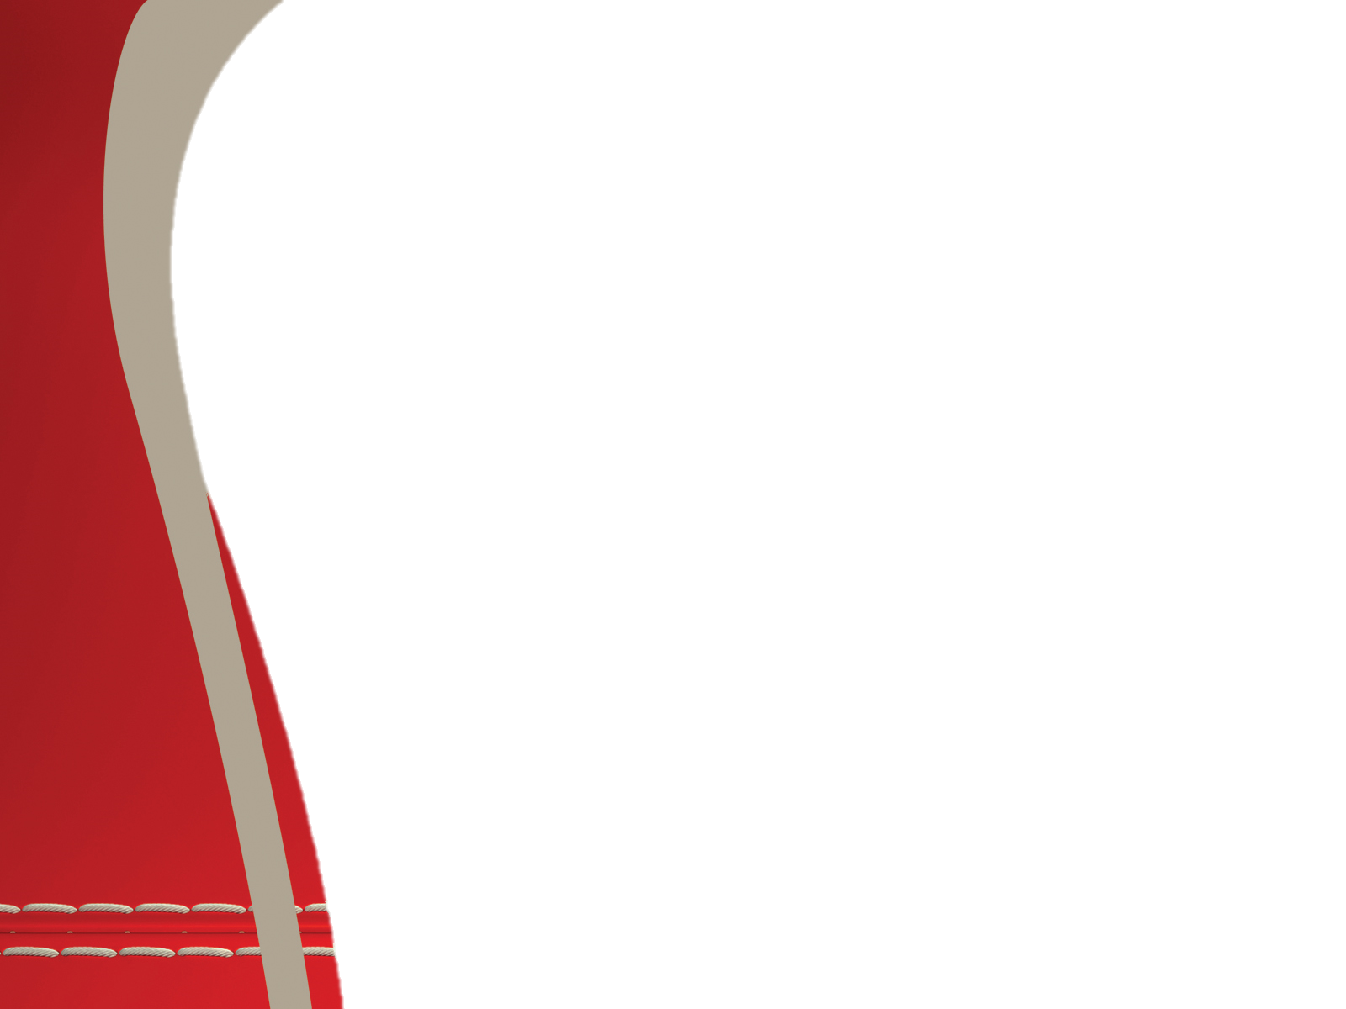

MyCare
Team members:
Daniel Akua Noy Jacob Olga Yerushalimov

Slide 2
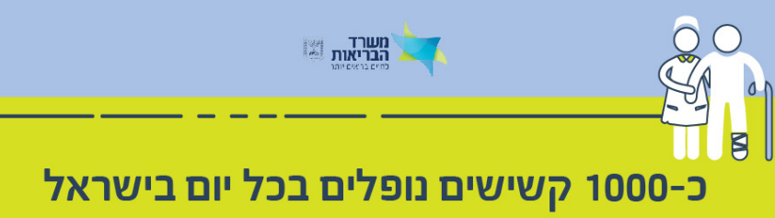
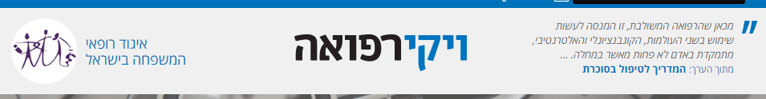
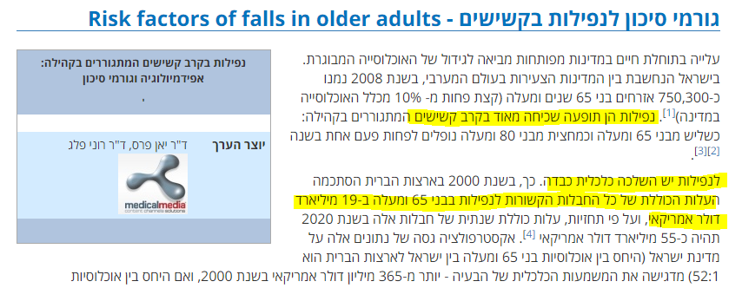

Slide 3
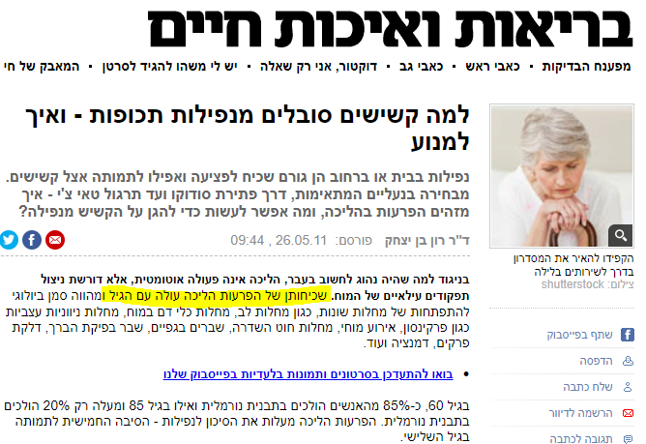
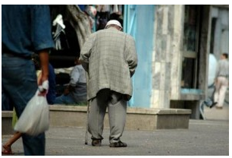
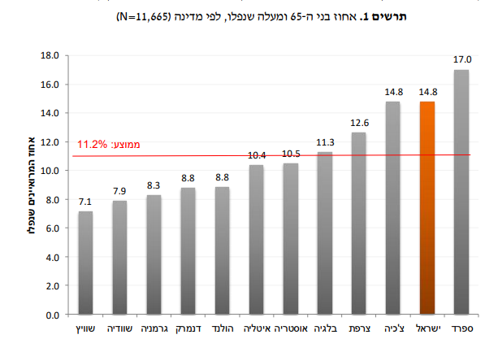
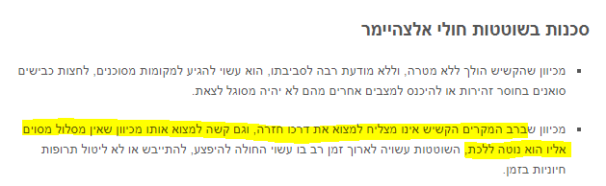

Slide 4



Here MyCare comes in for you
and your loved ones

Slide 5
Why MyCare?
MyCare is a monitoring app designed to ensure the well being of the elderly.
The main goals of the app:
Enabling independence.
Fast reaction to distress calls.
Real-time updates of personal history database in the cloud.
Remote access to the database of a person.
Keeping the care-takers informed.

Slide 6

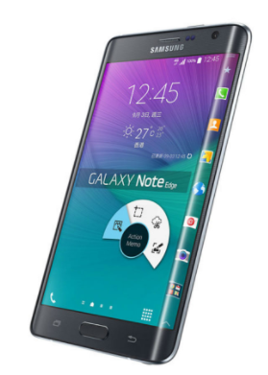

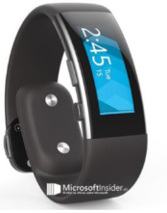
Technologies
Azure cloud:
databases
email services
function apps
Patients’ phone:
falling detection algorithm
Caretakers’ phone:
email notifications
and monitoring
Band:
heart rate
accelerometer

Slide 7
The Band
The app uses the information from the band to update the database in the cloud in real-time, sampling the following sensors:
Optical heart-rate monitor: Sampling heart rate.
Accelerometer: detecting sudden movements and falls (peaks).
Bluetooth: announcing whether the bracelet is out of range.

Slide 8
The Cloud
The cloud keeps the patients’ and caretakers’ personal information.
The cloud updates the phone and informs difficult situations.
Difficult situations include:
Detected falls: as soon as a fall is detected a mail would be sent using SendGrid
to the caretakers.
Abnormal heart rate
Current Location

Slide 9
The Patient’s APP
Specialized to be used by the elderly:
Simple UI
Big buttons, font
Pleasant colours
The app contains the following features:
Real time Heart rate
Profile
Medical team contact in case of emergency
Recording current location

Slide 10
The Caretaker’s APP
Friendly inviting UI.
The app contains the following features:
Last recorded medical information of the patient
Patient List which include access to patients’ profiles
Notifications by e-mail in case of patient’s emergency
Getting Patient’s location with access to map

