Slide 1
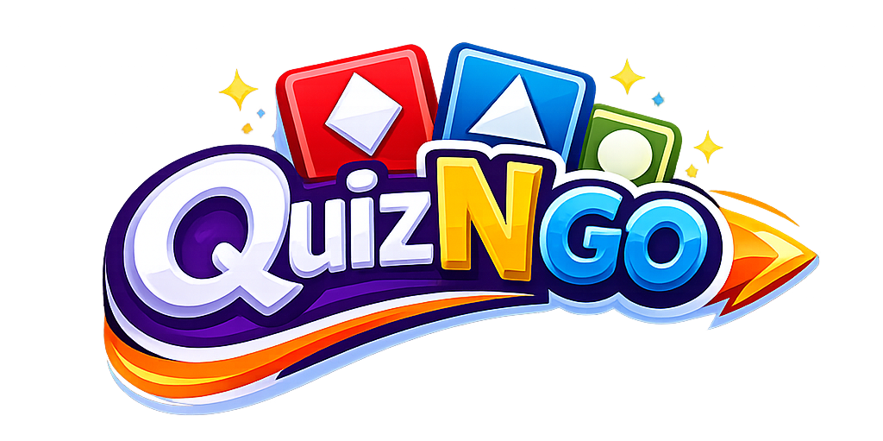
🎮
LIVE QUIZ
AI, Demystified
6 questions on the AI you already use every day

Slide 2
מחכים למשתתפים...
0
Waiting for players…
2
in
👾
👤
Preview

Slide 3
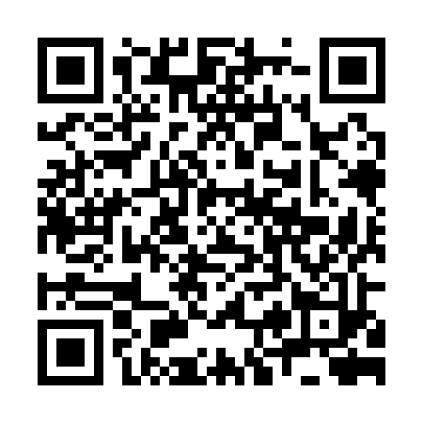
Go to game.quizngo.com
or scan the QR to join
GAME PIN:
742-069
🐸
Frogster
🦊
PixelFox
Waiting for players…
2
in
👾

Slide 5
What is artificial intelligence?

Slide 6
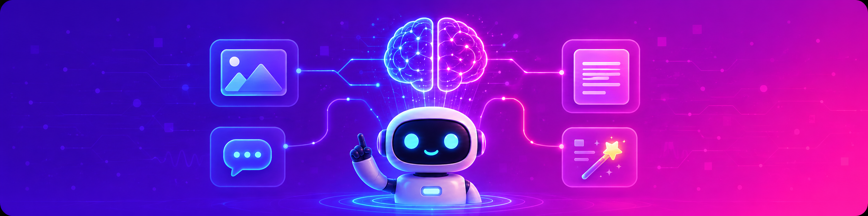
Question 1 / 6
What is artificial intelligence?
A computer that thinks exactly like a human
A system that does “smart” tasks — recognizing images, writing text
Only a physical robot
Software that runs the internet

Slide 7
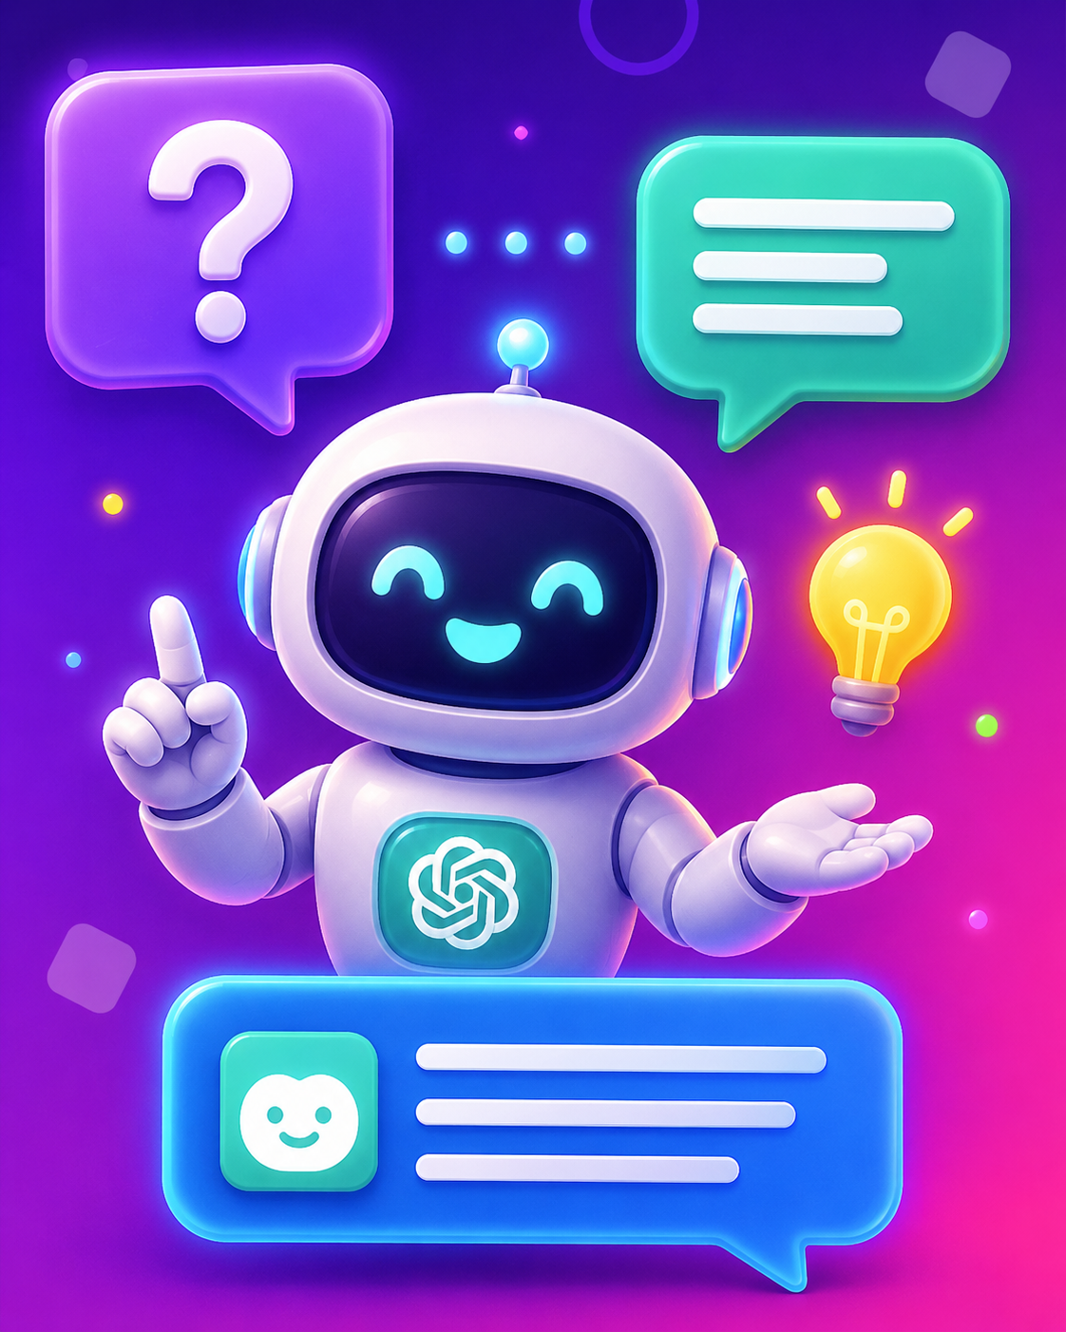





18
19
Question 2 / 6
ANSWERS
A computer game
A regular search engine
An AI tool that gives natural answers
Video-editing software only

Slide 8
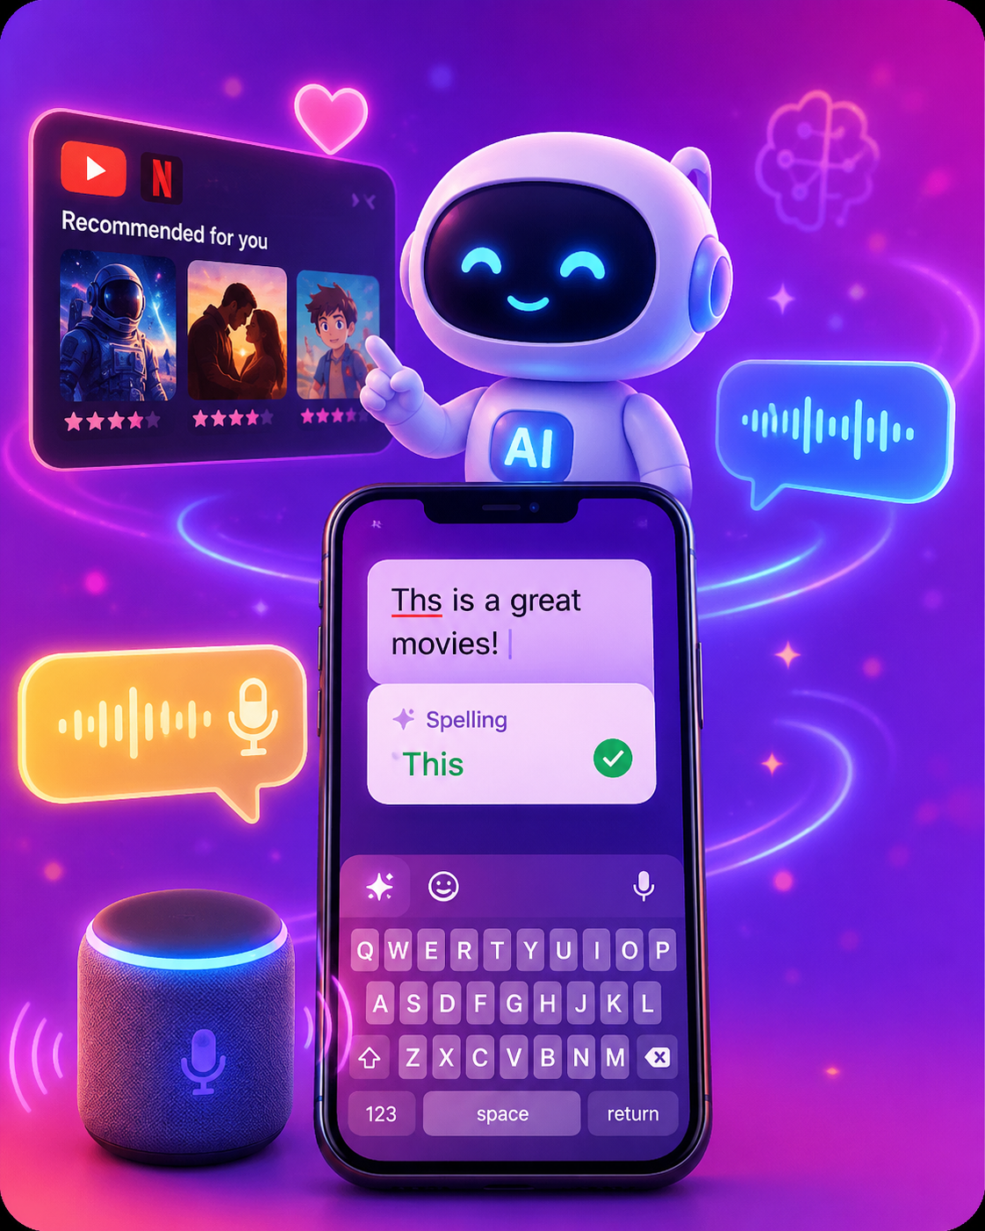
18
19
Question 5 / 10
ANSWERS
Which of these is an everyday use of AI?
Netflix & YouTube recommendations
Spell-check on
your phone
Voice assistants like Siri or Alexa
All of the above

Slide 9
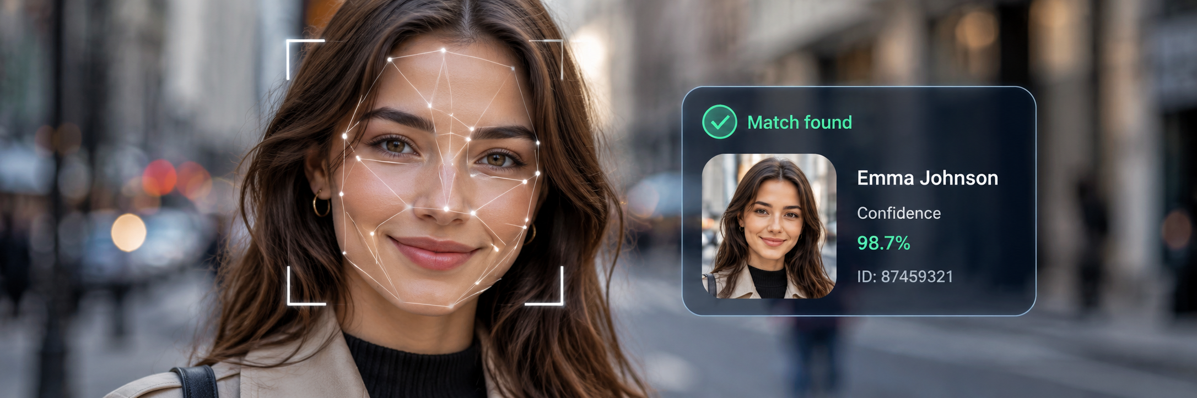
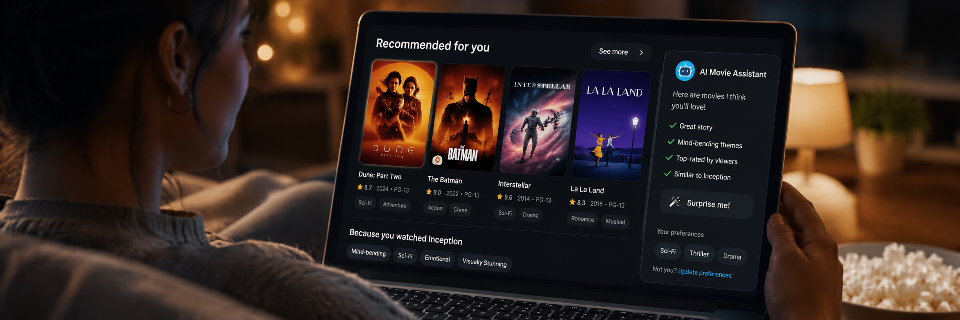


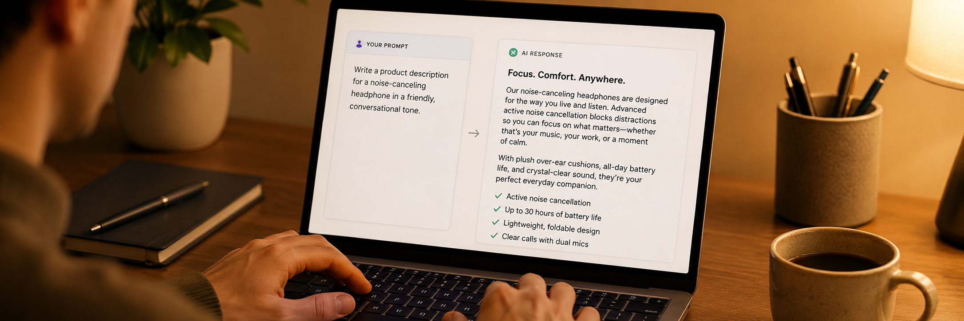
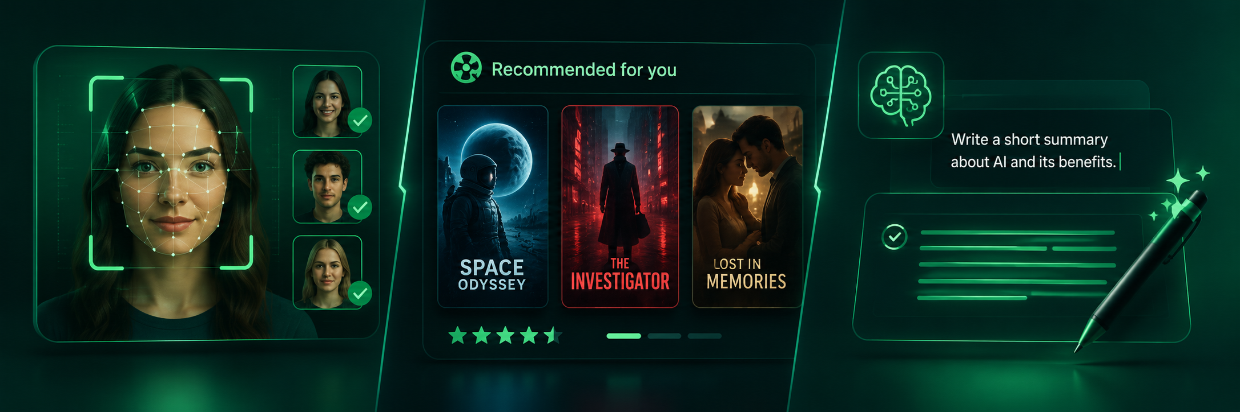


16
17
Question 2 / 10
ANSWERS
Which action can AI perform?
Recognize faces in a photo
Recommend movies
Write text on request
All of the above

Slide 10
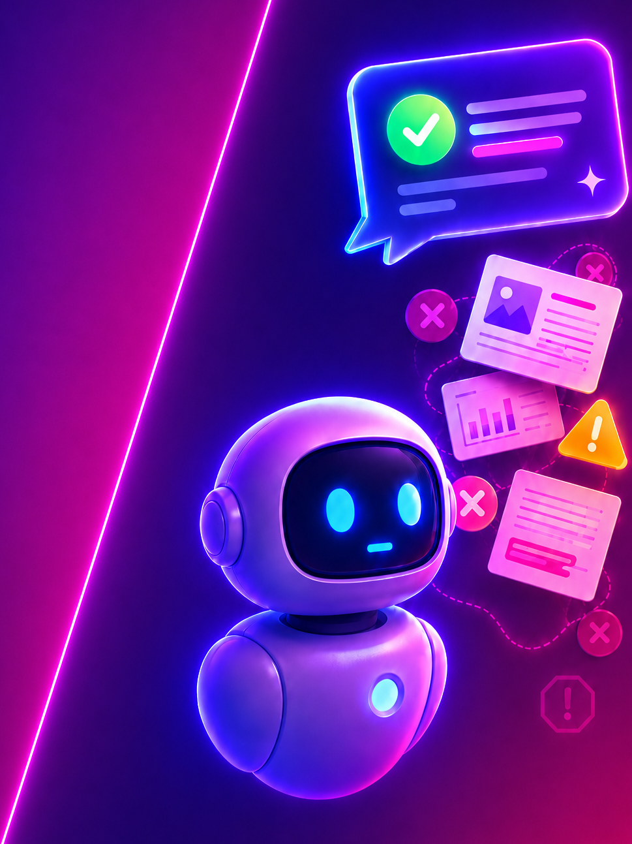
16
17
Question 2 / 10
ANSWERS
What is an AI “hallucination”?
When the computer overheats
When AI invents convincing but false information
When the internet disconnects
When the robot stops working

Slide 11
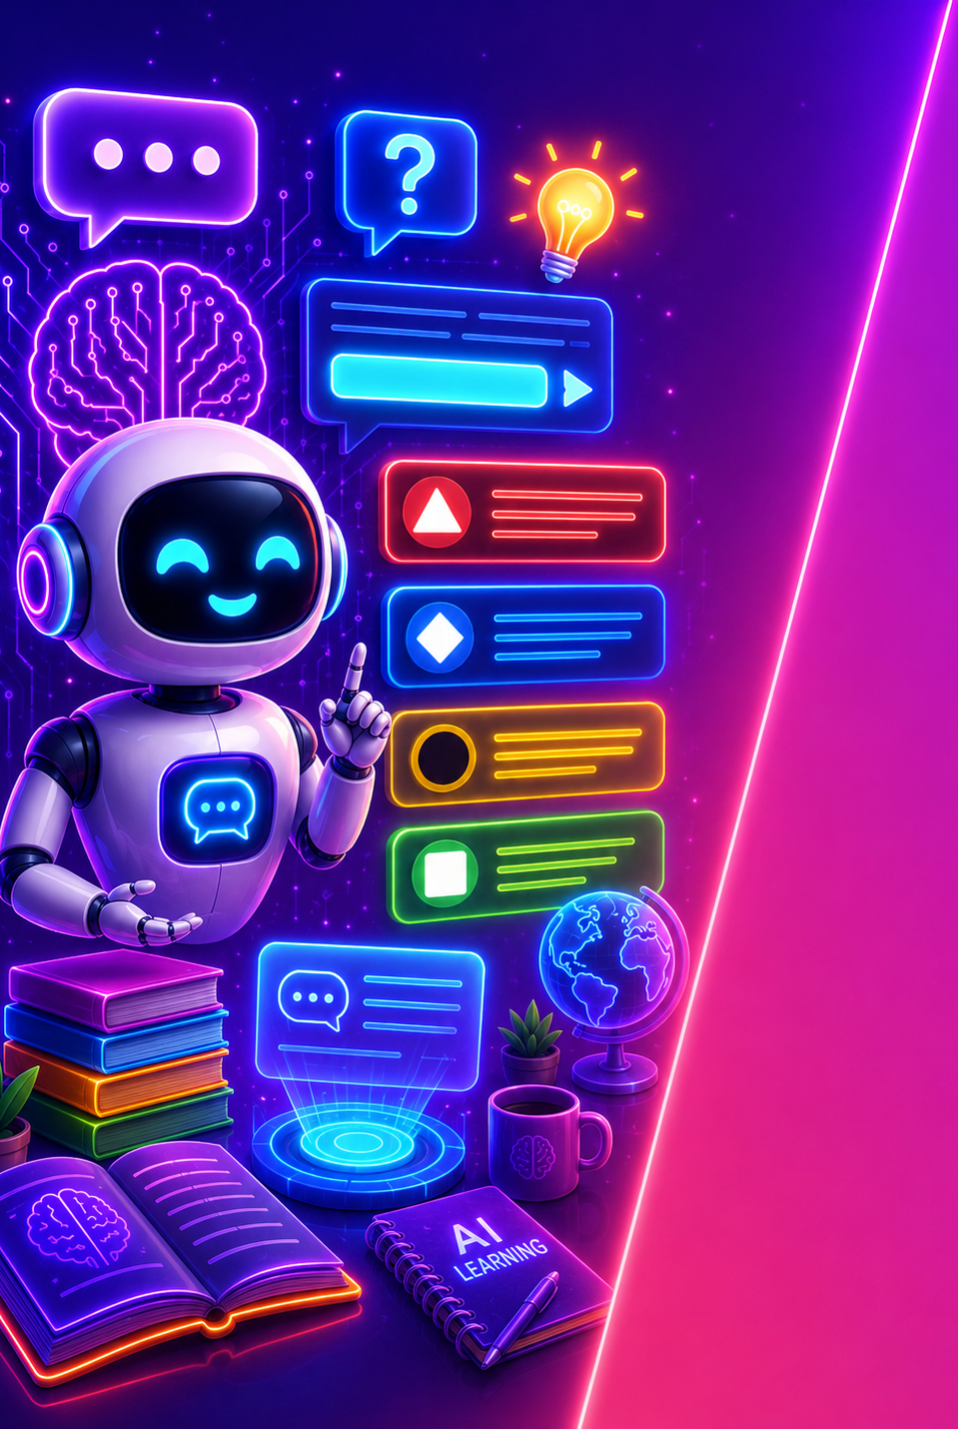

15
19
Question 6 / 6
ANSWERS
The user’s password
An instruction or question you give the AI
When the internet disconnects
A type of computer processor

Slide 12




RESULTS · QUESTION #
The Question is here
✓ Correct
0
0
0
0
Answer option 1
Answer option 2
Answer option 3
Answer option 4

Slide 13
SCOREBOARD
Top 3 — after Question #
1
🐸
Frogster
6,420
+980
2
🦊
PixelFox
5,980
+870
3
🐯
NeonTiger
5,310
+1000

Slide 14
🎉 THE WINNERS 🎉
Game Over!
🏆
🥈
🐸
🦊
🥉
Frogster
🐯
PixelFox
9,640
8,910
NeonTiger
1
8,200
2
3

