Slide 1
Developing a Predictive Deep Learning Model for the Early Detection of Maize Leaf Diseases in Tanzania
Eastern Africa Statistical Training Centre
Severia M. Banda | Moshi M. Kassim | Gidion F. Machumu | Rebeca P. Shauri | Edgar S. Materu
Bachelor of Data Science, Year III | Academic Year 2025/2026
Supervisor: Mr. Kelvin Rweshobora

Slide 2
Background
Maize is the primary staple crop in Tanzania and is highly vulnerable to foliar diseases.
Common Rust, Northern Leaf Blight and Gray(Cercospora) Leaf Spot can cause substantial yield losses if not detected early.
Current diagnosis depends on manual field scouting and extension officers, which is slow and limited by staff shortages.
Convolutional Neural Networks can learn disease patterns from labelled leaf images and support automated classification.
This project develops and evaluates such a model for maize leaf disease detection.

Slide 3
General Objective
To develop a deep learning image classification model capable of automatically identifying and diagnosing three maize leaf diseases , Common Rust, Northern Leaf Blight and Gray Leaf Spot.

Slide 4
Specific Objectives
To preprocess a sourced dataset of healthy and diseased maize leaf images.
To train Convolutional Neural Network (CNN) models.
Evaluate predictive performance using accuracy, precision, recall, F1-score, and confusion matrix.
Deploy the selected model in an interactive graphical interface for real-time image diagnosis.
Classes used: Disease Class Images
Blight 1146
Common Rust 1306
Gray Leaf Spot 574
Healthy 1162
Total Images: 4,188

Slide 5
Research Questions
What image preprocessing techniques are required to prepare raw leaf data for deep learning?
Which CNN architecture performs best?
How accurately can the CNN classify maize leaf diseases?
How can the model be deployed for real-time diagnosis?

Slide 6
Methodology Overview
Approach: Predictive analytics and computer vision using supervised image classification.
Data source: PlantVillage maize subset (4,188 labelled RGB images).
Development environment: Python 3.10+, TensorFlow/Keras, OpenCV, scikit-learn.
Workflow: Data acquisition, preprocessing, model training, evaluation, model selection, deployment.
Two architectures were compared: a Custom CNN and ResNet50 transfer learning.

Slide 7
Data Preprocessing
Resizing: All images resized to 128 x 128 pixels.
Colour conversion: RGB converted to BGR to match the training pipeline.
Normalization: Pixel values scaled from 0 to 255 down to the range 0 to 1.
Batch formatting: Input tensor shape (1, 128, 128, 3) for model inference.
Data augmentation was applied during training to reduce overfitting.

Slide 8
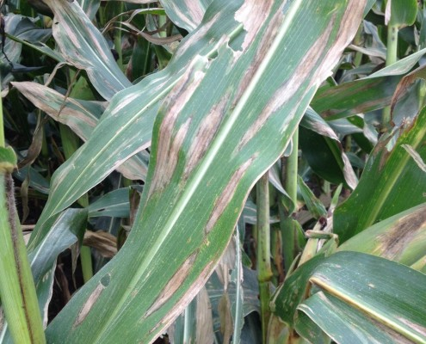
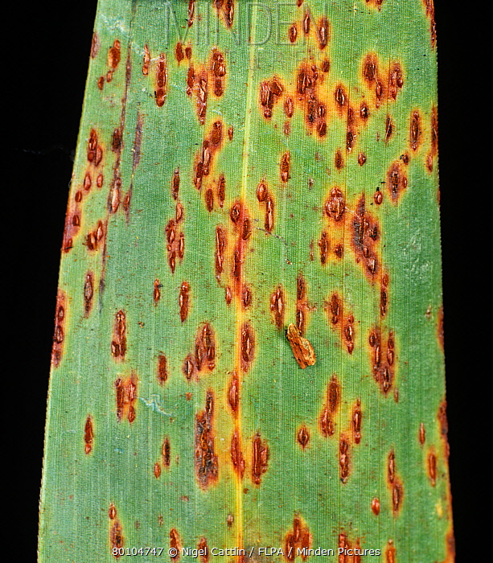
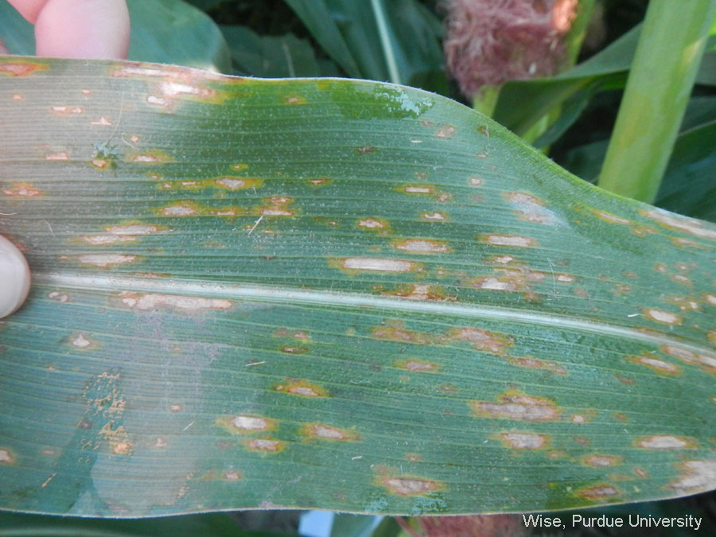

Dataset and Sampling
Four disease classes: Healthy, Common Rust, Northern Leaf Blight, Cercospora Leaf Spot.
Northern Leaf Blight Common Rust Cercospora Leaf Spot Healthy
Total sample: 4,188 images from the PlantVillage repository.
Stratified random split to preserve class proportions across sets.
Split | Images | Percentage
Training | 2,931 | 70%
Validation | 628 | 15%
Test | 629 | 15%
Total | 4,188 | 100%

Slide 9
Workflow
Image Dataset
↓
Preprocessing
↓
Custom CNN & ResNet50
↓
Model Training
↓
Model Evaluation
↓
Dashboard Deployment

Slide 10
Model Training and Validation
Training performed on 2,931 images with validation monitoring during each epoch.
Validation set (628 images) used to track loss and accuracy during training.
Final evaluation conducted on a held-out test set of 629 images.
Test images were not used during training.
Metrics recorded: accuracy, loss, precision, recall, F1-score, and confusion matrix.

Slide 11
Model Comparison and Selection
Model | Test Accuracy | Test Loss | Selected
Custom CNN | 92.37% | 0.3725 | Yes
ResNet50 (frozen) | 77.42% | 0.5277 | No
Why the custom CNN was Selected.
The Custom CNN achieved 92.37% test accuracy, which is 14.95% higher than the frozen ResNet50 (77.42%).
Loss reduction: The Custom CNN reached a lower test loss of 0.3725, compared to 0.5277 for ResNet50

Slide 12
Findings:
Pre-class Performance(Custom CNN)
Class | Precision | Recall | F1-Score
Common Rust | 0.97 | 0.96 | 0.97
Northern Leaf Blight | 0.83 | 0.94 | 0.88
Healthy | 1.00 | 1.00 | 1.00
Cercospora Leaf Spot | 0.85 | 0.65 | 0.74
Custom CNN achieved 92.37% test accuracy on 629 unseen images.
Healthy and Common Rust classes were classified with near-perfect performance.
Northern Leaf Blight showed strong recall (0.94) with moderate precision (0.83).
Cercospora Leaf Spot was the most challenging class (recall 0.65).
Results confirm that deep learning can classify maize foliar diseases from digital images.

Slide 13
Findings: Confusion Matrix (Test Set)
Actual \ Predicted | NLB | Rust | CLS | Healthy
Northern Leaf Blight | 162 | 5 | 5 | 0
Common Rust | 3 | 188 | 5 | 0
Cercospora Leaf Spot | 22 | 8 | 56 | 0
Healthy | 0 | 0 | 0 | 175
The model is perfect at identifying Healthy leaves. It got 175 correct and 0 wrong.
The model is very strong with Common Rust, getting 188 correct.
The model it did well with Northern Leaf Blight, getting 162 correct.
Cercospora Leaf Spot was the hardest class The model only got 56 CLS images right. It mistakenly called 22 CLS images 'Northern Leaf Blight', and it called 8 CLS images 'Rust'.

Slide 14
Discussion
Results align with prior plant disease studies using deep learning on PlantVillage data.
A simpler Custom CNN exceeded a frozen ResNet50, suggesting domain-specific architectures can be effective at this dataset scale.
Strong performance on Healthy and Common Rust supports reliable detection of clear symptom patterns.
Lower recall for Gray Leaf Spot indicates need for additional training samples and augmentation.
Laboratory accuracy (92.37%) is competitive, though field validation on Tanzanian farm images remains necessary.

Slide 15
Limitations
Dataset images originate from controlled PlantVillage conditions, not Tanzanian field environments.
Input resolution of 128 x 128 pixels may reduce fine lesion detail.
Cercospora Leaf Spot classification requires further improvement.
Model performance under varied lighting, backgrounds and camera quality has not yet been validated in the field.

Slide 16
Recommendation
Increase dataset size.
Collect real field images from Tanzanian farms.
Improve prediction confidence.
Develop a mobile application.
Include more maize diseases.

Slide 17
Thank You
Questions and Discussion

