Slide 1
Title TITLE: Developing a Predictive Deep Learning Model for the Early Detection of Maize Leaf Diseases in Tanzania

Slide 2
BACKGROUND
Agriculture employs approximately 55% of Tanzania's workforce.
Maize is Tanzania's most important staple crop.
Diseases such as: Common Rust, Northern Leaf Blight, Cercospora Leaf Spot Cause significant yield losses.
Traditional diagnosis relies on visual inspection by agricultural experts, which is often slow and inaccessible to many farmers.

Slide 3
Problem Statement
Smallholder farmers frequently detect crop diseases only after significant damage has occurred, largely due to a severe shortage of agricultural extension officers in many regions, one officer serves hundreds or thousands of farmers. This delay often leads to misdiagnosis and indiscriminate pesticide use, increasing costs and environmental harm while failing to control the disease. An automated, accessible and accurate diagnostic tool could close this gap by giving farmers real-time answers without waiting for expert visits.
To address these challenges, we developed a deep learning-based maize leaf disease detection system.

Slide 4
General
Objective
To develop a deep learning image classification model capable of automatically identifying and diagnosing common maize leaf diseases and deploy it in an interactive dashboard for real-time diagnosis.

Slide 5
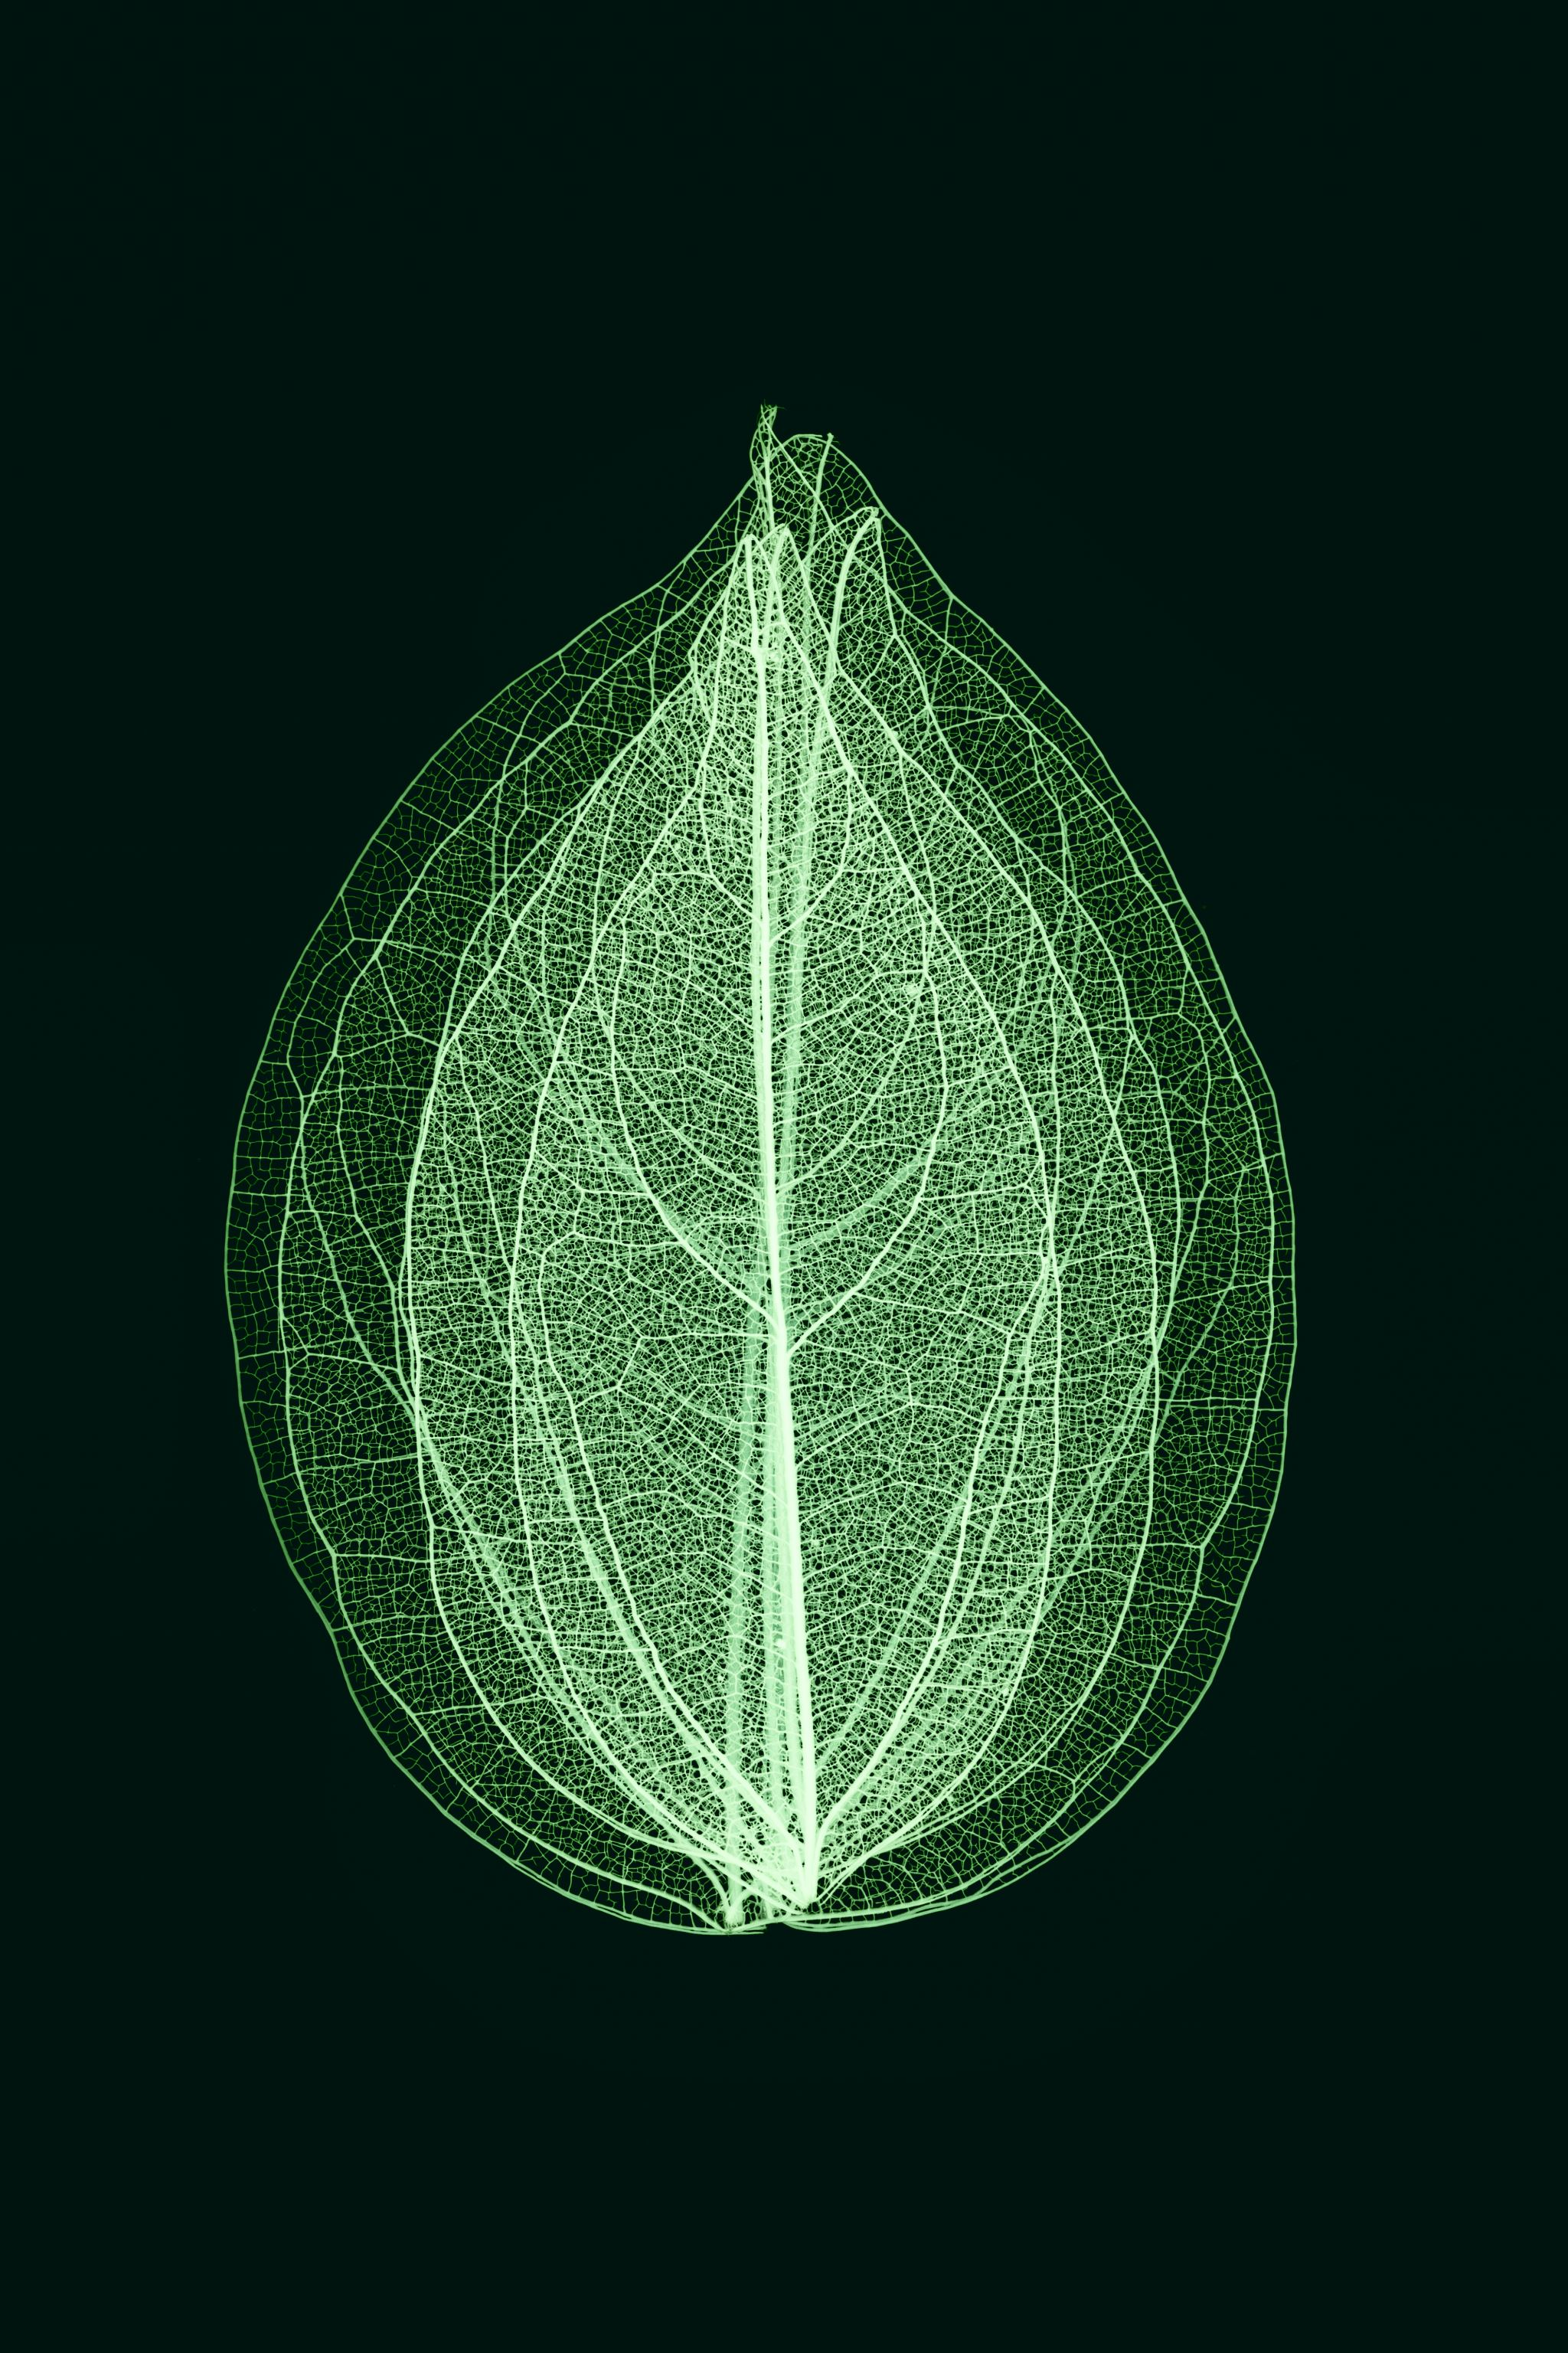
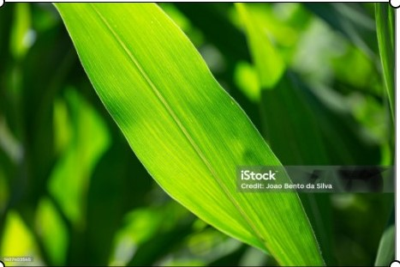
Specific Objectives
• To preprocess a sourced dataset of healthy and diseased maize leaf images. • To train Convolutional Neural Network (CNN) models. • To evaluate the model using Accuracy, Precision, Recall, F1-Score and Confusion Matrix. • To deploy the trained model into an interactive dashboard.

Slide 6
Research Questions
• What image preprocessing techniques are required? • Which CNN architecture performs best? • How accurately can the CNN classify maize leaf diseases? • How can the model be deployed for real-time diagnosis?

Slide 7
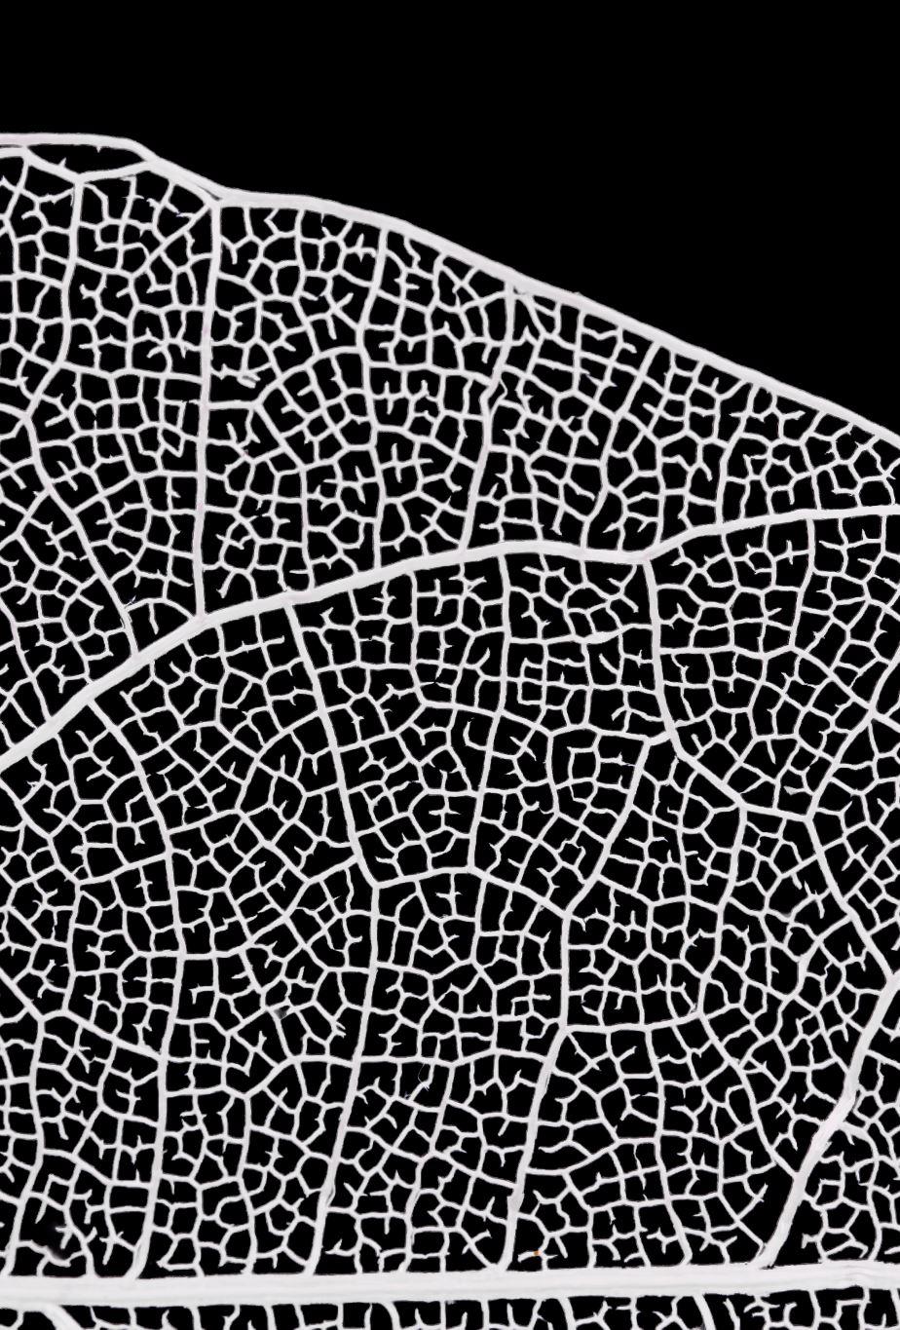
Findings – Objective 1
• Collected 4,188 labelled maize leaf images. • Four classes: Healthy, Common Rust, Northern Leaf Blight and Cercospora Leaf Spot.

Slide 8
Methodology
Data Preprocessing
Image resizing (128 × 128 pixels)
Normalization
Label encoding
Dataset splitting

Slide 9
Model Development
Models Developed
Custom CNN
Built from scratch
Convolution layers
Pooling layers
Dense layers
Dropout layer
ResNet50
Transfer Learning model
Pretrained on ImageNet
Fine-tuned for maize disease classification

Slide 10
Workflow
Image Dataset
↓
Preprocessing
↓
Custom CNN & ResNet50
↓
Model Training
↓
Model Evaluation
↓
Dashboard Deployment

Slide 11
Findings – Objective 2
• Trained two models:
Custom CNN and ResNet50. • Custom CNN outperformed ResNet50 and was selected for deployment.

Slide 12
Findings – Objective 3
• Custom CNN Accuracy: 92.37% • ResNet50 Accuracy: 77.42%
ResNet50 Lower than CNN
• So Custom CNN achieved better predictive performance.

Slide 13
: Confusion Matrix Findings
The confusion matrix showed:
Most disease classes were correctly classified.
Common Rust and Gray Leaf Spot occasionally showed misclassification.
Healthy leaves were accurately recognized.
Interpretation
The model learned disease patterns effectively and achieved strong classification performance.

Slide 14
Findings – Objective 4
• Developed a Streamlit dashboard. • Upload maize leaf image. • Automatic disease prediction. • Confidence score and management advice. • Rejects non-maize images.

Slide 15
Conclusion
A deep learning model for maize disease detection was successfully developed.
The model achieved approximately 92.4% accuracy.
The system can automatically identify maize diseases from leaf images.
The dashboard provides real-time diagnosis and confidence scores.
The project demonstrates the potential of AI in supporting Tanzanian agriculture.

Slide 16

Thank You
For listening. We welcome your questions and comments."

