Slide 1
RL speedup EXPERIMENT
State Abstraction Speedup Method

Slide 2
Required knowledge
Reinforcement Learning – only what you study at the “Advanced topics in Artificial Intelligence” course of Prof. Sarit Kraus
Specifically- the Q-Learning method
Basic Java programming skills
Notice: the presentation contains animations to support the textual explanations. Switch to full screen mode to enjoy them ☺

Slide 3


Problem domain – the Pursuit game
A grid world with predators (lions) and preys (zebras)
The predators goal is to catch one of the preys

Slide 4
Movement rules
At every turn, each animal perform one of the allowed actions in a predefined order- first the preys plays and then the predators.
The animals move one after another, so in every given moment at most one animal is while a move.
The allowed actions are: Left, Right, Up, Down and Stay in place.
In case an animal chooses an action that leads to other animal location, or outside the grid-world limits, the animal stays in it’s place.

Slide 5
Gameplay
Divided to ‘turn’, ‘episode’ and ‘run’.
A turn is a set of movements in which each animal moves one step.

Slide 6
Gameplay
Episode is a sequence of 5000 turns at most. The episode may be shorter in case one of the predators catches one of the preys earlier.
The location of the animals is randomized at the episode initialization.
Episode Start
Episode End

Slide 7
Gameplay
A run is a sequence of episodes in which the “knowledge” is accumulated during them.
In our context- the Q-Table of the predators isn’t wiped at an episode end.
The length of a run is fixed to a ‘large’ number, that allows the learning process to converge.
As the run progresses, we expect the predators performance to improve, in terms of the amount of steps required to catch the prey.
Create new Q table for each predator
Choose random placement for all animals
Run episode
Run end
Run start
Fixed number of times

Slide 8
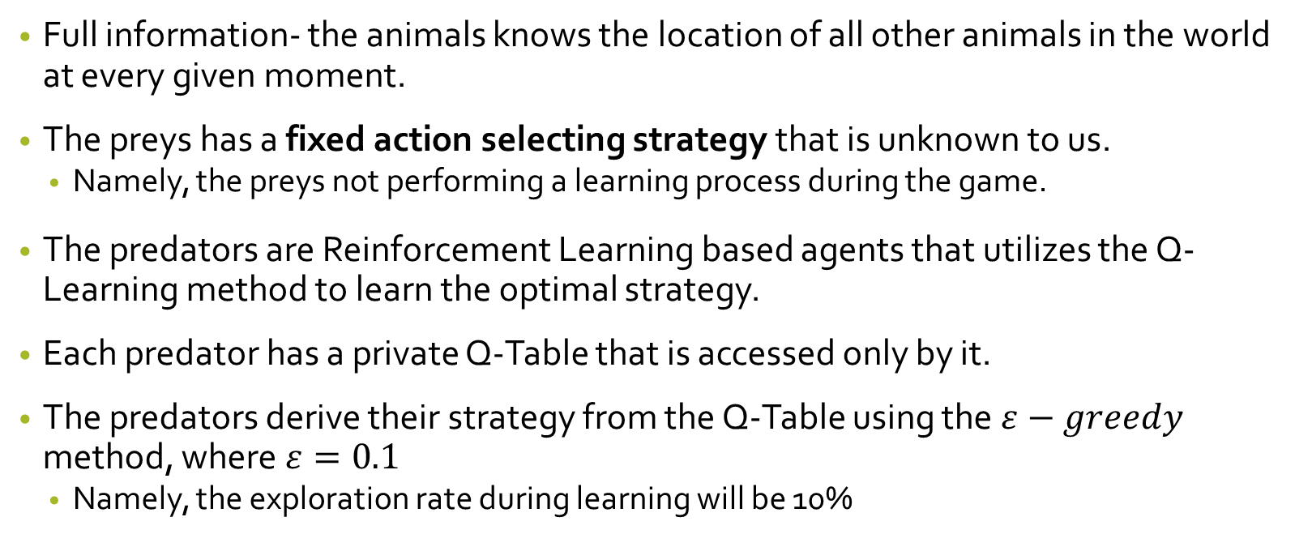
Action selection logic
Full information- the animals knows the location of all other animals in the world at every given moment.
The preys has a fixed action selecting strategy that is unknown to us.
Namely, the preys not performing a learning process during the game.
The predators are Reinforcement Learning based agents that utilizes the Q-Learning method to learn the optimal strategy.
Each predator has a private Q-Table that is accessed only by it.
The predators derive their strategy from the Q-Table using the $ε−greedy$ method, where $ε=0.1$
Namely, the exploration rate during learning will be 10%

Slide 9
Predator learning process
Predator is at state s
Select action a and perform it
Transited to state s’
Receives a reward signal of R(s, a, s’)
Updates its Q-Table using the received reward signal

Slide 10
Reward method
The preys has a fixed strategy, so they aren’t receive rewards.
The reward for each of the predator actions is zero.
In case the predator action leaded to catching the prey, the episode ends and all the predators receive reward of 1.

Slide 11
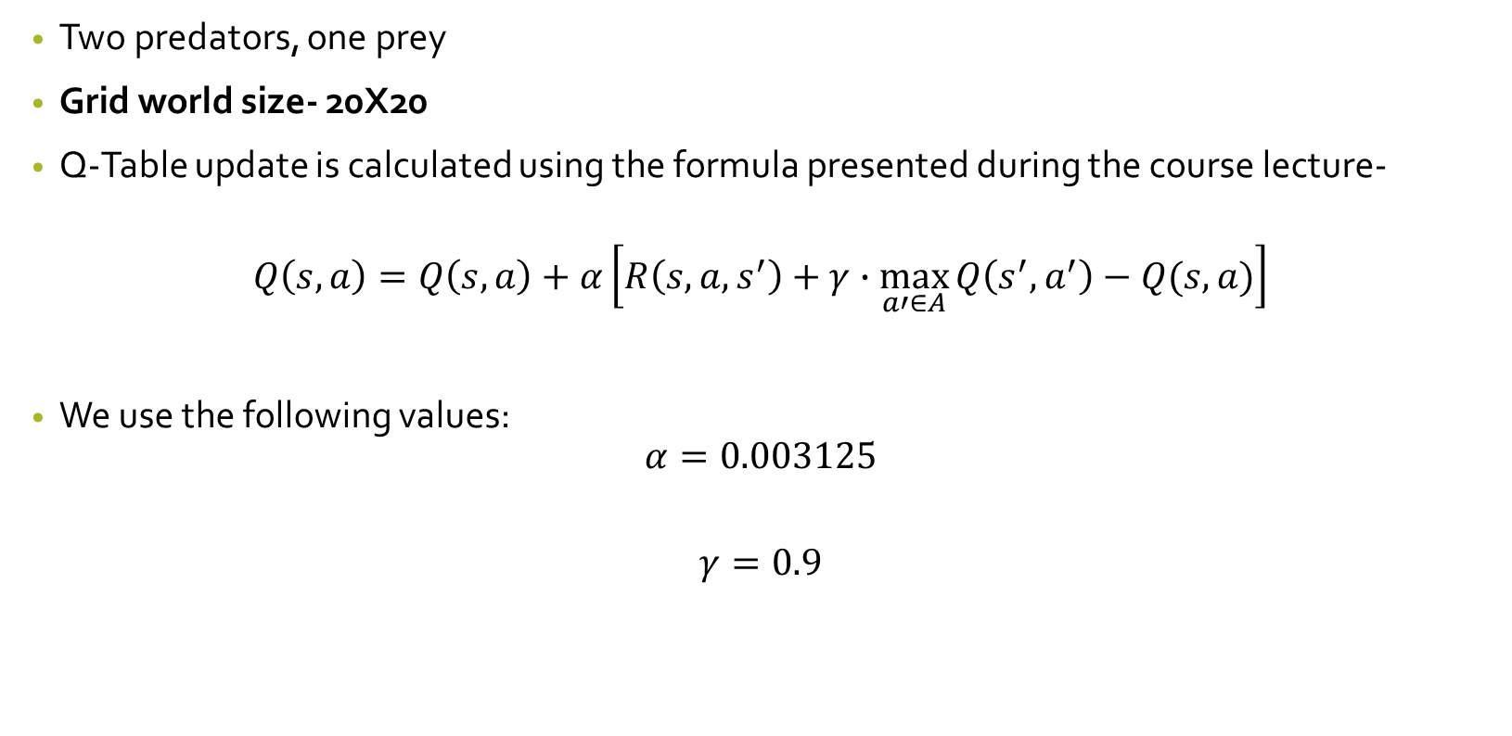
Additional settings
Two predators, one prey
Grid world size- 20X20
Q-Table update is calculated using the formula presented during the course lecture-
$$Q\left(s,a\right)=Q\left(s,a\right)+α\left[R\left(s,a,s^{′}\right)+γ∙\max_{a′∈A}{Q\left(s^{′},a^{′}\right)−Q(s,a)}\right]$$
We use the following values:
$$α=0.003125$$
$$γ=0.9$$

Slide 12
The problem

Slide 13
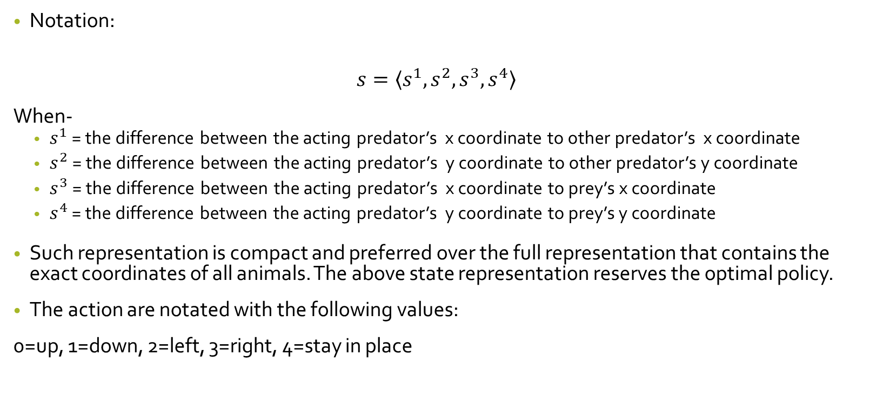
Basic Q Learning- representation
Notation:
$$s=\left\langle s^{1},s^{2},s^{3},s^{4}\right\rangle$$
When-
$s^{1}$ = the difference between the acting predator’s x coordinate to other predator’s x coordinate
$s^{2}$= the difference between the acting predator’s y coordinate to other predator’s y coordinate
$s^{3}$= the difference between the acting predator’s x coordinate to prey’s x coordinate
$s^{4}$ = the difference between the acting predator’s y coordinate to prey’s y coordinate
Such representation is compact and preferred over the full representation that contains the exact coordinates of all animals. The above state representation reserves the optimal policy.
The action are notated with the following values:
0=up, 1=down, 2=left, 3=right, 4=stay in place

Slide 14
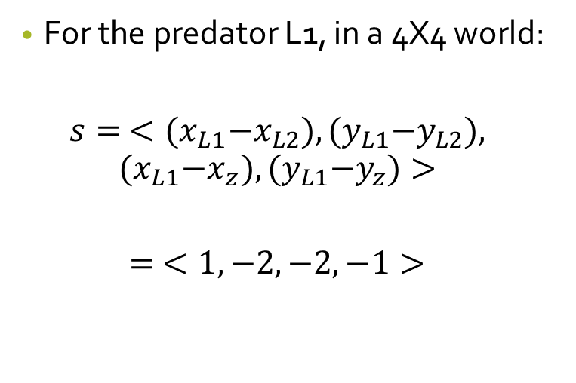
State representation- example
0
1
2
3
For the predator L1, in a 4X4 world:
$$s= <{(x}_{L1}−x_{L2}),{(y}_{L1}−y_{L2}),$$
$${(x}_{L1}−x_{z}),{(y}_{L1}−y_{z})>$$
$$= <1, −2, −2, −1>$$
0
L1
1
2
Z
L2
3

Slide 15

Q-Table size
State space size- every $s^{i}∈s$ upholds $s^{i}∈\left[−19, 19\right]−\{0\}$, so-
$$\left|S\right|≈{38}^{4}=2,085,136$$
State-Action space size-
$$\left|A\right|=5$$
$$\left|S×A\right|=\left|S\right|∙\left|A\right|=10,425,680$$

Slide 16
The problem
The required Q-Table size is too large for us to handle.
Such Q-Table will produce a very slow learning process that requires a huge number of episodes for optimal policy convergence.
We can get to the optimal policy, in which about 22 steps are required for the predators to catch the prey, but it takes more than a million episodes.
Our goal is to inject your knowledge about the domain to the learning agents so the learning process will be accelerated.

Slide 17
State abstraction learning acceleration

Slide 18
State Abstraction
One of the most common ideas to speed the learning up is by reducing the state space size.
The idea is to represent each world-state by its most unique features, so multiple ‘similar’ world-states will be represented by a single state, so the need to learn and store each of them separately will be reserved. (see example at the next slide)
Method efficiency is critically depends on the chosen representation, because a flawed representation can slow the learning down or even to disrupt it.

Slide 19
State representation- example
Consider the following states:
0
1
2
3
0
1
2
3
L1
0
0
L1
1
1
L2
2
2
Z
L2
3
3
Z

Slide 20
State representation- example (cont.)
In fact, even at the ‘basic’ learning process we already use some abstraction- we chose to represent world-states using the distances between the animals rather than a full coordinates system.
That way, both of the states from the previous slide will be represented by the same state.
The representation is relays on the human insight that there is no essential difference between the states, and that the predators will apparently choose the same actions on both.

Slide 21
Knowledge injection method
Your task is to implement a function that receives the coordinates of all animals and returns a set of features that for your understating represents the state in a way that will accelerate the learning process best.
After the presentation end it is recommended to think what are the parameters that would affect your action selecting decision in case you would play the game as one of the predators.

Slide 22
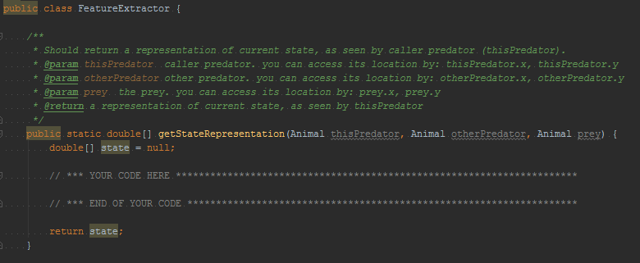
Code implementation
You should implement the method getStateRepresentation of the class FeatureExtractor
The returned double[] array length must be the same for all possible state.

Slide 23
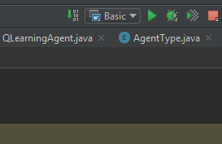
Code evaluation
You will be using JetBrains Intellij development environment.
Press the green triangle on the top-right corner to run the code.
As learning process begins, a graph-window will be presented- (see screenshot example on the next slide)
X axis- the number of episodes passed to that point
Y axis- the average number of steps required for the predators to catch the prey on the last 100 episodes.
Close the graph-window to terminate the code run.

Slide 24
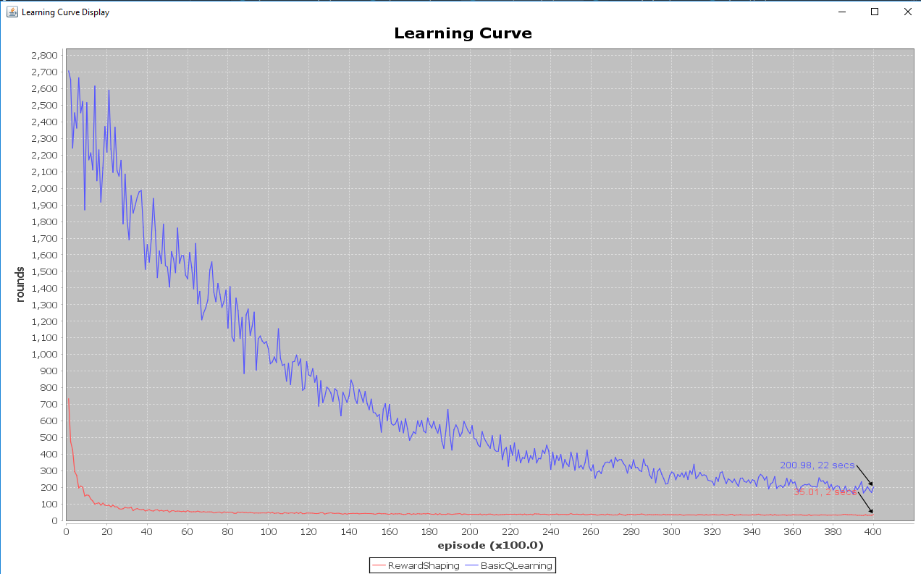
On the basic q-learning process, after 10k episodes, about 1100 steps required for the predators to catch the prey

Slide 25
Good luck!
You have 45 minutes for completing the coding task from the moment you end that presentation
For any question or issue- consult the laboratory assistant.

Slide 26
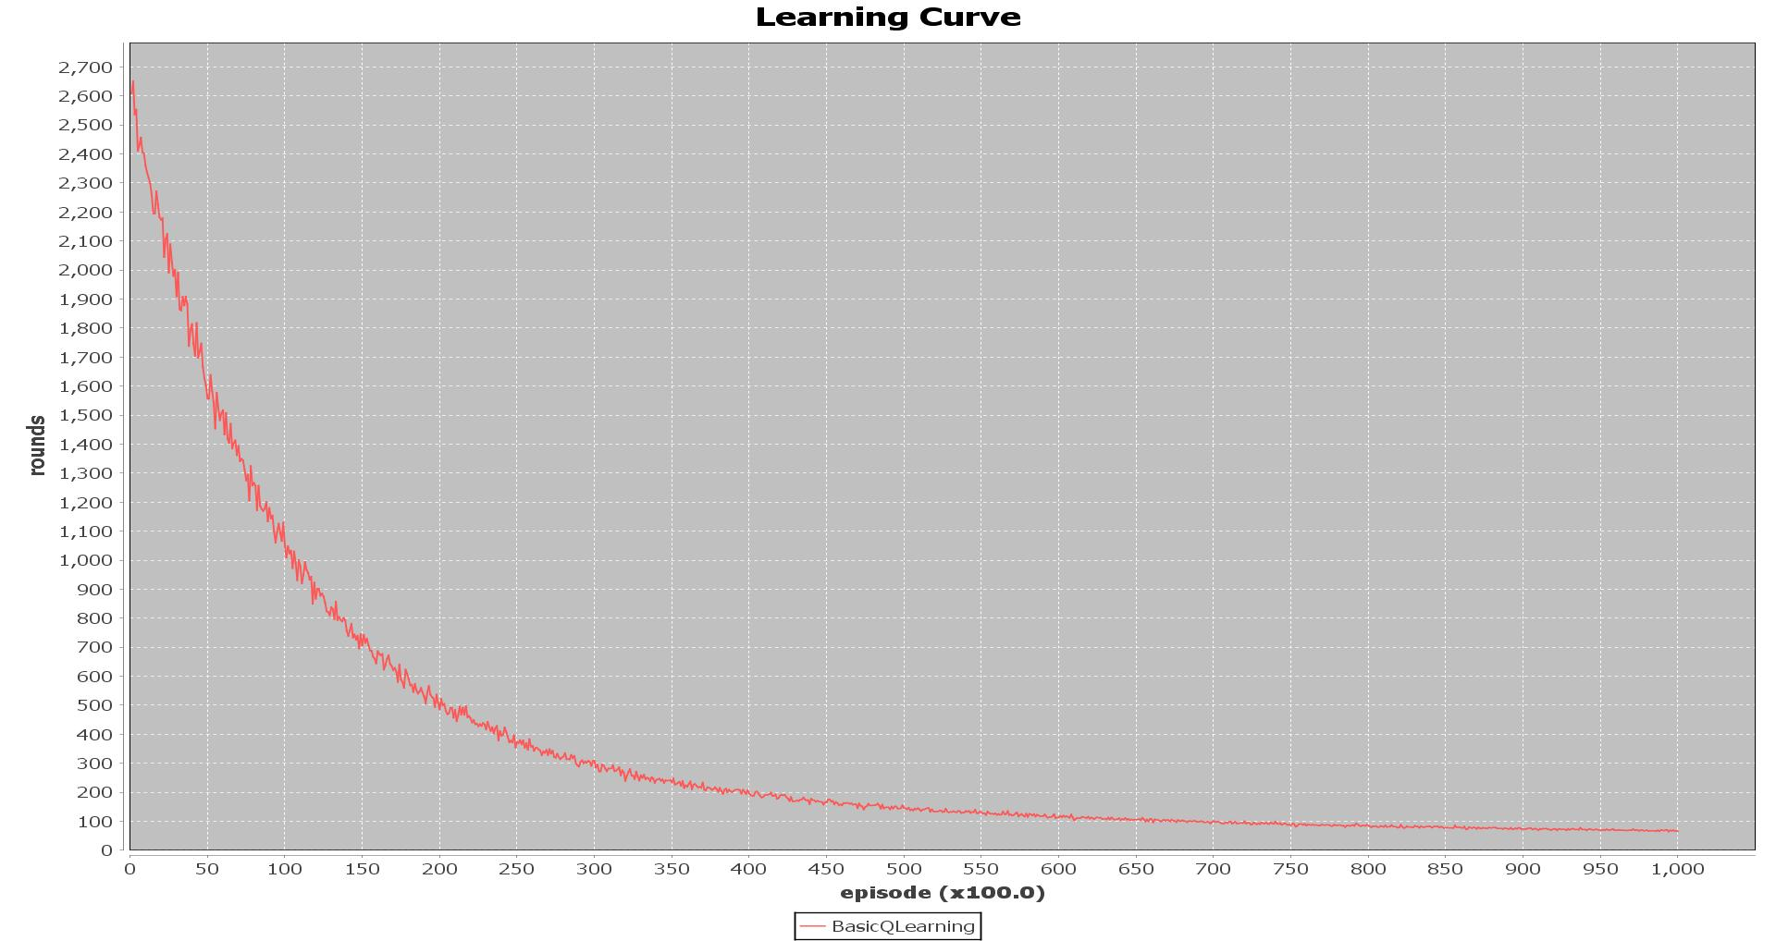

Slide 27
