Slide 1

www.ona.io

Slide 2


Slide 3
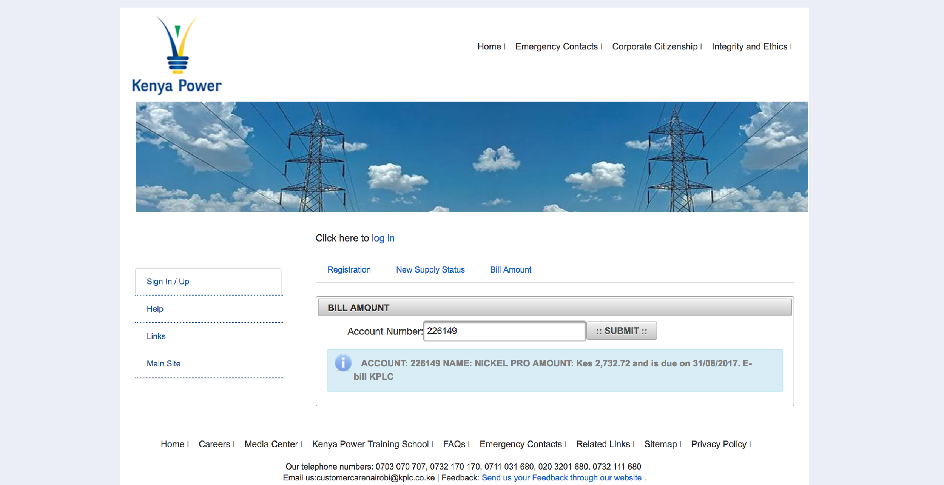

Slide 4
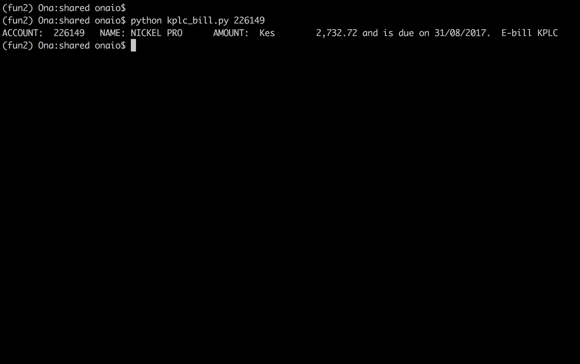

Slide 5
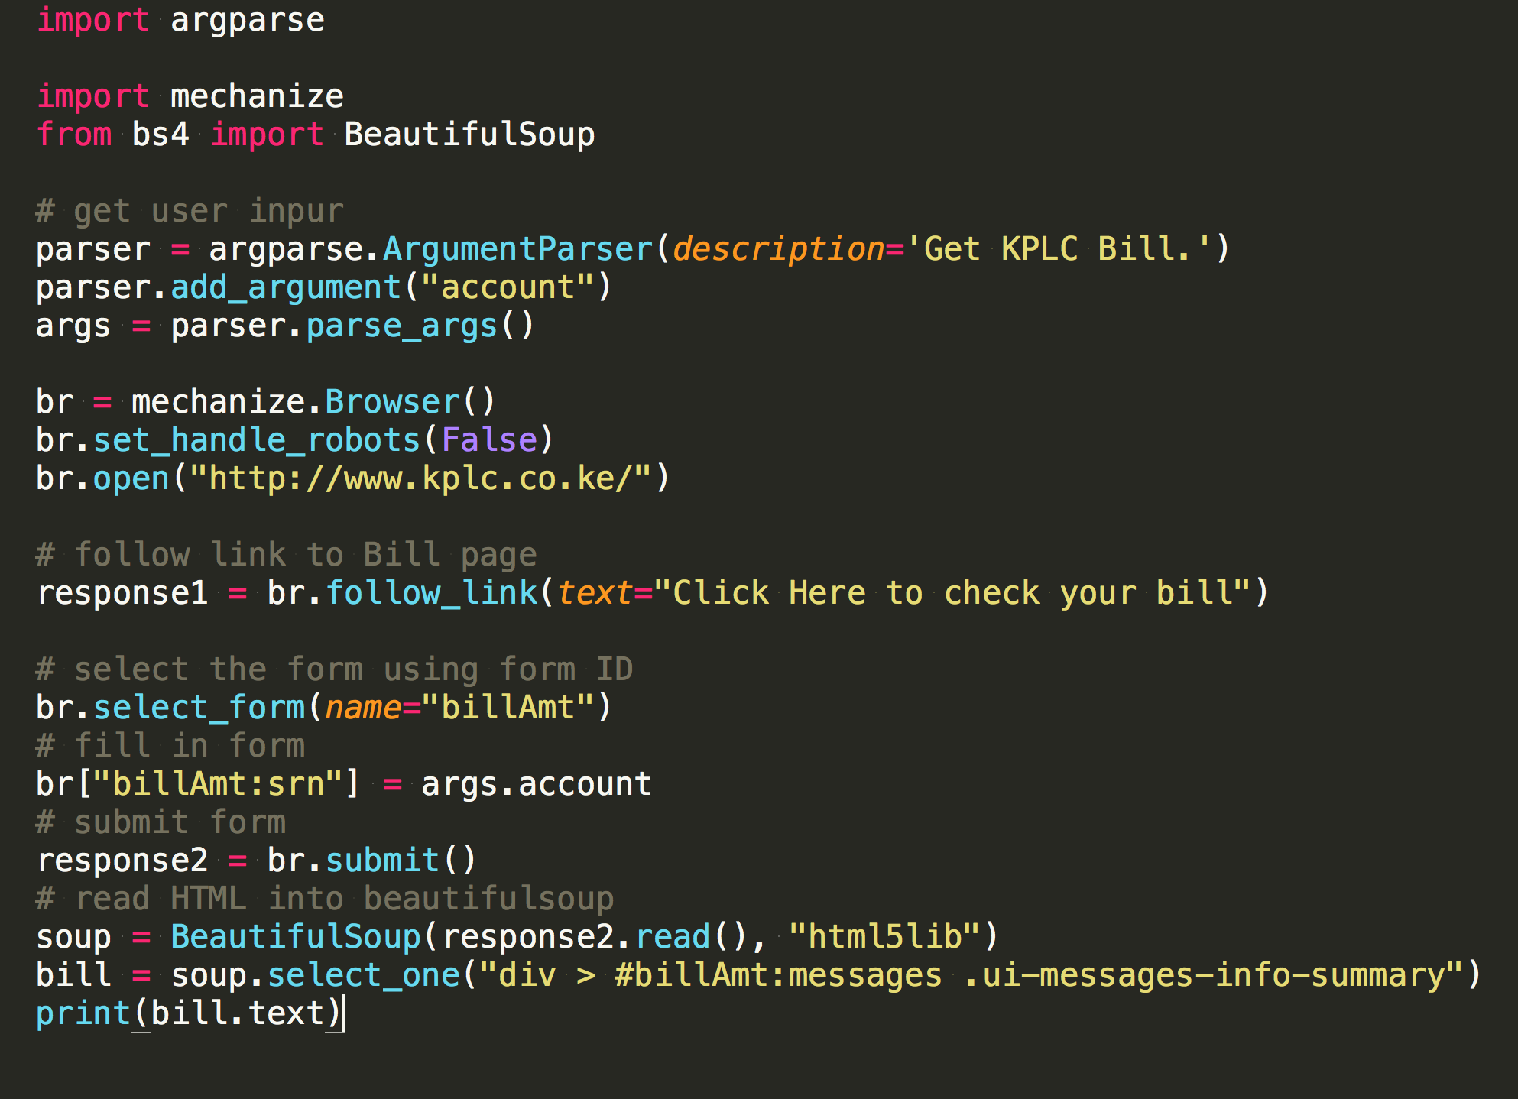

Slide 6
Kelvin Jayanoris @moshthepitt kjayanoris@ona.io

