Slide 1

Emoji Generate Based on Facial Emotion ☺
Umama Tasnim(mus854)
Hasanul Banna(bxw174)

Slide 2

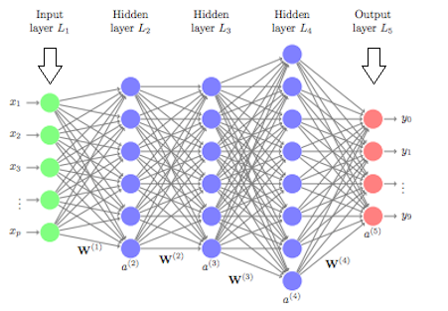

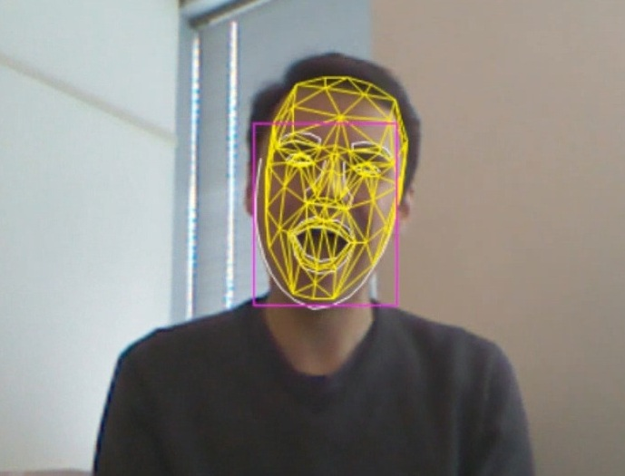
Introduction
Emojis or avatars are ways to indicate nonverbal cues.
In this project, we classify human facial expressions to filter and map corresponding emojis or avatars.
Figure: An overview of the project
Notes:
1. These cues have become an essential part of online chatting, product review, brand emotion, and many more. It also leads to increasing data science research dedicated to emoji-driven storytelling

Slide 3






Dataset
We used the FER2013[1] dataset consists of 48*48 pixel grayscale face images.
Number of samples: 28,709
Normalize the dataset between [0-1]
This dataset has the following categories of facial emotions:
Happy
Fearful
Angry
Disgusted
Neutral
Sad
Surprised

Slide 4
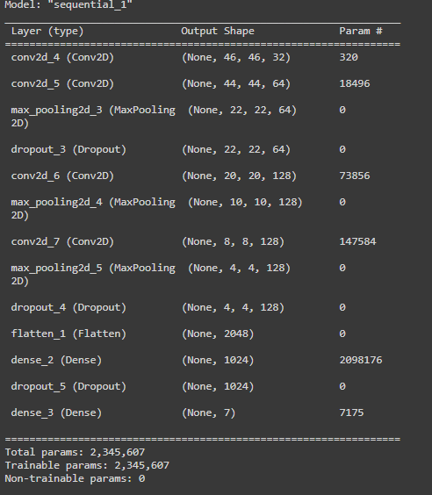
Model Architecture

Slide 5
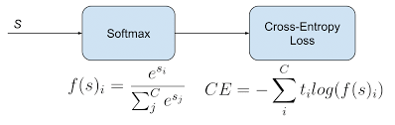
Model Training
We build a convolutional neural network and used the FER2013 dataset to train the model for emoji classification.
We used the “Categorical Cross Entropy” as our loss function that is used in multi-class classification tasks.
We used “Adam” optimizer [2].
Learning rate: 0.001
Epoch: 50
Notes:
s “Adam”. Adam optimization is a stochastic gradient descent method that is based on adaptive estimation of first-order and second-order moments

Slide 6
Steps and Current Status
Import required libraries
Initialize the training
Building the CNN model (our current stage)
Train the model
Implement GUI and mapping with emoji

Slide 7
Challenges
We are building our project based on deep learning and CNN and we’re in learning stage, so it was challenging for us.
Finding a rich dataset was another challenge for us, currently we’re using the dataset from Kaggle, which is good. But it would work more precisely if we find more rich dataset.
We’re having some trouble interfacing the webcam to take the input.

Slide 8
Final Result and Improvement
Model should work as expected.
Train the model successfully using the dataset.
Emojis should be mapped correctly based on the input.
We need to improve the model, so that it can detect the input even in darker environment, currently well lit environment is needed.
It doesn’t work properly if the image is blurry, this need to improve.

Slide 9
Reference
[1] Giannopoulos, P., Perikos, I., & Hatzilygeroudis, I. (2018). Deep learning approaches for facial emotion recognition: A case study on FER-2013. In Advances in hybridization of intelligent methods (pp. 1-16). Springer, Cham.
[2] Zhang, Z. (2018, June). Improved adam optimizer for deep neural networks. In 2018 IEEE/ACM 26th International Symposium on Quality of Service (IWQoS) (pp. 1-2). IEEE.

