Slide 1
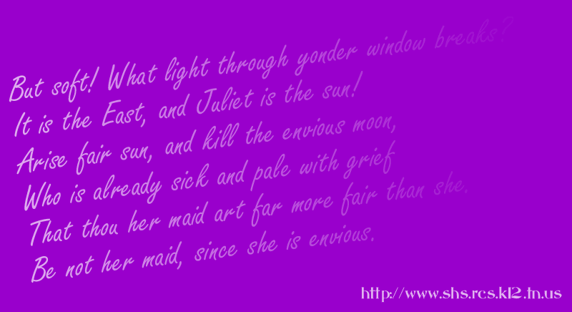
Complements
English I
9.1.2004

Slide 2
Predicate Nominatives
Follow a linking verb
Rename the subject
He is a good student.

Slide 3
Predicate Adjectives
Follow a linking verb
Modify (describe) the subject
She is beautiful.

Slide 4
Direct Object
Follows an action verb
Answers “who” or “what” after the verb
He gave her the book.

Slide 5
Indirect Object
Follows an action verb
Answers “to whom” or “for whom” after a direct object
He gave her the book.

Slide 6
Subject
Verb
Linking
Action
Predicate Nominative
Direct Object
Predicate Adjective
Indirect Object

