Slide 1


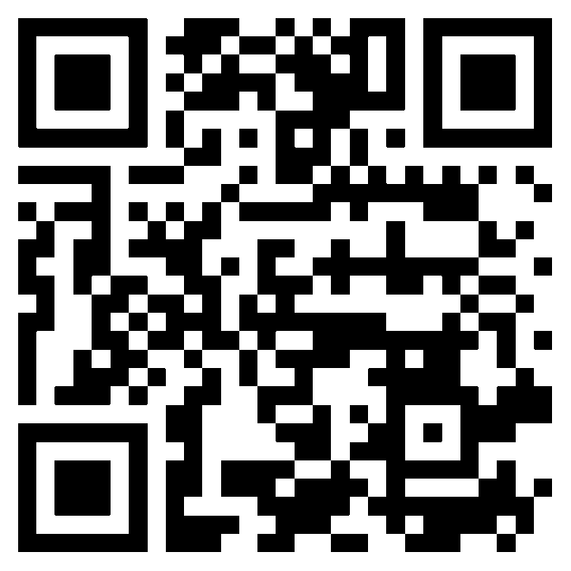
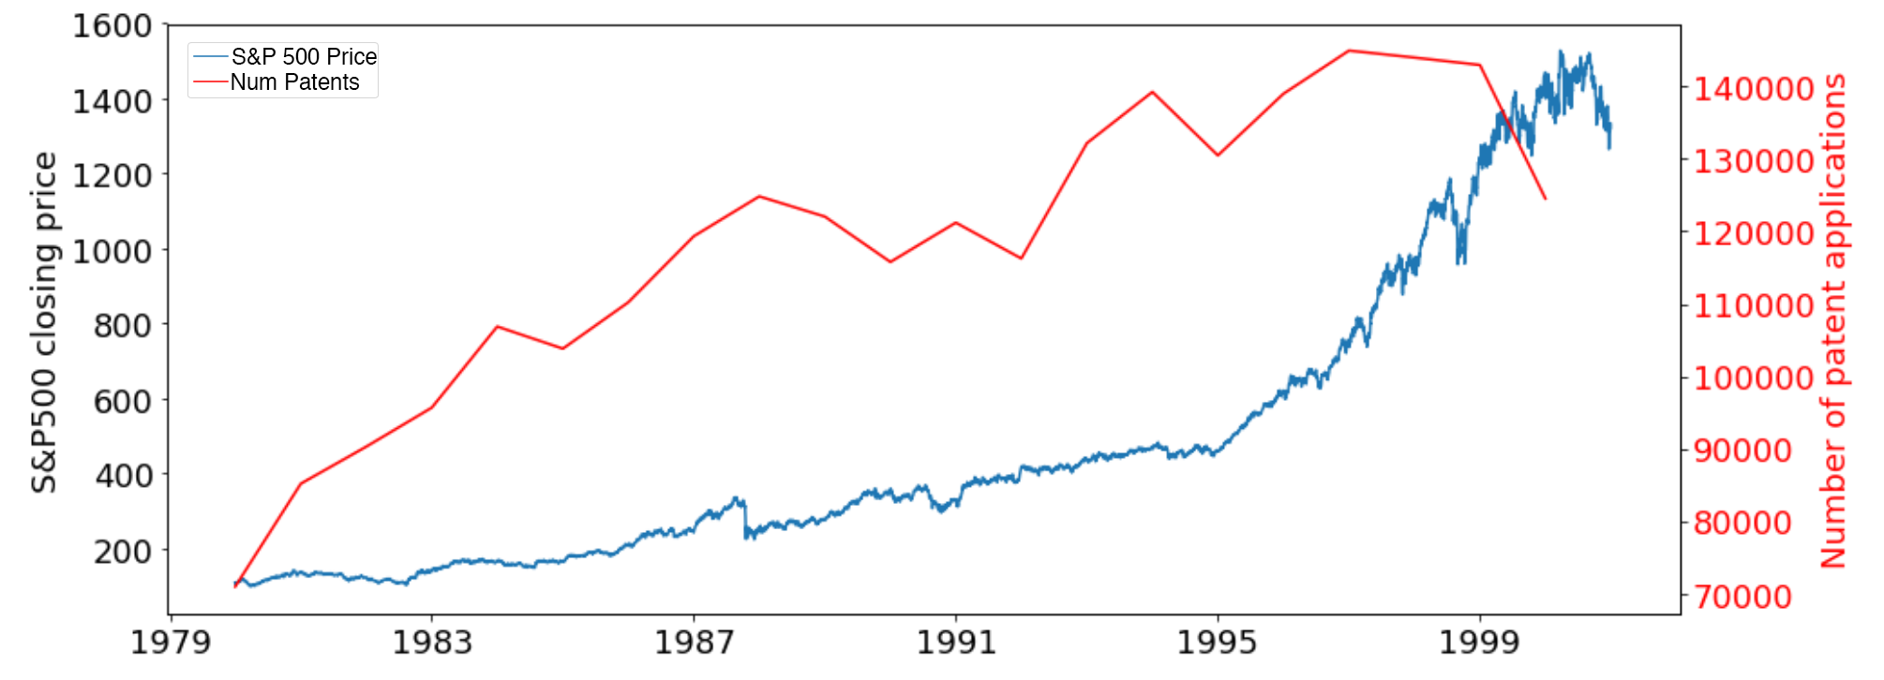
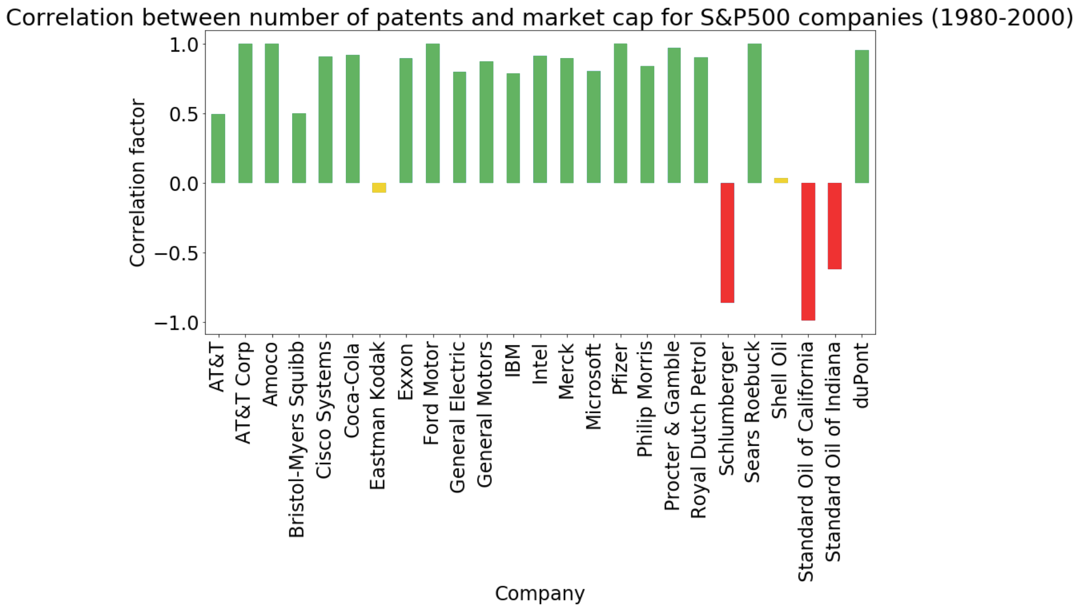
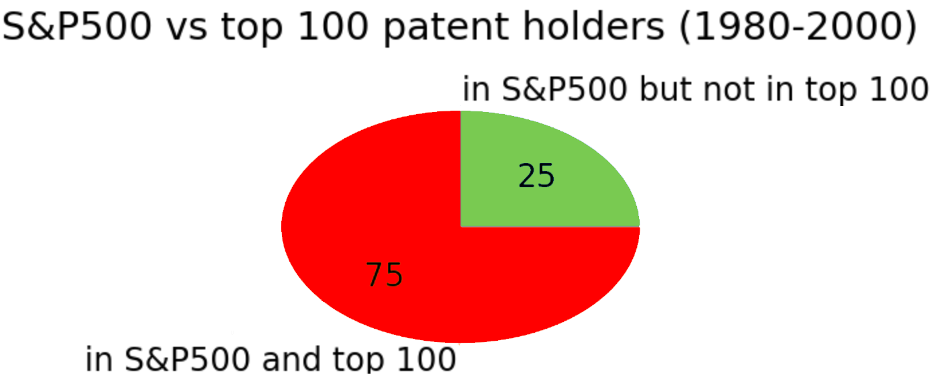
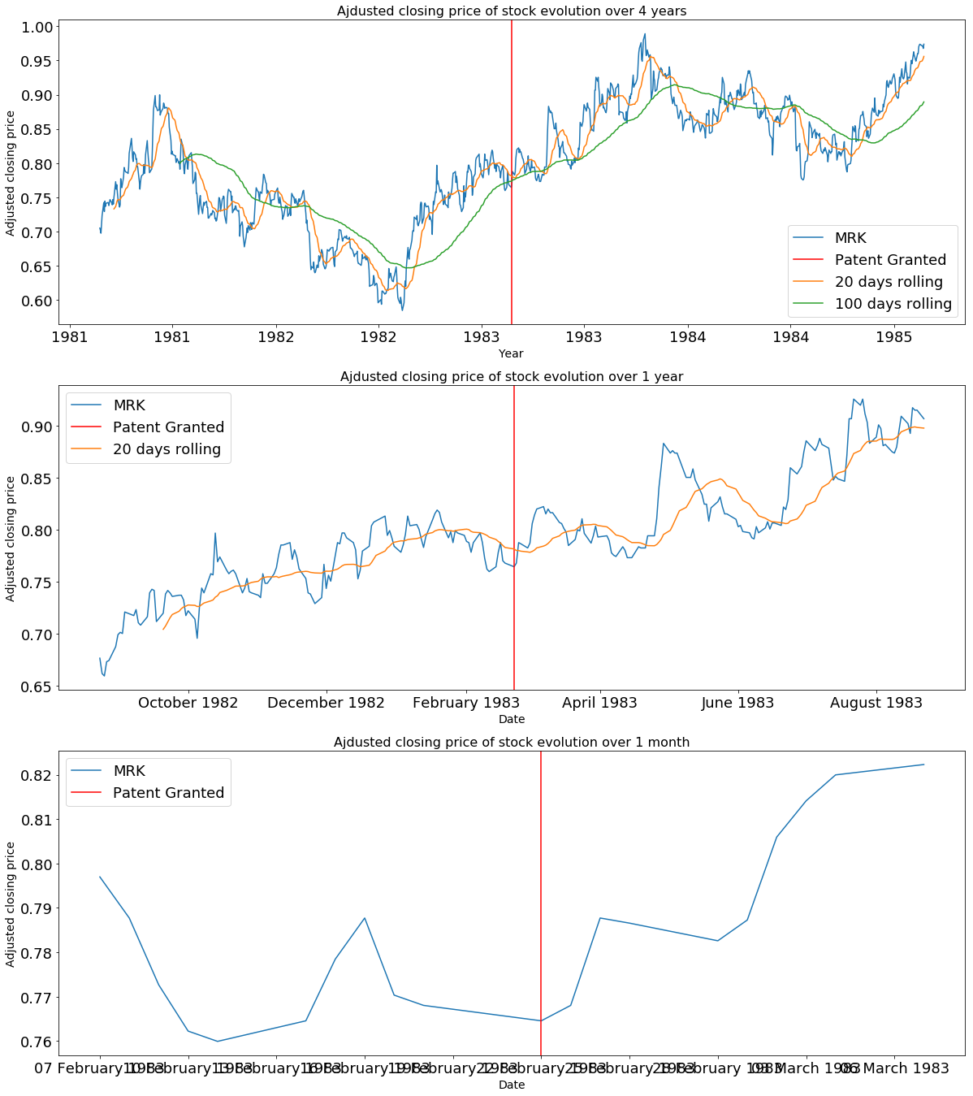
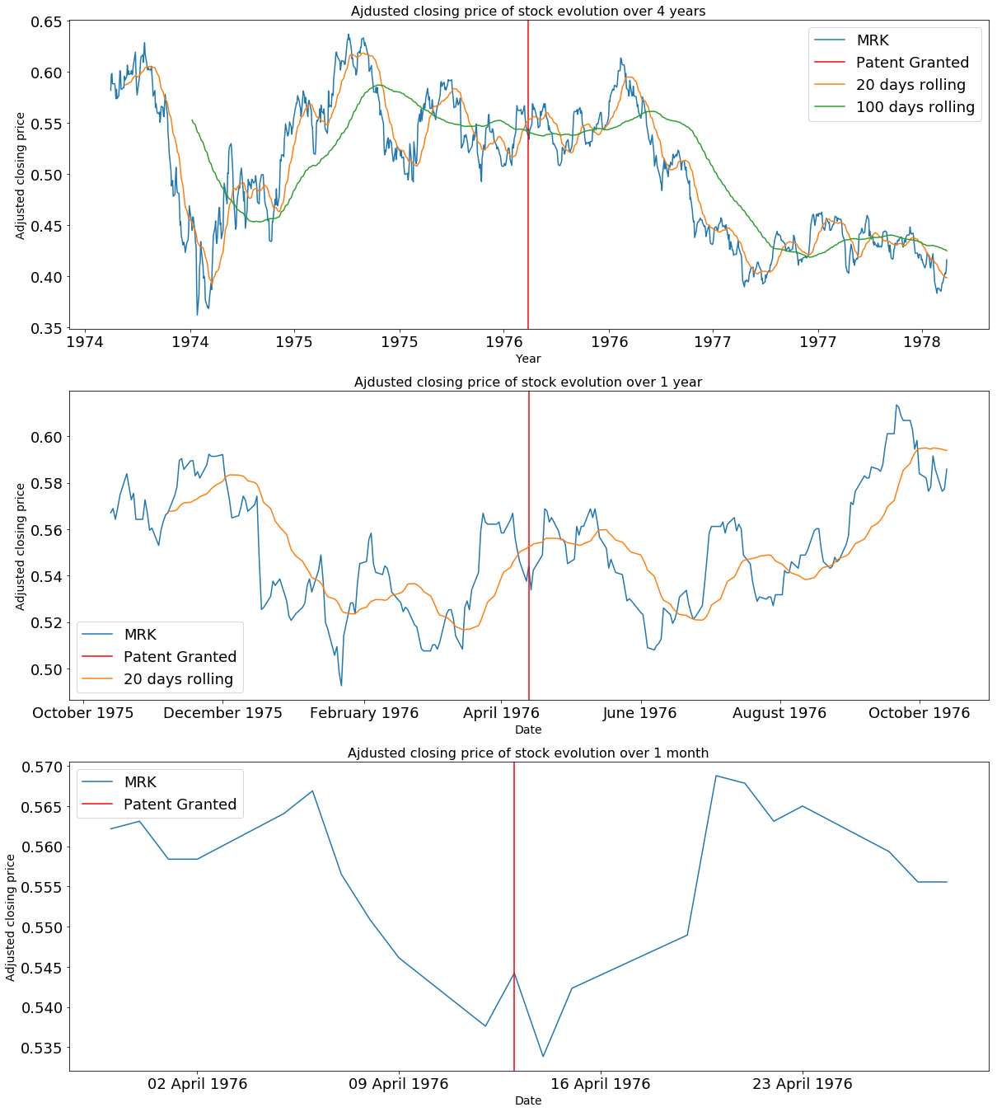
Do Markets Follow Patents?
Clothilde Vauvelle, Myriam Mosimann, Laurent Bindschaedler
Project Goals
Methodology
Companies with strong innovation culture are often rewarded with high valuations. In this project, we take patents as a proxy for innovation and attempt to understand if and how patenting inventions leads to a higher valuation.
3 research questions,
Is there a correlation between patents and market cap?
Are large patent holders systematically highly valued?
Are there examples of key patents boosting valuations?
Data Sources
National Bureau of Economic Research (NBER) Patent Dataset
Stanford University’s Patent Graph
ETFDB.com’s Top 10 of S&P 500
Wharton Research Data Services (WRDS)
Yahoo! Finance
1. Combine NBER’s Dataset with Stanford’s Patent Graph
Graph encodes patent importance, relationships, etc.
2. Match company names with ETFDB and WRDS
Unified index across all datasets
Non trivial due to mergers, acquisitions, splits, renaming, etc.
Patents and Economic Growth
Observations:
There is some correlation between number of patents granted and the S&P 500 price
From 1996, the S&P started to grow a lot faster than patents granted due to
Dotcom bubble
Edge effect
Top Patent Holders
Key insights:
¾ of top 100 companies in the S&P 500 are also in the top 100 of patent holders
Most companies’ valuation is correlated with the number of patents they have
With a few notable exceptions (oil companies, Eastman Kodak)
Influencial Patents and Company Valuation (Merck)
Aminoacid Derivatives as Antihypertensives (1983)
Patent covers a key sector for Merck
Antibiotic Thienamycin (1976)
Patent had no immediate market applications
Patent is part of a larger growth trend
No long-term effect on price
Boost in
stock price
No/negative effect on price

