Slide 1

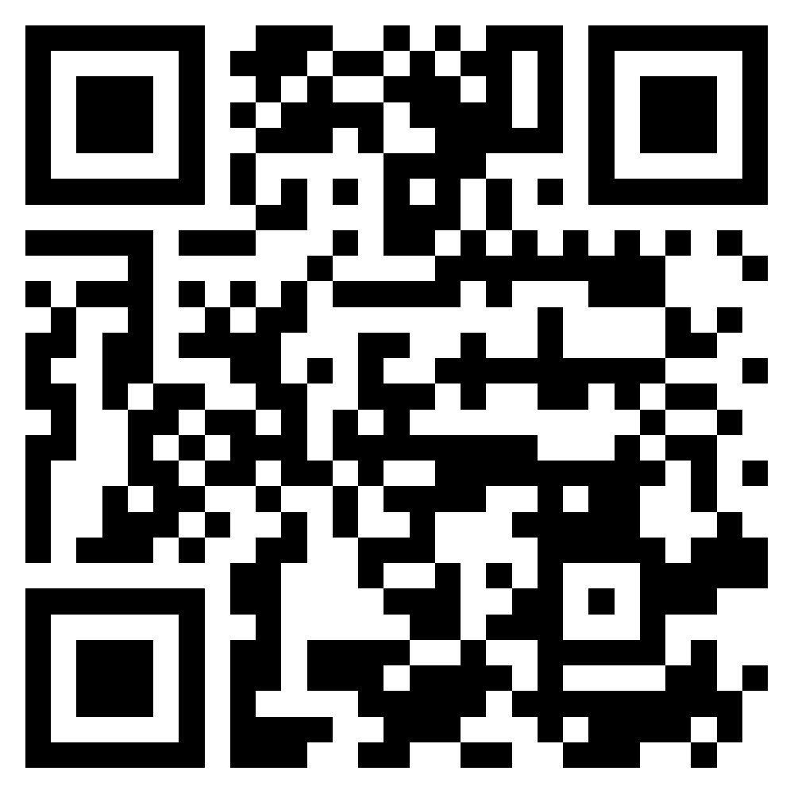
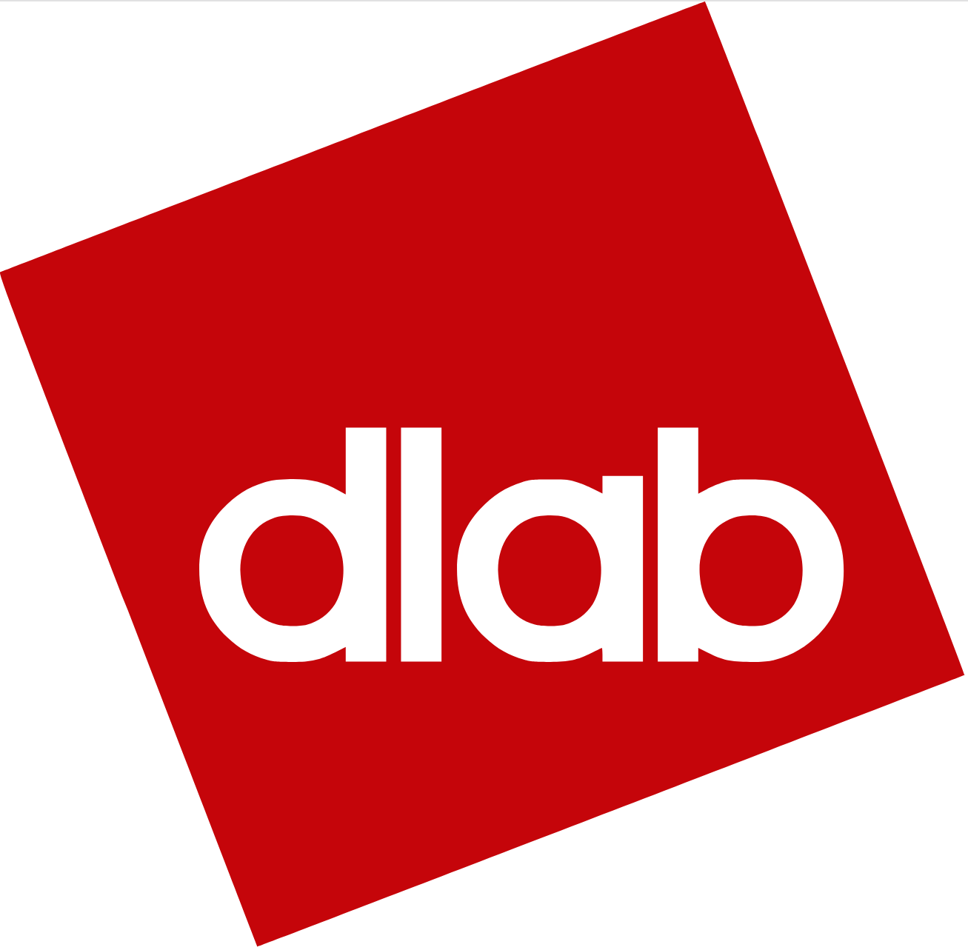
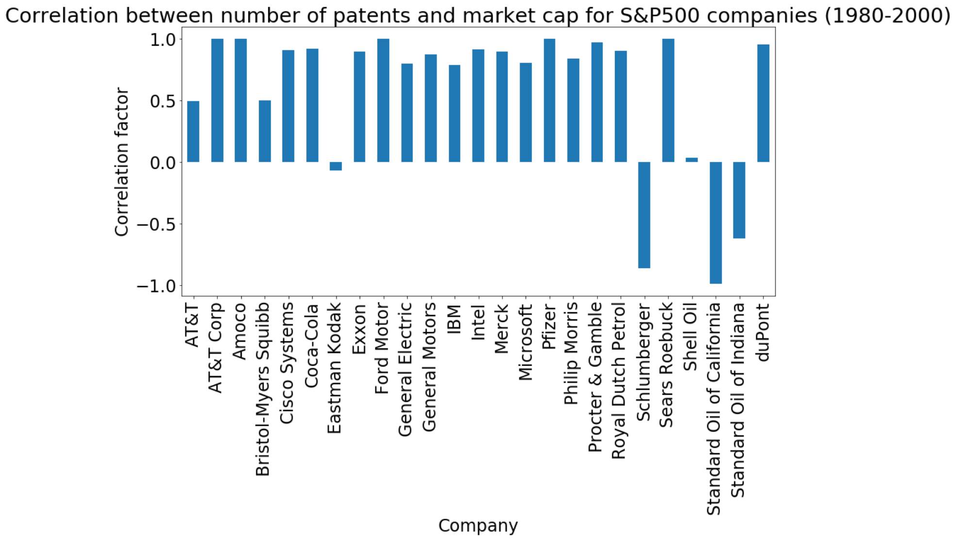
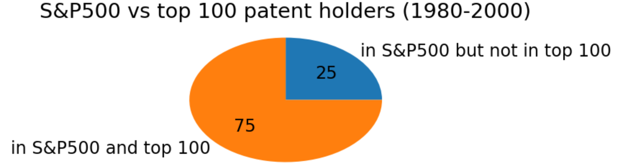
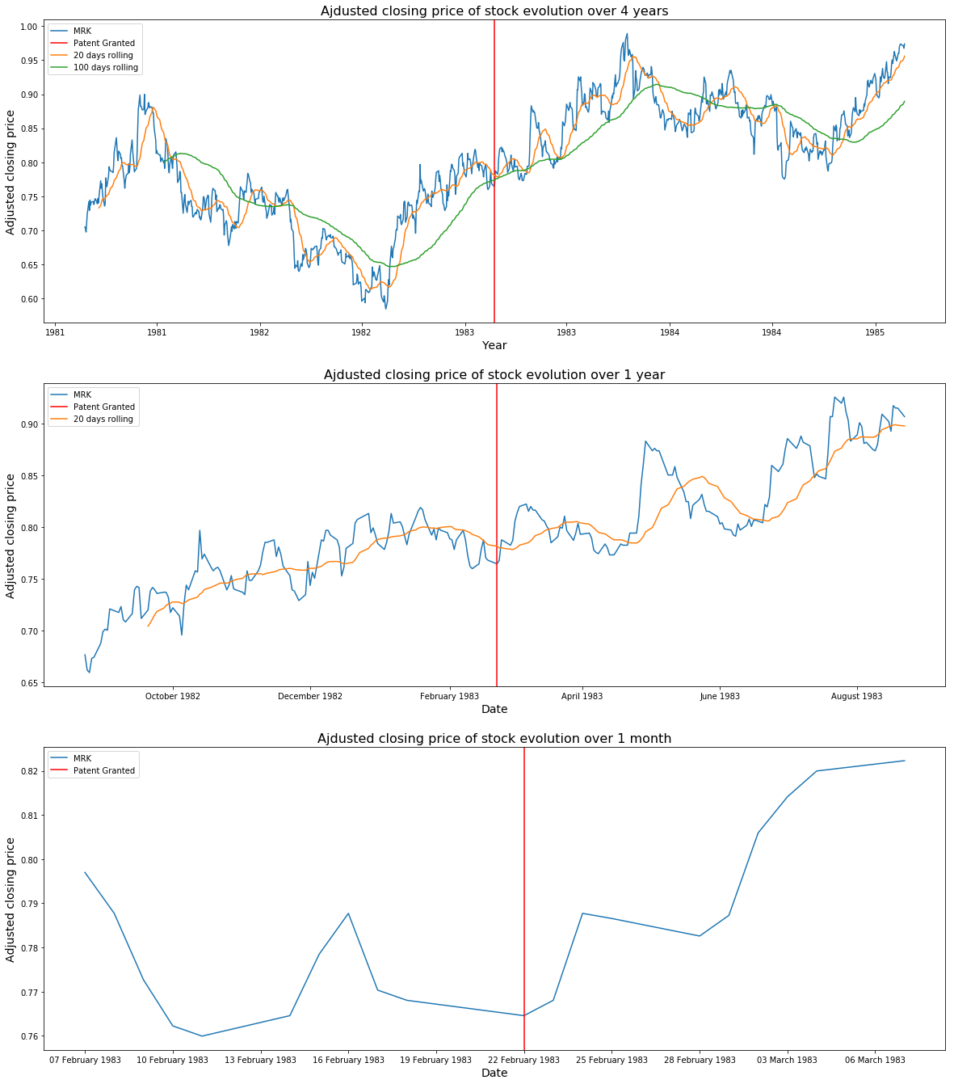
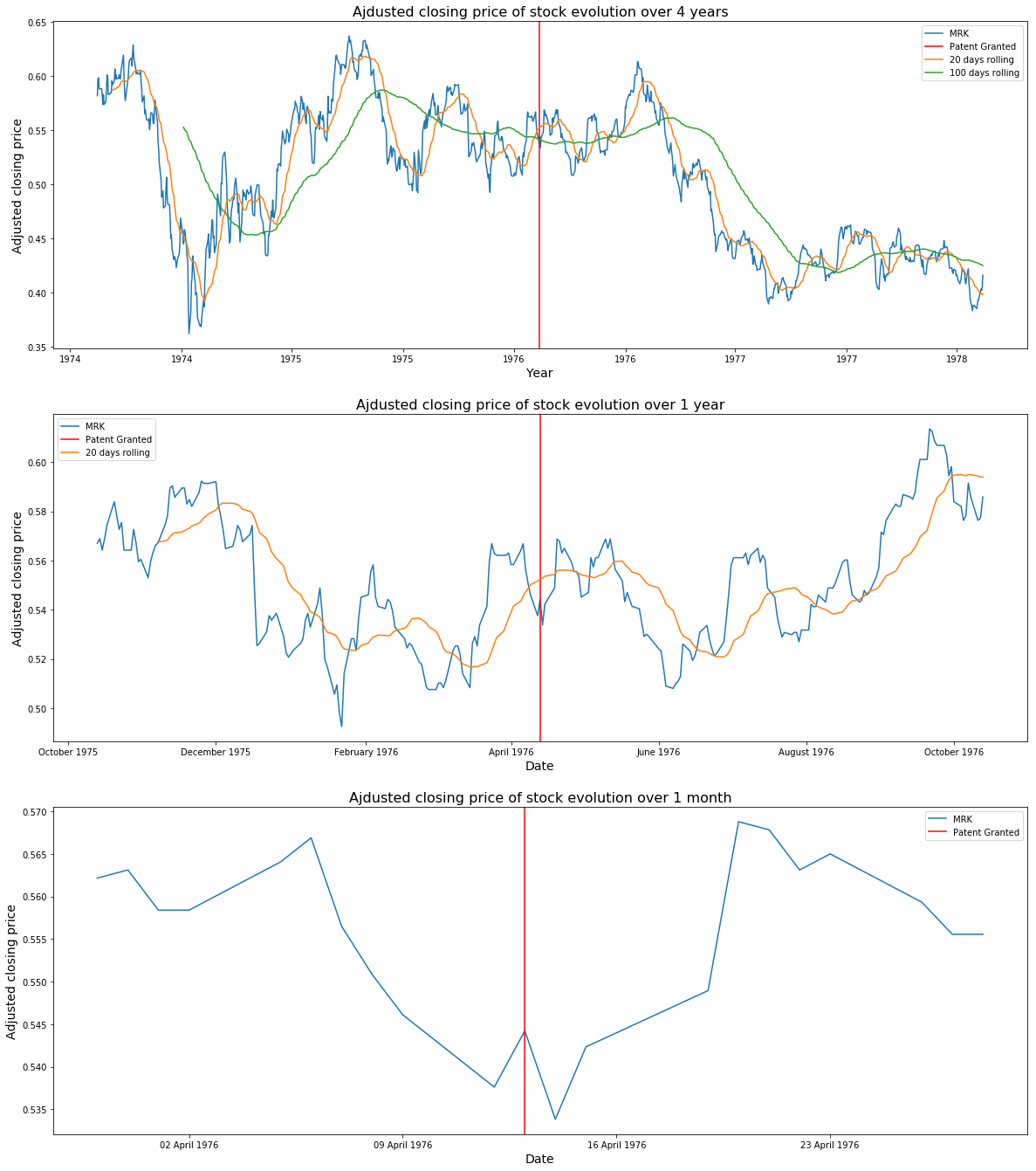
Do Markets Follow Patents?
Clothilde Vauvelle, Myriam Mosimann, Laurent Bindschaedler
Project Goals
Methodology
Companies with strong innovation culture are often rewarded with high valuations. In this project, we take patents as a proxy for innovation and attempt to understand if and how patenting inventions leads to a higher valuation.
3 research questions,
Is there a correlation between patents and market cap?
Are large patent holders systematically highly valued?
Are there examples of key patents boosting valuations?
Data Sources
National Bureau of Economic Research (NBER) Patent Dataset
Stanford University’s Patent Graph
ETFDB.com’s Top 10 of S&P 500
Wharton Research Data Services (WRDS)
Yahoo! Finance
1. Combine NBER’s Dataset with Stanford’s Patent Graph
Graph encodes patent importance, relationships, etc.
2. Match company names with ETFDB and WRDS
Unified index across all datasets
Non trivial due to mergers, acquisitions, splits, renaming, etc.
Patents and Market Cap
There is a correlation between the total number of patent applications and the S&P 500
Top Patent Holders
Key insights:
¾ of top 100 companies in the S&P 500 are also in the top 100 of patent holders
Most companies’ valuation is highly correlated with the number of patents they have
A few notable exceptions (oil companies, Eastman Kodak)
Influencial Patents and Company Valuation (Merck)
Aminoacid Derivatives as Antihypertensives (1983)
Antibiotic Thienamycin (1976)

