Slide 1
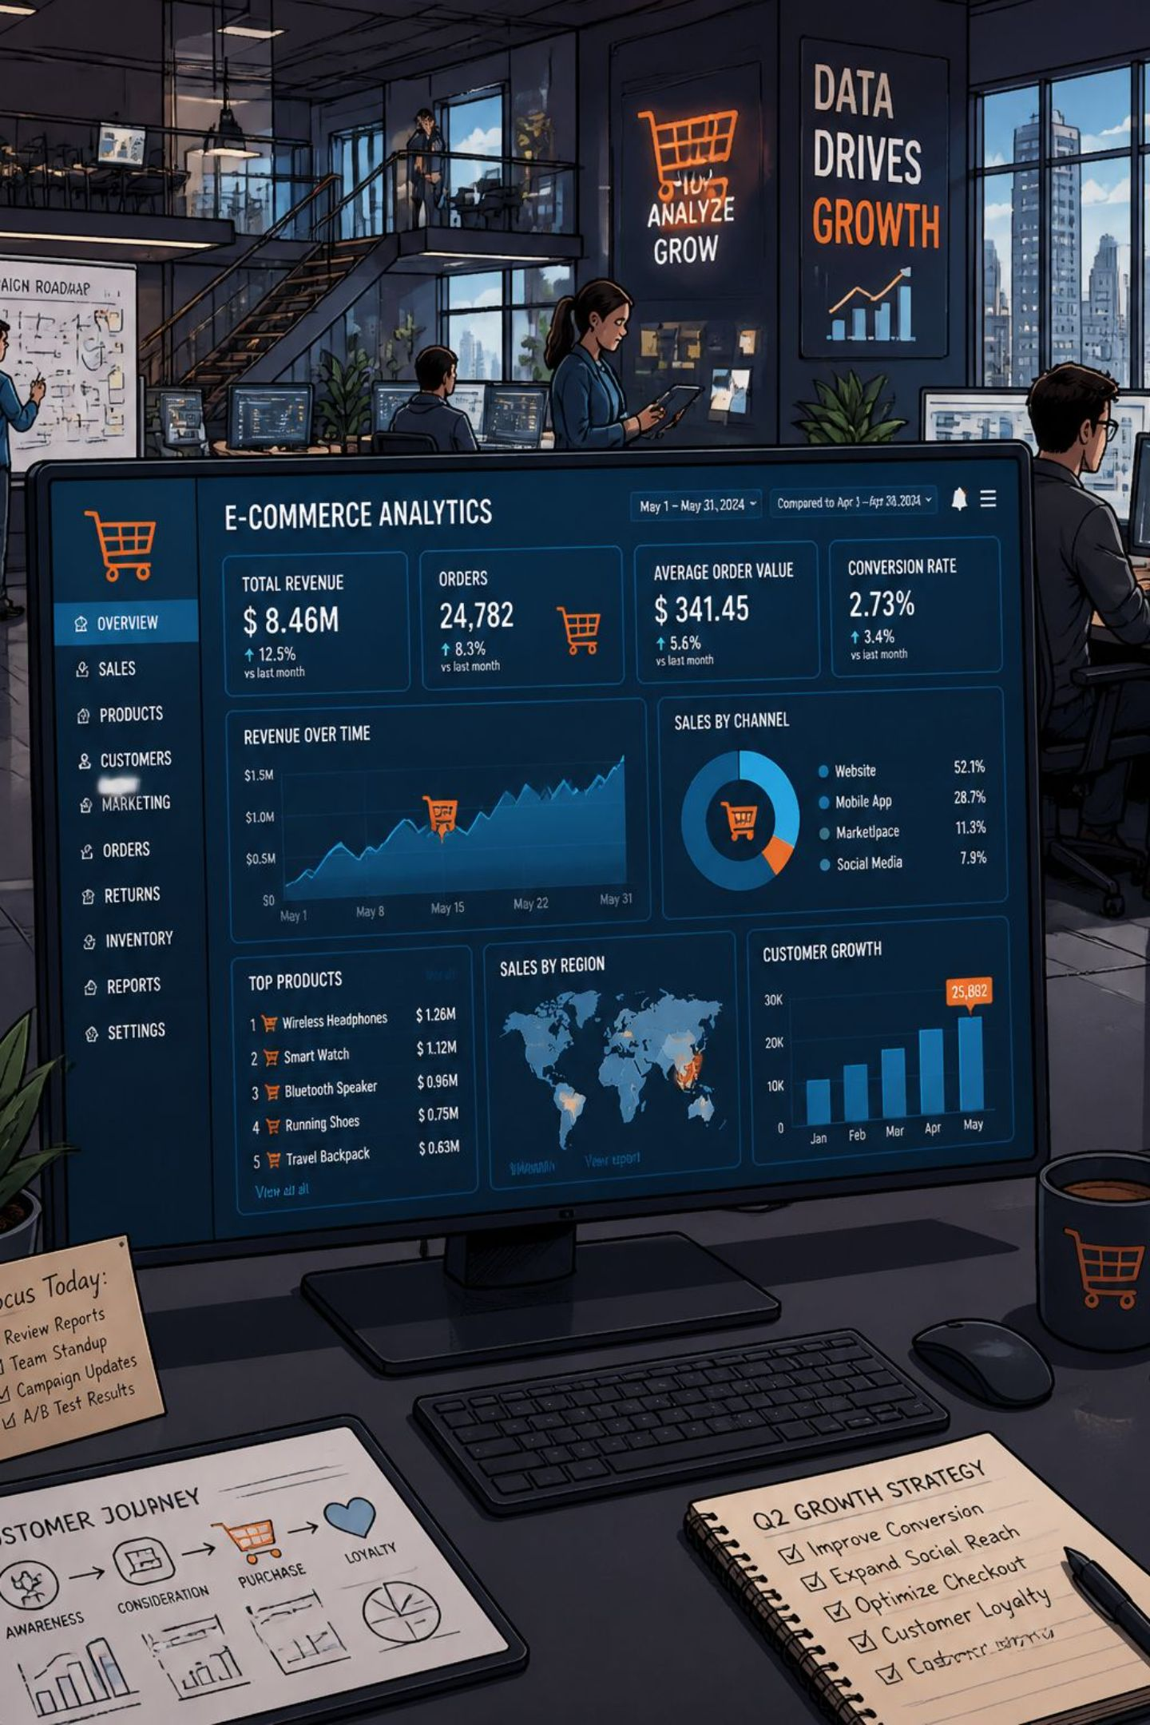
Customer Shopping Behavior Analysis
Uncovering spending patterns, customer segments, and product preferences from 3,900 transactions to guide strategic business decisions.

Slide 2
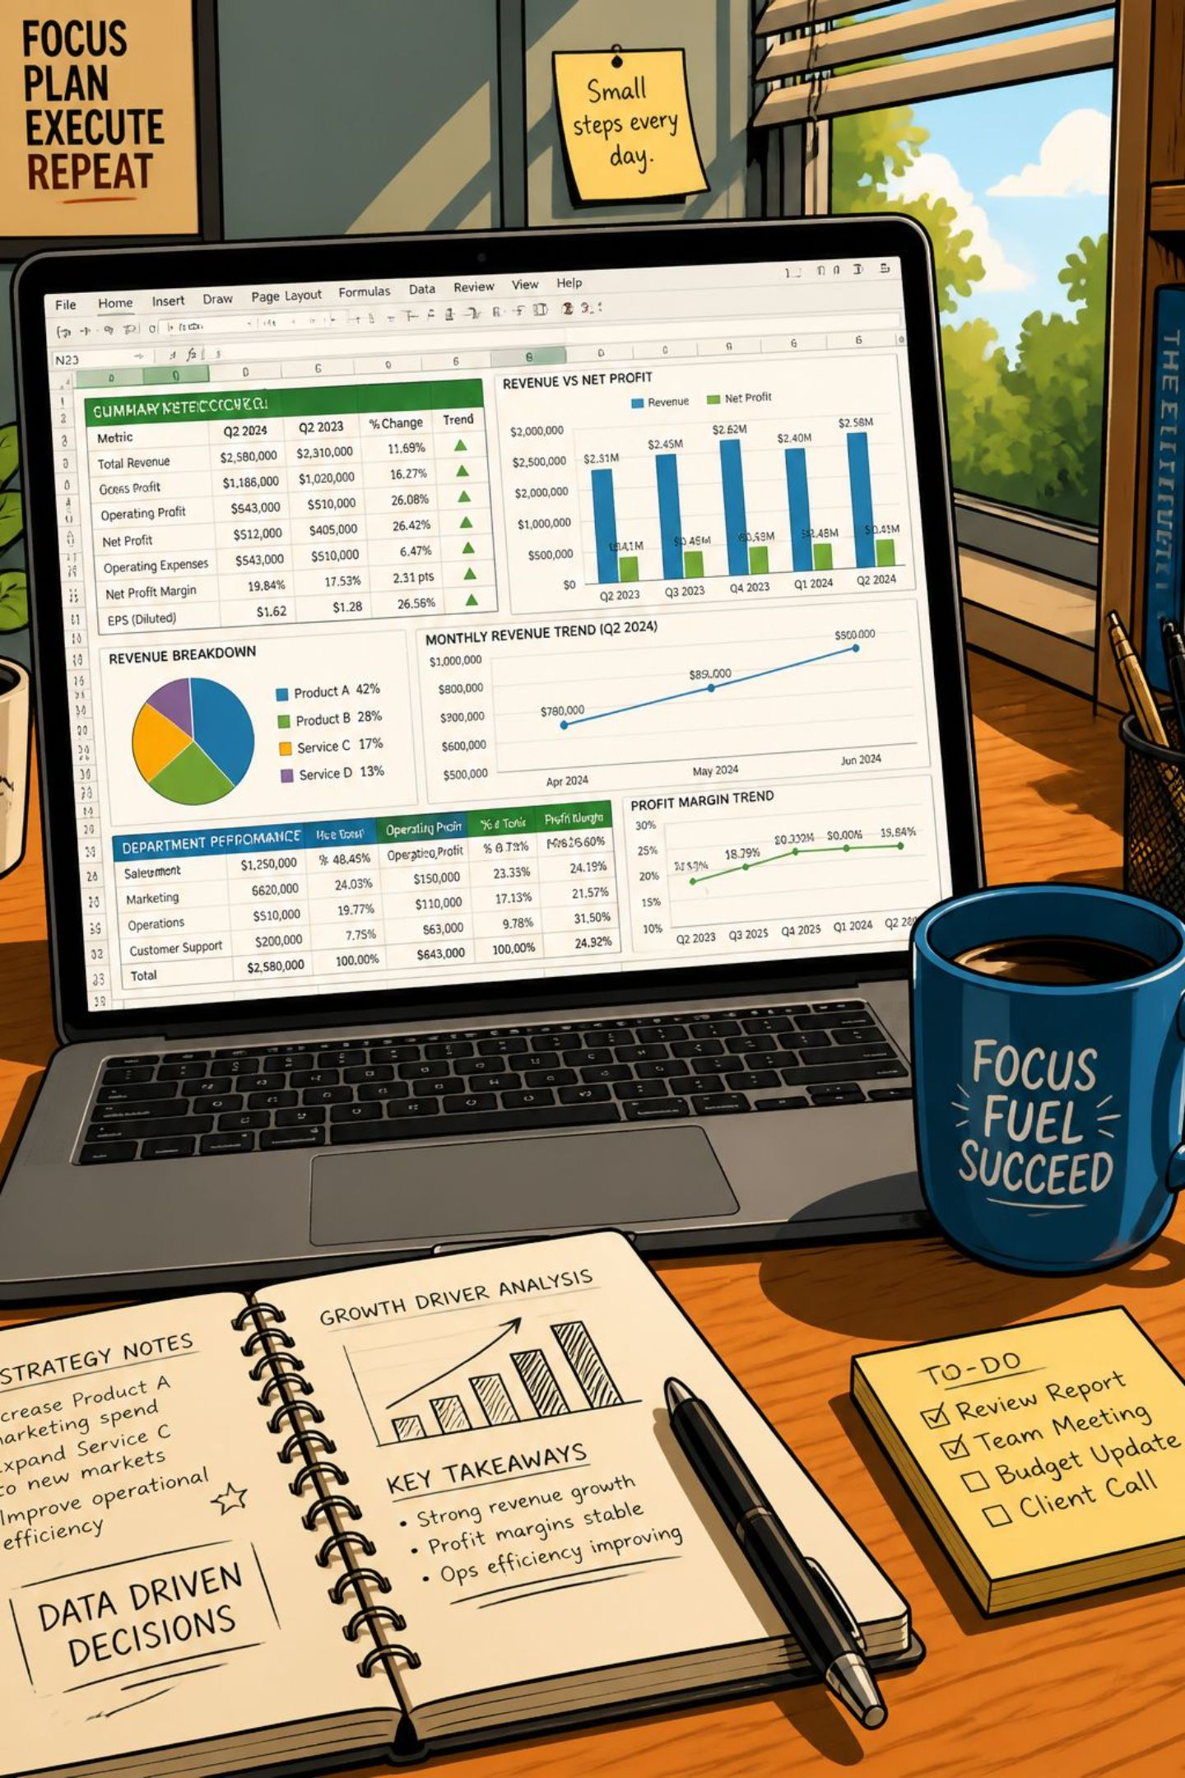
Dataset at a Glance
3,900
18
Transactions
Columns
37
Missing Values
Review Rating only
Features span demographics, purchase details, and shopping behavior — including discounts, promo codes, and subscription status.

Slide 3

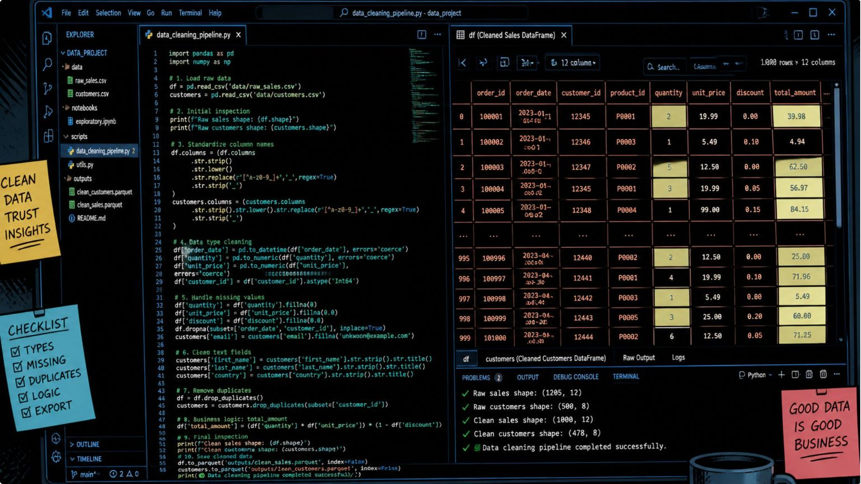
Data Preparation in Python
Clean & Standardize
Imputed missing ratings by category median; renamed columns to snake_case
Feature Engineering
Created age_group and purchase_frequency_days
Load to PostgreSQL
Cleaned DataFrame loaded for SQL analysis

Slide 4
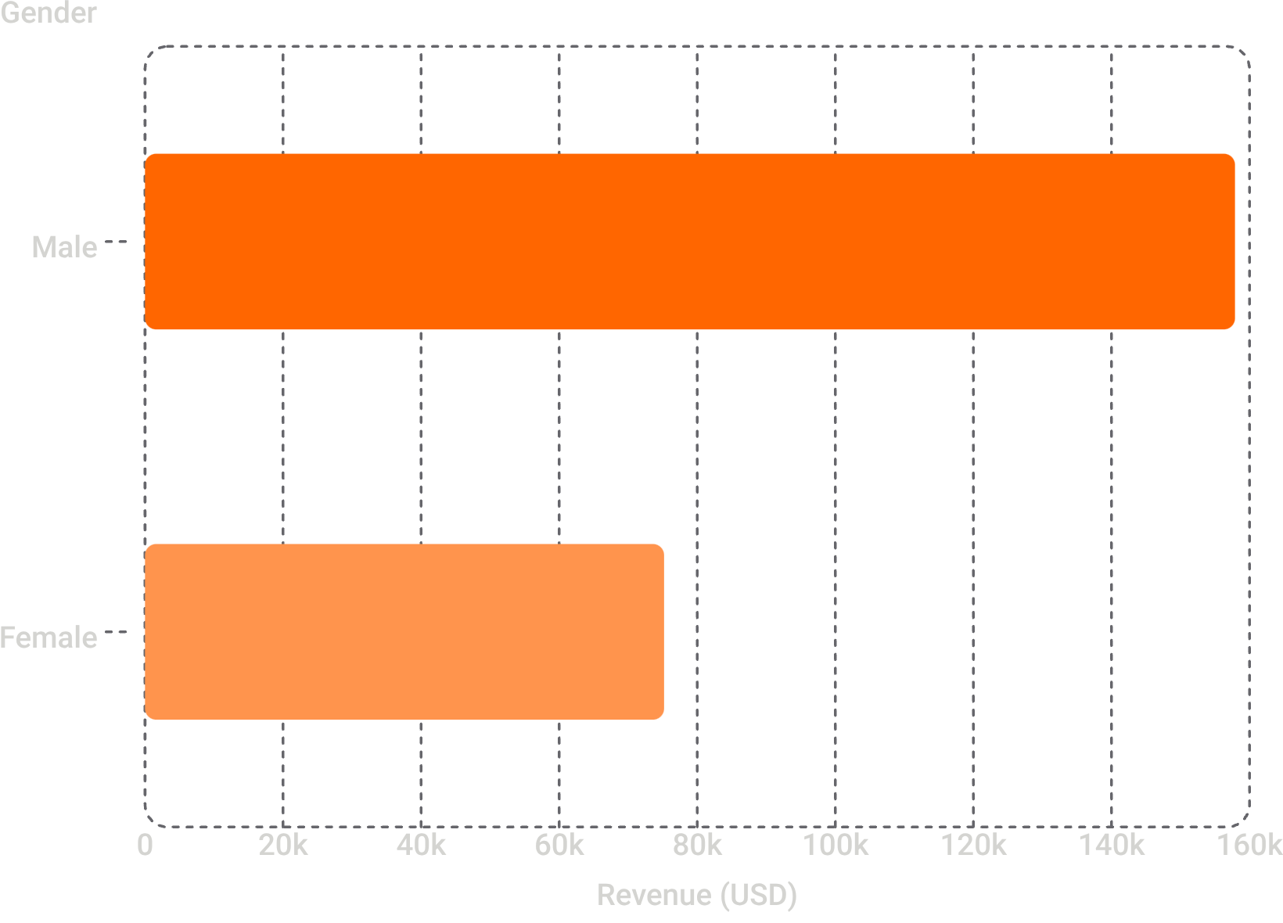
Revenue by Gender
Key Finding
Male customers generated 2.1× more revenue than female customers — a critical segment to understand and target.

Slide 5
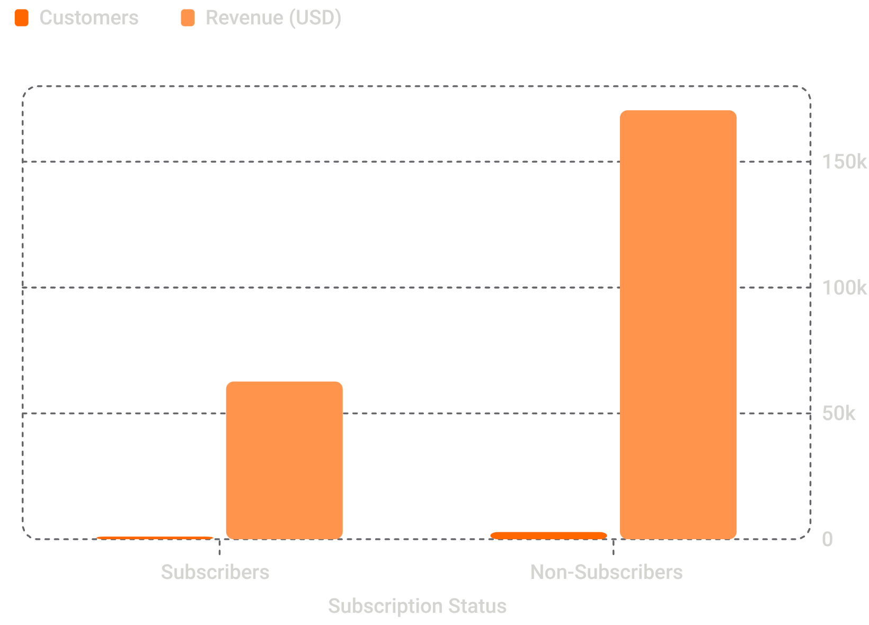
Subscribers vs. Non-Subscribers
Insight
Non-subscribers drive 73% of total revenue despite similar average spend (~$59). Subscription conversion is a major growth opportunity.

Slide 6
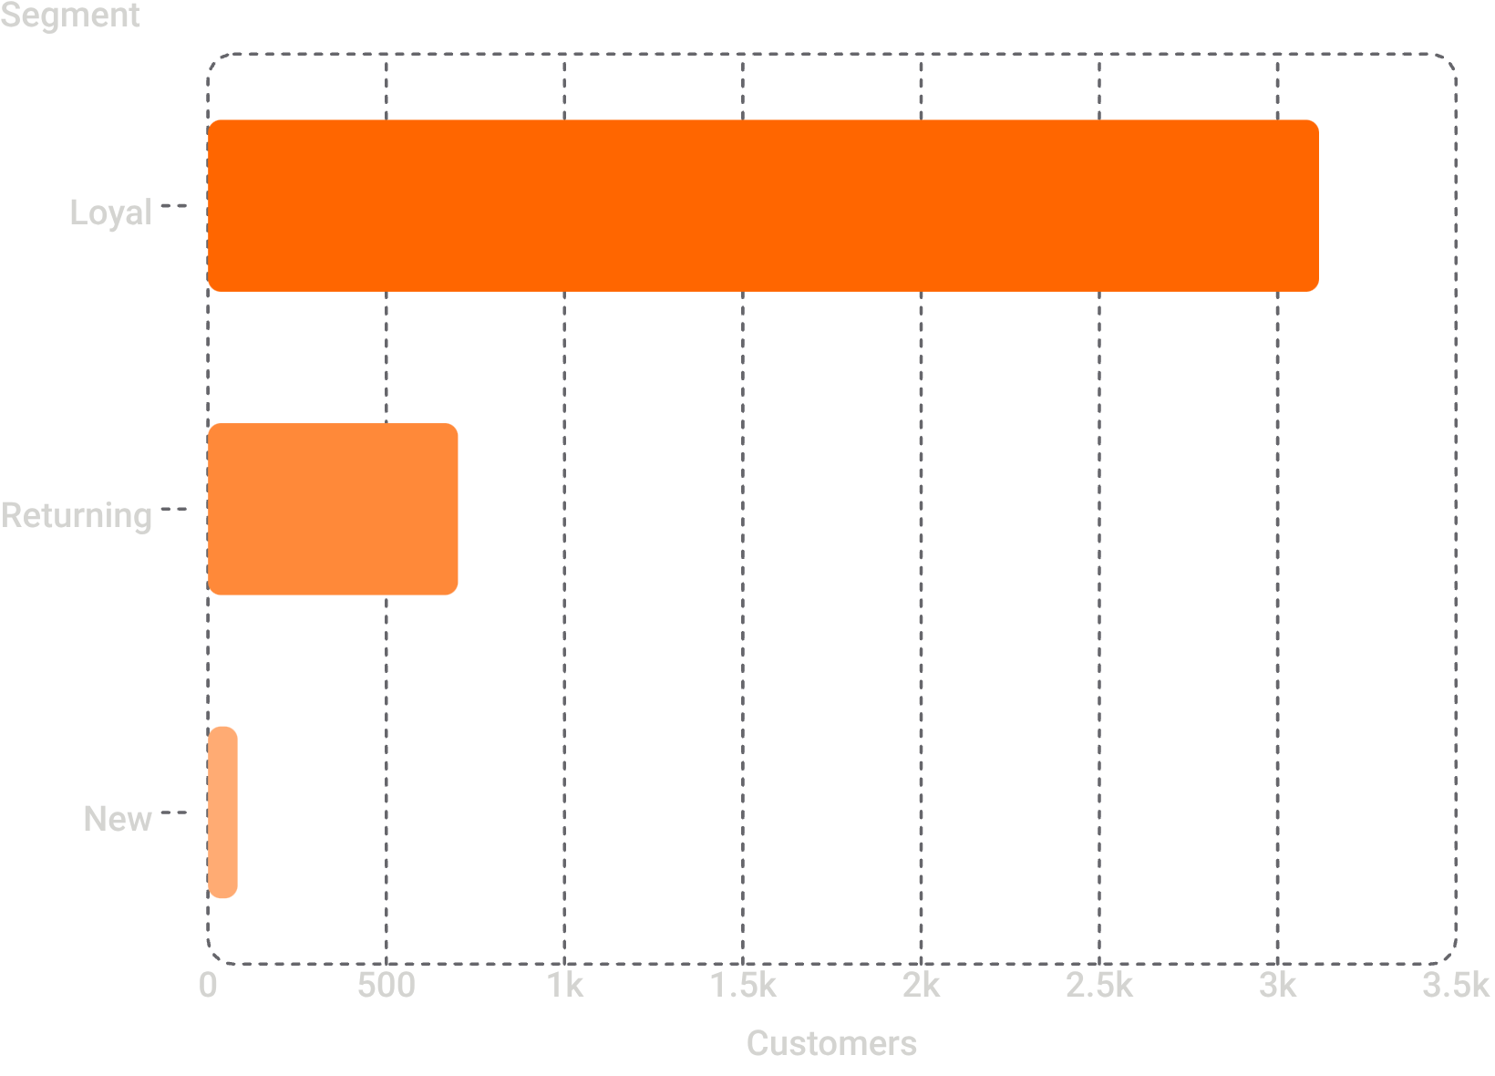

Customer Segmentation
Segment Breakdown
Loyal: 3,116 customers (10+ purchases)
Returning: 701 customers (2–10 purchases)
New: 83 customers (1 purchase)
80% of customers are already Loyal — retention programs can deepen engagement.

Slide 7
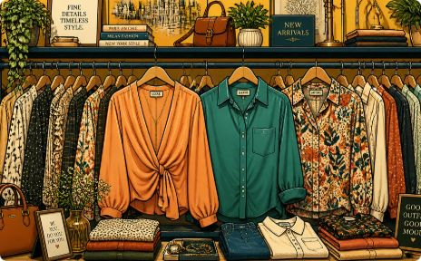

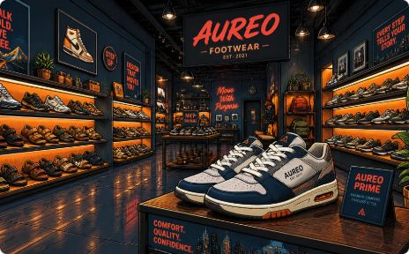
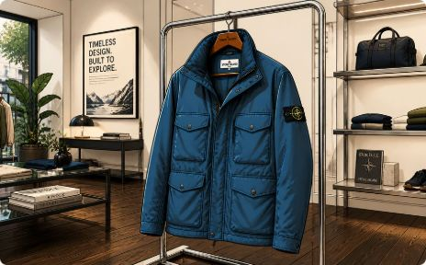
Top Products & Categories
Clothing
Accessories
Footwear
Outerwear
Blouse, Pants, Shirt — highest order volume
Jewelry, Sunglasses, Belt lead the category
Sandals, Shoes, Sneakers top sellers
Jacket and Coat dominate purchases

Slide 8
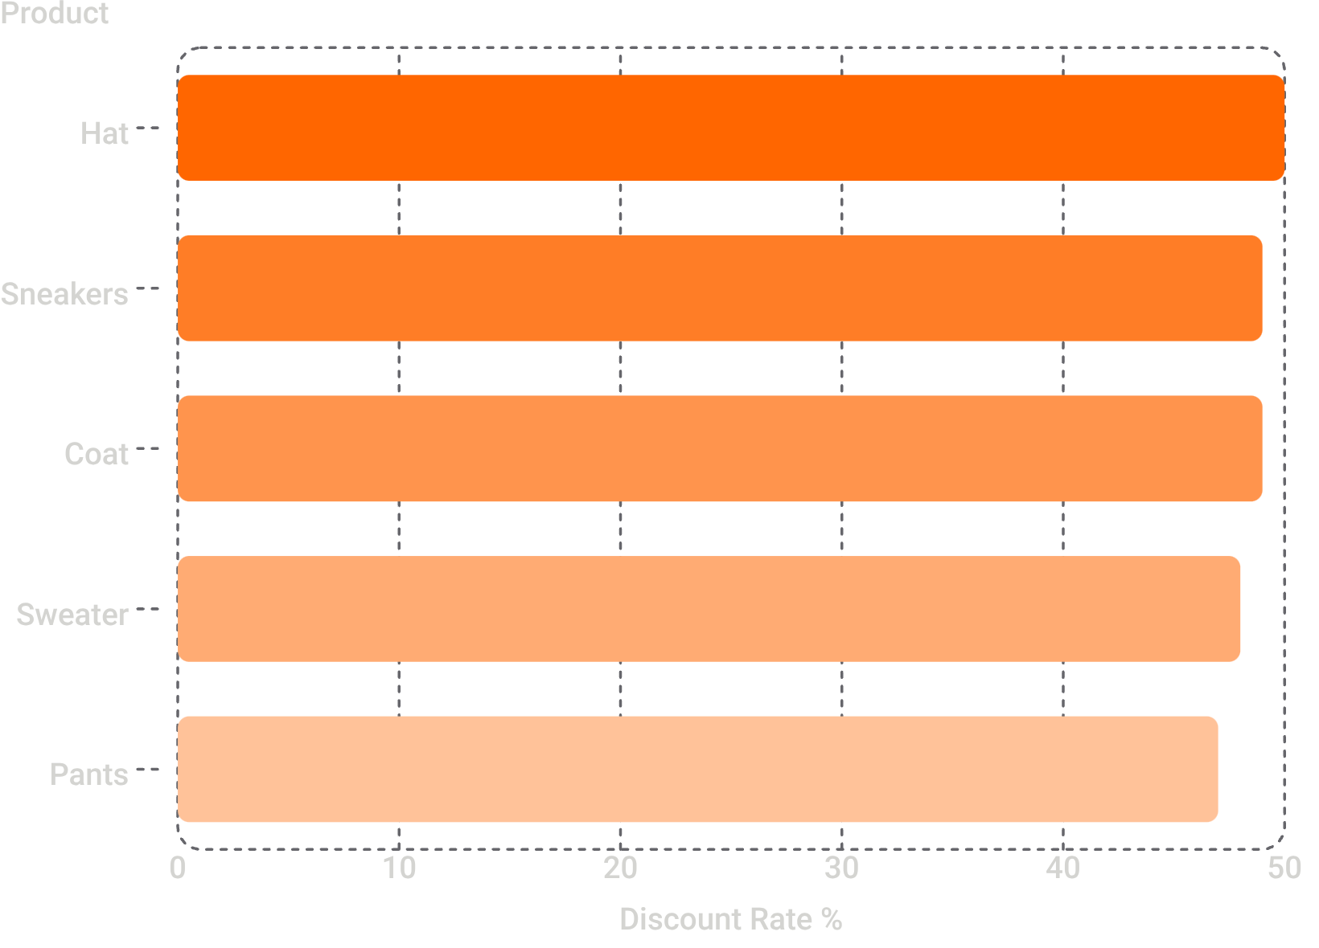
Discounts & Ratings
Products Most Dependent on Discounts
Top-Rated Products
Gloves (3.86★), Sandals (3.84★), Boots (3.82★) lead in customer satisfaction.
High discount rates on Hats & Sneakers suggest price sensitivity — review margin impact.

Slide 9
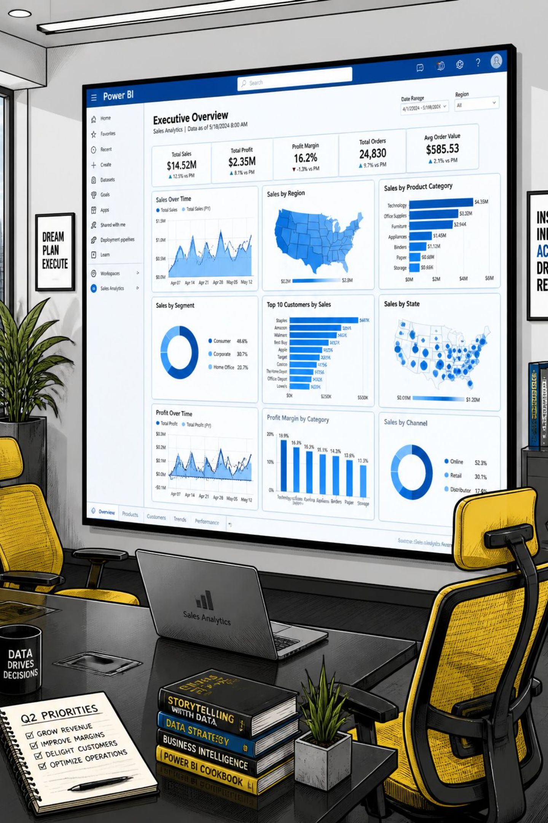
Power BI Dashboard
3.9K
Total Customers
$59.76
Avg. Purchase Amount
3.75★
Avg. Review Rating
27%
Subscription Rate
Interactive filters: Subscription Status, Gender, Category, Shipping Type. Visuals cover revenue, sales, and age group breakdowns.

Slide 10





Business Recommendations
Boost Subscriptions
Loyalty Programs
Review Discount Policy
Promote exclusive subscriber benefits
Reward repeat buyers
Balance sales with margins
Product Positioning
Targeted Marketing
Highlight top-rated products
Focus on high-revenue age groups

