Slide 1
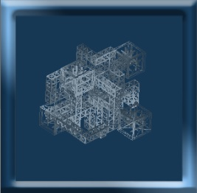
UI and minimap
MinimapRotation.cs
Update:
-transform.RotateAround
OnPreRender/OnPostRender:
-GL.wireframe

