Slide 1
That One Game
Kim Flieger, Dong Du, Shaun Prasad,
Juan Escobar

Slide 2
Design Aspects
First Person
Gravity Inversion
Only affecting the y-axis
Orginally the character was going snap to each of the walls but couldn’t get it done in time i.e. 90 degree rotation

Slide 3
Controls
Rigid body controller script
First person camera to affect mouse sensitivity on the x- axis and y-axis
Affect the gravity of rigid bodies with a button press
“G” button on the keyboard

Slide 4
Gravity Inversion
Used Physics.gravity to change the gravity
Used Quaternion.Slerp to change the rotation of the character and camera
Makes the rotation a lot smoother and seemless
Originally flipped the camera but thought it to be clunky and……..it just didn’t look good

Slide 5
Technical Issues
Problem with Unity character controller and character motor
Couldn’t control movement on the ceiling when gravity was inverted
Rewrote the character controller to affect the rigid body of the character to move using force and velocity
Rotating the camera and character

Slide 6
Procedural Generation
Complex randomized map created by using procedural generation.
Uses prefabs to instantiate and join different segments of the maze.
Each segment prefab has a certain number of exits and connectors attached to these exits.
Each connector has tag identifying which connectors can be attached to it.

Slide 7
Ai
Pathfinding / A* algorithm
Uses Nodes to find the shorest path
Just Trolls but script can be used on many enemies
Senser to find Player

Slide 8
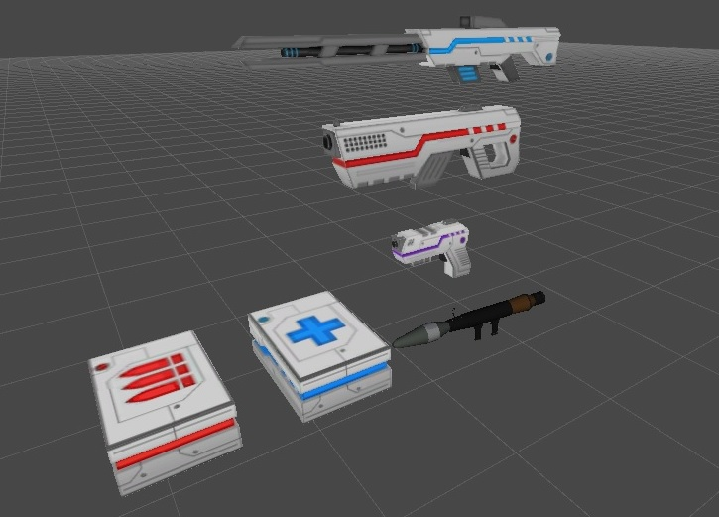
Weapon
Weapon:
Laser Gun
Machine Gun
Shoot Fun
Rocket Launcher
Power Ups:
Damage Box
Health Box

Slide 9
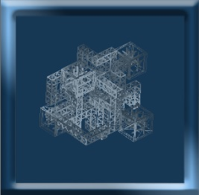
UI and minimap
MinimapRotation.cs
Update:
-transform.RotateAround
OnPreRender/OnPostRender:
-GL.wireframe

