Slide 1
That One Game
Kim Flieger, Dong Du, Shaun Prasad,
Juan Escobar

Slide 2
Controls
Rigid body controller script
First person camera to affect mouse sensitivity on the x- axis and y-axis
Affect the gravity of rigid bodies with a button press
“G” button on the keyboard
Used Physics.gravity to change the gravity
Used Quaternion.Slerp to change the rotation of the character and camera

Slide 3
Procedural Generation
Complex randomized map created by using procedural generation.
Uses prefabs to instantiate and join different segments of the maze.
Each segment prefab has a certain number of exits and connectors attached to these exits.
Each connector has tag identifying which connectors can be attached to it.

Slide 4
Ai
Pathfinding / A* algorithm
Uses Nodes to find the shorest path
Just Trolls but script can be used on many enemies
Senser to find Player

Slide 5
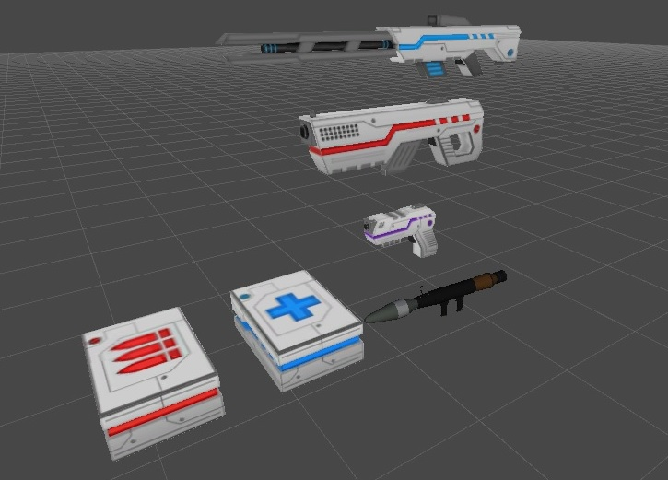
Weapon
Weapon:
Laser Gun
Machine Gun
Shoot Fun
Rocket Launcher
Power Ups:
Damage Box
Health Box

Slide 6
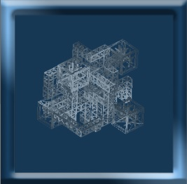
UI and minimap
MinimapRotation.cs
Update:
-transform.RotateAround
OnPreRender/OnPostRender:
-GL.wireframe

