Slide 1

HMS (Hospital Management System )
Mohamed Mosleh 19106762

Slide 2


Agenda
Real life problem
Scenario
ERD
EERD
Mapping

Slide 3

Real Life problem
No one can deny that collecting data play important role for establishing a correct data base which allow us to make successful system. There is a lot of advantage for making successful system especially hospital system as monitoring the patients & medical staff and reduce error rate & provide healthcare services. but for making a real system we have to follow some steps. At the beginning we want to design an ER schema for keeping track of hospitals. In addition, we must collect sufficient information about all individuals involved in this system for example if we are talking about doctors, we have to collect information like full name, id, specialization, date of hiring etc. Also, we have to define the relation between all hospital personnel and clients and patients. Last but not least after collecting all data and information needed you have to organized it correctly and map it in order to use it in proper way and facilitate for us a lot of problems and difficult which is impossible to solve it without a strong database system .

Slide 4
Scenario
User Login and Signup :
Doctor Functionality :
User:
visits the hospital management system website he User provides necessary details like name, email,
can register and also can log in and make appointment if logged in or not
Login are the privilege to cancel or delete the appointment
Admin:
admin dashboard we will use this template now on the left side we'll have some option for
adding employee means regular stuff or doctor and admin will also be
able to assign salary for the employee and admin will also be able to update or delete all the employee now admin will also require one more option which is book appointment .
Doctor can view the list of available rooms and request room assignment for specific periods.
Doctor can create new appointments with patients, specifying the date, time, and purpose of the appointment.
Doctor views their dashboard, which displays their upcoming appointments, patient records, and other relevant information.
Doctor can update their profile information, including contact details, specialization, and availability.
Patient Functionality :
Patient can search for doctors based on specialization, availability, or location.
Patient can request appointments with preferred doctors, specifying the preferred date and time.
Patient can view their appointment history, including past appointments and associated doctors.
Patient can view and download their prescription details and test results.

Slide 5
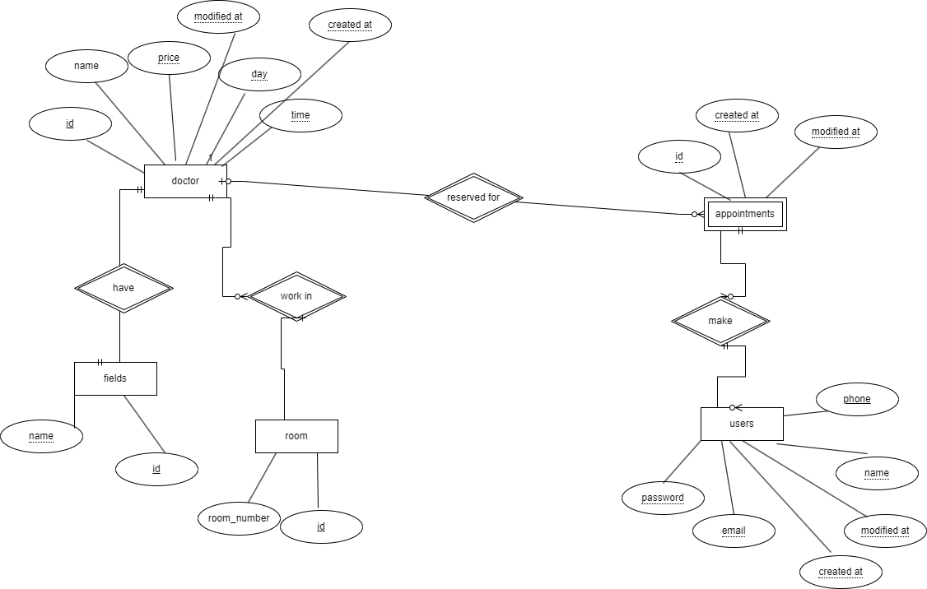
ERD

Slide 6
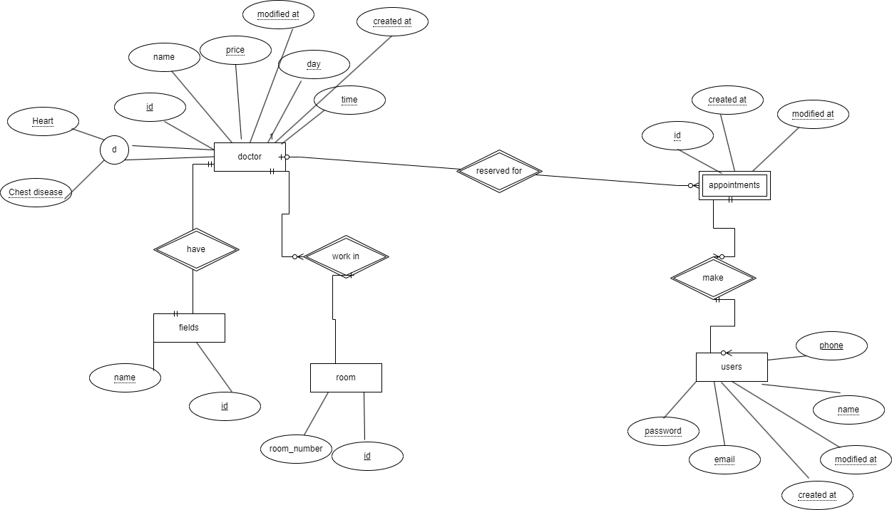
EERD

Slide 7
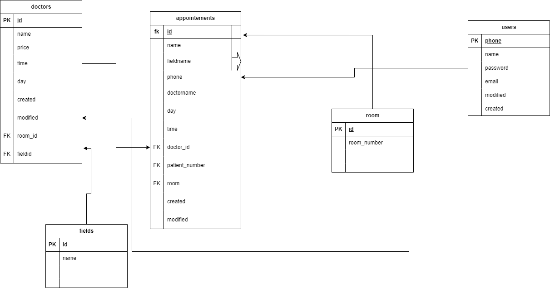
Mapping

Slide 8


