Slide 1

PRISM
Predictive and Interactive System for Medications

Slide 2
Recap
Initial goals
Identify_side_effects(proposed_medication, current_medications) -> side_effects
Suggest_alternative_medications(proposed_medication, side_effects) -> alternative_medications
Recommend_medications(current_medications, medical_conditions) -> recommended_medications
Adjust_medications(current_medications, required_medication) -> adjusted_medication_plan
What we have accomplished

Slide 3
Demonstration

Slide 4
Concepts & Technologies
SPARQL & WikiData
Large Language Model | Gemini 2.0 Exp
Python modules
FuzzyWuzzy
Chainlit

Slide 5
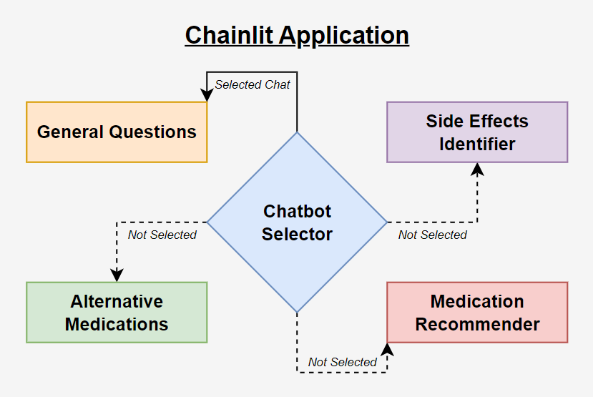
application structure

Slide 6
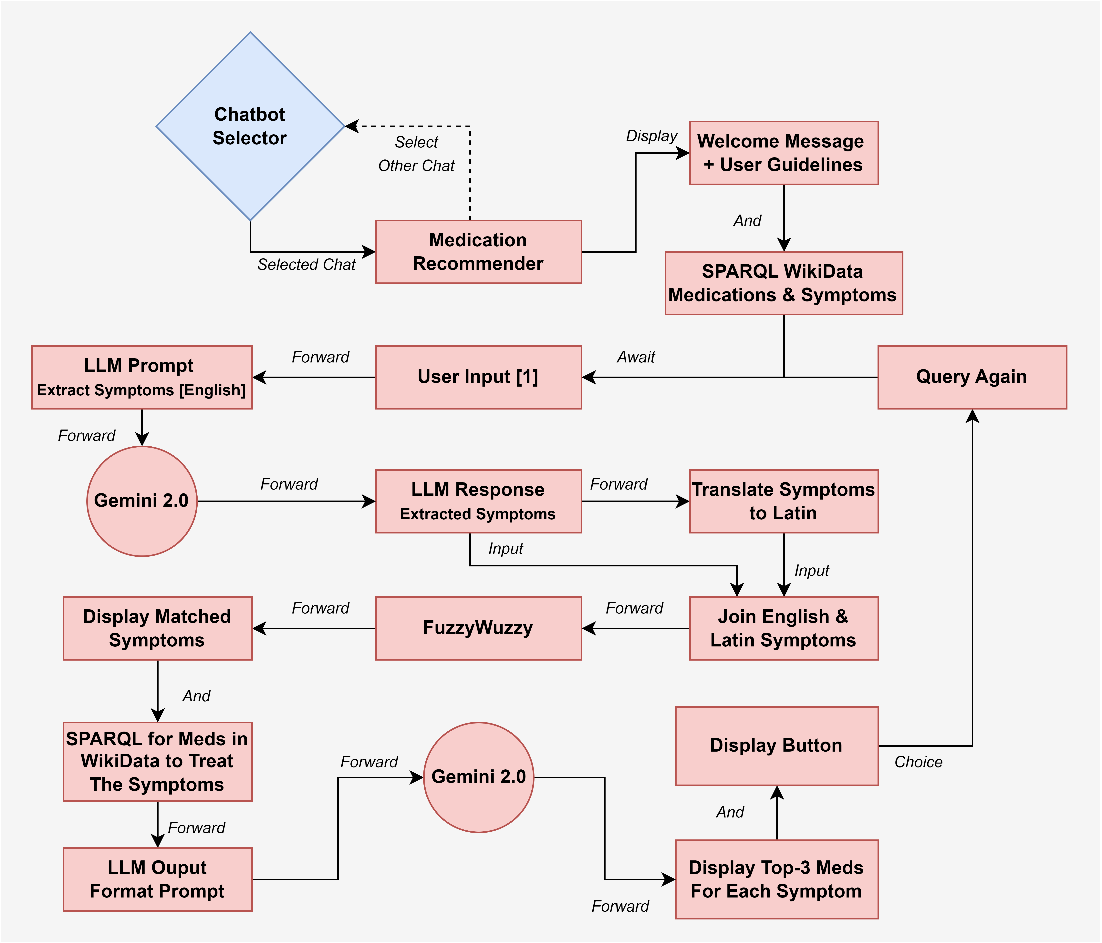
MEDICATION Recommender

Slide 7




lessons learned

Slide 8
Q & A
Thank you for listening

