Slide 1
EXECUTIVE BRIEFING · CONFIDENTIAL
IT Portfolio & Access Management
Enterprise governance for applications, licenses,
identity, and executive decision support
Audience: CIO · IT Directors · Department Managers · Executive Management
Notes:
Open as a governance and risk conversation — not a software demo. Promise a clear arc: current state → risk → solution → value → roadmap → decision.

Slide 2
AGENDA
Strategic narrative
A decision journey — not a feature tour
01
02
03
04
Why change
What we propose
How value is created
What comes next
Challenges & business impact
Enterprise IT Governance Platform
Capabilities, security, analytics
Roadmap, ROI, live proof
Agenda | IT Portfolio & Access Management · Confidential
2 / 18
Notes:
Keep agenda under 45 seconds. Emphasize this is a strategic initiative briefing.

Slide 3
01 EXECUTIVE SUMMARY
We cannot govern what we cannot see
Key message: Manual portfolio management does not scale
Scattered
records
Blind
spots
Risk &
cost
Governed
platform
Executive
clarity
Fragmented control
Rising exposure
Limited foresight
Apps, licenses, and owners live in spreadsheets and inboxes
Expiry, access drift, and audit friction go unnoticed
Leaders lack a trusted view for decisions
01 Executive Summary | IT Portfolio & Access Management · Confidential
3 / 18
Notes:
State the thesis once. Do not list features. Connect to audit season and renewal surprises.

Slide 4
02 CURRENT CHALLENGES
Today’s operating model creates avoidable complexity
Key message: The issue is not effort — it is the absence of a system of record
Inventory
Licenses & Vendors
Governance
● Scattered spreadsheets
● Expiry surprises
● Inconsistent access
● Unknown owners
● Weak utilization view
● Thin audit trail
● No single inventory
● Environment blind spots
● Slow reporting
● Shadow / duplicate apps
● Unclear vendor criticality
● Knowledge loss
02 Current Challenges | IT Portfolio & Access Management · Confidential
4 / 18
Notes:
Ask rhetorically: can we produce an authoritative list of production apps, owners, and licenses expiring this quarter in under one hour?

Slide 5
03 BUSINESS IMPACT
What inaction costs the organization
Key message: Fragmentation is a risk, cost, and accountability issue
↑ Risk
↑ Cost
↓ Speed
↓ Trust
Unowned systems &
unclear access
Shelfware &
late renewals
Manual reporting
cycles
Conflicting sources
of truth
Operational risk
→
Compliance pressure
→
Poor decisions
→
Duplicate spend
03 Business Impact | IT Portfolio & Access Management · Confidential
5 / 18
Notes:
Keep sober — no scare tactics. One real internal anecdote is enough if available.

Slide 6
04 PROPOSED SOLUTION
An Enterprise IT Governance Platform
Key message: From fragmented records → governed enterprise intelligence
Application
Portfolio
License
Governance
IT Portfolio &
Access Management
Identity &
Access
Executive
Insights
04 Proposed Solution | IT Portfolio & Access Management · Confidential
6 / 18
Notes:
Name the product once, then stay on outcomes: system of record + system of insight.

Slide 7
05 CORE CAPABILITIES
Nine capabilities that turn governance into daily practice
Key message: Every capability maps to a business outcome
01
02
03
Centralized Portfolio
License Lifecycle
Vendor Management
Digital asset governance
Cost optimization
Third-party clarity
04
05
06
Department Ownership
Environment Tracking
Users & Roles
Accountability
Operational awareness
Access governance
07
08
09
Identity / SSO
Audit Logging
Executive Dashboards
Enterprise authentication
Compliance evidence
Decision support
05 Capabilities | IT Portfolio & Access Management · Confidential
7 / 18
Notes:
Read 3–4 capabilities aloud. Translate live: license management = stop paying for shelfware.

Slide 8
06 BUSINESS BENEFITS
Outcomes leadership should expect
Key message: Value appears when the platform becomes the trusted default
Better
governance
Single source
of truth
Lower
ops risk
Faster
audits
Less software
waste
Stronger
compliance
Executive
visibility
Clear
accountability
06 Benefits | IT Portfolio & Access Management · Confidential
8 / 18
Notes:
Pick two benefits that resonate (often audit speed + license waste).

Slide 9
07 SECURITY & GOVERNANCE
Control by design — not by heroics
Key message: The portfolio platform must itself be governed
RBAC
SSO
Map
Role-based
access control
Enterprise
authentication
Role
mapping
Audit
Track
Least
Audit
logging
Activity
tracking
Least
privilege
07 Security & Governance | IT Portfolio & Access Management · Confidential
9 / 18
Notes:
Reassure security stakeholders. Avoid protocol deep-dives unless asked.

Slide 10
08 EXECUTIVE DASHBOARD
Decision-ready portfolio intelligence
Key message: Leadership questions answered without assembling a deck
67
6
5
3
59
1
120+
Applications
Licenses
Active Vendors
Departments
Users
SSO Providers
Audit Events
License Status
Applications by Department
Licenses by Environment
08 Executive Dashboard | IT Portfolio & Access Management · Confidential
10 / 18
Notes:
This slide uses live portfolio indicators. Invite the room to pick one question for the live demo.

Slide 11
09 ANALYTICS & DECISION SUPPORT
From data hunting to decision-ready insight
Key message: If a question needs three spreadsheets, it is already too late
License Utilization
Application Growth
Seats by Environment
80%
seats used vs licensed
Licensed: 30,482
Used: 24,497
Available: 6,647
09 Analytics | IT Portfolio & Access Management · Confidential
11 / 18
Notes:
Prime the demo: ask which question they want answered first on the live dashboard.

Slide 12
10 FUTURE ROADMAP
A platform designed to grow with enterprise ambition
Key message: Start with control and truth — then add prediction
Portfolio Management
License Governance
Identity & SSO
Automation & AI
Phase 1
Phase 2
Phase 3
Phase 4
Portfolio
Management
License
Governance
Identity
& SSO
Automation
& AI
Inventory, owners,
departments
Utilization, renewals,
environments
Federation, role mapping,
least privilege
Alerts, workflows,
predictive insight
10 Roadmap | IT Portfolio & Access Management · Confidential
12 / 18
Notes:
Do not over-promise dates. Emphasize sequenced risk reduction before sophistication.

Slide 13
11 RETURN ON INVESTMENT
Where value appears in the operating model
Key message: The cheapest control failure is the one prevented by visibility
⏱
✓
◎
↓
⚡
Reduced Manual Effort
Better Compliance
Improved Visibility
Lower Ops Risk
Faster Reporting
Hours saved on audits,
renewals, leadership packs
Evidence on demand —
not reconstruction
One trusted view for
CIO and directors
Fewer surprises from
expiry & access drift
Minutes instead of
multi-day collation
11 ROI | IT Portfolio & Access Management · Confidential
13 / 18
Notes:
Propose a 90-day value baseline with finance: reporting hours, urgent renewals, shelfware candidates.

Slide 14
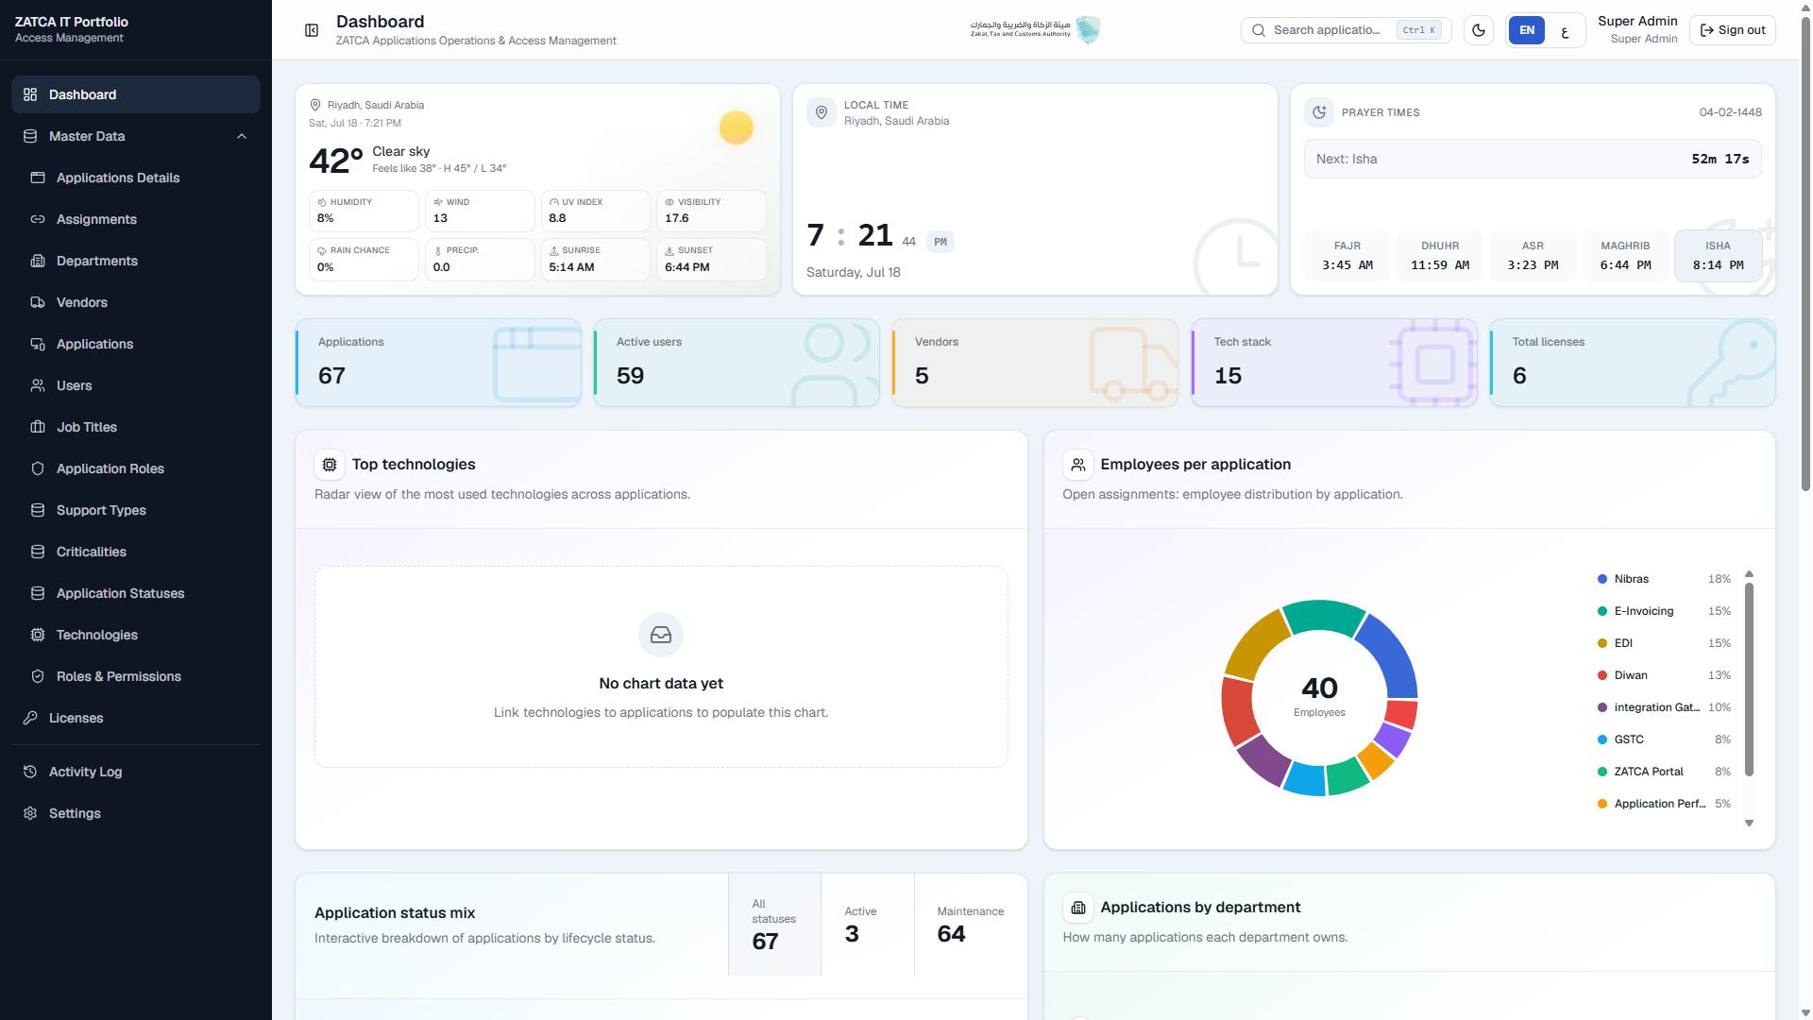
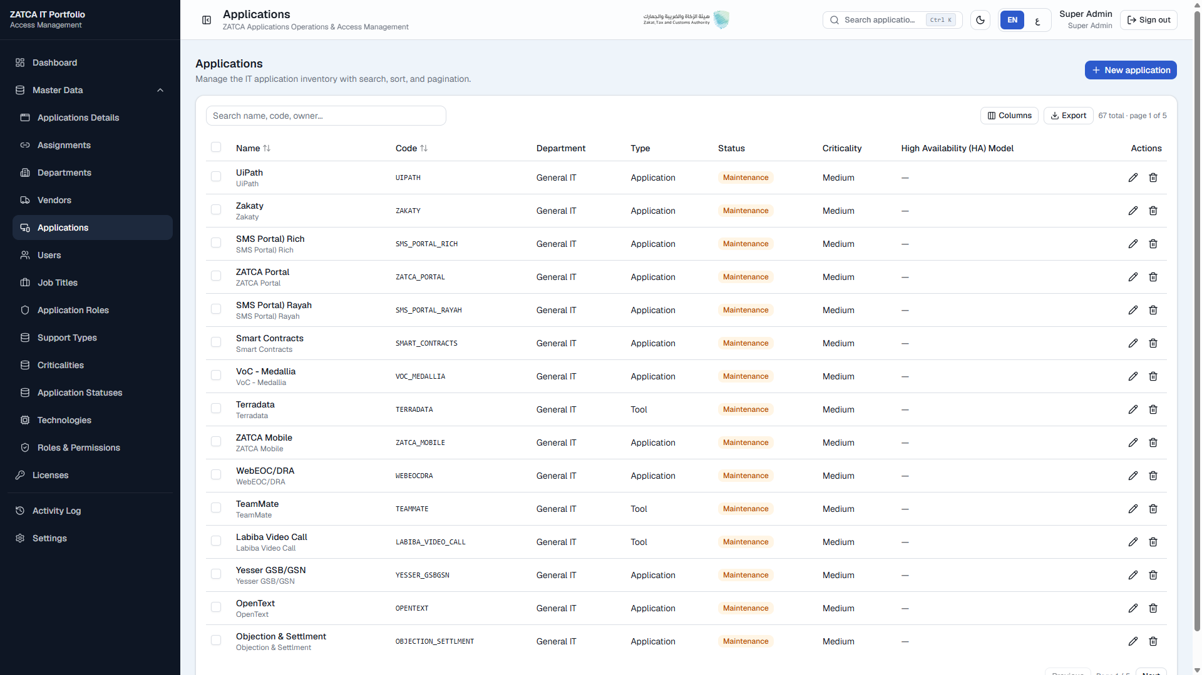
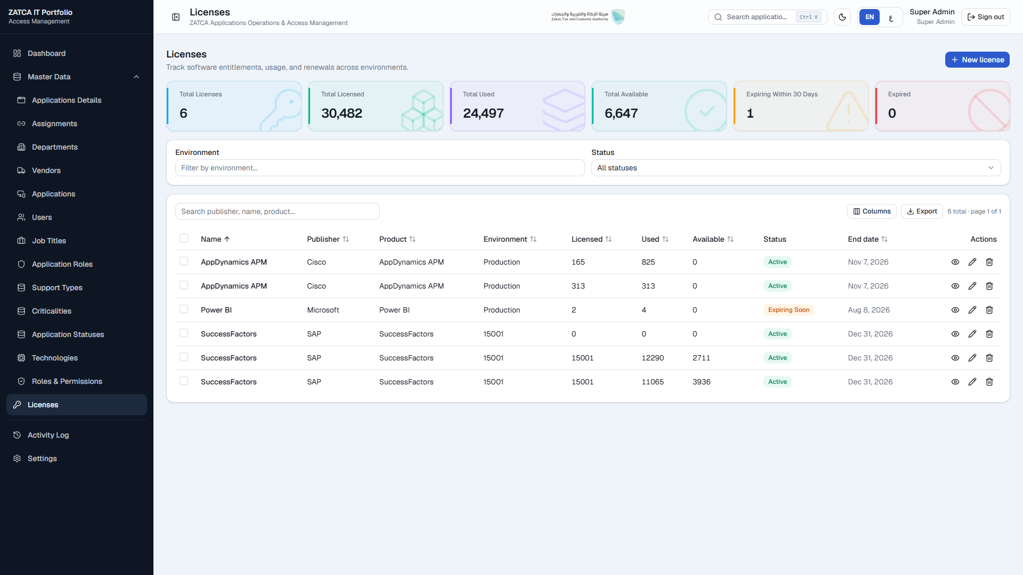
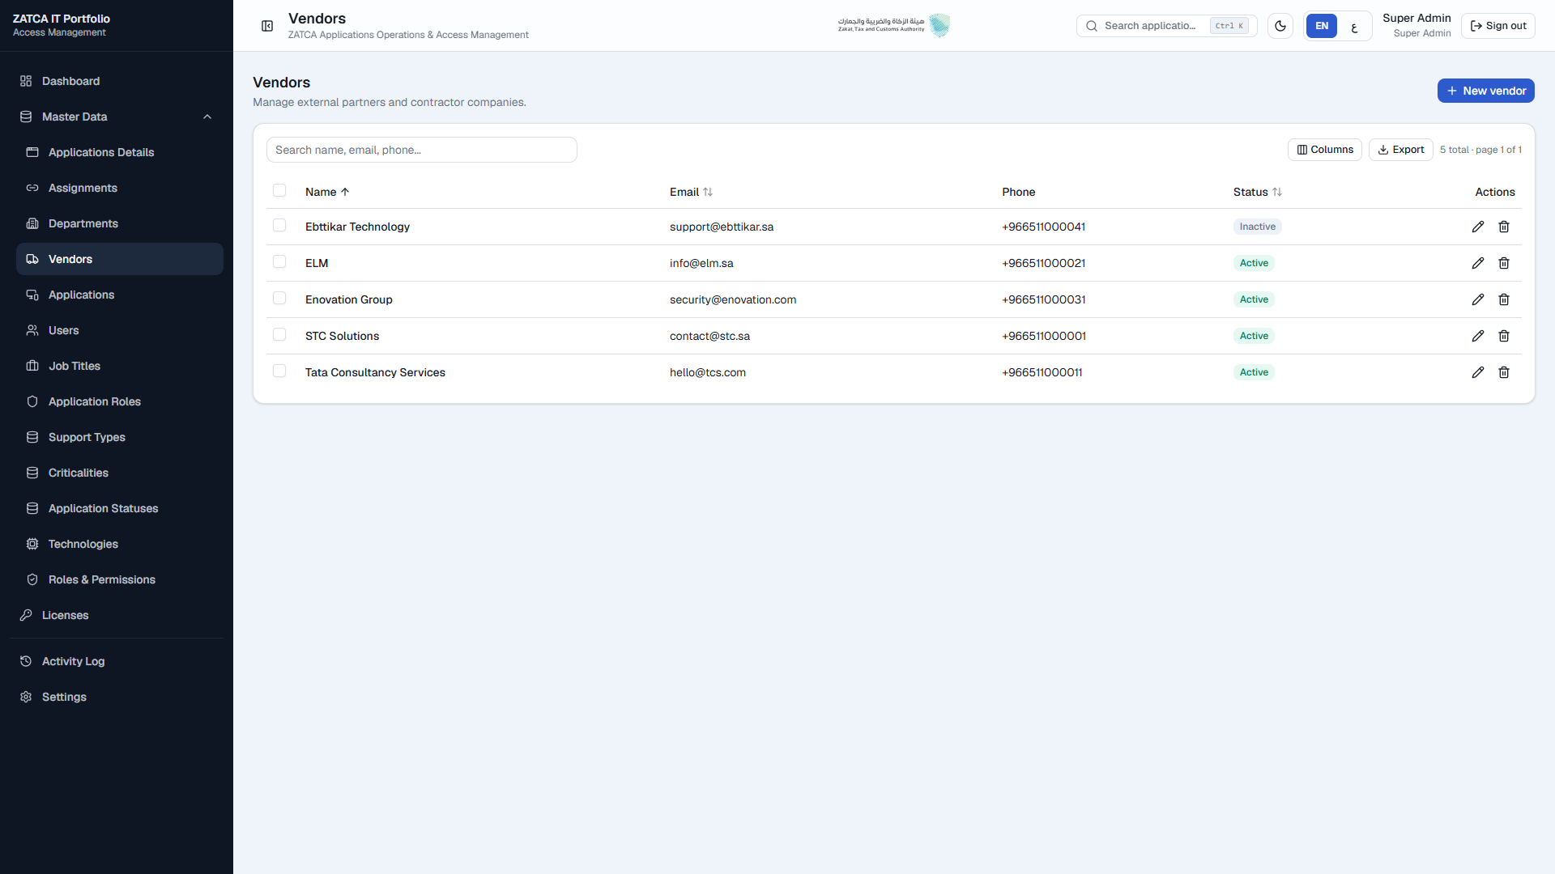
12 PLATFORM PROOF — PORTFOLIO
Governance made visible
Key message: The system of record leaders can trust
Executive Dashboard
Applications Management
License Management
Vendors
12 Platform Proof | IT Portfolio & Access Management · Confidential
14 / 18
Notes:
Use as visual proof before or during demo. Stay on business narrative — do not click through forms.

Slide 15
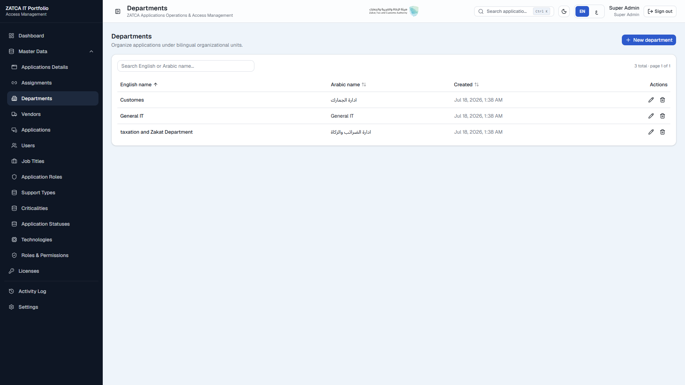
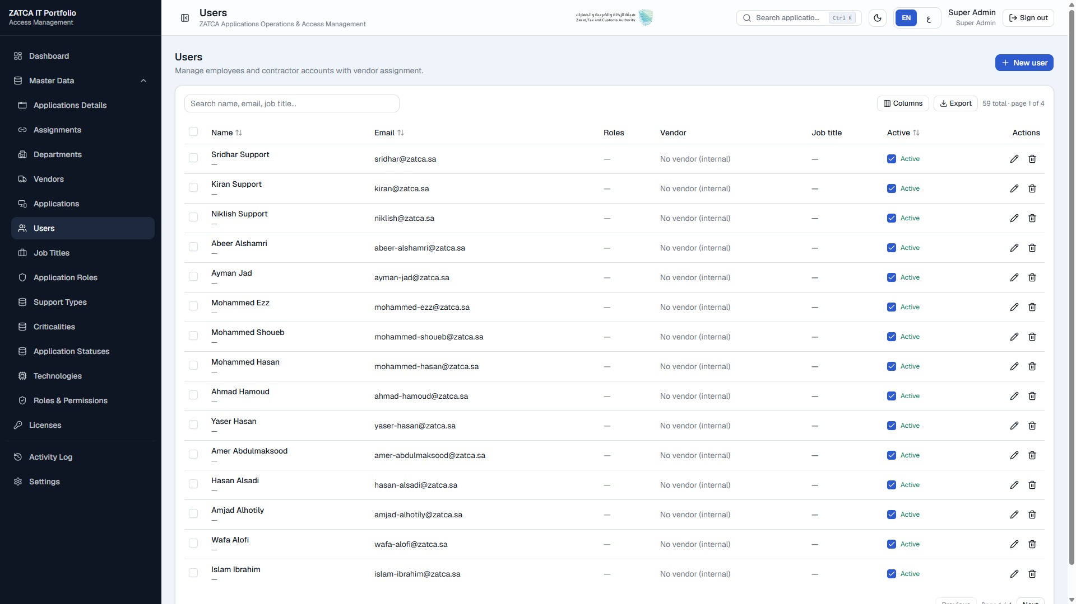
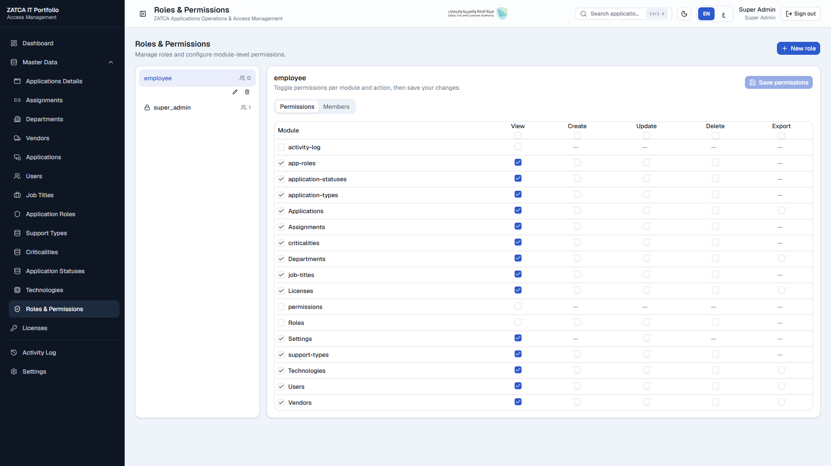
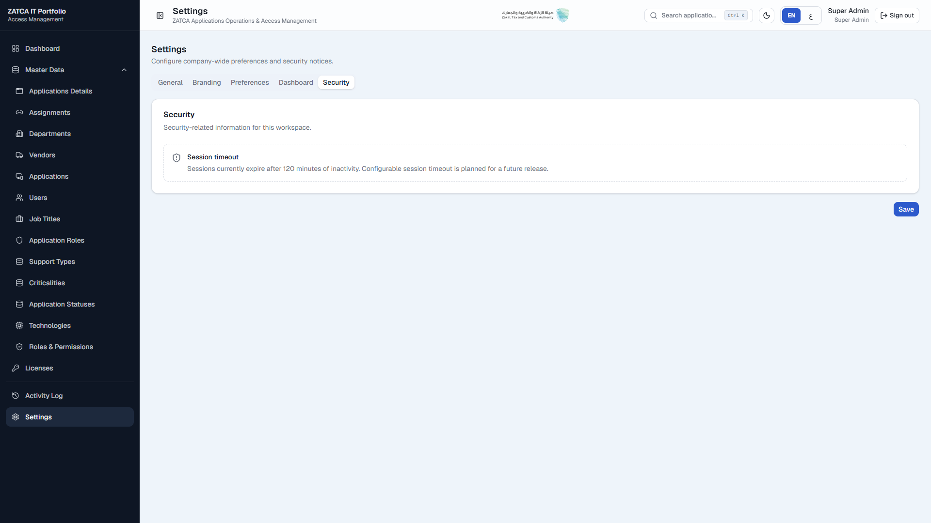
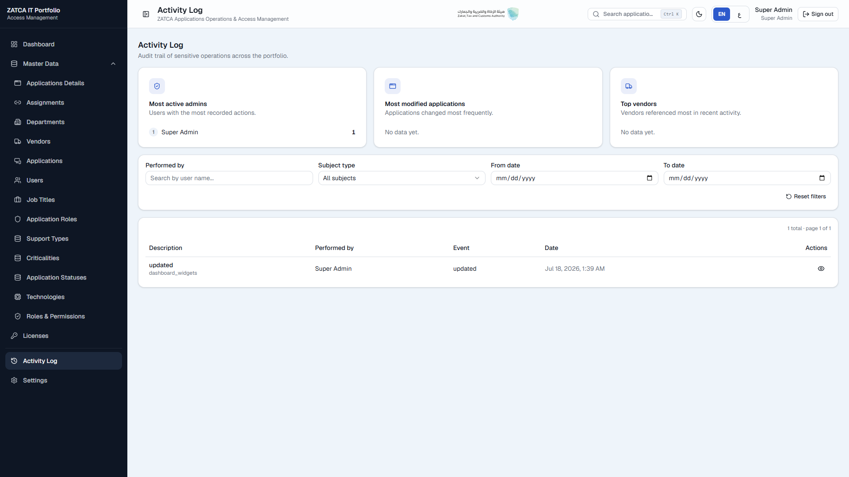
13 PLATFORM PROOF — GOVERNANCE
Identity, access, and assurance
Key message: Control and evidence are built in
Departments
Users
Roles & Permissions
Identity Providers (SSO)
Audit Logs
Settings / Reports context
13 Platform Proof | IT Portfolio & Access Management · Confidential
15 / 18
Notes:
Highlight SSO and audit for security/risk stakeholders; roles for IT directors.

Slide 16
14 LIVE DEMONSTRATION
A business story told through the platform
Key message: Demo to decide — not to explore every field
01
02
03
04
05
Dashboard
Applications
Licenses
Vendors
Departments
06
07
08
09
10
Users
Roles
SSO
Audit
Insights
Facilitation: See → Own → Control → Govern → Prove | Keep demo to 12–15 minutes | End on the dashboard
14 Live Demo | IT Portfolio & Access Management · Confidential
16 / 18
Notes:
Restate the flow in one breath before switching to the live system. Capture questions separately.

Slide 17
15 DECISION & NEXT STEPS
Convert alignment into sponsorship
Key message: Governance improves when leadership chooses — and uses — one system
1
2
3
Endorse the platform
Name accountable owners
Approve a 90-day value plan
Confirm as the enterprise system of record for applications & licenses
Business + IT owners for data quality, access, and license stewardship
Baseline reporting effort, renewals at risk, and utilization — then track
15 Decision | IT Portfolio & Access Management · Confidential
17 / 18
Notes:
Be explicit about the ask. Offer a one-page decision memo as follow-up.

Slide 18
APPENDIX
How we speak about the platform
Key message: Language determines whether this is seen as admin software — or enterprise control
CRUD modules
→
Centralized Governance
Users screen
→
Identity Management
Roles
→
Access Governance
SSO setup
→
Enterprise Authentication
Activity logs
→
Compliance & Audit Evidence
Dashboard
→
Executive Decision Support
License records
→
Cost Optimization
Application list
→
Digital Asset Governance
Appendix | IT Portfolio & Access Management · Confidential
18 / 18
Notes:
Optional leave-behind for presenters. Elevator pitch: single trusted view of apps, licenses, ownership, and access.

