Slide 1
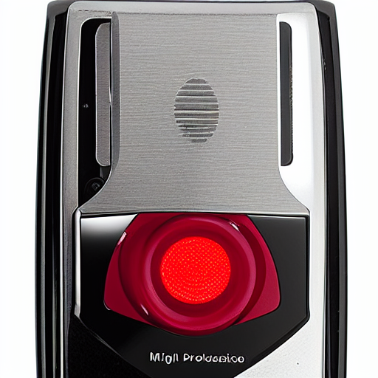
COMP_SCI 5542: GenAI Stable Diffusion Challenge
Insert UMKC logo
assets/umkc_logo.png
Data-Driven E-Commerce Image Generation
Tuan (Tony) Nguyen
University of Missouri-Kansas City
MS in Data Science and Analytics
Hero result (structured prompt)
UMKC COMP_SCI 5542
Notes:
Introduce objective: generate e-commerce product visuals from metadata.
Explain that the project compares naive and structured prompt strategies.
Mention evaluation combines CLIP metrics with manual quality scoring.

Slide 2
Scenario Description
E-commerce needs scalable, consistent product imagery.
Manual studio photography is expensive and slow.
Goal: generate commercial-style product visuals from metadata.
Compare naive title-only prompts versus structured prompt engineering.
UMKC COMP_SCI 5542
Notes:
Frame this as a practical engineering problem with business impact.
State that metadata availability motivates data-driven generation.

Slide 3
Dataset
Source: Amazon Product Dataset metadata samples.
Project subset: 10 products across mixed categories.
Fields used: id, title, category, color, material, style.
Data file in repo: data/products.json.
UMKC COMP_SCI 5542
Notes:
Mention subset size is intentionally small for controlled experiments.
Explain how each field contributes to prompt richness.

Slide 4
Methodology Overview
1) Metadata ingest and prompt construction.
2) Image generation via SD/SDXL (optional ControlNet).
3) Evaluation: CLIP, consistency, diversity, manual quality.
4) Reports exported to CSV and HTML for review.
5) Three execution modes: local CLI, Colab batch, Colab API.
UMKC COMP_SCI 5542
Notes:
This slide is your architecture bridge into implementation detail.
Keep this high-level and transition to pipeline specifics next.

Slide 5
Stable Diffusion Pipeline
Supports SD 1.5 and SDXL with Diffusers backend.
Configurable: resolution, steps, CFG, seed, view count.
Optional ControlNet adds structural conditioning.
Reproducibility maintained via deterministic seed strategy.
UMKC COMP_SCI 5542
Notes:
Emphasize engineering controls: parameters, seeds, and mode toggles.
Explain when SDXL is preferred versus SD 1.5.

Slide 6
Methodology: Prompt Design
Naive prompt:
- Uses product title only
Structured prompt:
- Injects color, material, category, and style
- Adds studio quality boosters
- Uses negative prompt for artifact suppression
prompt = (
f"{photography_style} of "
f"{product['color']} {product['material']} {product['title']}, "
f"category: {product['category']}, style: {product['style']}, "
f"{quality_boosters}"
)
UMKC COMP_SCI 5542
Notes:
Walk the audience through naive versus structured prompt construction.
Highlight this is from the actual prompt_builder.py implementation.
Explain why metadata-rich phrasing gives better controllability.

Slide 7
Control Strategy
ControlNet with Canny edges anchors object structure.
Improves cross-view consistency for the same product.
Applied when reference image or edge guidance is available.
Tradeoff: tighter structure can reduce visual diversity.
UMKC COMP_SCI 5542
Notes:
Explain why this is critical for multi-view e-commerce listings.
Connect this to consistency metric improvements.

Slide 8
Tools and Technologies
Core stack: Python, Diffusers, Stable Diffusion, ControlNet, CLIP.
Execution: local environment and Google Colab GPU runtime.
Deployment/demo: Flask API + ngrok + browser frontend.
Evaluation and reporting: pandas, CSV/HTML outputs, quality workflow.
UMKC COMP_SCI 5542
Notes:
Keep this concise and map each tool to one specific role.
Mention that AI tool disclosure appears on the final slide.

Slide 9
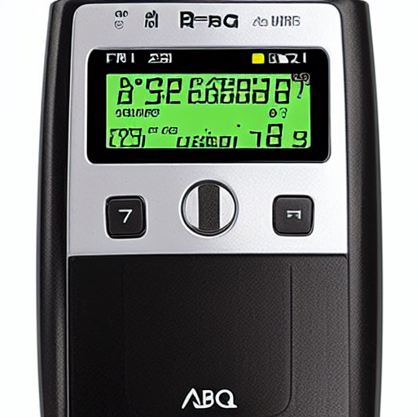
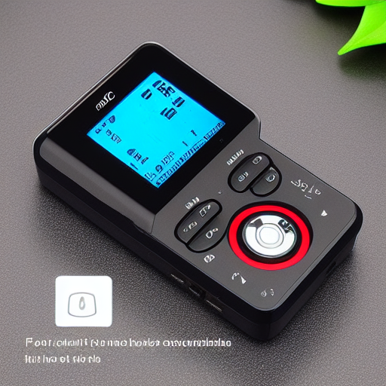
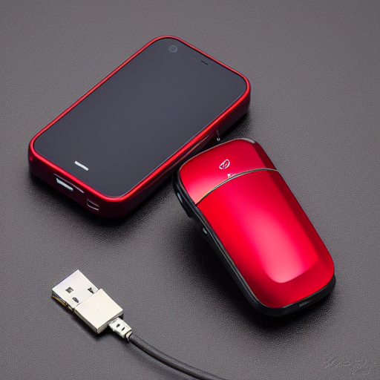
Results (Images): Naive vs Structured
Naive View 1
Naive View 2
Structured View 1
Structured View 2
Visual check: structured prompts tend to improve product framing and studio consistency.
Use this slide to call out concrete examples during presentation.
UMKC COMP_SCI 5542
Notes:
Compare naive and structured rows explicitly.
Point to lighting/background differences and shape consistency.
Mention this example uses outputs from product 0101635370.

Slide 10
Evaluation
Metrics: CLIP alignment, consistency, diversity, human quality score.
Sample (results/local_summary.csv, product 0101635370):
Naive: CLIP 0.2997 | Consistency 0.7745 | Diversity 0.0442.
Structured: CLIP 0.2714 | Consistency 0.7169 | Diversity 0.0442.
Use full multi-product summary for final aggregate conclusions.
UMKC COMP_SCI 5542
Notes:
Explain why one product snapshot is illustrative but not definitive.
Encourage panel to focus on full-table trends in report artifacts.

Slide 11
Findings and Insights
Structured prompts improve controllability and presentation consistency.
Control signals reduce geometric drift across product views.
Qualitative scoring complements embedding-based metrics.
Failure-case analysis reveals practical prompt and control fixes.
UMKC COMP_SCI 5542
Notes:
Tie findings back to problem statement and business relevance.
Use one concrete before/after visual when speaking.

Slide 12
Limitations
Current sample size is limited for broad statistical claims.
CLIP is useful but not a full proxy for commercial quality.
Model behavior depends on seed, runtime, and prompt sensitivity.
Colab/API demo environments can introduce session instability.
UMKC COMP_SCI 5542
Notes:
Present limitations confidently as future-work opportunities.
Mention that reproducibility controls are already in place.

Slide 13
Video, Repository, and AI Disclosure
GitHub URL:
https://github.com/mosomo82/COMP_SCI_5542.git
Demo Video URL:
https://youtu.be/REPLACE_WITH_YOUR_VIDEO_ID
AI tools used (required disclosure):
- Claude Code
- ChatGPT
- Antigravity AI
Human verification:
All code, outputs, metrics, and conclusions were manually reviewed.
UMKC COMP_SCI 5542
Notes:
Replace placeholder video URL with your final demo before submission.
Reiterate disclosure transparency and manual validation practices.
Invite questions and transition to Q&A.

