Slide 1


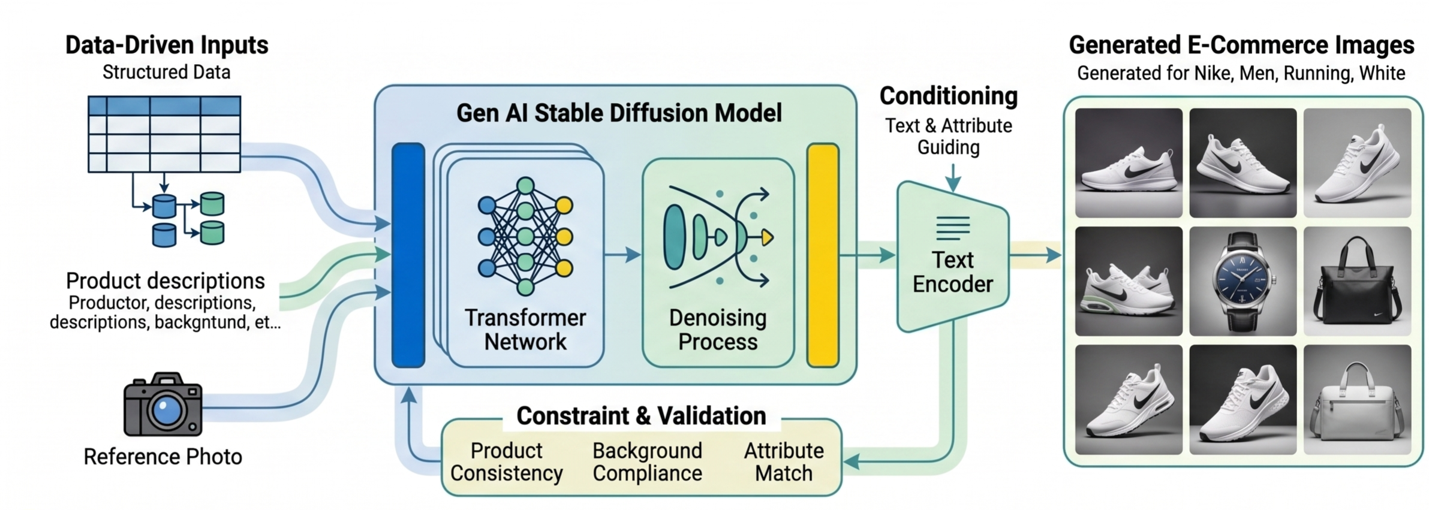
Data-Driven E-Commerce Image Generation
Tony Nguyen
University of Missouri – Kansas City
COMP_SCI 5542 Gen AI Stable Diffusion MS in Data Science and Analytics

Slide 2
Problem Statement & Objectives
Industry Gap
Project Goals
E-commerce platforms need consistent, high-quality product images.
Manual studio photography is expensive and slow.
Product metadata often exists before images are finalized.
Develop a reproducible pipeline for metadata-to-image synthesis.
Compare baseline prompts against metadata-structured prompts.
Quantify quality with CLIP-based metrics and manual ratings.

Slide 3
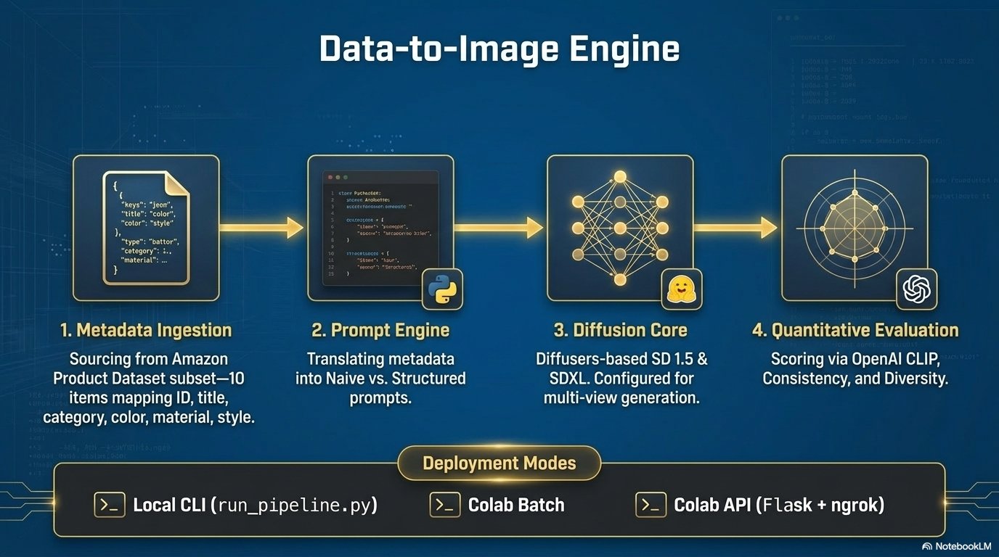

Slide 4
Dataset
Source: Amazon Product Dataset metadata samples.
Project subset: 10 products in Electronic categories.
Fields used: id, title, category, color, material, style.
Data file in repo: data/products.json.

Slide 5
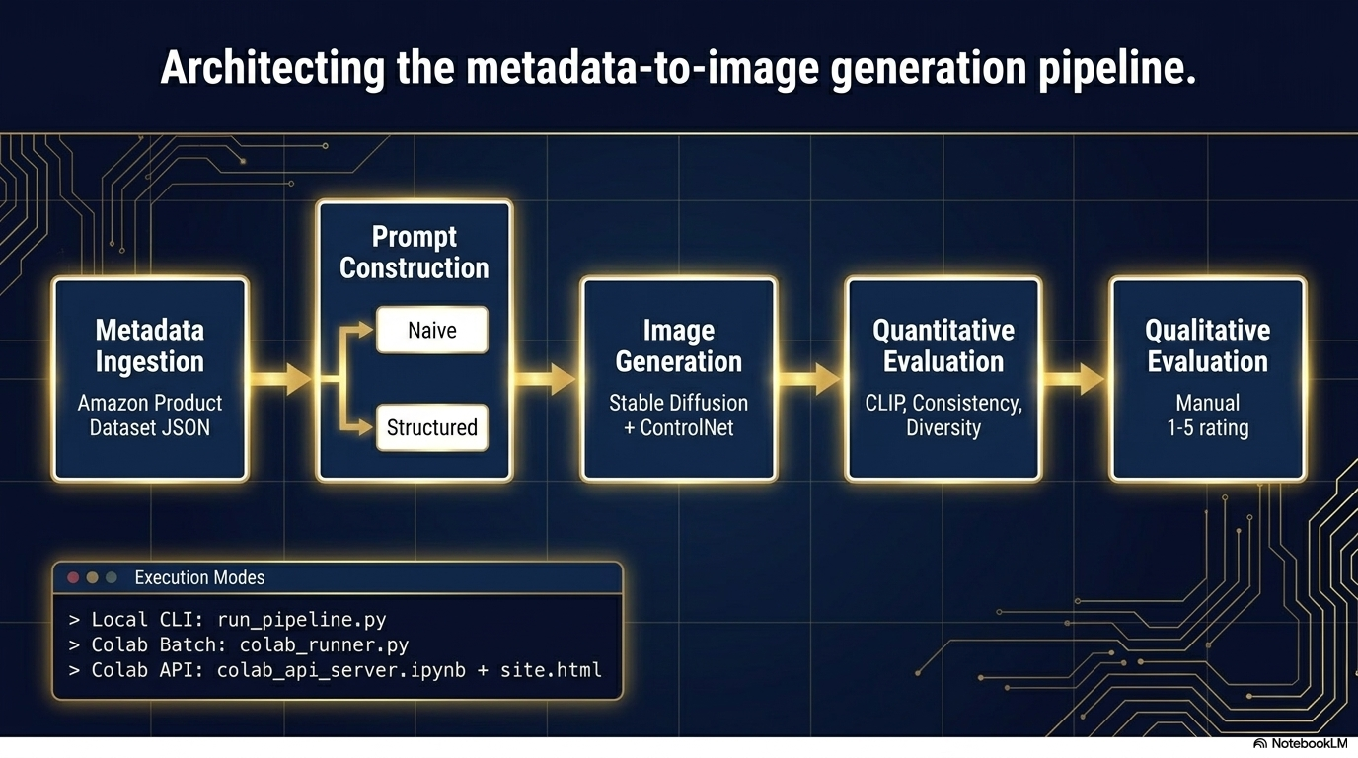

Slide 6
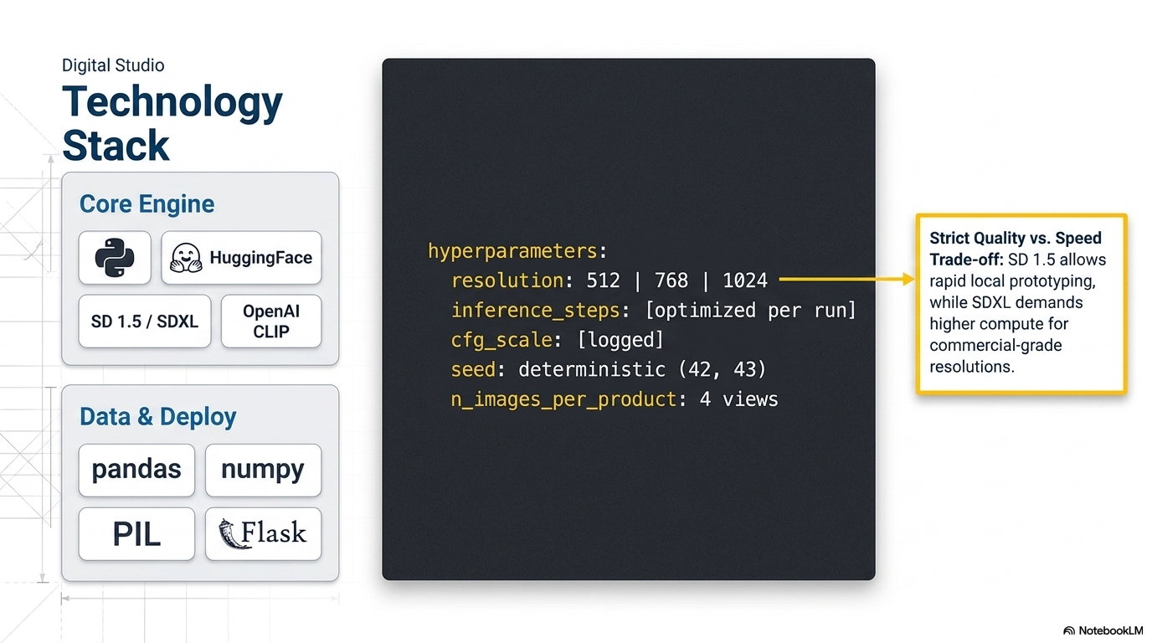

Slide 7
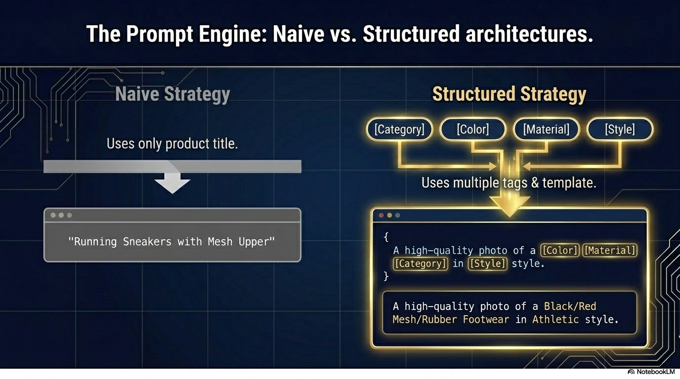

Slide 8
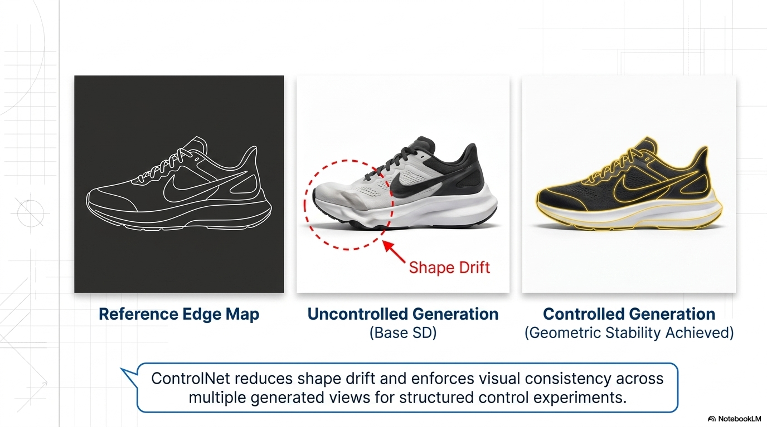

Slide 9
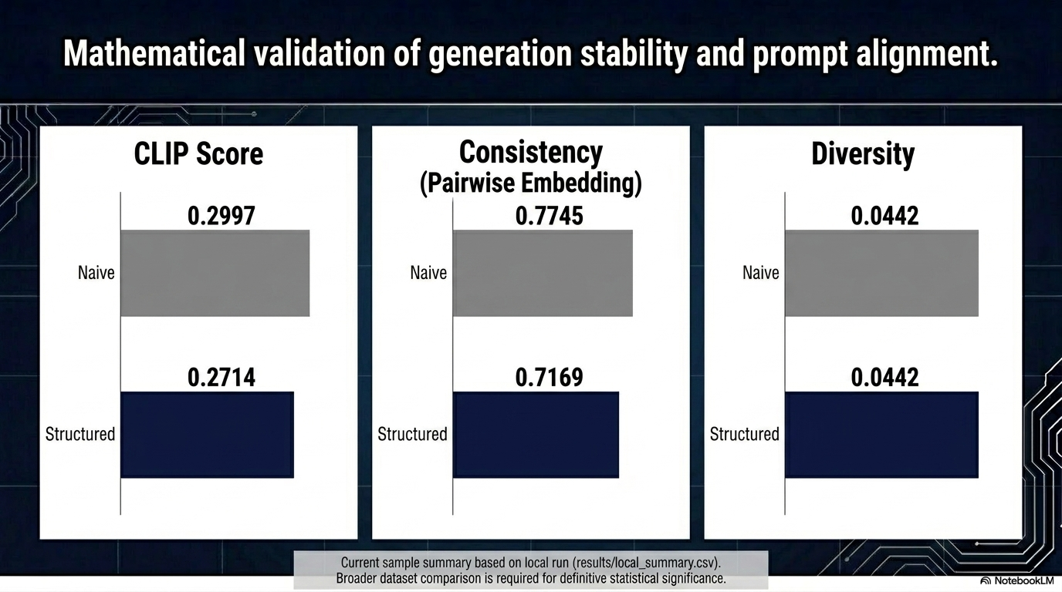

Slide 10
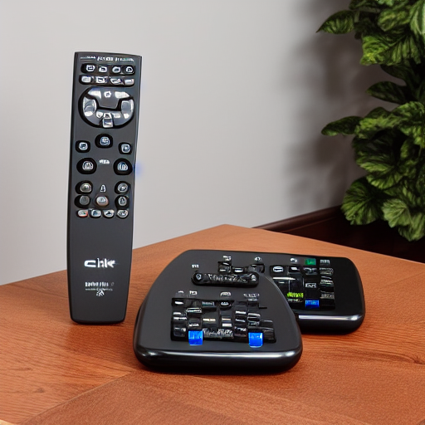
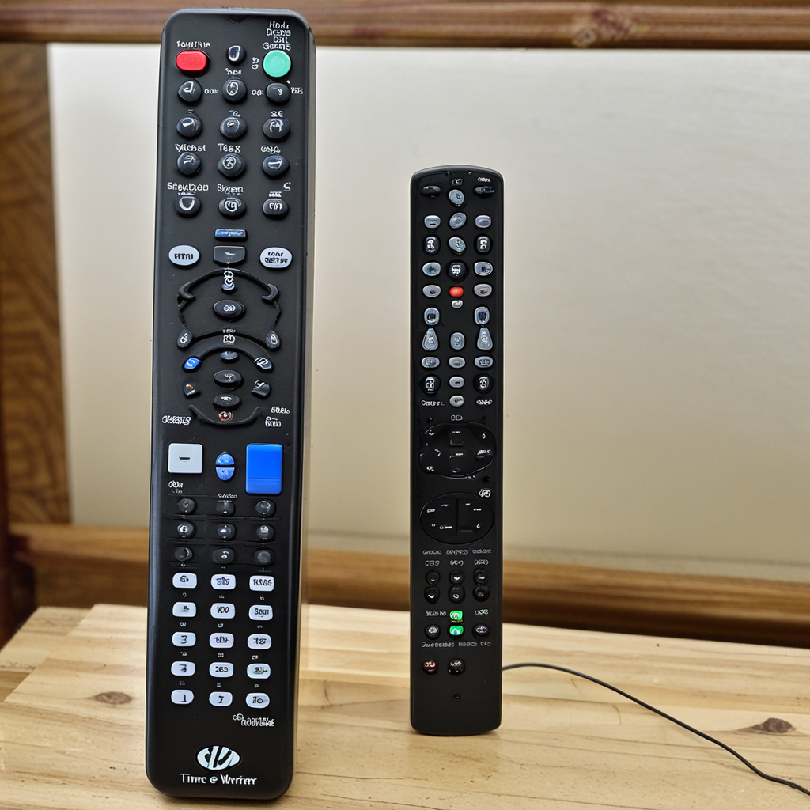
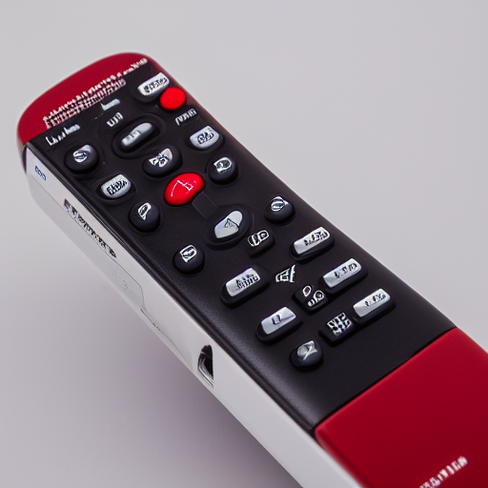
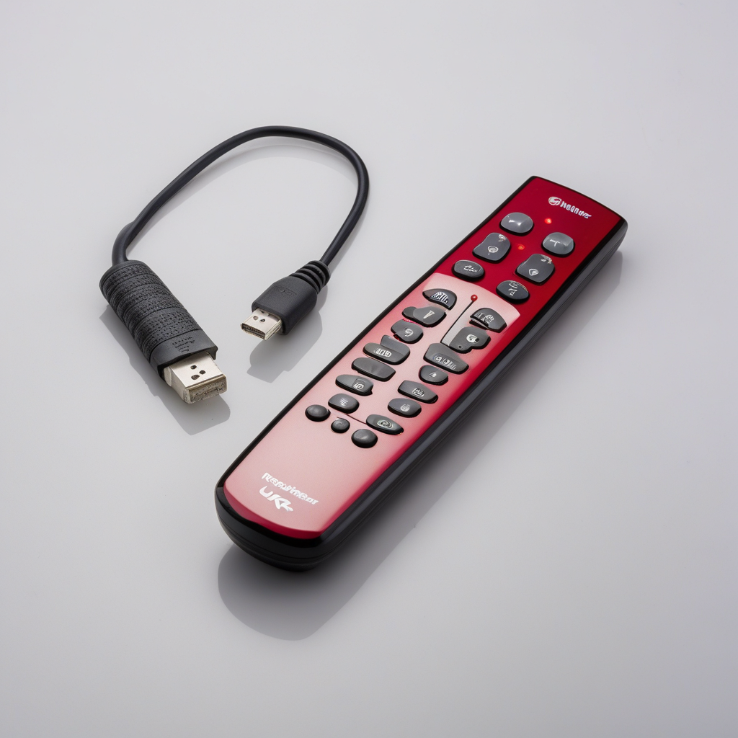
Visual Results: Product ID 0511189877
Naive View SD Seed 44
Naive View SDXL Seed 44
Naïve Approach
Subject to background contamination and style variance.
Structured View SD Seed 44
Structured View SD Seed 44
Structured Approach
Consistent, studio-quality commercial presentation.

Slide 11
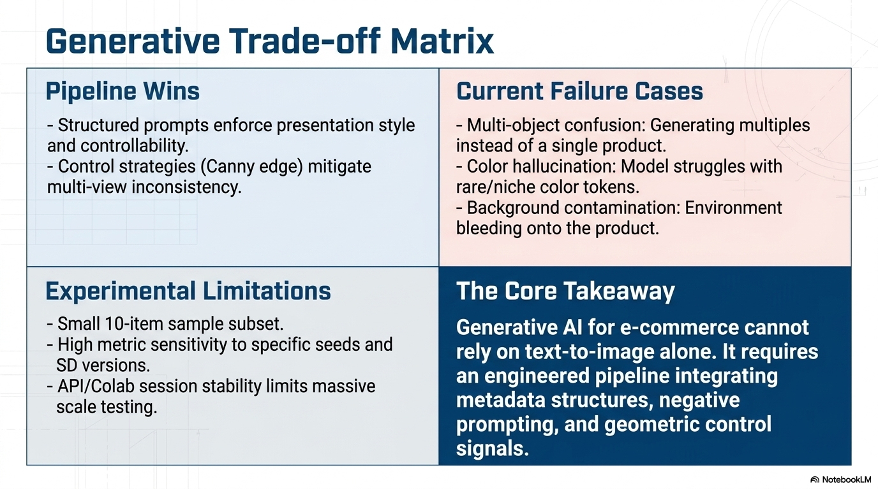

Slide 12

In Conclusion
GitHub repository: https://github.com/mosomo82/COMP_SCI_5542.git
Project video: https://youtu.be/s9AUJty11L0

