Slide 1
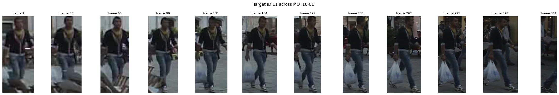
Pedestrian Tracking on MOT16
COMP-SCI 5567 DEEP LEARNING · MIDTERM
Workload, timeline, progress and methods of two pipelines: Faster R-CNN + Siamese ReID (A) and YOLO + ReID + BoT-SORT (B)
Rehan Ali · Bosia N’dri · Tony Nguyen · University of Missouri–Kansas City · October 2026
Notes:
[Bosia · about 30 seconds] Hello. We are Bosia N'dri, Rehan Ali, and Tony Nguyen. Our project is pedestrian tracking on the MOT16 dataset. Today we follow the midterm requirements: first our workload, then our timeline, then our progress, and then the methods we use. We also show a short demo. [Next: the aim of the project]

Slide 2
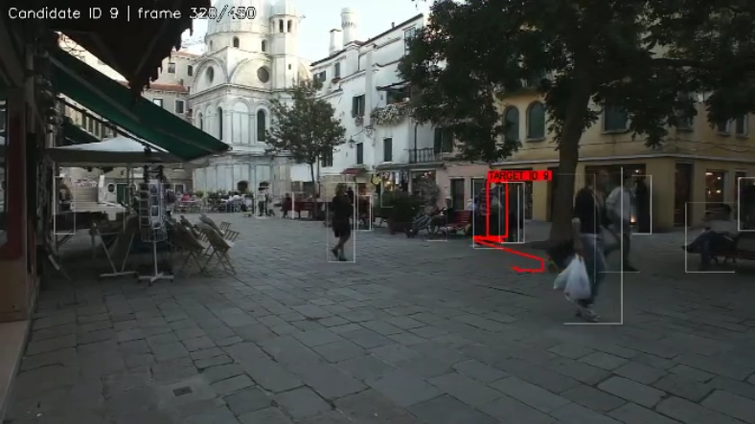
Follow every person and keep one ID
THE AIM OF THE PROJECT
Offline multi-object tracking on MOT16: find every pedestrian in each frame and give each person one ID for the whole video.
Occlusion – people vanish behind others
Look-alikes – dark jackets everywhere
Leaving – an ID must not jump to a newcomer
Today: workload · timeline · progress · methods · demo
Our first prototype on MOT16-01: the red trail jumps to another person. That is an ID switch, exactly what we must avoid.
Bosia N’dri · 2
Notes:
[Bosia · about 1 minute] The aim of the project is offline multi-object tracking. A detector finds the people in each frame. A tracker must also give each person one number for the whole video. This is used in surveillance and in self-driving cars. It is hard for three reasons: people hide behind others, many people look alike, and people leave while new people arrive. The picture shows a mistake from an early prototype: the red line jumps to another person. This is called an ID switch. At the end of the course we must deliver our code, a tracking video of one person on a MOT16 test video, a report, and a presentation. [Next: Rehan, the workload]

Slide 3
Who is responsible for what
1 · WORKLOAD DISTRIBUTION
Workload
Shared deliverables
Member | Main work
Rehan Ali | Pipeline A: design and integration, own tracker (Kalman, Hungarian, gating), own metric code, MOT16-01 target video; contact with the professor
Bosia N’dri | Pipeline A models: Faster R-CNN fine-tuning, Siamese ReID training; midterm demo and closing
Tony Nguyen | Pipeline B: YOLO fine-tuning, ReID model, repair step; TrackEval evaluation; comparison of both pipelines; combined report draft
Done so far
Pipelines A and B built; common evaluation on MOT16-09; report draft written
Still to do (everyone)
Final report, final presentation, individual anonymous questionnaire
Pipeline A code and notebooks 01–05: Pipeline A repository. Pipeline B notebooks 01–07, report and deck: this repository.
Rehan Ali · 3
Notes:
[Rehan · about 1 minute] This slide shows who is responsible for what. [Each member reads their own row. Team: please confirm the rows before Thursday.] Bosia and I worked on Pipeline A: the design, the models, our own tracker, our own metric code, and the MOT16-01 target video. Tony built Pipeline B and did the evaluation and the comparison of both pipelines. Together we share the final report, the final presentation, and the individual questionnaire. [Next: timeline]

Slide 4

From kickoff to the final presentation
2 · PROJECT TIMELINE
Sep 23
Sep 26–29
Oct 15–17
Oct 22
Midterm rules
Topic fixed
A and B built
Midterm talk
Done
Next, before the final
Final deliverables
Topic and data (MOT16), Pipeline A, Pipeline B, common evaluation, report draft, two target videos.
Test a second validation sequence, train with static-person labels, apply the repair to Pipeline A’s tracker, finish the report.
Code (no weights), target video on a MOT16 test sequence, PDF report (at least 4 pages), final presentation, anonymous questionnaire. Date to be announced.
Rehan Ali · 4
Notes:
[Rehan · about 45 seconds] This is our timeline. We started on September 23 with the midterm rules. After the second meeting on September 26, the professor fixed the topic: human video tracking on the provided data. Between October 15 and 17 we built and compared the two pipelines. Today, October 22, is the midterm. Before the final we will test a second sequence and finish the report. The final presentation date is still to be announced. [Next: our progress]

Slide 5
Where we are today
3 · CURRENT PROGRESS
2 of 2
7
2
12 pages
pipelines built and running end to end
Colab notebooks (Pipeline B and comparison); Pipeline A has 5 more
target videos on test sequences: MOT16-01 and MOT16-14
report draft with tables and figures
Done
In progress
Data prepared (split by sequence), detectors fine-tuned, ReID models trained, trackers run and scored with TrackEval, comparison and per-person analysis.
Final report (figures, bibliography), rehearsal of the presentation. Still open: a second validation sequence.
Rehan Ali · 5
Notes:
[Rehan · about 45 seconds] Here is our progress. Both pipelines run from start to end. We have seven Colab notebooks for Pipeline B and the comparison, and five more in the Pipeline A repository. We made two target videos, one on MOT16-01 and one on MOT16-14. The report draft has 12 pages with tables and figures. Still open are the second validation sequence and the final polish. [Next: Tony, data and evaluation]

Slide 6
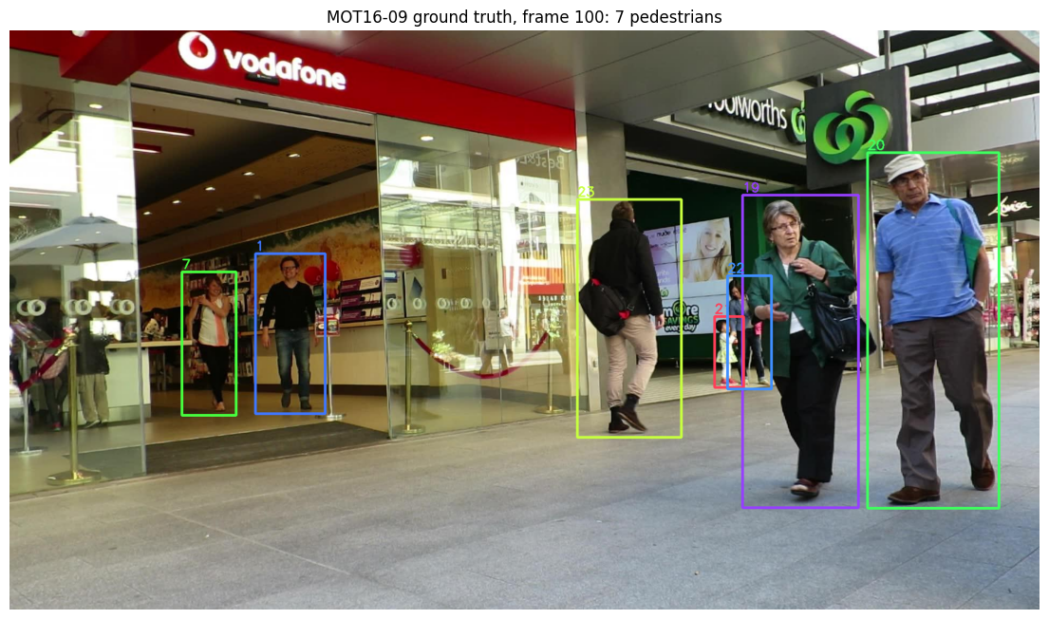
MOT16 and how we score it
4 · METHODOLOGY · DATA AND EVALUATION
Sequence | Frames | People | Boxes | Use
MOT16-02 | 600 | 54 | 17,833 | train
MOT16-04 | 1,050 | 83 | 47,557 | train
MOT16-05 | 837 | 125 | 6,818 | train
MOT16-10 | 654 | 54 | 12,318 | train
MOT16-11 | 900 | 69 | 9,174 | train
MOT16-13 | 750 | 107 | 11,450 | train
MOT16-09 | 525 | 25 | 5,257 | validation
MOT16-01 | 450 | – | no labels | test video
Ground truth = box + ID per person per frame. Reflections, static people, people on vehicles and distractors are “don’t care”.
We split by whole video, not by random frames (neighbouring frames are near-identical). Scores: TrackEval. HOTA = finding people (DetA) + linking them (AssA); IDF1 = how long each person keeps one ID; MOTA mostly counts misses and false boxes.
Tony Nguyen · 6
Notes:
[Tony · about 1 minute] Now the methods. We use MOT16, a set of busy street videos. Some come with answers: a box and an ID for every person in every frame. We train on six videos and keep MOT16-09 hidden: 525 frames, 25 people, 5,257 boxes. We split by whole video, not by random frames, because neighbouring frames look almost the same. We score with the official TrackEval tool. HOTA is the balance between finding people, called DetA, and linking them, called AssA. IDF1 tells how long each person keeps the same ID. MOTA mostly counts misses and false boxes. Pipeline A first used its own metric code. TrackEval gives the same numbers, for example IDF1 60.35 against 60.3. [Next: Rehan, Pipeline A]

Slide 7
Two trained models, one designed tracker
4 · METHODOLOGY · PIPELINE A
Video frame
Faster R-CNN
Siamese Re-ID
Tracker
1920×1080, 30 fps
two-stage detector
128 numbers per person
Kalman + Hungarian
Where are people?
Is this the same person?
Who goes where?
Region proposals, then classification. COCO weights, 2 classes, backbone frozen (16.4 M of 43.3 M trained), 4 epochs.
Same network for both crops (shared weights); triplet loss, margin 0.3; 20,146 crops of 362 people.
Kalman predicts, Hungarian matches (0.6 look + 0.4 overlap), distance gate, two passes (0.7 / 0.6), offline rules.
Code
Our own code: the tracker, the ReID training and the metric code. Library: the torchvision detector.
Rehan Ali · 7
Notes:
[Rehan · about 1 minute] Pipeline A has three parts. Faster R-CNN is a two-stage detector from the R-CNN family: it first proposes regions, then classifies them. We start from COCO weights, change the last layer to two classes, freeze the main part, and train 16 million of 43 million numbers for 4 epochs. The Siamese network uses the same network for both pictures and gives 128 numbers per person. The tracker predicts with a Kalman filter and matches with the Hungarian algorithm, using 60 percent look and 40 percent overlap. The tracker and the ReID training are our own code; the detector comes from torchvision. [Next: Tony, Pipeline B]

Slide 8
A newer detector, a larger ReID model, our own repair
4 · METHODOLOGY · PIPELINE B
Video frame
YOLO (yolo26m)
ReID ResNet-50
BoT-SORT + repair
1920×1080, 30 fps
one-stage detector
2048 numbers per person
Kalman + our repair
Where are people?
Is this the same person?
Who goes where?
One pass over the image. Fine-tuned at size 960, all layers, up to 30 epochs (best epoch 21).
ResNet-50 with BNNeck; identity loss + triplet loss; 12 epochs.
BoT-SORT (library) + our repair: split if the look changes (0.5), merge tracks (0.35, up to 150 frames).
Code
Library: the YOLO detector and BoT-SORT. Our own code: the ReID training, the repair step, the evaluation and the target selection.
Tony Nguyen · 8
Notes:
[Tony · about 1 minute] Pipeline B uses newer parts. YOLO is a one-stage detector: it finds the boxes in one pass over the image. We train all its layers at image size 960. The ReID network is a ResNet-50 with 2048 numbers per person, trained with an identity loss and a triplet loss. The tracker is BoT-SORT from a library, and it does not use appearance. So we wrote a repair step: it cuts a track when the look changes, and it joins tracks that look the same and are close in time. The detector and BoT-SORT are library code. The ReID training, the repair, the evaluation, and the target selection are our own work. [Next: Bosia, re-identification]

Slide 9
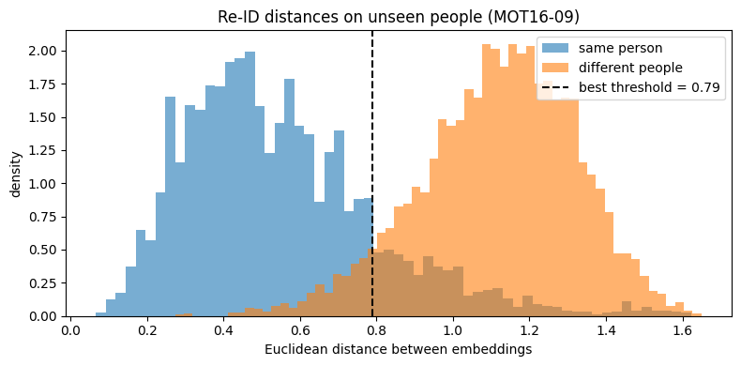
A Siamese network learns a distance
4 · METHODOLOGY · RE-IDENTIFICATION
One shared network embeds each crop
Same person close, different people far
Batch-hard triplet loss, 16 people × 4 crops
Random erasing imitates occlusion
TRIPLET LOSS
L = max(0, d(a, p) − d(a, n) + 0.3)
a = anchor, p = same person (hardest), n = other person (closest)
Pipeline A: distances on 24 unseen people; the two groups are clearly separated.
A: ResNet-18, 128 numbers. B: ResNet-50, 2048 numbers, plus an identity loss. It learns a distance, not names, so it works on unseen people. Common test: Rank-1 0.767 (A), 0.922 (B).
Bosia N’dri · 9
Notes:
[Bosia · about 1 minute 15 seconds] Both pipelines use a Siamese network for re-identification: the same network embeds two pictures, and we compare the numbers. Same person: close. Different people: far apart. We train it with triplet loss. We take an anchor picture, another picture of the same person, and a picture of a different person. The loss pulls the same person closer and pushes the different person away by at least 0.3. We pick the hardest examples in each batch. Pipeline B adds an identity loss. We also hide parts of the pictures to copy occlusion. Both models start from ImageNet weights, which is transfer learning, like the detector. On a common test, Rank-1 is 0.767 for A and 0.922 for B. B is larger, and we chose its checkpoint on this video. [Next: Tony, tracking]

Slide 10
Every frame: predict, match, keep alive
4 · METHODOLOGY · TRACKING
1 · Predict
2 · Match
Kalman filter
Hungarian algorithm
Predicts where each person will be in the next frame from their speed.
Best global pairing of boxes and tracks; cost = 0.6 × look + 0.4 × overlap.
3 · Guard
4 · Offline rules
Motion gate + strict Re-ID
Exit rule + short gap fill
A match must be nearby and look alike, so IDs cannot jump across the frame.
A person who walks out has left; detector drop-outs of ≤5 frames are filled.
Pipeline B: BoT-SORT does predict, match and guard without appearance. Our repair then cuts a track when the look changes (0.5) and merges tracks that look alike (0.35, gap up to 150 frames).
Tony Nguyen · 10
Notes:
[Tony · about 1 minute] Every frame, the tracker does four steps. Predict: a Kalman filter guesses where each person will be. Match: the Hungarian algorithm pairs boxes and tracks all at once. Guard: a match must be close and look alike, so an ID cannot jump across the picture. Offline rules: when a person leaves, the track ends; gaps of up to 5 frames are filled; very short tracks are dropped. This is Pipeline A. Pipeline B's BoT-SORT follows the same ideas without appearance, and our repair adds appearance after tracking. [Next: results so far]

Slide 11
A keeps IDs stable; the repair gives B the best HOTA
3 · CURRENT PROGRESS · RESULTS ON MOT16-09 (HELD OUT)
Run | HOTA | IDF1 | ID sw.
A · published tracks | 50.40 | 60.35 | 35
B · BoT-SORT | 48.40 | 55.65 | 46
Hybrid · YOLO in A’s tracker | 51.08 | 62.65 | 30
B · BoT-SORT + repair | 55.30 | 68.04 | 56
48.40 → 55.30
HOTA of Pipeline B with the repair
46 → 56
HOTA balances finding people and linking them; IDF1 = how long each person keeps one ID. Hybrid = YOLO detections in Pipeline A’s tracker, thresholds 0.6 / 0.5.
ID switches of Pipeline B: the repair also adds switches
Detection and ReID: AP@0.5 0.7896 (B) vs 0.7798 (A); ReID Rank-1 0.922 (B) vs 0.767 (A) on a common test. All settings were tuned on this video, so scores are optimistic.
Tony Nguyen · 11
Notes:
[Tony · about 1 minute 15 seconds] These are our results so far, on the hidden video, scored by TrackEval. Pipeline A keeps identities more stable than BoT-SORT: 35 ID switches against 46. Our repair raises Pipeline B a lot: HOTA from 48.40 to 55.30, and IDF1 from 55.65 to 68.04. But the ID switches also rise from 46 to 56. If we put YOLO detections into Pipeline A's tracker, we get 30 ID switches. For detection, the average precision is similar: 0.7896 for B and 0.7798 for A. For ReID, B scores higher, but it is a larger model. All settings were chosen on this video, so the scores are a little too good. [Next: experiments with the code]

Slide 12
Four things we changed, and what happened
3 · CURRENT PROGRESS · EXPERIMENTS WITH THE CODE
1 · Augmentation (B)
2 · Tracker steps (A)
YOLO scale 0.5 → 0.0
Add one step at a time
Precision 0.901 → 0.948, recall 0.748 → 0.736, mAP50 0.867 → 0.864 (one seed: within noise).
IDF1 47.7 (IoU only) → 56.2 (+ Kalman) → 62.2 (+ Siamese) → 60.3 (final).
3 · Repair thresholds (B)
4 · Score thresholds (hybrid)
Split and merge
0.7/0.6 → 0.4/0.3
Split 0.5 + merge 0.35: HOTA 48.40 → 55.30. Split 0.4 cuts too often (74–75 ID switches).
Misses 1,609 → 1,208, but AssA 44.57 → 38.40.
Tony Nguyen · 12
Notes:
[Tony · about 1 minute] The midterm asks us to play with the code, so here are four changes we tried. One: in YOLO training we set scale augmentation from 0.5 to 0. Precision went up and recall went down, and mAP did not change much; with one seed this is within noise. Two: in Pipeline A we added one tracker step at a time. IDF1 went from 47.7 to 56.2 with the Kalman filter, and to 62.2 with the Siamese network. The last steps lowered it to 60.3 but reduced misses. Three: for our repair, split 0.5 and merge 0.35 worked best, and split 0.4 cut too often. Four: lower score thresholds in the tracker find more people, with misses falling from 1,609 to 1,208, but they lower the association score from 44.57 to 38.40. [Next: Rehan, what goes wrong]

Slide 13
Most people still get several IDs
3 · CURRENT PROGRESS · WHAT GOES WRONG
Run | One ID | Perfect | IDs/person
A · published tracks | 5 | 2 | 2.94
B · BoT-SORT | 3 | 1 | 3.50
B · BoT-SORT + repair | 3 | 1 | 3.78
Hybrid · YOLO in A’s tracker | 4 | 2 | 2.78
18 long-lived people (at least 100 frames). Perfect = one ID covering at least 90% of their frames.
Pole occlusion
False tracks
Static people missed
A man behind a light pole came back with a new ID (IDs 235 and 263).
Two boxes with no person (IDs 144, 154) near a lit entrance cover.
People who sit or stand still are not detected (likely not in our training labels; not tested).
Rehan Ali · 13
Notes:
[Rehan · about 45 seconds] We also counted how many people keep one ID. Of 18 people who appear for at least 100 frames, no run has more than 2 perfect people. In our test video we saw three problems. A man behind a light pole got two IDs. Two false tracks appeared near a bright entrance. And people who sit or stand still were not detected. We think static people were not in our training labels, but we did not test this. [Next: Bosia, the demo]

Slide 14
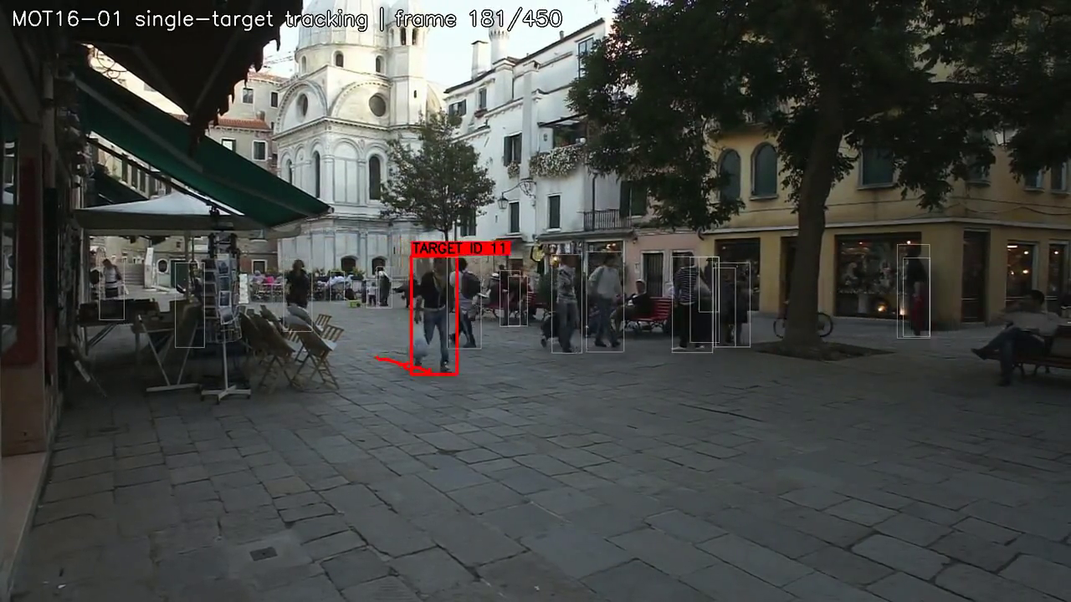
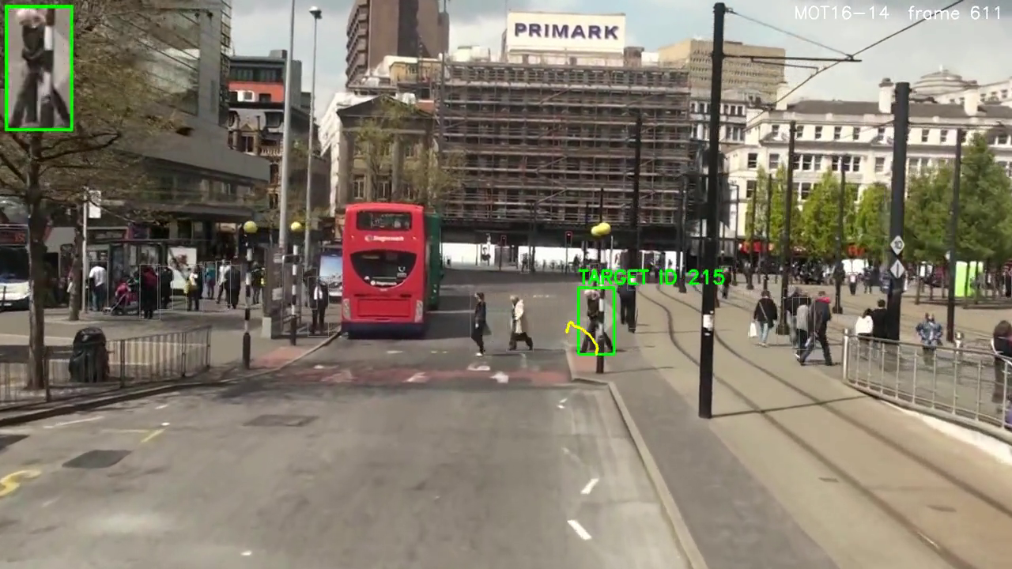
DEMO · TARGET VIDEOS (CLICK A VIDEO TO PLAY)
361 / 361
Pipeline A · MOT16-01 · ID 11: frames with a box, one ID, until he walks out on the right edge
Pipeline A · MOT16-01 · target ID 11
Pipeline B · MOT16-14 · moving camera · target ID 215
Backup links: MOT16-01 target video (GitHub) · MOT16-14 target video and results folder (Google Drive)
Bosia N’dri · 14
Notes:
[Bosia · about 1 minute, with video] Now the demo. [Click the left video and play about 15 seconds, then click the right video.] In Pipeline A's video, the target has ID 11 from frame 1 to frame 361, with no missing frame, and he leaves on the right. In Pipeline B's video the camera moves, and the man with ID 215 crosses the road toward the camera. We chose these targets because they are clean, so they show good cases. The per-person numbers show that most people are harder. [If a video does not play, use the links at the bottom of the slide.] [Next: next steps and questions]

Slide 15
Thank you. Questions?
NEXT STEPS · QUESTIONS
Test
Train
Combine
Write
a second validation sequence
with static people in the labels
the repair with Pipeline A’s tracker
the final report and the final presentation
Limits
Who answers questions
One validation video; settings chosen on it. YOLO and Faster R-CNN scores differ in scale. Speeds are from different GPUs. Test videos are qualitative.
Rehan: Pipeline A and the data. Tony: Pipeline B and the evaluation. Bosia: re-identification and the demo.
Bosia N’dri · 15
Notes:
[Bosia · about 45 seconds] Next steps. We will test a second validation sequence, train with static people in the labels, apply our repair to Pipeline A's tracker, and finish the final report. Our limits: one validation video, settings chosen on it, speeds from different GPUs that are not comparable, and test videos that are only qualitative. Thank you. We are happy to answer questions. [For questions: Rehan for Pipeline A and the data, Tony for Pipeline B and the evaluation, Bosia for re-identification and the demo.]

Slide 16
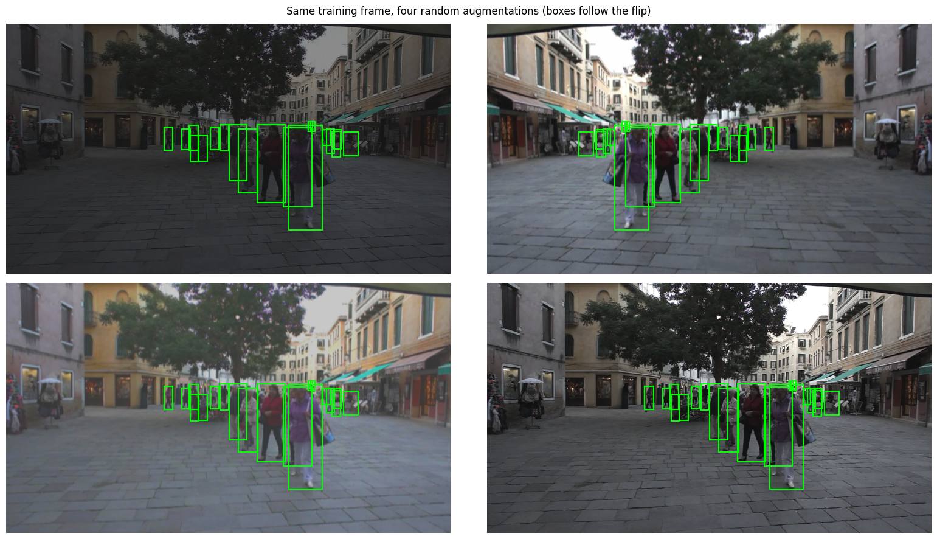
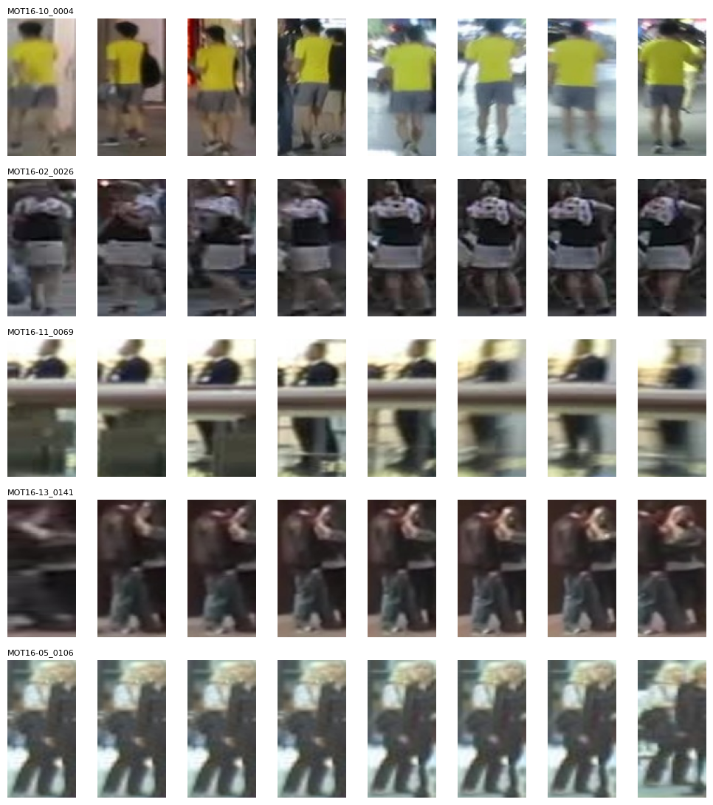
Two training sets from the same labels
BACKUP · PIPELINE A · DATA PREPARATION
For the detector: augmented frames
For Re-ID: person crops
20,146
crops of 362 people for training
24
unseen people (MOT16-09) for testing
One folder per person = same ID, so positive and negative pairs come for free
2,396 frames · flip (boxes flip too), colour jitter, Gaussian blur
Backup · data preparation
Notes:
[Backup slide for questions] Detector data: every second frame of the six training videos (2,396 frames) with flip, colour jitter and blur. ReID data: person crops, one folder per person: 20,146 crops of 362 people for training and 24 unseen people for testing.

Slide 17
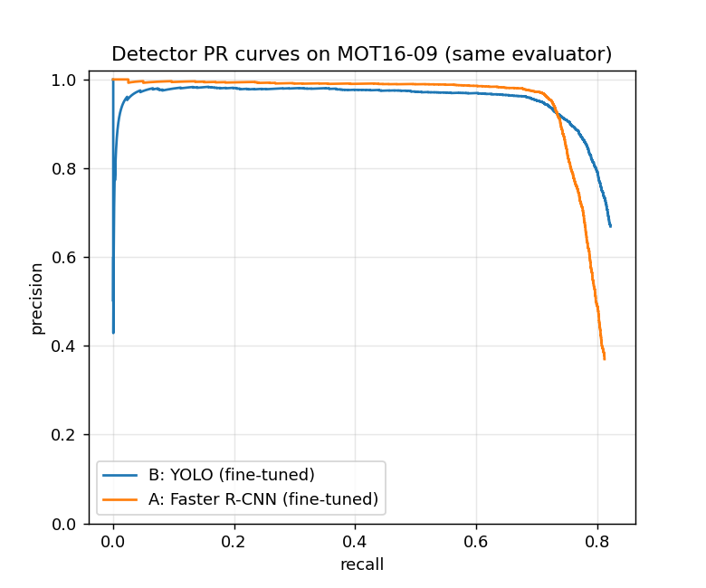
Similar AP; YOLO finds more hidden people
BACKUP · RESULTS · DETECTION
Same evaluator for both, MOT16-09, all 525 frames
AP@0.5: 0.7896 (YOLO), 0.7798 (Faster R-CNN)
At precision 0.80: hidden people found 0.471 (B) vs 0.316 (A)
Final outputs: unmatched boxes 478 (B) vs 1,073 (A)
Same evaluator | Pipeline A | Pipeline B
AP@0.5 | 0.7798 | 0.7896
Recall, visibility < 0.25 | 0.316 | 0.471
Recall, all (precision 0.80) | 0.757 | 0.798
Unmatched boxes, final tracks | 1,073 | 478
Hidden people are the main limit for both: 79% of Pipeline B’s misses have visibility < 0.25.
Backup · detection results
Notes:
[Backup slide for questions] Same evaluator for both detectors on all 525 frames. AP@0.5 is 0.7896 for YOLO and 0.7798 for Faster R-CNN. At precision 0.80, YOLO finds 0.471 of hidden people and Faster R-CNN 0.316; overall 0.798 and 0.757. In the final outputs, unmatched boxes are 478 (B) and 1,073 (A). For Pipeline B, 79 percent of the misses have visibility below 0.25.

Slide 18
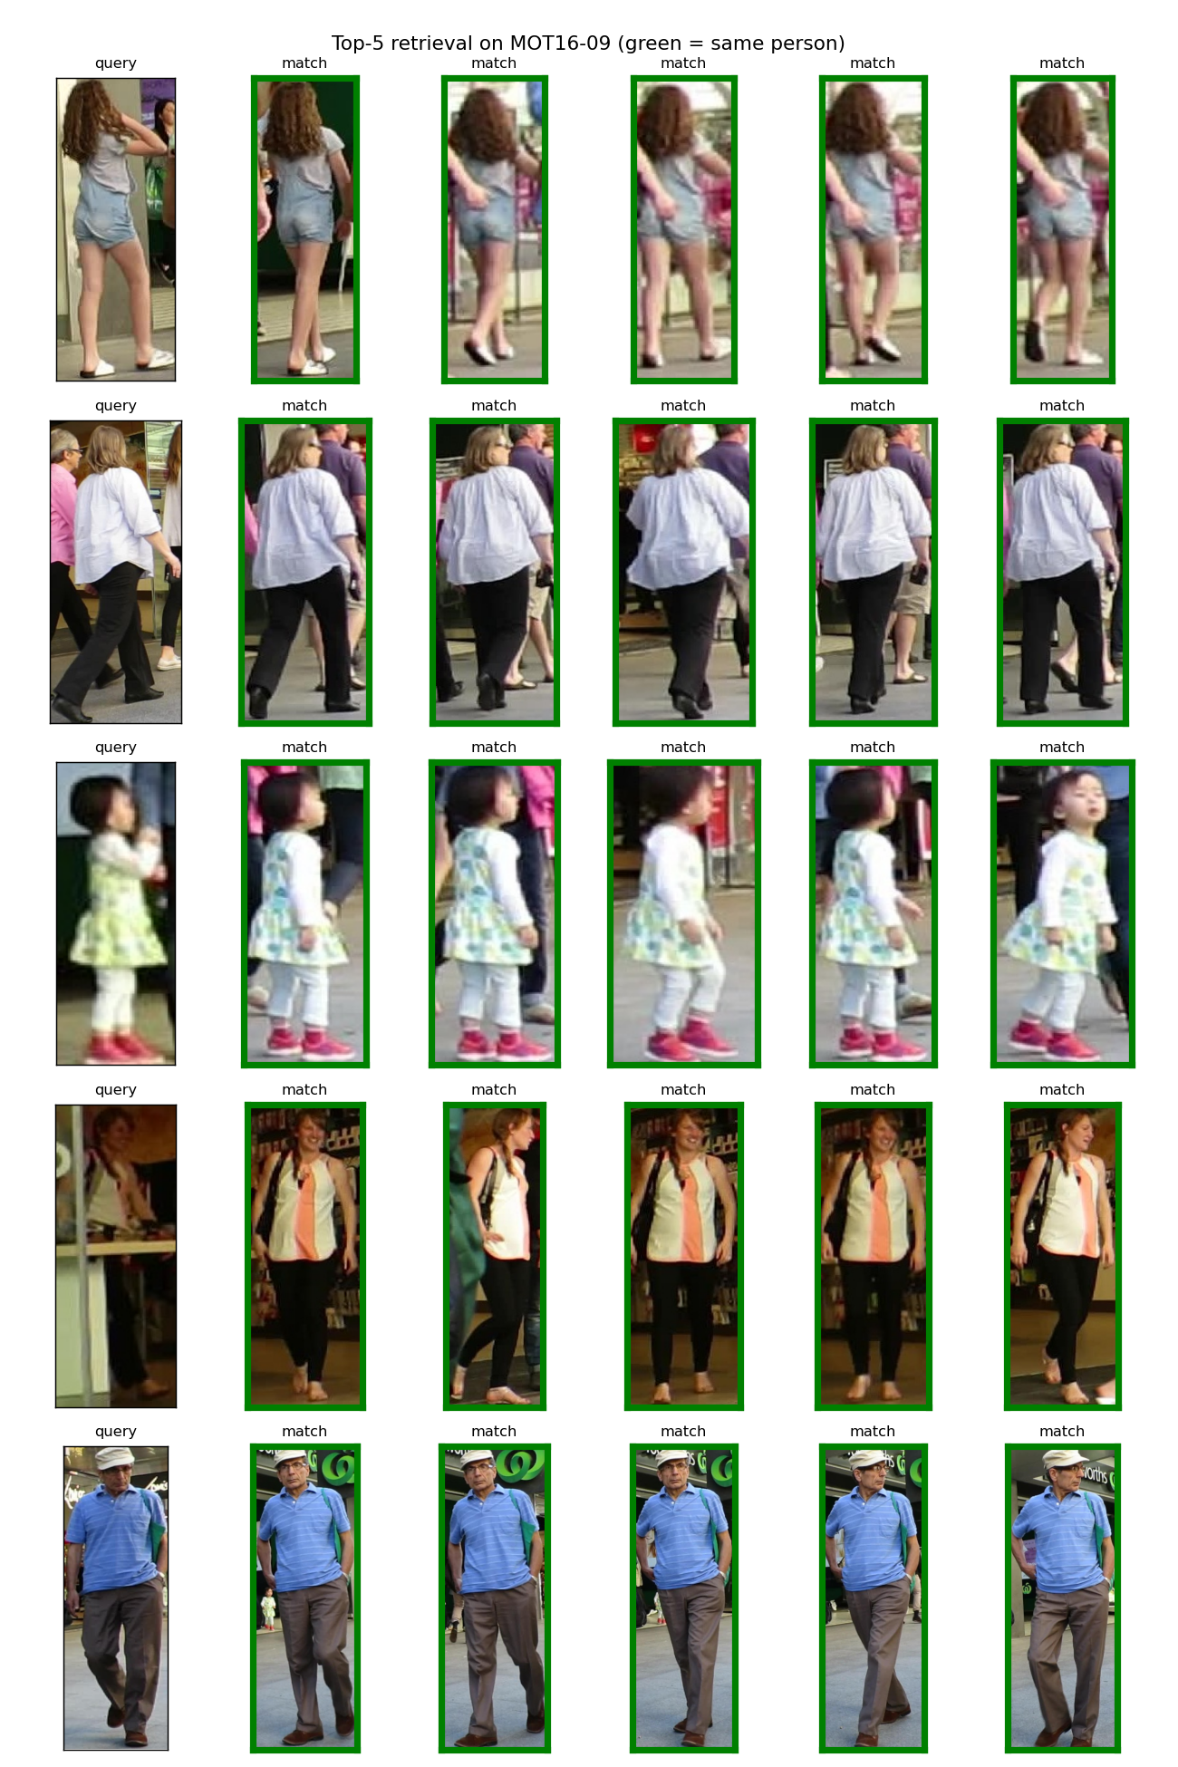
Training helps both; the larger model scores higher
BACKUP · RESULTS · RE-IDENTIFICATION
Common protocol, MOT16-09 | mAP | Rank-1
A: ResNet-18, ImageNet only | 0.400 | 0.564
A: Siamese ResNet-18, triplet | 0.635 | 0.767
B: ResNet-50, ImageNet only | 0.460 | 0.533
B: ResNet-50 + BNNeck, ID + triplet | 0.844 | 0.922
Be careful: Pipeline B has a larger network and a larger input, and its checkpoint was chosen on this video. Pipeline A’s own, easier test gave Rank-1 0.914.
Pipeline B: top-5 matches (green = same person)
Backup · ReID results
Notes:
[Backup slide for questions] Common protocol on MOT16-09: A ImageNet 0.400 mAP, 0.564 Rank-1; A trained 0.635, 0.767; B ImageNet 0.460, 0.533; B trained 0.844, 0.922. B has a larger network and input, and its checkpoint was chosen on this video. Pipeline A's own, easier test gave Rank-1 0.914.

