Slide 1
Hopeless
James Clemer
John Greene
Josiah Matlack

Slide 2

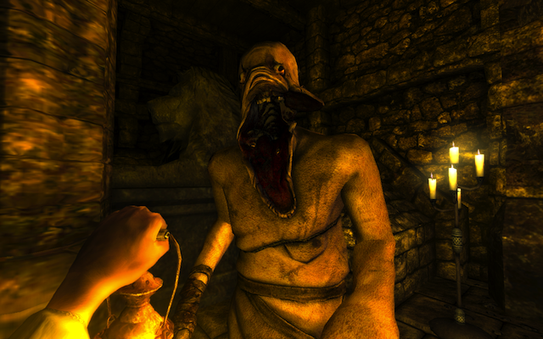
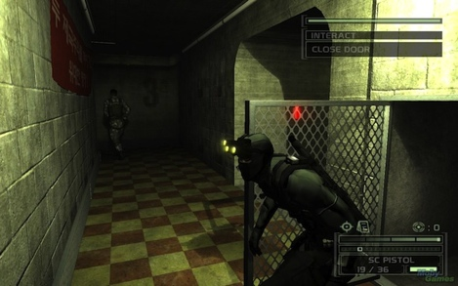
What’s the Big Idea!?
Defenseless player using stealth to accomplish goals
Notes:
Main idea of our game
Blend of Amnesia and Splinter Cell

Slide 3
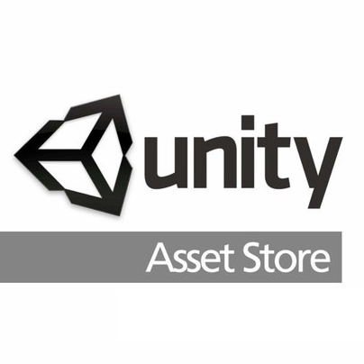
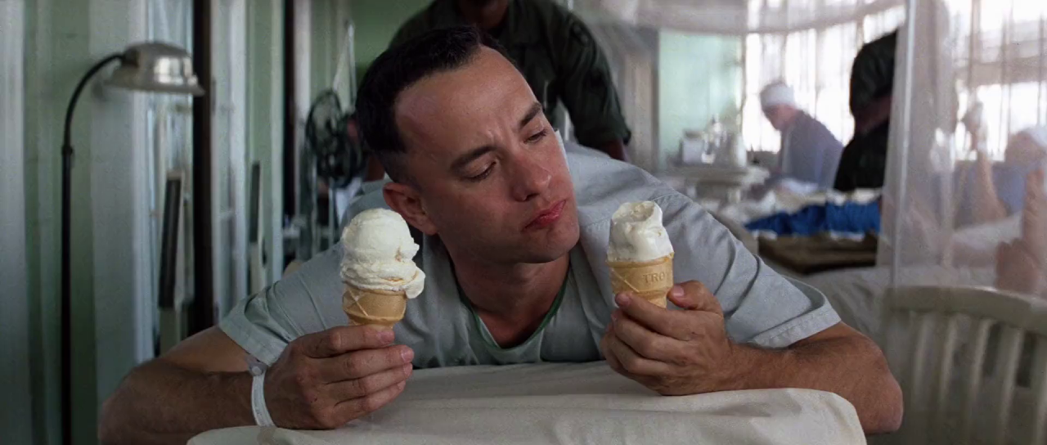
What Went Right?
The Unity Asset Store
Class feedback
Frequency analysis
Short sprints (3-day)
Fast pivots
Long, collaborative coding sessions
Specialization
Notes:
Frequency of class feedback let us prioritize fixes
Short sprints allowed for quick changes if features were either good or bad
Specialization was good for accomplishing specific goals

Slide 4
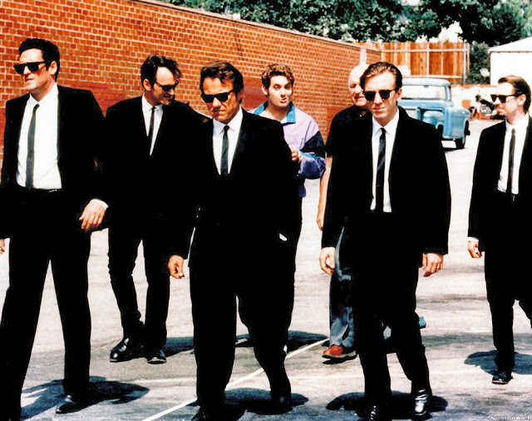
What Went Wrong?
Scope and vision issues
Industry reliance
Short quarter
Version control
Maladjusted sprint schedule
Notes:
Scope and vision: tried to do too much in all aspects, so everything was shortened and some features were cut
Industry reliance: features we’ve seen, but don’t necessarily need
Version control: don’t be discouraged
Schedule didn’t align with reviews

Slide 5

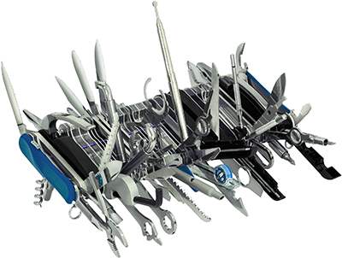
The Hardest Button to Button
Deciding on features!
Notes:
So much that we wanted to accomplish, but only so much time

Slide 6
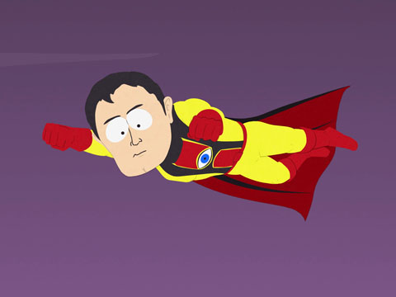
Twenty-twenty Surgery for Cheap
Build a game that you’re willing to play
A lot
No, seriously
Nobody cares about features if your core mechanics suck
Merge conflicts suck
(Not the team)

Slide 7
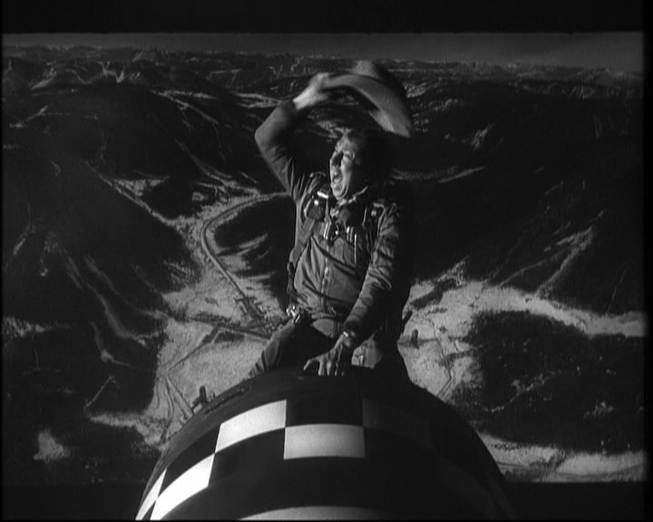
I Learned to Stop Worrying…
Unity is easy!
“Why aren’t there infinity games?”
Easy for you != easy for players
Explosions are really cool
And they scare your players!
The Asset store is your friend
All that boring stuff (animation, terrain building, raycasting, physics, etc.)
Notes:
Game testing is tedious, and boy is it time-consuming
But then you run into the problem of being really, really good at your game

