Slide 1
Lecture 10 Dynamic Programming
CSE373: Design and Analysis of Algorithms

Slide 2
Maximum-sum Interval
Given a sequence of real numbers a₁a₂…a_{n} , find a substring (a.k.a., interval in numeric sequence) with the maximum sum. E.g.:
(2, -5, 9, –3, 1, 7, –15, 2, 3)
Maximum sum interval is: (9,-3,1,7)
with sum = 9-3+1+7 = 14
Brute force approach: For each position, we can compute the maximum-sum interval starting at that position in O(n) time. Total time of this approach is O(n²).

Slide 3
DP Solution for Max Sum Interval
The recurrence relation: Define S_{i} to be the maximum sum of the intervals ending at position i. There are two cases:
Case 1: If it adding a_{i} with S_{i-1} increases the running sum then: S_{i} = S_{i-1} + a_{i}
Case 2: If adding a_{i} with S_{i-1} decreases the running sum then: S_{i} = a_{i} (i.e., consider a new substring starting from i-th index)
a_{i}
If S_{i} < 0, concatenating a_{i} with its previous interval gives less sum than a_{i} itself. So in this case we will take a_{i} instead of taking S_{i-1}+a_{i}

Slide 4
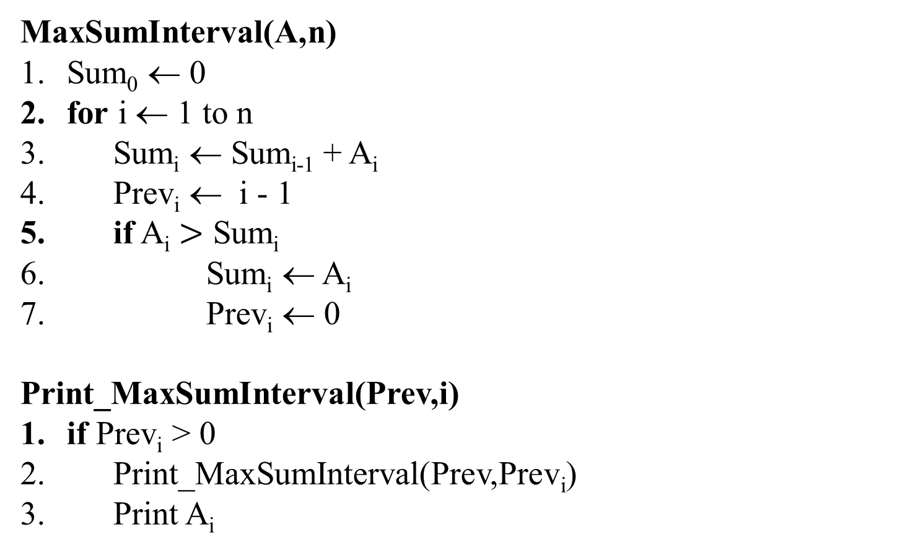
Dynamic Programming Solution
MaxSumInterval(A,n)
Sum₀ ← 0
for i ← 1 to n
Sum_{i} ← Sum_{i-1} + A_{i}
Prev_{i} ← i - 1
if A_{i} $>$ Sum_{i}
Sum_{i} ← A_{i}
Prev_{i} ← 0
Print_MaxSumInterval(Prev,i)
if Prev_{i} > 0
Print_MaxSumInterval(Prev,Prev_{i})
Print A_{i}
O(n) time

Slide 5
Dynamic Programming Solution
9 –3 1 7 –15 2 3 –4 2 –7 6 –2 8 4 -9
 | 0 | 1 | 2 | 3 | 4 | 5 | 6 | 7 | 8 | 9 | 10 | 11 | 12 | 13 | 14 | 15
A | 0 | 9 | -3 | 1 | 7 | -15 | 2 | 3 | -4 | 2 | -7 | 6 | -2 | 8 | 4 | -9
Sum | 0 | 9 | 6 | 7 | 14 | -1 | 2
Prev | 0 | 0 | 1 | 2 | 3 | 4 | 0

Slide 6
Dynamic Programming Solution
9 –3 1 7 –15 2 3 –4 2 –7 6 –2 8 4 -9
 | 0 | 1 | 2 | 3 | 4 | 5 | 6 | 7 | 8 | 9 | 10 | 11 | 12 | 13 | 14 | 15
A | 0 | 9 | -3 | 1 | 7 | -15 | 2 | 3 | -4 | 2 | -7 | 6 | -2 | 8 | 4 | -9
Sum | 0 | 9 | 6 | 7 | 14 | -1 | 2 | 5 | 1 | 3 | -4 | 6 | 4 | 12 | 16 | 7
Prev | 0 | 0 | 1 | 2 | 3 | 4 | 0 | 6 | 7 | 8 | 9 | 0 | 11 | 12 | 13 | 14
The maximum sum
The maximum-sum interval: 6 -2 8 4

Slide 7
Longest increasing subsequence (LIS)
The longest increasing subsequence is to find a longest increasing subsequence of a given sequence of distinct integers a₁a₂…a_{n} .
e.g. 9 2 5 3 7 11 8 10 13 6
2 3 7
5 7 10 13
9 7 11
5 3 11 13
are increasing subsequences.
We want to find a longest one.
are not increasing subsequences.

Slide 8
Can we use LCS to solve LIS?
Yes. How?
LIS(X) = LCS(X, sort(X))
sort takes O(nlgn) time [assuming, |X| = n]
LCS takes O(n²) times
So total time to compute LIS in this approach is O(n²)
Here we converted the input of an LIS problem into the input of an LCS problem and then we output the solution of that LCS problem as a solution of our original LIS problem. In other words, an LCS problem is reducible to LIS problem.
We will talk more about reducibility while discussing about NP-completeness
Can we solve LIS directly without using LCS (and thus avoid the cost of sorting)?

Slide 9
A Naïve DP Approach to Solve LIS
Let L[i] be the length of a longest increasing subsequence ending at position i.
L[i] = 1 + max _{j = 0..i-1}{L[j] | a_{j} < a_{i}} (use a dummy a₀ = infimum of a, and set L[0]=0)
Index,i | 0 | 1 | 2 | 3 | 4 | 5 | 6 | 7 | 8 | 9 | 10
Input, a | 0 | 9 | 2 | 5 | 3 | 7 | 11 | 8 | 10 | 13 | 6
L | 0
prev | -1
6
1
1
2
2
3
4
4
5
6
3
0
0
2
2
4
5
5
7
8
4
LIS length is 6 and the subsequence (2,3,7,8,10,13) is an LIS.
Can you write an algorithm that uses the above recurrence to fill up L and prev arrays?
Notes:
Infimum of a set of numbers is the largest number which is < all the numbers in that set

Slide 10
LIS-Naïve-DP(X, n)
L[0] ← 0
prev[0] ← -1
maxLength ← 0 //largest value in L array
maxIndex ← 0 //index of the largest value in L array
for i ← 1 to n do
L[i] ← 0
for j ← 0 to i-1 do
if a[j] < a[i] and L[j]+1 > L[i] then
L[i] ← L[j]+1
prev[i] ← j
if L[i] > maxLength then
maxLength ← L[i]
maxIndex ← i
return L, prev, maxLength, and maxIndex
Running time: Θ(n²)
Can we design a faster algorithm?

Slide 11
LIS-Naïve-DP(X, n) Issue and Its Solution
for i ← 1 to n do
L[i] ← 0
for j ← 0 to i-1 do
if a[j] < a[i] and L[j]+1 > L[i] then …
LIS-Naïve-DP spends too much time (specifically, O(n)) in lines 7-8 searching in the unsorted array a (search for an a[j] which satisfies the condition of line 8).
We know that searching takes much less time (specifically, O(lgn) when we apply binary search) on a sorted array
Since LIS is a sorted array, searching in LIS is more efficient.
Specifically, we want to keep track of the LISs of length j , where 1 ≤ j ≤ |LIS(X)|
There may exist multiple LISs with the same length. For each length j, we want to keep track of that LIS whose last element is the smallest because this LIS is more likely (than other LISs) to be extended upon reading the next number from array a
Instead of keeping track of each LIS, it is easier for us to keep track of L[j] = smallest number with which an LIS of length j ends
After reading a[i], we will update this L array in the following way:
If a[i] > last/largest element of L then L = (L, a[i])
Otherwise, replace the smallest element of L which is ≥ a[i] by a[i]
Step b above requires searching in L which can be done in O(lgn) time
We will also use a prev array using which we can form LIS afterwards

Slide 12
Modified DP Approach to Solve LIS
Index, i | Input, a | L | prev = index (in a) of the element of L which comes just before a[i] in L; -1 if no such element is in L
0 | 0 | {} | -1
1 | 2 | {2} | -1
2 | 5 | {2,5} | Index of 2 in a = 1
3 | 3 | {2,3} | Index of 2 in a = 1
4 | 6
5 | 1
6 | 2
7 | 10
8 | 7
9 | 9
Notes:
Infimum of a set of numbers is the largest number which is < all the numbers in that set

Slide 13
Modified DP Approach to Solve LIS
Index, i | Input, a | L | prev = index (in a) of the element of L which comes just before a[i] in L; -1 if no such element is in L
0 | 0 | {} | -1
1 | 2 | {2} | -1
2 | 5 | {2,5} | Index of 2 in a = 1
3 | 3 | {2,3} | Index of 2 in a = 1
4 | 6 | {2,3,6} | Index of 3 in a = 3
5 | 1 | {1,3,6} | -1
6 | 2 | {1,2,6} | Index of 1 in a = 5
7 | 10 | {1,2,6,10} | Index of 6 in a = 4
8 | 7 | {1,2,6,7} | Index of 6 in a = 4
9 | 9 | {1,2,6,7,9} | Index of 7 in a = 8
Notes:
Infimum of a set of numbers is the largest number which is < all the numbers in that set

Slide 14
Modified DP Approach to Solve LIS
Index, i | Input, a | L | prev = index (in a) of the element of L which comes just before a[i] in L; -1 if no such element is in L
0 | 0 | {} | -1
1 | 2 | {2} | -1
2 | 5 | {2,5} | Index of 2 in a = 1
3 | 3 | {2,3} | Index of 2 in a = 1
4 | 6 | {2,3,6} | Index of 3 in a = 3
5 | 1 | {1,3,6} | -1
6 | 2 | {1,2,6} | Index of 1 in a = 5
7 | 10 | {1,2,6,10} | Index of 6 in a = 4
8 | 7 | {1,2,6,7} | Index of 6 in a = 4
9 | 9 | {1,2,6,7,9} | Index of 7 in a = 8
Notes:
Infimum of a set of numbers is the largest number which is < all the numbers in that set

Slide 15
Modified DP Approach to Solve LIS
Index, i | Input, a | L | prev = index (in a) of the element of L which comes just before a[i] in L; -1 if no such element is in L
0 | 0 | {} | -1
1 | 2 | {2} | -1
2 | 5 | {2,5} | Index of 2 in a = 1
3 | 3 | {2,3} | Index of 2 in a = 1
4 | 6 | {2,3,6} | Index of 3 in a = 3
5 | 1 | {1,3,6} | -1
6 | 2 | {1,2,6} | Index of 1 in a = 5
7 | 10 | {1,2,6,10} | Index of 6 in a = 4
8 | 7 | {1,2,6,7} | Index of 6 in a = 4
9 | 9 | {1,2,6,7,9} | Index of 7 in a = 8
Notes:
Infimum of a set of numbers is the largest number which is < all the numbers in that set

Slide 16
Modified DP Approach to Solve LIS
Index, i | Input, a | L | prev = index (in a) of the element of L which comes just before a[i] in L; -1 if no such element is in L
0 | 0 | {} | -1
1 | 2 | {2} | -1
2 | 5 | {2,5} | Index of 2 in a = 1
3 | 3 | {2,3} | Index of 2 in a = 1
4 | 6 | {2,3,6} | Index of 3 in a = 3
5 | 1 | {1,3,6} | -1
6 | 2 | {1,2,6} | Index of 1 in a = 5
7 | 10 | {1,2,6,10} | Index of 6 in a = 4
8 | 7 | {1,2,6,7} | Index of 6 in a = 4
9 | 9 | {1,2,6,7,9} | Index of 7 in a = 8
Notes:
Infimum of a set of numbers is the largest number which is < all the numbers in that set

Slide 17
Modified DP Approach to Solve LIS
Index, i | Input, a | L | prev = index (in a) of the element of L which comes just before a[i] in L; -1 if no such element is in L
0 | 0 | {} | -1
1 | 2 | {2} | -1
2 | 5 | {2,5} | Index of 2 in a = 1
3 | 3 | {2,3} | Index of 2 in a = 1
4 | 6 | {2,3,6} | Index of 3 in a = 3
5 | 1 | {1,3,6} | -1
6 | 2 | {1,2,6} | Index of 1 in a = 5
7 | 10 | {1,2,6,10} | Index of 6 in a = 4
8 | 7 | {1,2,6,7} | Index of 6 in a = 4
9 | 9 | {1,2,6,7,9} | Index of 7 in a = 8
Notes:
Infimum of a set of numbers is the largest number which is < all the numbers in that set

Slide 18
Modified DP Approach to Solve LIS
Index, i | Input, a | L | prev = index (in a) of the element of L which comes just before a[i] in L; -1 if no such element is in L
0 | 0 | {} | -1
1 | 2 | {2} | -1
2 | 5 | {2,5} | Index of 2 in a = 1
3 | 3 | {2,3} | Index of 2 in a = 1
4 | 6 | {2,3,6} | Index of 3 in a = 3
5 | 1 | {1,3,6} | -1
6 | 2 | {1,2,6} | Index of 1 in a = 5
7 | 10 | {1,2,6,10} | Index of 6 in a = 4
8 | 7 | {1,2,6,7} | Index of 6 in a = 4
9 | 9 | {1,2,6,7,9} | Index of 7 in a = 8
LIS = (2,3,6,7,9)
Notes:
Infimum of a set of numbers is the largest number which is < all the numbers in that set

Slide 19
LIS-Fast-DP(X, n)
L[0] ← -∞, L’[0] ← -1, prev[0] ← -1 //sentinel values
for i ← 1 to n do
if L[L.length] < a[i] then
append a[i] at the end of L
L’[L.Length] ← i
prev[i] ← L’[L.length-1]
else
(s,h) ← (0, L.length)
while s < h do //binary-search for the smallest L[j] which is ≥ a[i]
m ← (s+h)/2
if L[m] < a[i] then
s ← m+1
else
h ← m
L[s] ← a[i]
L’[s] ← i //save index of a[i] in L’, so that we can use it for prev later
prev[i] ← L’[s-1]
return L, prev
└ ┘
Run-time: Θ(n lg n); as binary search (lines 9-14) takes
Θ(lgn) time in each of the Θ(n) iterations of the outer loop.

