Slide 1
Lecture 13 Graph-Based Algorithms
CSE373: Design and Analysis of Algorithms

Slide 2
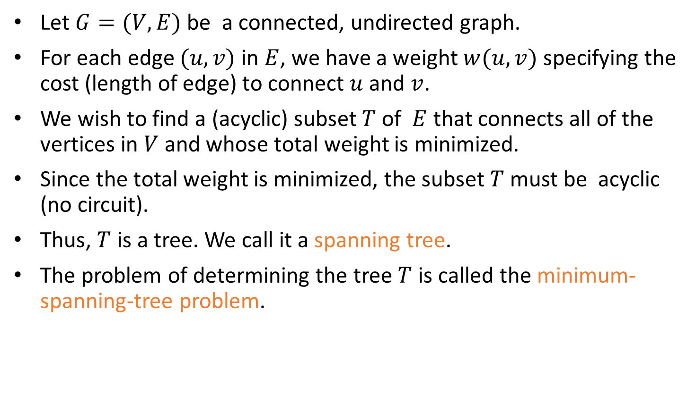
Definition of MST
Let $G=(V,E)$ be a connected, undirected graph.
For each edge $(u,v)$ in $E$, we have a weight $w(u,v)$ specifying the cost (length of edge) to connect $u$ and $v$.
We wish to find a (acyclic) subset $T$ of $E$ that connects all of the vertices in $V$ and whose total weight is minimized.
Since the total weight is minimized, the subset $T$ must be acyclic (no circuit).
Thus, $T$ is a tree. We call it a spanning tree.
The problem of determining the tree $T$ is called the minimum-spanning-tree problem.

Slide 3

Application of MST
In the design of electronic circuitry, it is often necessary to make a set of pins electrically equivalent by wiring them together.
To interconnect n pins, we can use n-1 wires, each connecting two pins.
We want to minimize the total length of the wires.
Minimum Spanning Trees can be used to model this problem.

Slide 4
Application of MST
Problem: Laying Telephone Wire
Central office

Slide 5
Application of MST
Wiring: Naïve Approach
Central office
Expensive!

Slide 6
Application of MST
Wiring: Better Approach
Central office
Minimize the total length of wire connecting the customers

Slide 7
MST Example
Here is an example of a connected graph and its minimum spanning tree:
8
7
b
c
d
9
4
2
a
11
i
14
e
4
7
6
8
10
h
g
f
1
2
Notice that the tree is not unique:
replacing (b,c) with (a,h) yields another spanning tree with the same minimum weight.
ST: a collection of edges (here blue edges) which ensures that there is a path between every
pair of nodes/vertices in the input graph via those edges.
MST: a ST whose total edge weight is minimum possible, i.e., there is no other ST whose total
edge weight is less.

Slide 8
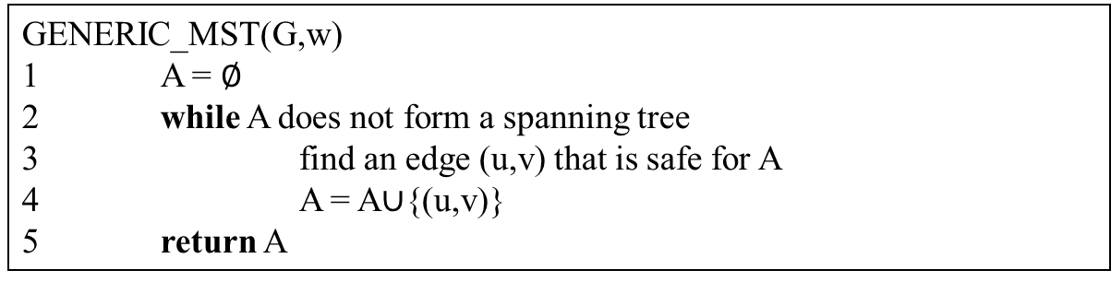

Growing a MST(Generic Algorithm)
Set $A$ is always a subset of some minimum spanning tree. This property is called the invariant Property.
An edge $(u,v)$ is a safe edge for $A$ if adding the edge to $A$ does not destroy the invariant.
A safe edge is just the CORRECT edge to choose to add to T.
GENERIC_MST(G,w)
1 A = $∅$
2 while A does not form a spanning tree
3 find an edge (u,v) that is safe for A
4 A = A∪{(u,v)}
5 return A

Slide 9
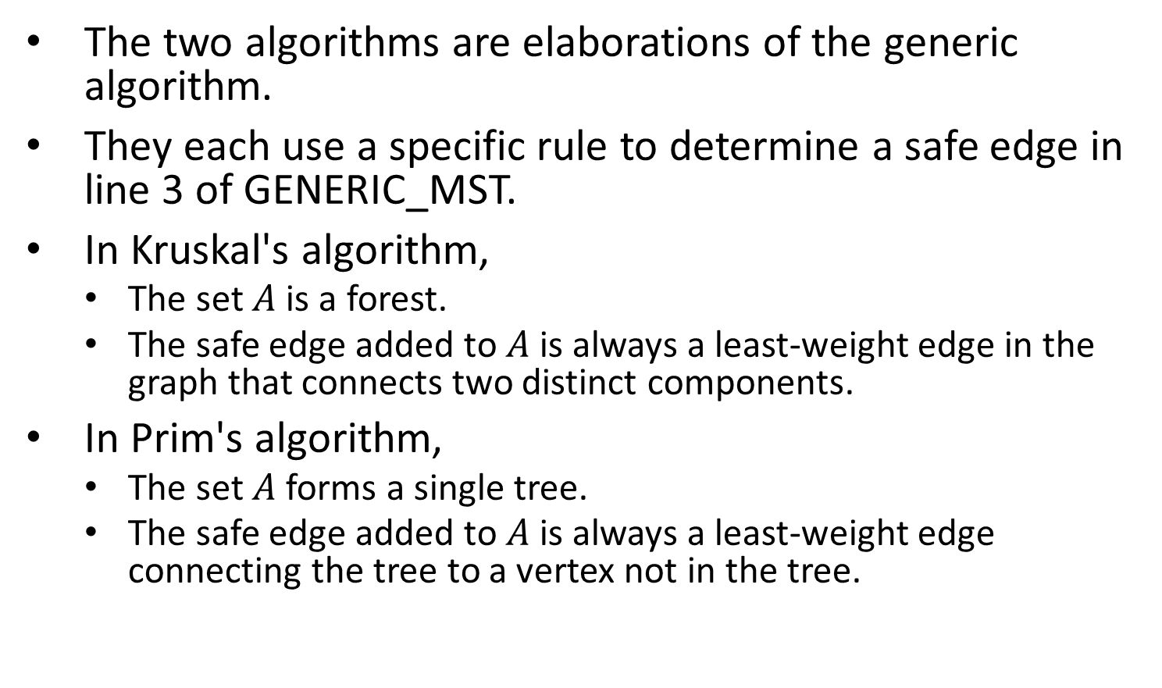
The Algorithms of Kruskal and Prim
The two algorithms are elaborations of the generic algorithm.
They each use a specific rule to determine a safe edge in line 3 of GENERIC_MST.
In Kruskal's algorithm,
The set $A$ is a forest.
The safe edge added to $A$ is always a least-weight edge in the graph that connects two distinct components.
In Prim's algorithm,
The set $A$ forms a single tree.
The safe edge added to $A$ is always a least-weight edge connecting the tree to a vertex not in the tree.

Slide 10
Related Topics
Disjoint-Set (Chapter 21, Page 571)
Keep a collection of disjoint sets: S₁, S₂, .., S_{k},
Each S_{i} is a set, e,g, S₁={v₁, v₂, v₈}.
Three operations
Make-Set(x) - creates a new set whose only member is x.
Union(x, y) – unites the sets that contain x and y, say, S_{x} and S_{y}, into a new set that is the union of the two sets.
Find-Set(x) - returns a pointer to the representative of the set containing x.

Slide 11
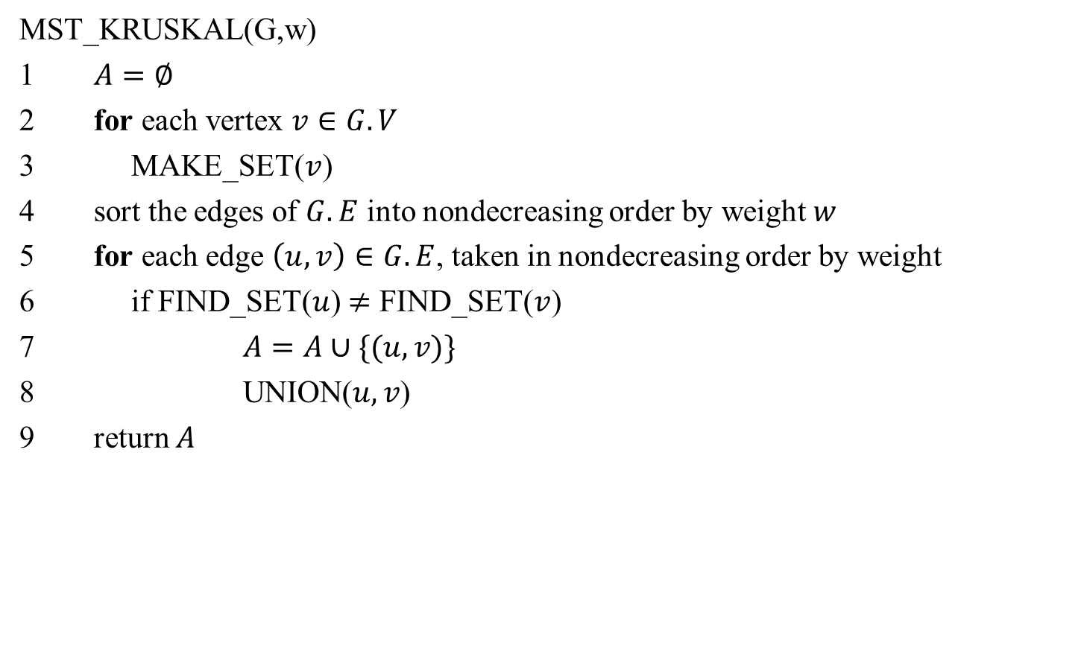
Kruskal's Algorithm
MST_KRUSKAL(G,w)
1 $A=∅$
2 for each vertex $v∈G.V$
3 MAKE_SET($v$)
4 sort the edges of $G.E$ into nondecreasing order by weight $w$
5 for each edge $\left(u,v\right)∈G.E$, taken in nondecreasing order by weight
6 if FIND_SET($u$) $≠$ FIND_SET($v$)
7 $A=A∪\{(u,v)\}$
8 UNION($u,v$)
return $A$

Slide 12
Time Complexity of Kruskal's Algorithm
Line 4 sorts E edges => it takes O(E lgE) time, if we use MergeSort
But lg E = O(lg V), since E < V² => lg E < 2 lg V => lg E is O(lg V)
Hence O(E lg E) = O(E lg V)
If we make total m calls of Make_set, Union, and Find_set in any algorithm, then these calls will take total O(m lg n) time, where n is the number of Make-Set calls.
The 1st for loop makes O(V) MAKE_SET() calls and the 2nd for loop makes O(E) Find_SET and UNION calls
Total O(V+E) calls of MAKE_SET, FIND_SET, and UNION, out of which O(V) calls were MAKE_SET calls => O((V+E) lgV) time
E ≥ V-1, since the graph is connected
=> V is O(E)=> O((V+E) lgV) = O(E lgV)
Hence total time = O(E lg V)

Slide 13
Kruskal's Algorithm: Example
The edges considered by the algorithm are sorted by weight.
The edge under consideration at each step is shown with a red weight number.
8
7
b
c
d
9
4
2
a
11
i
14
e
4
7
6
8
10
h
g
f
1
2

Slide 14
Kruskal's Algorithm: Example
The edges are considered by the algorithm in sorted order by weight.
The edge under consideration at each step is shown with a red weight number.
8
7
b
c
d
9
4
2
a
11
i
14
e
4
7
6
8
10
h
g
f
1
2

Slide 15
Kruskal's Algorithm: Example
The edges are considered by the algorithm in sorted order by weight.
The edge under consideration at each step is shown with a red weight number.
8
7
b
c
d
9
4
2
a
11
i
14
e
4
7
6
8
10
h
g
f
1
2

Slide 16
Kruskal's Algorithm: Example
The edges are considered by the algorithm in sorted order by weight.
The edge under consideration at each step is shown with a red weight number.
8
7
b
c
d
9
4
2
a
11
i
14
e
4
7
6
8
10
h
g
f
1
2

Slide 17
Kruskal's Algorithm: Example
The edges are considered by the algorithm in sorted order by weight.
The edge under consideration at each step is shown with a red weight number.
8
7
b
c
d
9
4
2
a
11
i
14
e
4
7
6
8
10
h
g
f
1
2

Slide 18
Kruskal's Algorithm: Example
The edges are considered by the algorithm in sorted order by weight.
The edge under consideration at each step is shown with a red weight number.
8
7
b
c
d
9
4
2
a
11
i
14
e
4
7
6
8
10
h
g
f
1
2

Slide 19
Kruskal's Algorithm: Example
The edges are considered by the algorithm in sorted order by weight.
The edge under consideration at each step is shown with a red weight number.
8
7
b
c
d
9
4
2
a
11
i
14
e
4
7
6
8
10
h
g
f
1
2

Slide 20
Kruskal's Algorithm: Example
The edges are considered by the algorithm in sorted order by weight.
The edge under consideration at each step is shown with a red weight number.
8
7
b
c
d
9
4
2
a
11
i
14
e
4
7
6
8
10
h
g
f
1
2

Slide 21
Kruskal's Algorithm: Example
The edges are considered by the algorithm in sorted order by weight.
The edge under consideration at each step is shown with a red weight number.
8
7
b
c
d
9
4
2
a
11
i
14
e
4
7
6
8
10
h
g
f
1
2

Slide 22
Kruskal's Algorithm: Example
The edges are considered by the algorithm in sorted order by weight.
The edge under consideration at each step is shown with a red weight number.
8
7
b
c
d
9
4
2
a
11
i
14
e
4
7
6
8
10
h
g
f
1
2

Slide 23
Kruskal's Algorithm: Example
The edges are considered by the algorithm in sorted order by weight.
The edge under consideration at each step is shown with a red weight number.
8
7
b
c
d
9
4
2
a
11
i
14
e
4
7
6
8
10
h
g
f
1
2

Slide 24
Kruskal's Algorithm: Example
The edges are considered by the algorithm in sorted order by weight.
The edge under consideration at each step is shown with a red weight number.
8
7
b
c
d
9
4
2
a
11
i
14
e
4
7
6
8
10
h
g
f
1
2

Slide 25

Prim's Algorithm
MST_PRIM(G,w,r)
1 for each $u$ in $G.V$
$u.key=∞$
$u.π=$NIL
4 $r.key=0$
5 $Q=G.V$ //Q is a min-priority queue
6 while $Q≠∅$
7 $u=$EXTRACT_MIN($Q$)
8 for each $v∈G.Adj[u]$
9 if $v∈Q$ and $w\left(u,v\right)<v.key$
10 $v.π=u$
11 $v.key=w(u,v)$

Slide 26
Prim's Algorithm
Grow the minimum spanning tree from the root vertex r.
Q is a priority queue, holding all vertices that are not in the tree now.
key[v] is the minimum weight of any edge connecting v to a vertex in the tree.
parent[v] names the parent of v in the tree.
When the algorithm terminates, Q is empty; the minimum spanning tree A for G is thus A={(v,parent[v]):v∈V-{r}}.
Running time: O(Elg V).

Slide 27
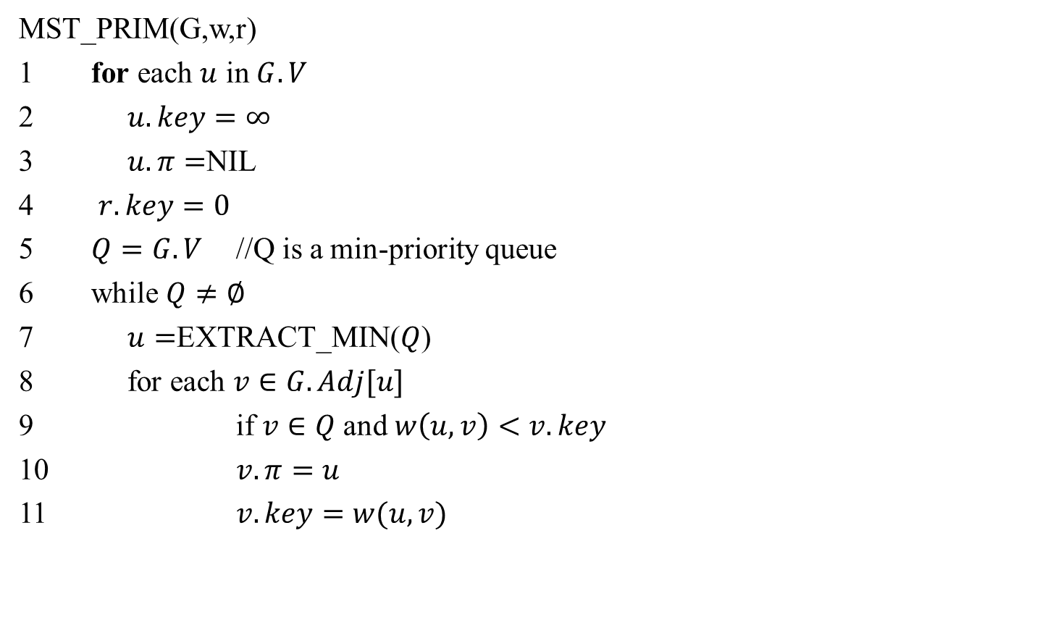
Running time of Prim's Algorithm
// O(V)
//Θ(V) time to build the heap
//V Heap-Extract-Min operations: O(V lg V)
//E Heap-Decrease-Key operations: O(E lg V)
Total time = O((V+E) lg V) = O(E lg V) since E ≥ V-1 => V is O(E)

Slide 28
Prim's Algorithm: Example
NIL,∞
8
NIL,∞
NIL,∞
the root vertex
c
7
d
b
9
4
NIL,∞
2
NIL,0
a
11
i
4
14
e
NIL,∞
7
6
8
10
h
g
f
NIL,∞
1
NIL,∞
2
NIL,∞

Slide 29
Prim's Algorithm: Example
a,4
8
NIL,∞
NIL,∞
c
7
d
b
9
4
NIL,∞
2
NIL,0
a
11
i
4
14
e
NIL,∞
7
6
8
10
h
g
f
a,8
1
NIL,∞
2
NIL,∞

Slide 30
Prim's Algorithm: Example
a,4
8
b,8
7
NIL,∞
b
c
d
9
4
NIL,∞
2
NIL,0
a
11
i
14
e
NIL,∞
4
7
6
8
10
h
g
f
a,8
1
NIL,∞
2
NIL,∞

Slide 31
Prim's Algorithm: Example
a,4
8
b,8
7
c,7
b
c
d
9
4
c,2
2
NIL,0
a
11
i
14
e
NIL,∞
4
7
6
8
10
h
g
f
a,8
1
NIL,∞
2
c,4

Slide 32
Prim's Algorithm: Example
a,4
8
b,8
7
c,7
b
c
d
9
4
c,2
2
NIL,0
a
11
i
14
e
NIL,∞
4
7
6
8
10
h
g
f
i,7
1
i,6
2
c,4

Slide 33
Prim's Algorithm: Example
a,4
8
b,8
7
c,7
b
c
d
9
4
c,2
2
NIL,0
a
11
i
14
e
f,10
4
7
6
8
10
h
g
f
i,7
1
f,2
2
c,4

Slide 34
Prim's Algorithm: Example
a,4
8
b,8
7
c,7
b
c
d
9
4
c,2
2
NIL,0
a
11
i
14
e
f,10
4
7
6
8
10
h
g
f
g,1
1
f,2
2
c,4

Slide 35
Prim's Algorithm: Example
a,4
8
b,8
7
c,7
b
c
d
9
4
c,2
2
NIL,0
a
11
i
14
e
f,10
4
7
6
8
10
h
g
f
g,1
1
f,2
2
c,4

Slide 36
Prim's Algorithm: Example
a,4
8
b,8
7
c,7
b
c
d
9
4
c,2
2
NIL,0
a
11
i
14
e
d,9
4
7
6
8
10
h
g
f
g,1
1
f,2
2
c,4

Slide 37
Prim's Algorithm: Example
a,4
8
b,8
7
c,7
b
c
d
9
4
c,2
2
NIL,0
a
11
i
14
e
d,9
4
7
6
8
10
h
g
f
g,1
1
f,2
2
c,4

