Slide 1
Lecture 2 Time complexity Analysis of Recursive Algorithms
CSE 373: Design & Analysis of Algorithms

Slide 2
Recursive Factorial Function
// Computes the factorial of a nonnegative integer.
// Precondition: n must be greater than or equal to 0.
// Postcondition: Returns the factorial of n; n is unchanged.
int Factorial(int n)
{
if (n == 0)
return (1);
else
return (n * Factorial(n-1));
}
void main()
{
int n; cin>>n;
Factorial(n);
}
T(n) = O(1) , if n = 0
T(n) = T(n-1)+O(1) , otherwise
O(1) time
O(1) time
O(1) time
So Factorial(n-1) call will take T(n-1) time
Let factorial(n) call takes total T(n) time

Slide 3
Binary Search: The Recursive Way
template<class ItemType>
bool BinarySearch(ItemType info[], ItemType item, int fromLocation, int toLocation)
{
if (fromLocation > toLocation) // Base case 1
return false;
else
{
int midPoint;
midPoint = (fromLocation + toLocation) / 2;
if (item < info[midPoint])
return BinarySearch(info, item, fromLocation, midPoint - 1);
else if (item == info[midPoint]) // Base case 2
return true;
else
return BinarySearch(info, item, midPoint + 1, toLocation);
}
}
What’s its time complexity?

Slide 4
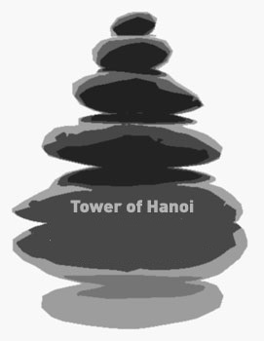

Slide 5
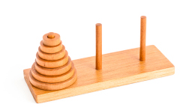
The Puzzle
Tower of Hanoi is a mathematical puzzle invented by a French Mathematician Edouard Lucas in 1883.
The game starts by having few discs stacked in increasing order of size. The number of discs can vary, but there are only three pegs.

Slide 6
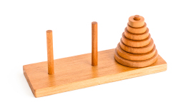
The Puzzle
The Objective is to transfer the entire tower to one of the other pegs. However you can only move one disk at a time and you can never stack a larger disk onto a smaller disk. Try to solve it in fewest possible moves.

Slide 7
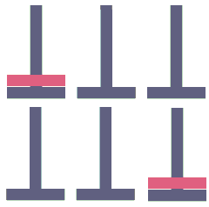
Recursive Solution
Problem: Move N discs from source peg to destination peg using auxiliary peg as via
Base case:
Move disc from source peg to destination peg (N = 1)

Slide 8
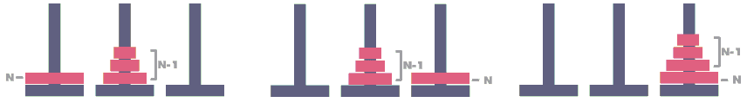
Recursive Solution
Problem: Move N discs from source peg to destination peg using auxiliary peg as via
General case:
Move N-1 discs from source peg to auxiliary peg via destination peg
Move disc from source peg to destination peg
Move N-1 discs from auxiliary peg to destination peg via source peg

Slide 9
Recursive Function for Solving Hanoi
#include <stdio.h>
void hanoi(int n, char src, char dst, char aux)
{
if(n == 1)
printf("Move disc from peg %c to peg %c\n", src, dst);
else
{
hanoi(n-1, src, aux, dst);
hanoi(1, src, dst, aux);
hanoi(n-1, aux, dst, src);
}
}
int main()
{
hanoi(4, 'A', 'C', 'B');
return 0;
}
What’s its time complexity?

