Slide 1
Introduction

Slide 2
Who Am I?
Dr. Ahsanur Rahman
Assistant Professor, ECE, NSU
B.Sc. in CSE from BUET
PhD in CS from Virginia Tech, USA
Website: https://sites.google.com/site/rahmanmahsanur/

Slide 3
Who are you (name, semester)? What’s your professional goal? Did you take CSE273/473, CSE426 before? Which languages do you know other than C/CPP/Java? At what level?

Slide 4
How to contact me?
Best way: meet me online during my office hours
Office hour meeting link: https://meet.google.com/bzp-xdze-yjv
Where is my office hour?
Soon be available in google classroom
Email: ahsanur.rahman@northsouth.edu
Message me in google classroom
I shall use google classroom and RDS SMS service for my notices

Slide 5
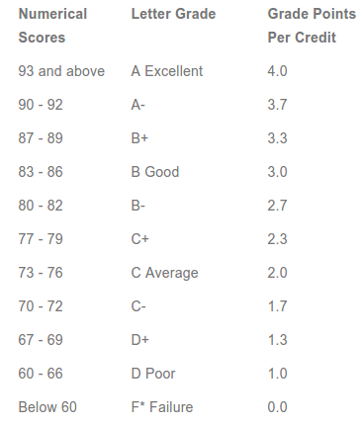
Grading system

Slide 6
Breakdown of Score
Class participation – 5%
Bonus marks for extra-ordinary performance in class
Assignments (coding) – 10%
Quizzes – 20%
Midterm – 25%
Presentation – 10%
Final exam – 30%
Subject to changes upon NSU/UGC instructions or disruptive situations due to COVID19

Slide 7
Midterms & Final exam
Tentative schedule:
Midterm: after about 10 classes
Final: after all 24 classes
Exact schedule will be announced later
Exam paper checking policy:
Write answers to the point: answer everything I asked for in details; don’t be unnecessarily lengthy
Partial marks are given to answers that are partially correct
Don’t write something you don’t know (totally guess)
zero for guesswork

Slide 8
Ground rules for the exams
Nobody is allowed to use any electronic device (phone/tab/…) except simple calculator
Calculator within mobile phone is not allowed
All electronic devices must be kept off and must be kept in the bag during exam
Turn off all your alarms in your devices
Keep all writing materials on your table & make sure that they work properly
Nobody can leave his/her table during the exam. Go beforehand, if needed.
Nobody is allowed to exchange anything online with anybody else

Slide 9
Ground rules for the exams
Nobody can talk, move, use phone/computers during exam – no cheating!
Question will be distributed to all and a few minutes will be given before the exam starts
Read & understand questions during this time
The invigilator will ask the students if they have any question/confusion about question, in which case he will explain it. Then the exam starts

Slide 10
Ground rules for the exams
Keep totally quiet during the exam
No question can be asked
No request can be made
Invigilators have the right to deduct marks or cancel anybody’s exam if the student adopts any unfair means

Slide 11
Ground rules for the exams
When the invigilator tells the students to stop, everyone must stop writing
A few minutes will be given to submit
Scan your papers, create a single PDF from those images, and then upload that to the designated link in google classroom
In case of take-home exam, a viva will be taken to assess your depth of understanding of the answers you have written.

Slide 12
Class participation
Based on the number of classes attended
Physically &
Mentally
Do
ask questions
answer my questions
Earn bonus by answering correctly & quickly
Bonus marks (0.1 ~ 1) depends on the question complexity
Focus on what I am saying
Take good preparation

Slide 13
Class participation
Don't
be late in joining the class
use cell-phones/gadgets during class
create nuisance
misguide/misinform me

Slide 14
Presentation
Choose a language other than C/CPP/Java
Do
Practice several times to finish within time & yet cover everything asked
prepare slides yourself
Make sure to run the code mentioned in slide and show output in your slides
Make sure you understand everything in your slide
Don't
copy/cheat/share

Slide 15
Assignment
All of them will be counted
Do
Think about logic & code independently
write your own code (partial submission is better than no submission or copying/sharing)
submit a single file (code) within deadline
Don't
Email me your code
Submit .zip/.rar file (won’t be accepted)
copy/cheat
Zero marks for cheating/sharing codes
Look at others’ codes from internet/friends’ codes/… (anything)
NO MAKE-UP/EXTRA ASSIGNMENT!!!

Slide 16
Quizzes
N=3 quizzes will be taken
Marks of the best (N-1) will be counted
Exact schedule will be announced later
NO MAKE-UP QUIZZES/mid/final/HW unless there is a real issue (in which case, please contact me right after you come online)!!!
In such a case, I shall decide how to resolve your case (taking makeup or something else)
Please be totally frank with me; I shall do whatever I can to ease your situation
But please don’t come up with fake excuses to exploit/harass me

Slide 17
Quizzes
Do
Take good preparation
Don't
copy/cheat
delay in submitting

Slide 18
Key to success
study regularly throughout the semester
follow the topics/problems discussed in the class
follow the DO's and avoid the DONT's mentioned here

Slide 19
Good Luck!

