Slide 1
EEE111.04 Summer 2024
09/07/2024
Introductory Class

Slide 2
Class Information
Course Name: Analog Electronics I
Course Code: EEE111
Credit Hours: 3
Pre-requisites: EEE 141/ETE 141 Electrical Circuits-I
Class time: ST 9:25am –10:40am
Google Meet Link:

Slide 3
Instructor Information
Instructor Name: Dr. Riasat Khan (RTk)
Position: Associate Professor, ECE
Email: riasat.khan@northsouth.edu
Office: SAC 920
Phone: 01879992680

Slide 4
Course Summary
In this course, a variety of electronic devices used in the design of analog electronics are studied.
A Basic understanding of semiconductor devices is covered. Emphasis is placed on diodes, BJT, and FET.
Small and large-signal characteristics and models of electronic devices, analysis and design of elementary electronic circuits are also included.
This course has separate mandatory laboratory sessions every week as EEE 111L.

Slide 5
Textbook
1. “Electronic Devices and Circuit Theory” by Boylestad & Nashelsky, 11th edition. Main textbook. Already posted in the Google Classroom.
2. “Microelectronic Circuits” by Sedra and Smith, 6th edition.

Slide 6
Lecture Plan
Contents | Book Sections | Tentative # of Lectures
Semiconductor Diodes: Intrinsic, Extrinsic Materials, Junctions & Diodes, Diode Equivalent Circuit, i-v characteristics, Zener Diode, LED | 1.1-1.11, 1.15, 1.16 | 3 (Quiz 1)
Diode Applications: Load Line Analysis, Series, Parallel Configuration, AND/OR Gates, HW & FW Rectification, Clippers & Clampers | 2.1-2.11 | 4 (Quiz 2)
BJT: Construction & Operation, Amplifying Action, Configuration CB, CE, CC | 3.1-3.7 | 2 (Quiz 3)
DC Biasing: Fixed, Emitter, Voltage divider, Collector FB Bias configuration etc. | 4.1-4.8, 4.16 | 4
MID TERM EXAM
AC Analysis: r_{e} and hybrid Transistor Model, CE Fixed, Voltage Divider, CE Emitter, Emitter Follower, CB, Collector Feedback Configuration | 5.1-5.10, 5.19, 5.22 | 3
FET: Construction & Transfer Characteristics, Depletion and Enhancement Type MOSFET, CMOS | 6.1-6.3, 6.6-6.8, 6.11 | 2 (Quiz 4)
FET Biasing: Self and Voltage Divider Biasing Configuration, Biasing for Depletion and Enhancement Type MOSFET | 7.1-7.4, 7.7-7.8 | 3 (Quiz 5)
FET Amplifier: E-MOSFET Drain Feedback and Voltage Divider Configuration | 8.8-8.11 | 3
FINAL EXAM

Slide 7
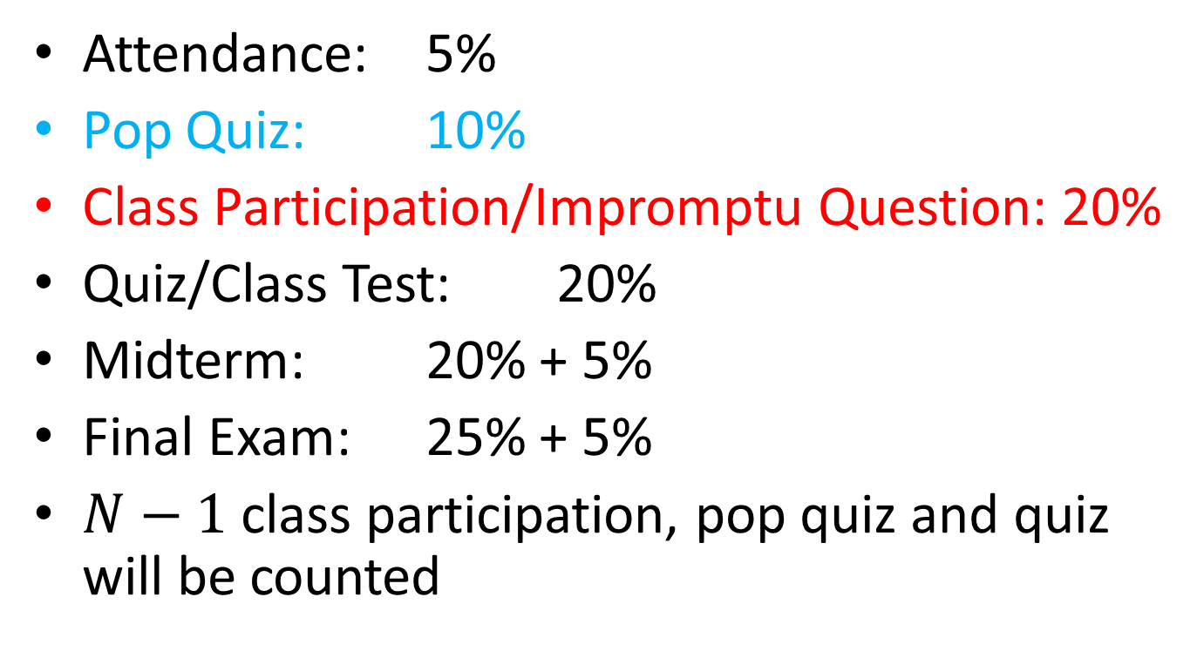
Tentative Marks Distribution
Attendance: 5%
Pop Quiz: 10%
Class Participation/Impromptu Question: 20%
Quiz/Class Test: 20%
Midterm: 20% + 5%
Final Exam: 25% + 5%
$N−1$ class participation, pop quiz and quiz will be counted

Slide 8
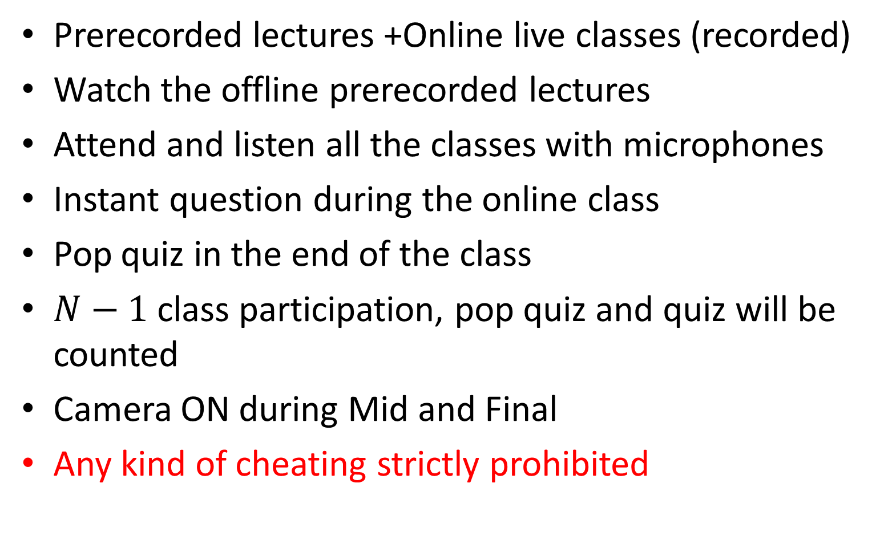
Common Rules
Prerecorded lectures +Online live classes (recorded)
Watch the offline prerecorded lectures
Attend and listen all the classes with microphones
Instant question during the online class
Pop quiz in the end of the class
$N−1$ class participation, pop quiz and quiz will be counted
Camera ON during Mid and Final
Any kind of cheating strictly prohibited

Slide 9
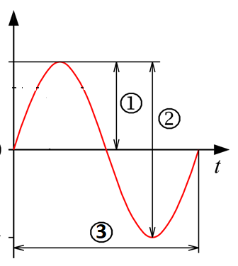
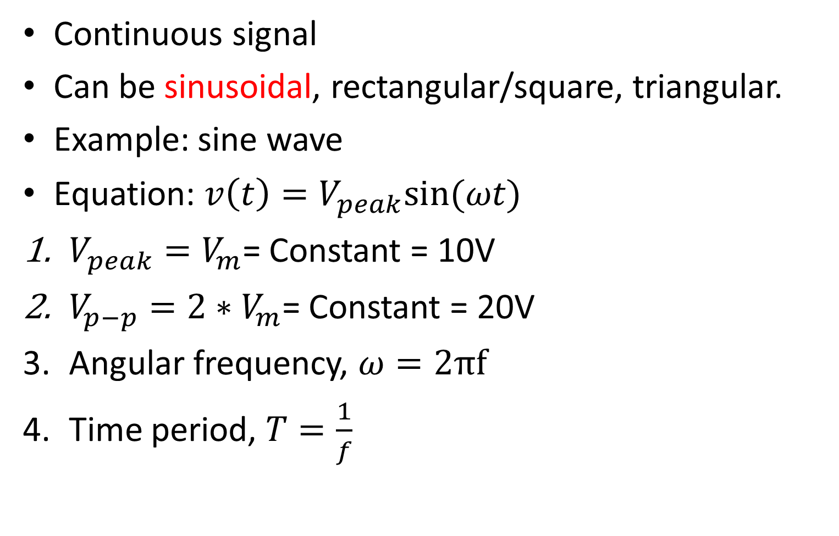

Analog Signal
Continuous signal
Can be sinusoidal, rectangular/square, triangular.
Example: sine wave
Equation: $v\left(t\right)=V_{peak}sin⁡(ωt)$
$V_{peak}=V_{m}$= Constant = 10V
$V_{p−p}=2∗V_{m}$= Constant = 20V
Angular frequency, $ω=2πf$
Time period, $T=\frac{1}{f}$
$$v\left(t\right)$$

Slide 10
Electronic Devices
Electronic devices are components for controlling the flow of electrical currents for the purpose of information processing and system control.
Constructed from semiconductor (silicon Si, germanium Ge, Gallium Arsenide GaAs)
Conductivity: Conductor > Semiconductor>Insulator
Resistivity: Conductor < Semiconductor < Insulator
Example: Diodes, Transistors
Transistors:
BJT: Bipolar Junction Transistor
FET: Field Effect Transistor

Slide 11
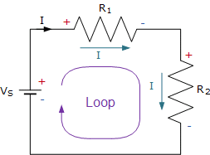
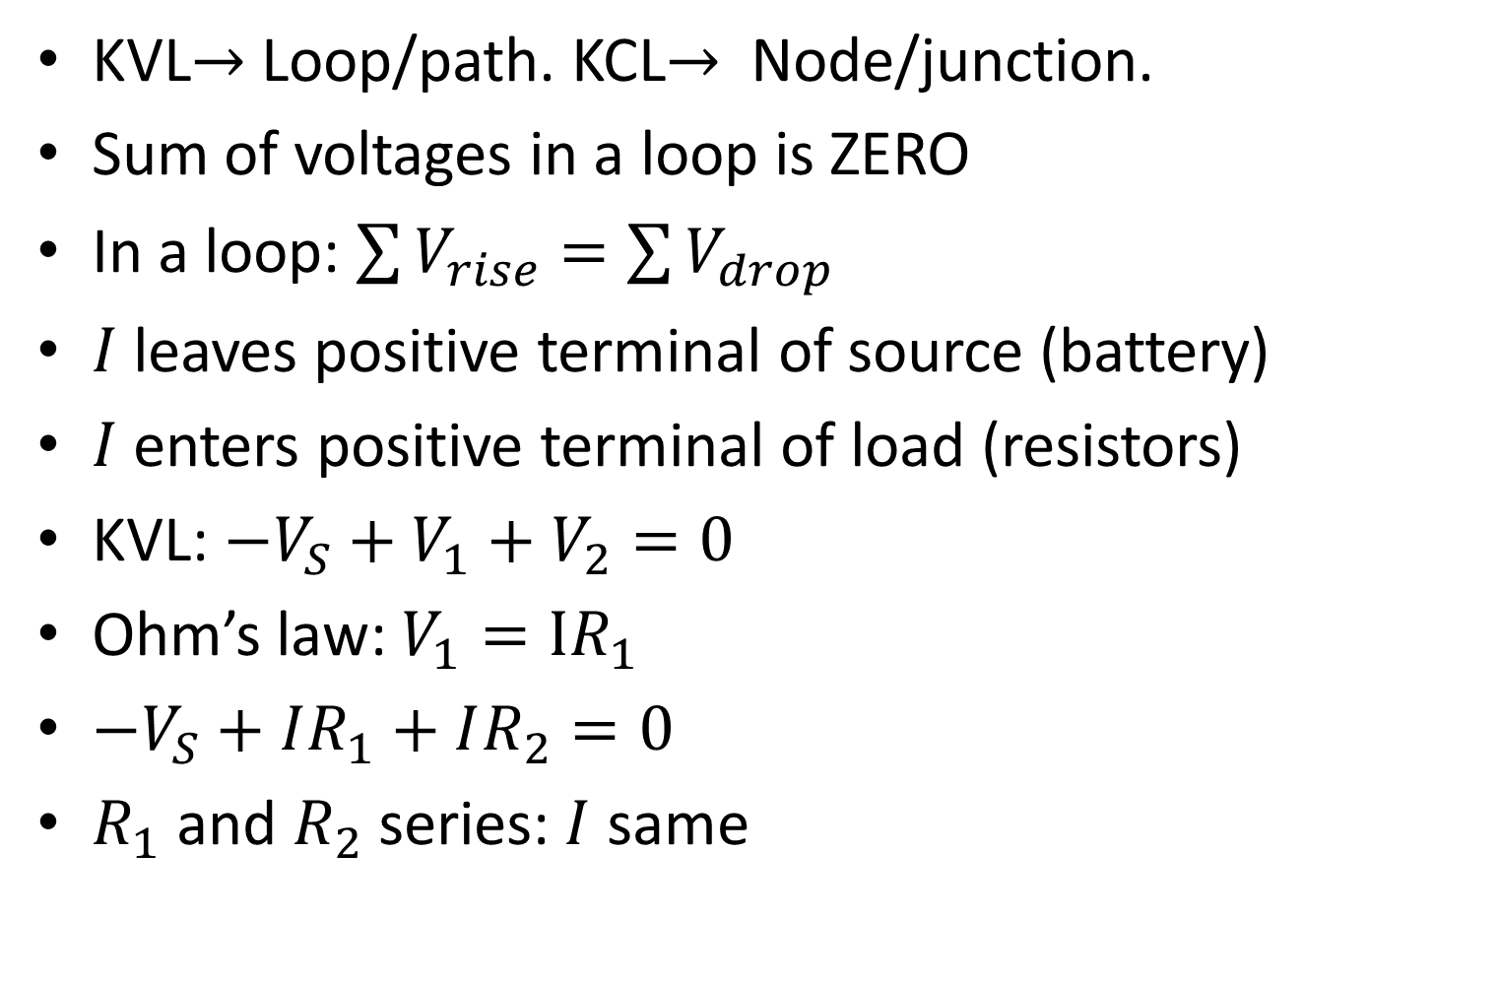
KVL
KVL$→$ Loop/path. KCL$→$ Node/junction.
Sum of voltages in a loop is ZERO
In a loop: $\sum{V_{rise}}=\sum{V_{drop}}$
$I$ leaves positive terminal of source (battery)
$I$ enters positive terminal of load (resistors)
KVL: $−V_{S}+V_{1}+V_{2}=0$
Ohm’s law: $V_{1}=IR_{1}$
$−V_{S}+IR_{1}+IR_{2}=0$
$R_{1}$ and $R_{2}$ series: $I$ same

Slide 12
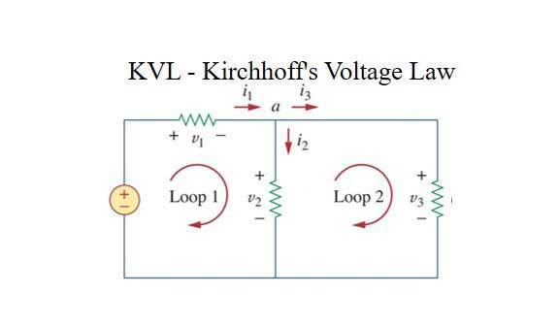

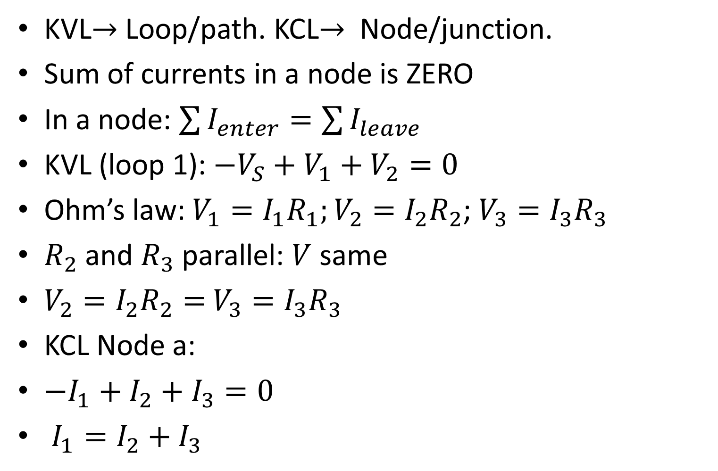



KCL
KVL$→$ Loop/path. KCL$→$ Node/junction.
Sum of currents in a node is ZERO
In a node: $\sum{I_{enter}}=\sum{I_{leave}}$
KVL (loop 1): $−V_{S}+V_{1}+V_{2}=0$
Ohm’s law: $V_{1}=I_{1}R_{1};V_{2}=I_{2}R_{2}$; $V_{3}=I_{3}R_{3}$
$R_{2}$ and $R_{3}$ parallel: $V$ same
$V_{2}=I_{2}R_{2}=$ $V_{3}=I_{3}R_{3}$
KCL Node a:
$−I_{1}+I_{2}+I_{3}=0$
$I_{1}=I_{2}+I_{3}$
$$R_{1}$$
$$R_{2}$$
$$R_{3}$$
$$V_{S}$$

