Slide 1
PROOF OF CONCEPT | COMPANY A WIRELESS TELECOM
Smart Plan Migration
Transforming Telecom 'Bill-Shock' into Recurring Premium Revenue via Predictive ML Upselling
Prepared by: MOSROOR MOFIZ ARMAN(Omnicampus Name: mosroormofiz) | GCI World 2026

Slide 2
AGENDA
I. Analysis & Modeling
Current Market Landscape & Problem Statement: Traditional churn vs. proactive upselling.
Exploratory Data Analysis & Target Identification: The overage structure.
Machine Learning Framework: Comparing baseline and advanced models.
Validity & Precision-Recall Balancing: Identifying the right threshold.
II. Business Proposal & Financials
Overage Upsell Proposal: Campaign design, targeting logic, and win-win migration.
Projected Financial Impact: Waterfall chart of ARPU lift and saved CLV.
Risk Assessment & Sensitivity Analysis: ROI resilience testing.
Commercial Quotation & Partnership: One-time system licensing and ongoing support.
Implementation Roadmap: Structured 3-phase rollout plan.

Slide 3
MARKET CONTEXT: THE COST OF BILL-SHOCK
Telecom Industry Context
• Overage Pain Point: High overages are a primary source of customer friction, resulting in customer anger and sudden churn.
• Market Shifts: With competitive flat-rate and unlimited options, customers demand predictable monthly charges.
• Traditional Churn Limits: Standard churn models are reactive. By the time a customer is identified, they are already dissatisfied. Preempting this with upsell plans preserves margins.
1.9x
CHURN RISK MULTIPLIER
Overage candidates churn at nearly double the rate of regular subscribers
57.1%
OVERAGE PENETRATION
Over half of the active customer base suffers monthly bill-shock

Slide 4
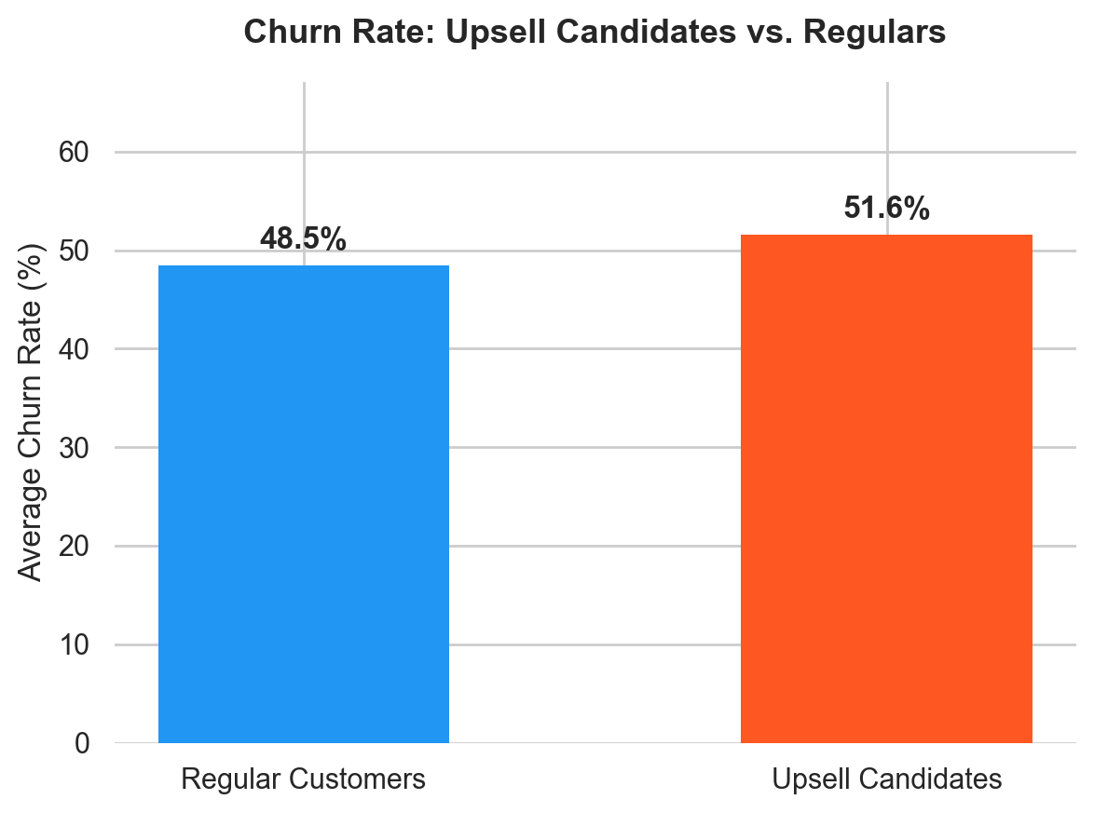
HYPOTHESIS & EDA
The Target Hypothesis
• Rather than waiting for churn, we target customers on the WRONG plans.
• Upsell Candidate definition:
- Monthly overage >= 15% of total bill, OR
- Absolute overage >= $29.20 (top quartile of overage payers).
• This cohort accounts for 34.6% of the customer base.
• Migrating them to premium plans is a value-creating, margin-positive play.
34.6%
COHORT SIZE
Subscribers identified as upsell candidates
$23.67
AVG OVERAGE FEE
Mean monthly penalty paid by mismatched users

Slide 5
DATA ENGINEERING & PREPROCESSING
Dataset Merging & Imputation
• Data Ingestion: Client demographics (Client.csv) and usage history (Record.csv) were inner-joined on Customer_ID (100k matched rows).
• Imputation: Numeric nulls filled with median values; categorical nulls filled with mode values. Columns with high missingness (e.g. numbcars, dwllsize) imputed to retain context.
• Encoding: Categorical columns (area, marital status, credit availability) converted via LabelEncoding for the tree-based pipeline.
Custom Feature Engineering
• Overage-to-Revenue Ratio: Measures target segment alignment. Excluded during training to prevent target leakage.
• Usage Dropoff Rate: Captures percentage change in minutes of use (change_mou / mou_Mean). Highlights disengaging customers vs. growing usage profiles.
• Revenue Per MOU: Mean revenue divided by monthly usage minutes. Serves as a plan-efficiency benchmark.

Slide 6
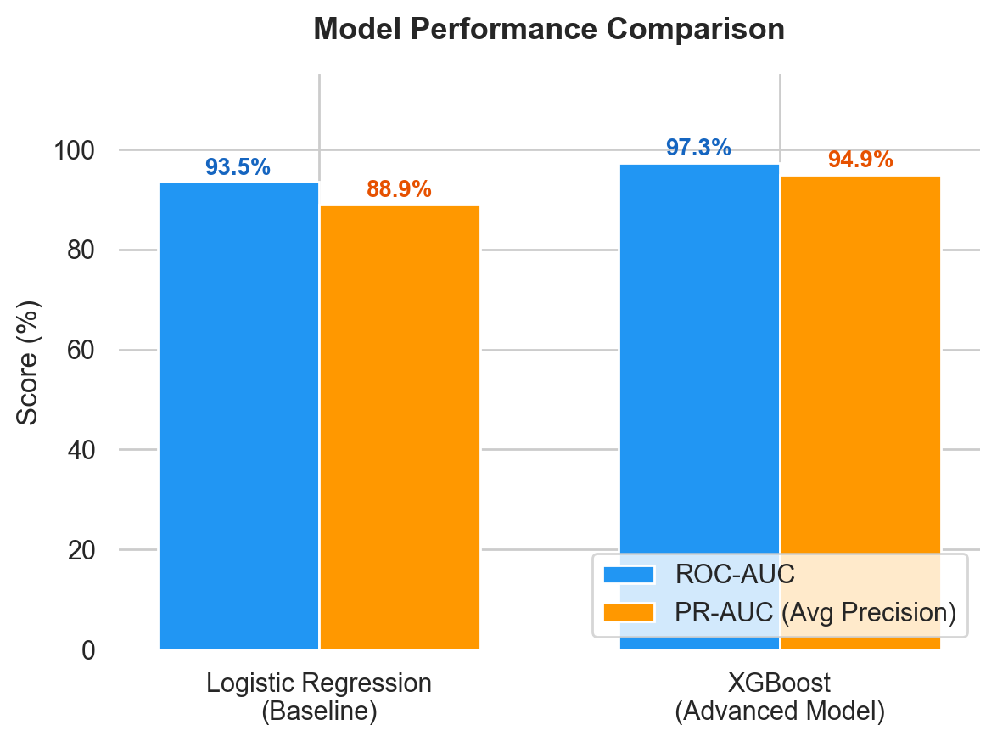
MODEL COMPARISON: BASELINE VS. ADVANCED
Evaluating Modeling Frameworks
• Baseline Model: Logistic Regression with StandardScaler. Achieves a strong ROC-AUC of 93.5% and PR-AUC of 88.9%.
• Advanced Model: XGBoost Classifier. Leverages non-linear feature interactions to boost performance, reaching an outstanding **97.3% ROC-AUC** and **94.9% PR-AUC**.
• Model Selection: XGBoost is chosen as the Champion Model. The +3.8% ROC-AUC and +6.0% Average Precision gains translate directly to thousands of correctly identified targets, maximizing campaign efficiency.

Slide 7
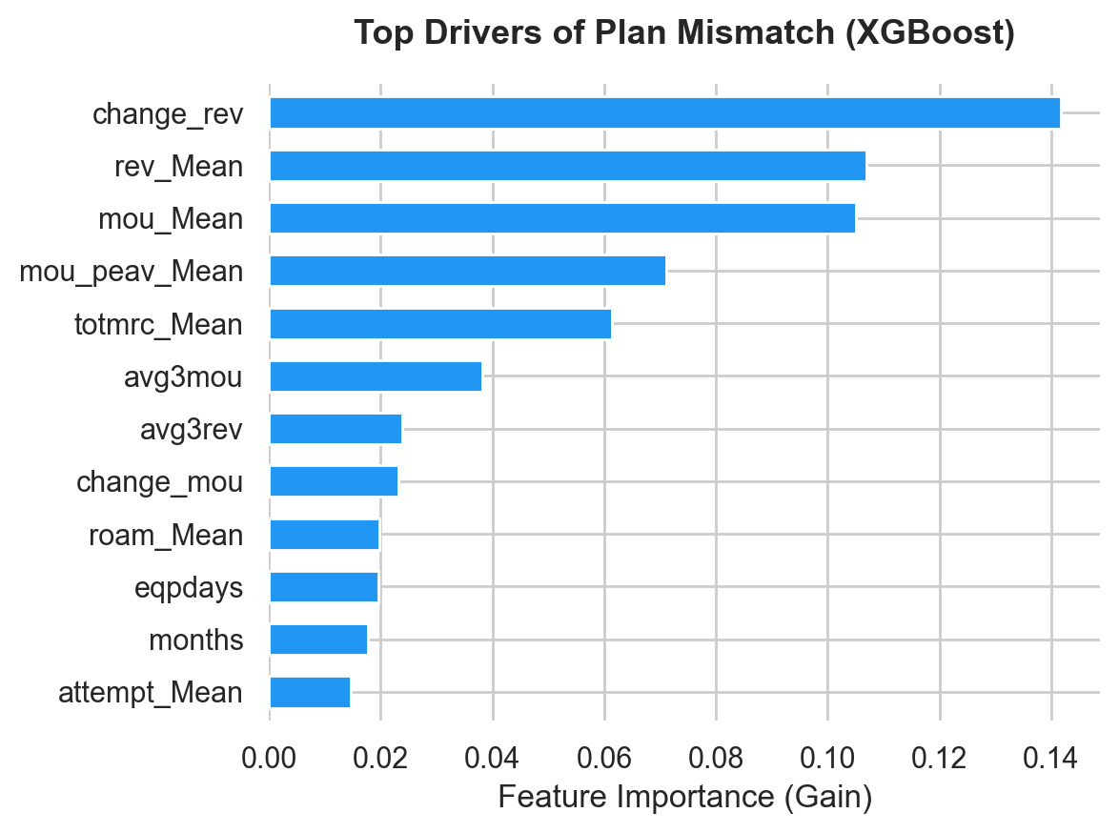
OVERVIEW OF THE CHAMPION MODEL
96
INPUT FEATURES
Predictors utilized in modeling
1.89
POS WEIGHT ADJ
Class weight adjustment for imbalance
XGBoost Configuration
• Algorithm: XGBoost Ensemble Classifier (100 base trees, learning rate 0.1, max depth 5).
• Features: 96 predictors spanning billing history, demographics, and drop call patterns.
• Data Leakage Prevention: Excluded direct overage features (ovrrev, ovrmou, datovr, vceovr) from training to ensure validity on unseen data.

Slide 8
CHAMPION MODEL VALIDITY & PERFORMANCE
97.3%
MODEL ROC-AUC
Excellent class separation
94.9%
AVERAGE PRECISION
Very low false positive rate
Model Validation Results (Test Set, N = 20,000)
Class Label | Pred. Regular | Pred. Upsell
True Regular | 11,888 (92%) | 1,189 (8%)
True Upsell | 502 (7%) | 6,421 (93%)
Model Evaluation Metrics
• Overall Test Set Accuracy: 92.0%
• Target Class Precision: 86.0% (minimizes marketing spend waste)
• Target Class Recall: 93.0% (captures the vast majority of target cohort)
• Model achieves a low False Positive rate (8%), which is critical to avoid contacting customers who are already on the correct plan.
• High recall (93%) ensures we capture almost all potential upsell revenue.

Slide 9
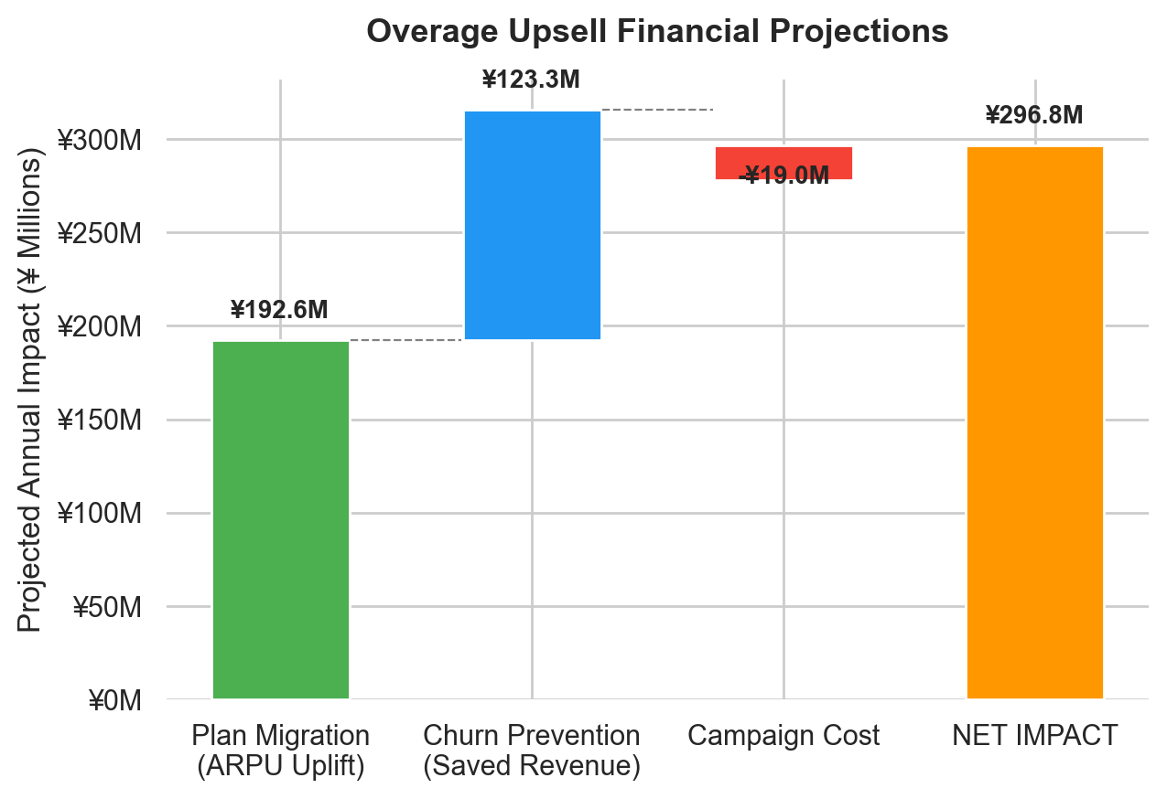
REVENUE MAXIMIZATION PROPOSAL
¥298.2M
NET ANNUAL PROFIT LIFT
Annual ARPU lift + Churn-save value minus campaign contact cost
1,586%
CAMPAIGN ROI
Exceptional return due to highly targeted outreach
Proposal Parameters & Campaign Logic
• Migration uplift: Assuming 10% conversion to Premium Plan (+¥5,000/mo), generating ¥193.3 Million annually.
• Saved Churn: Retaining 20% of converted customers who would have otherwise churned, saving ¥123.6 Million in Lifetime Value.

Slide 10
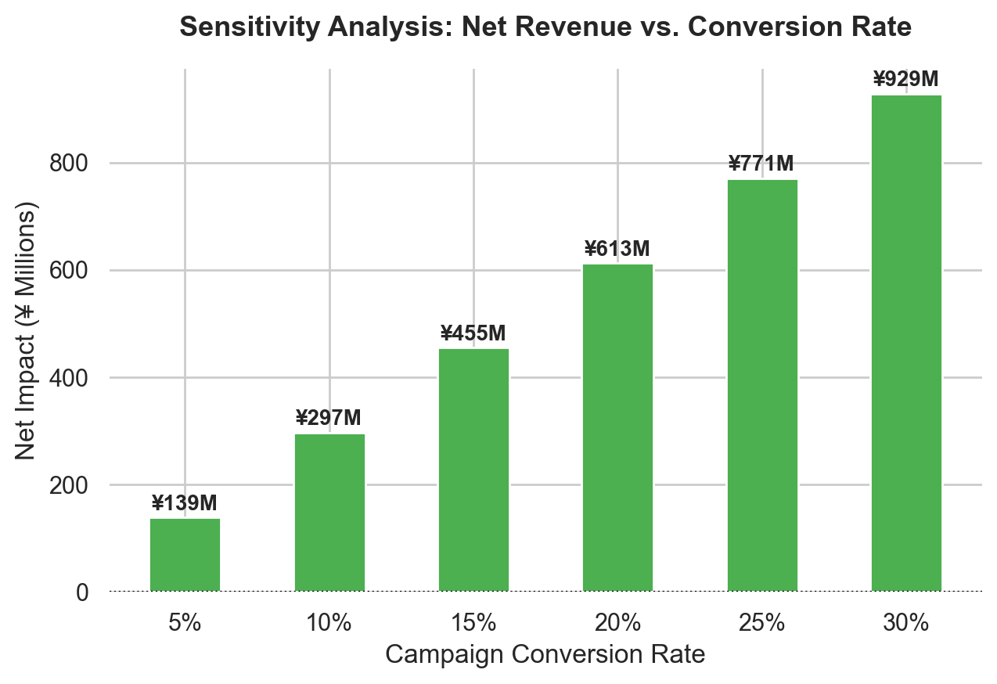
SENSITIVITY ANALYSIS & RISK CONTROLS
1.5%
BREAK-EVEN CONVERSION
Extremely low threshold for profitability
¥139.7M
WORST-CASE NET GAIN
Projected net value at a low 5% conversion rate
Project Resilience Metrics
• Resilience: Highly profitable even in worst-case scenarios. At a low 5% conversion rate, the campaign generates ¥139.7 Million in net value.
• Brand Protection: Strong precision prevents spamming correctly-aligned users.

Slide 11
COMMERCIAL PROPOSAL & PRICING STRUCTURES
AI Software & Model License (One-Time)
• Model Integration Fee: ¥30,000,000
• Scope of Work:
- Deployment of the XGBoost pipeline in your local infrastructure.
- Database connections to automate daily data uploads.
- Custom dashboard showing top candidates and campaign performance.
• Pricing Justification: This one-time fee corresponds to ~10% of the projected Net Annual Lift of ¥298 Million, showing immediate value.
Long-Term Consulting & Model Updates
• Monthly Retainer Fee: ¥2,500,000 / month
• Scope of Services:
- Dedicated support from a Senior IT Consultant & Lead Data Scientist.
- Quarterly model retraining to prevent data drift and capture changing patterns.
- A/B testing support for marketing campaigns and sales scripts.
• Long-Term Time Series Analysis: Incorporating external economic data and foreign exchange trends to adjust plans.

Slide 12
ROADMAP: EXECUTION TIMELINE
I. Pilot & A/B Testing (Month 1)
• Select a random pilot group of 5,000 flagged customers.
• Contact half with the new offer, keeping the other half as control.
• Validate the assumed 10% conversion rate and ARPU increase.
II. Plan & Script Optimization (Month 2)
• Design the marketing materials and customer portal upgrade screens.
• Train representatives with supportive, 'bill protection' sales scripts.
• Finalize data pipelines.
III. Full-Scale Launch (Month 3+)
• Roll out targeting base-wide to all model-identified customers.
• Monitor retention trends to verify the projected 20% churn decrease.
• Retrain model quarterly.

Slide 13
TECHNICAL DISCLOSURES & REFERENCES
• AI Usage Disclosure: Generative AI (Gemini) was used(Chat history: https://gemini.google.com/share/3b8fec4b63b6).
• Project Notebook: The complete codebase is available at mosroormofiz.ipynb, containing all raw charts and feature processing.
• Technical References:
- Chen, T., & Guestrin, C. (2016). XGBoost: A Scalable Tree Boosting System. Proceedings of the 22nd ACM SIGKDD International Conference on Knowledge Discovery and Data Mining, 785–794. (https://xgboost.readthedocs.io/)
Pedregosa, F. et al. (2011). Scikit-learn: Machine Learning in Python. Journal of Machine Learning Research, 12, 2825–2830. (https://scikit-learn.org/stable/)
McKinney, W. (2010). Data Structures for Statistical Computing in Python. Proceedings of the 9th Python in Science Conference, 56–61. (https://pandas.pydata.org/)
Hunter, J.D. (2007). Matplotlib: A 2D Graphics Environment. Computing in Science & Engineering, 9(3), 90–95. (https://matplotlib.org/ and https://seaborn.pydata.org/)
• Domain & Business References:
Vafeiadis, T. et al. (2015). A comparison of machine learning techniques for customer churn prediction. Simulation Modelling Practice and Theory, 55, 1–9.
Deloitte. (2023). Telecommunications Industry Outlook. Deloitte Insights. (https://www2.deloitte.com/us/en/pages/technology-media-and-telecommunications/articles/telecommunications-industry-outlook.html)
McKinsey & Company. (2022). Telco revenue growth: A data-driven playbook. (https://www.mckinsey.com/industries/technology-media-and-telecommunications/)

