Slide 1
Elections in U.S.
M. Jashim Uddin
NSU

Slide 2
Sequence of the Lecture
What is Election?
Significance of Elections
Elections: U.S. Perspectives
Questions raised by Prof. Roskins regarding elections:
Why do People Vote?
Why low turnout in U.S. Elections?
Who Votes?
Who Votes How?
What Wins Elections?

Slide 3
What is Election?
An election is a formal decision-making process by which a population chooses an individual to hold public office. Elections have been the usual mechanism by which modern representative democracy has operated since the 17th century.
It is important to distinguish between the ‘form’ and the ‘substance’ of elections. In some cases, electoral forms are present but the substance of an election is missing, as when voters do not have ‘a free and genuine choice’ between at least two alternatives.

Slide 4
Significance of Election
Elections enable the people to choose their leaders who make decisions on their behalf. Other forms of government like dictatorships do not have this option.
Democracy is based on all people having the same rights.
Without elections, democracy isn't based on “the wants and needs of the people.” It turns into another type of government where decisions are made by one person or a group of person based on their own motivating factors.

Slide 5
Significance of Elections
What are the key components of democracy?
They are free and fair elections, the active participation of citizens in the government, protection of human rights for citizens.
Who holds political power in a democracy?
The people hold political power in a democracy. The system lets people choose their leaders through a competitive process and hold them accountable .
How are differences usually settled in a democracy?
Participants settle differences through elections
What's the definition of "representative democracy"?
Representative democracy is a governmental structure based upon citizens electing representatives to serve on their behalf

Slide 6
U.S. Elections
Presidential Elections
The U.S. holds national elections every 2 years, but Presidents are only up for election every 4 years. The President is elected by electors of the Electoral College. The winner of the election is the candidate with at least 270 Electoral College votes.
To nominate the president candidate, the parties hold a series of primary elections in every state starting in February, which determine who becomes as the official presidential candidate.
At the party conventions held in July, where candidates are formally confirmed, e.g., Democrat Hillary Clinton and Republican Donald Trump were officially nominated at their party's conventions in July 2016.

Slide 7
U.S. Elections
Congressional Elections
Congress has two chambers: the Senate and the House of Representatives.
Senate Elections: The Senate has 100 members, elected for a six-year term in dual-seat constituencies (2 from each state), with one-third being renewed every two years
House of Representatives Elections: The House of Representatives has 435 members, elected for a two-year term in single-seat constituencies. House of Representatives elections are held every two years

Slide 8
Elections: U.S. Perspectives
Prof Roskins and others raised some important questions:
Why do People Vote?
Why voting turnout is low in the U.S.?
Who Votes?
Who Votes Whom and How?
What Wins Elections?

Slide 9
Why do People Vote?
Anthony Down’s landmark contribution in 1957, An Economic theory of Democracy argued that “people vote if the returns outweigh the costs.” If the stakes seems important, citizens will go to the trouble of voting.
Property owners fearing tax hikes are more likely to vote than renters not immediately hurt by the tax.
Accordingly, the poor and uneducated in most cities are the least likely to vote. For instances, India.

Slide 10
Elections: U.S. perspectives
Why low turnout in U.S. Elections?
In 2012 U.S. elections largely turned on turnout. The democrats realized that boosting the participation rates of their typical voters would bring victory, and concentrated much efforts on local organizing to get disposed people to register and vote.
Some Republicans accused the Democrats of unfairly boosting the turnout of their voters. Concerning the Republican views, Authors argued that an effective election campaign is supposed to do what the Democrats have done.
However, in 2012, 59 percent of those eligible voted, lower than 63 percent in 2008.

Slide 11
Why low turnout in U.S. Elections?
Historically voters turnout in the U.S. was never high; In nonpresidential elections, U.S. turnout seldom exceeds 40 percent. Turnout in Sweden, Germany and Italy has occasionally reached 90 percent.
Why do American vote so little?
1. More than half of the U.S. voters said that they are uninterested in or dissatisfied with candidates. Their vote makes no difference or that none of the candidates is good.
2. The U.S. party system is another reason; the two large parties may not offer or an interesting or cut-clear choice. In 2012, both candidates sounded similar as they promised jobs, healthcare and a strong America.
3. Fewer than one in 20 American adults is involved enough in politics to attend a political meeting.

Slide 12
Why low turnout in U.S. Election?
4. Two out of five Americans never vote.
Two School of thoughts concerning the low turnout
One school argues that no electoral participation means that many Americans are turning away from the political system, which loses legitimacy.
Another school is unworried and argue that low turnout means that many Americans are basically satisfied with the system or not sufficiently dissatisfied to register and vote.
Countries with very high voter turnouts may have a sort of political fever in which partisan politics has become too tense.
Starting in 2008, many states now allow early voting, which boosts turnout.

Slide 13
Who Votes Whom and Why?
Voters | Non Voters
Middle-aged/old people | Young
Better educated | Less educated
Urban people | Rural people
White-collar jobs | Blue-collar jobs

Slide 14
Who Votes and Why?
Income, education, race, age, gender etc are key factors in who votes.
1. Income and Education:
High income people vote more than the less affluent, well educated more than the high school dropouts. These two features often come together (good education leads to good incomes) and reinforce each other.
Factory workers may see little difference between candidates, but executives see a direct relationship between who wins and their personal interests.
Education is the strongest determinant of who votes, but this leads to a puzzle, as U.S. turnout declined precisely as educational level increased. Why? Quality of education; people are more self-centric

Slide 15
Who Votes and Why?
2. Race
African-American voting rates until recently have been lower than white voting rates. However, the gap is being filled in as black income and education levels rose. Several surveys found that black turnout actually edged white turnout in 2012. Many blacks have learned the value of participation and voting, a trend accelerated by a Black President. Some previously racist white politicians became respectful toward their black constituents. Latinos have also participated more.
3. Age
Young people under 25 feel less politically involved and vote less. About half of the U.S. citizens age 18 to 25 and not registered to vote. Young people with little income fell economically uninvolved with election outcomes. When they start paying taxes, their interests grows.

Slide 16
Who Votes and Why?
4. Gender
Traditionally men were more likely to vote than women in almost every society. Women had only comparatively recently won the right to vote. (Switzerland enfranchised women only in 1971). Since 1920, when female suffrage was granted in the U.S., the gap between men’s and women’s voter turnout narrowed and then reversed. In recent American elections, women have voted more than men.
5. Place of Residence
Voter turnout in the U.S. South is somewhat lighter than in the North and West, a reflection of lower living standards and a lack of party competition.

Slide 17
Who Votes Whom and How?
The factors can be divided into long-term and short-term variables. Loyalty to a political party is a long-term influence. Here the Authors review the variables that predict who votes how and whom.
Party Identification
Party ID is an attachment many feel toward one party for a long time, sometimes all their lives. Strong party identifiers habitually vote for that party; weak identifiers can be swayed to vote for another party. People with no party ID may shift their votes every election.
Party ID is heavily influenced by parents early in life. Party ID is important to electoral stability. Typically, the swing from one major party to another ranged from only about 1 percent to 5 percent.

Slide 18
Who Votes How?
Class Voting
Social class is one determinant of party identification and voting behavior. Wage workers tend to register and vote Democrat, especially in families where breadwinners are union members. In 2012, a majority of voters from families earning under $50,000 a year voted for Obama. However, many well-off professional people went for Obama as well, suggesting he enjoyed bimodal support.
Regional Voting
Some regions identity strongly with certain parties. For examples, California with Democrats and Texas with Republicans.
Religious Blocks
Religious versus secular is the single stronger predicator in U.S. voting. In 2012, Romney won most white Protestant; Obama won most secular, Catholics and Jews

Slide 19
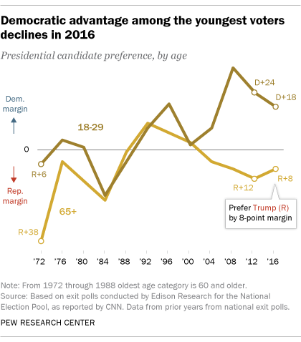
Who Votes How?

Slide 20
Who votes How?
Age Groups
Younger people are not necessarily more radical than their elders. Rather they tend to catch the tide that is flowing in their youth. In 2008 and 2012, most 18-to29-old voters went for Obama, partly because they were more open on race and worried about their jobs during the financial crisis. Older voters were less open on race question.
Gender Gap
Women vote for democrats by several percentage points more than men. Women tend to like the Democrats’ support for welfare measures and abortion rights, and to dislike Republicans opposition to such views and their vows to increase defense spending.

Slide 21
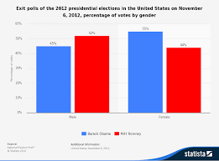
Votes by Gender

Slide 22
Who Votes How?
Marriage Gap
Unmarried people are several percentage points more Democrat than are married. The responsibilities of raising a family make voters conservative, and Republicans focus on “family values”. Romney won among married, Obama among single. A problem for Republicans is that fewer Americans marry!
Gay Group
In 2012, for the first time, exit polls asked voters their sexual orientation. 5 percent identified as gay, and of them ¾ voted for Obama. Ironically, Obama has shield away from the issue of same sex. But vice president pushed him into supporting. The author views that Obama’s narrow margin of victory may have come from gays.

Slide 23
Who Votes and How?
Race
Non-white are growing electoral force. A few study found that racial minorities formed 28 percent of electorate in 2012, up from 26 percent in 2008. So, this demographic shifts work against republican; more than 80% African-American vote for Democrat and more than two-third Hispanic vote for Democrat.
On the other hand, several states’ tough laws against illegal immigrants, passed by Republican state legislatures and signed by Republican governors, drew strong white support.
Urban Voting
Big cities worldwide tend strongly to vote liberal or left. The working-class vote is concentrated in cities. A map of U.S. elections shows a major urban-rural split. Cities went strongly for Obama in 2012 but Republican candidate won small towns and rural areas.

Slide 24
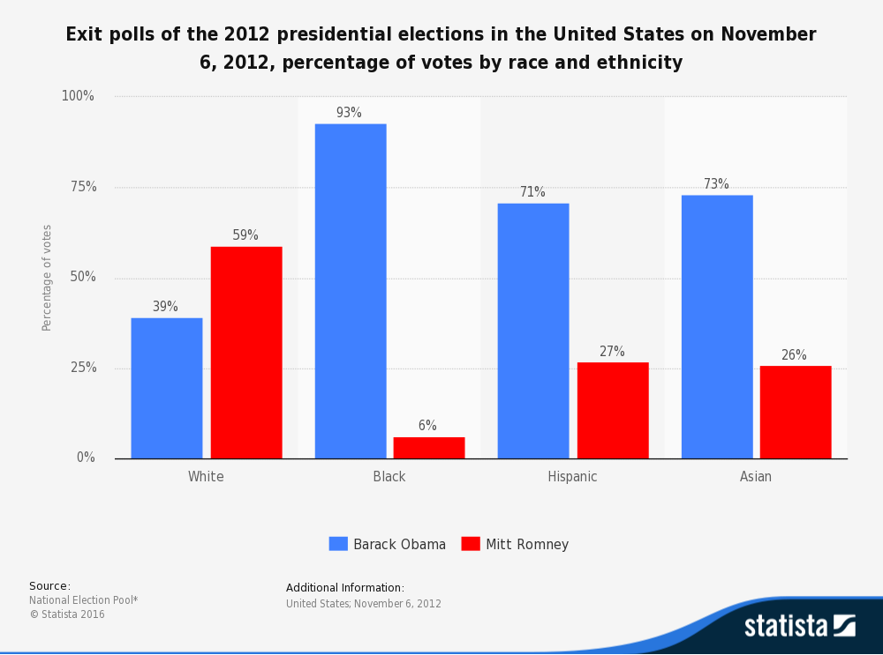
Vote by race and ethnicity

Slide 25
What Wins Elections?
In theories, elections enable citizen to choose their government. However, in modern elections, the element of rational choice is heavily manipulated by the twin factors:
Personality of the candidates
Modern parties showcase their leaders’ personalities. Ads and TV spots feature the leaders’ images, sometimes without even mentioning their parties. The leader is presented as charismatic and decisive but calm and caring. Ronald Reagan and Barack Obama were excellent examples of winning political personalities.
Role of Mass media; TV debate

Slide 26
What Wins Elections?
Retrospective Voting
Few voters carefully evaluate issues in a presidential election, but they do form an overall evaluation of the performance of an incumbent president.
President’s 4 year performance is evaluated as a whole in particular whether he has done a good job or poor one on the economy.
When Americans feel good about the economy, they generally vote for the incumbent’s party; they reward the incumbent’s party: Reagan in 1984, Clinton in 1996. The financial meltdown of 2008 turned the election decisively to Obama.

Slide 27
What Wins Elections?
Candidate Strategies and Voter Groups
The campaigns try to boost turnout among those who favor them but often do not vote. The Democrats’ emphasis on neighborhood turnout operations gave them their 2012 victory.
Presidential candidates focus on states with
1) more electoral votes and
2) close to 50-50 voting, or swing states, concentrating on such “battleground” states as Florida, Ohio etc.
States such as California (Democrat) and Texas (Republican) get little time and money.

Slide 28
The U.S. Electoral System Defective?
The Electoral College consists of 538 electors. A majority of 270 electoral votes is required to elect the President. (Senate 100+ representatives 435+ 3 for district of Columbia= 538)
The Electoral College is widely considered to be an undemocratic. It breaks the connections between popular will and electoral result but can not be seriously reformed because 17 small states with five or fewer representatives like being overrepresented.
These states can block any constitutional change, which requires two-thirds of each house plus three-fourths o the state legislatures.

Slide 29
Electoral College 2012

Slide 30
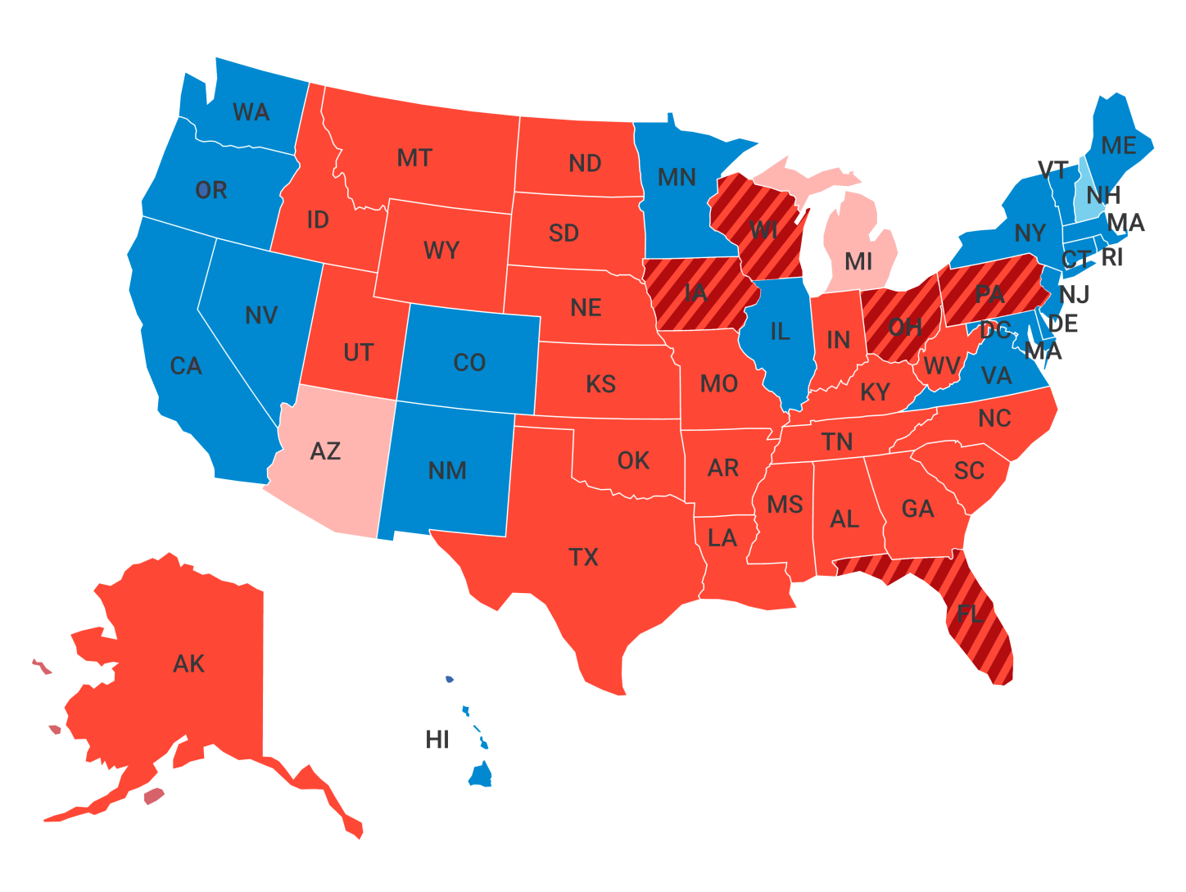
U.S. Election 2016

Slide 31
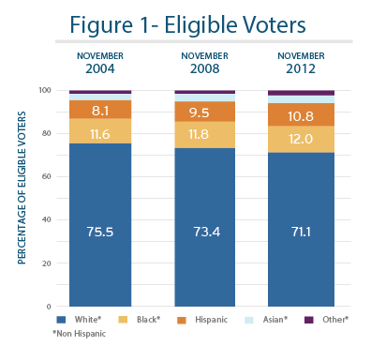
A Comparison percentage of eligible voters

