Slide 1
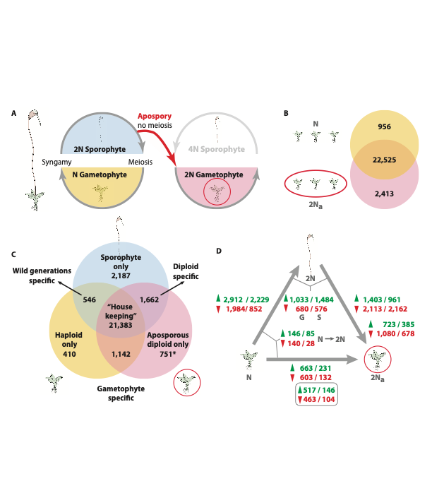

Whole genome
Chromosome

Slide 2
NOTE: there is no file in the Funaria_Genome_Scaffold directory that lists genes that only belong on the 26 chromosomes
Whole genome
Chromosome
Number of scaffolds: 98
Number of genes: 37426
Number of scaffolds: 26
Number of genes: 36415
I made new files to match the 26 scaffolds in the cluster
# in the 26 scaffolds ≠ numbers in the chr image (in the upcoming slides) FOR SPECS only
Specs:
DG_specs: 736
DG_S : 1617
HG_DG: 1115
HG_specs: 394
HG_S: 534
S_specs: 2126
Specs:
DG_specs: 669
DG_S : 1504
HG_DG: 1049
HG_specs: 355
HG_S: 498
S_spec:1880
DE_fold:
HG_DG: 1513
S_DG: 6047
HG_S: 7316
DE_fold:
HG_DG: 1586
S_DG: 6498
HG_S: 7802

Slide 3
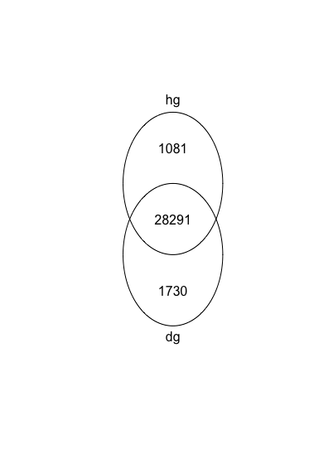
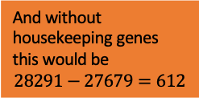
Whole genome
And without housekeeping genes this would be
$$28291−27679=612$$

Slide 4
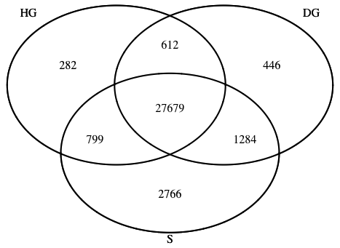
Whole genome

Slide 5
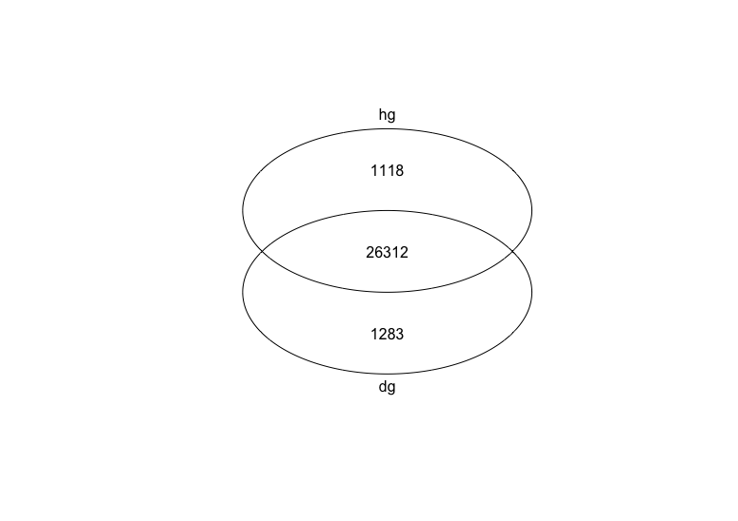

Chromosome
And without housekeeping genes this would be
$$26312−25816=496$$

Slide 6
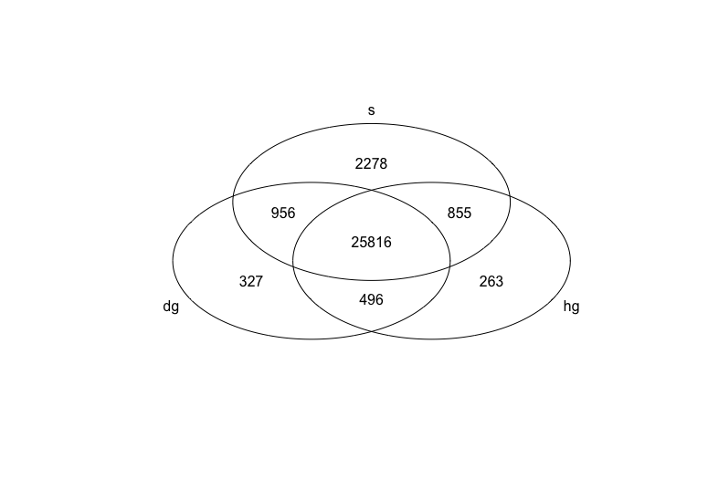
Chromosome

Slide 7
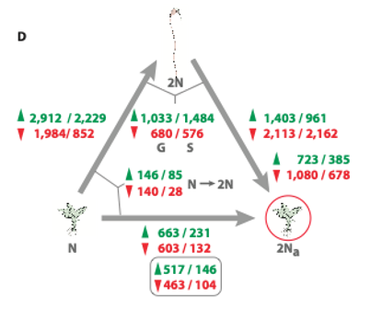
Whole genome

Slide 8
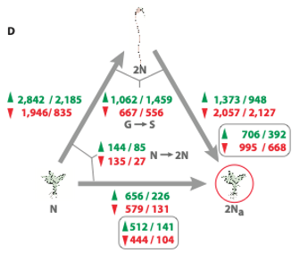
Chromosome
2840/2184
1945/833
1314/896
1950/1887
654/225
578/129

Slide 9
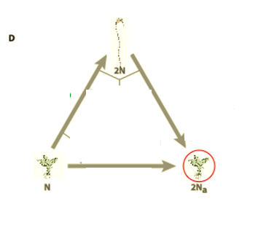
4596
2644
2151
3815
3
1
733
628

