Slide 1
ITI Project
Presentation of shop app

Slide 2
Screens

Slide 3
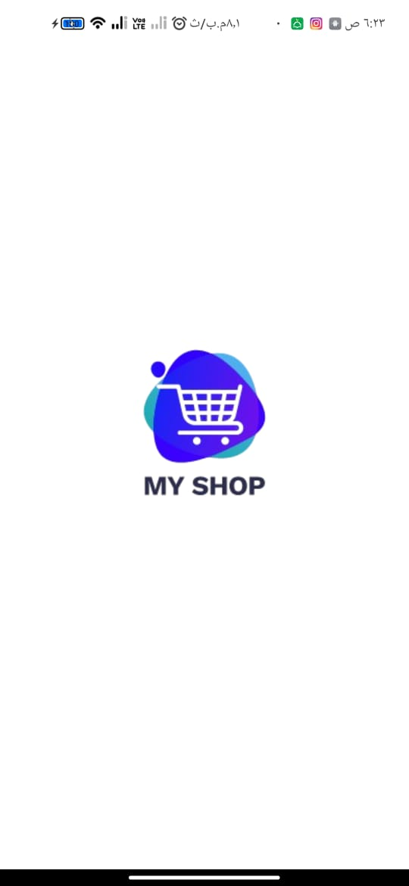
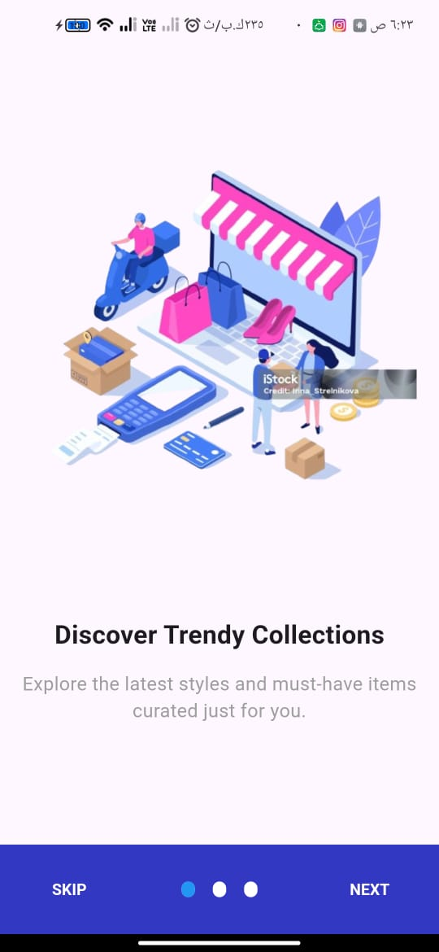
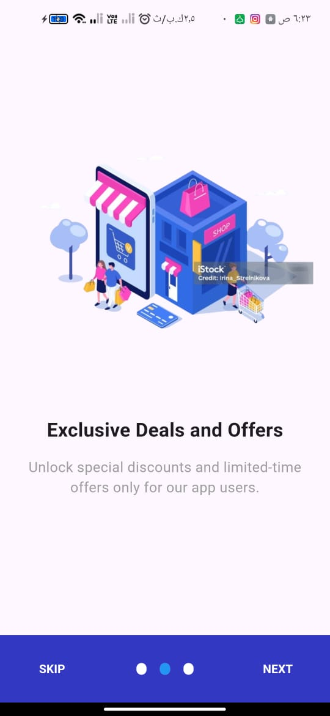
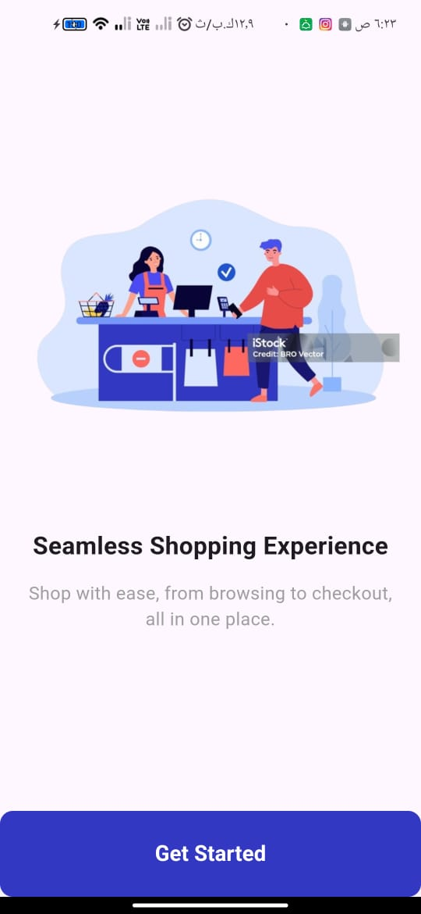

Slide 4
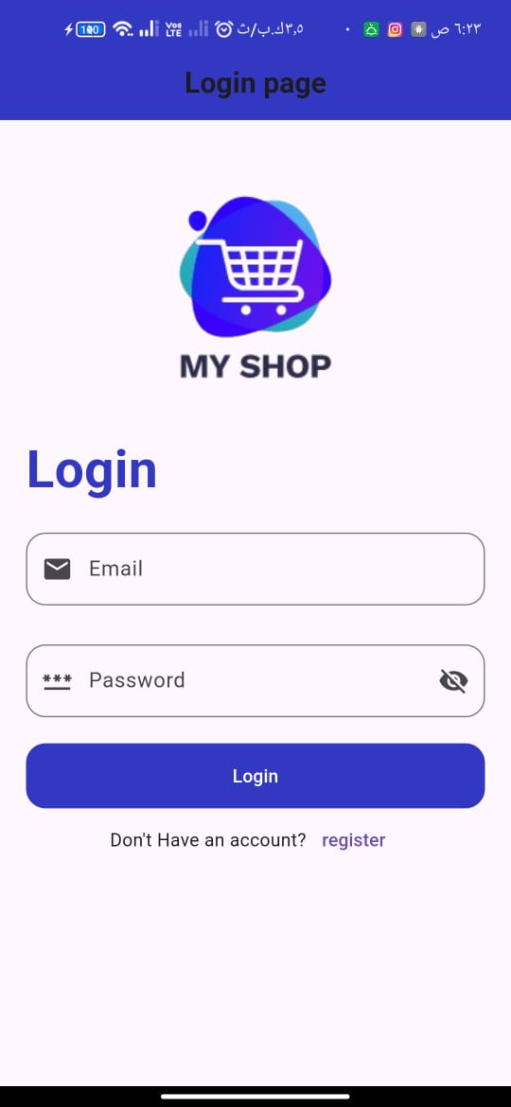
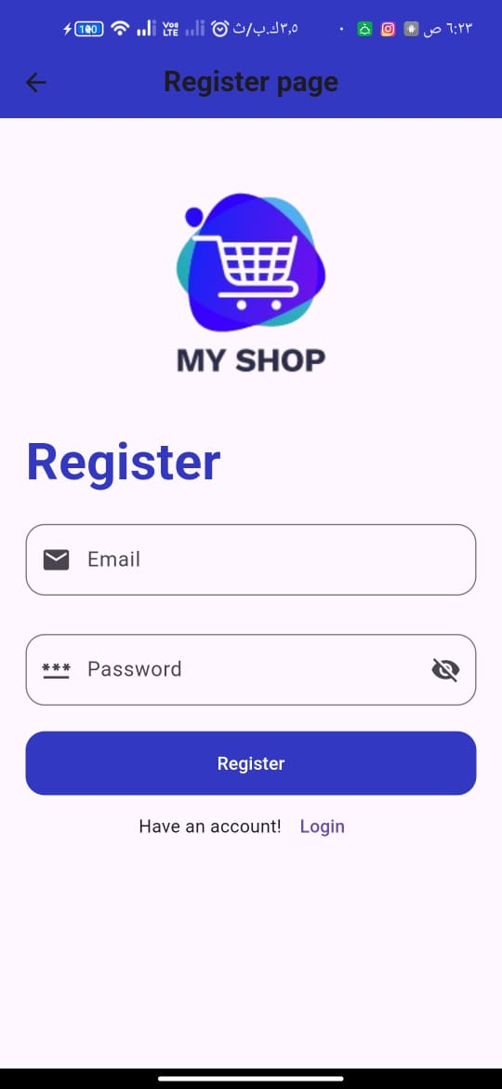

Slide 5
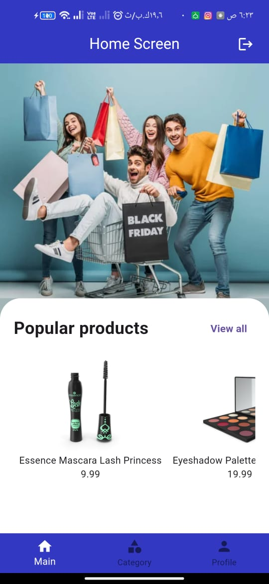
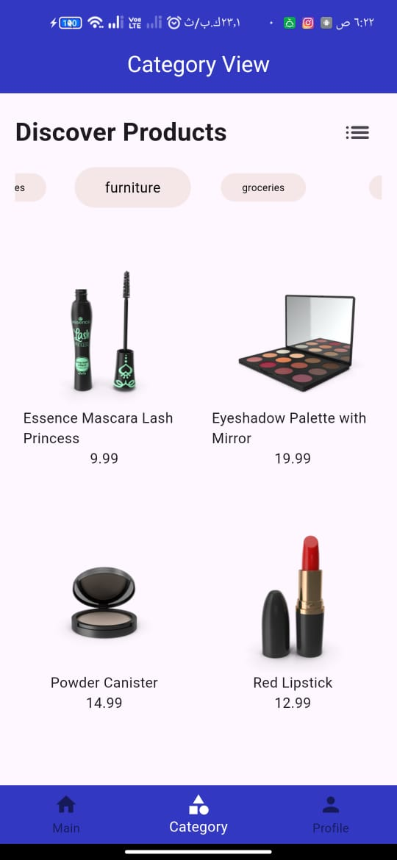
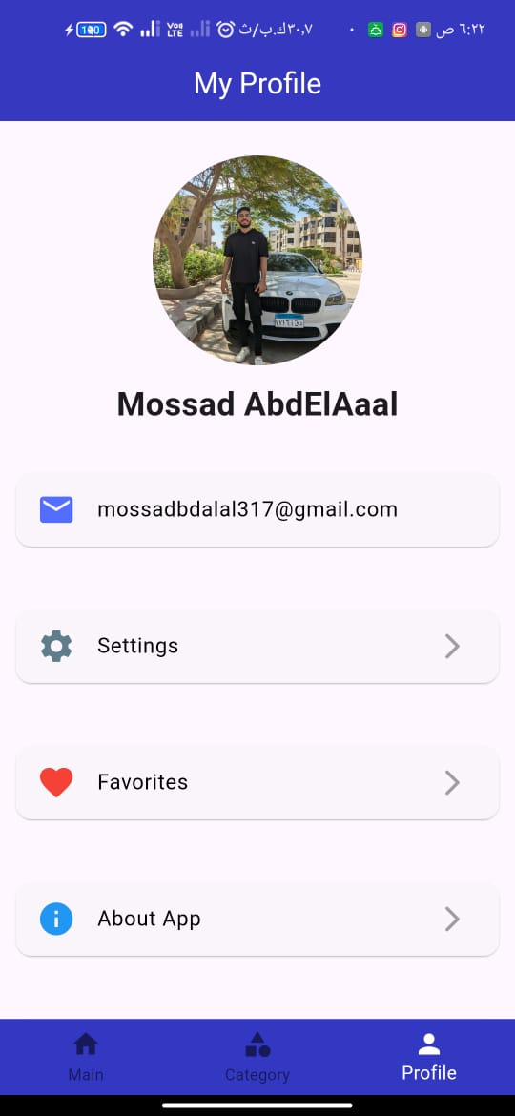

Slide 6
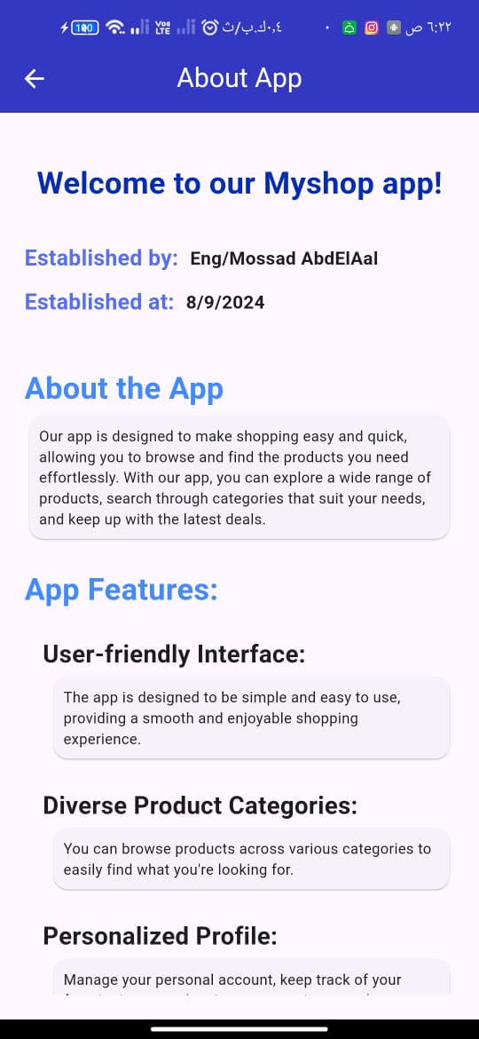
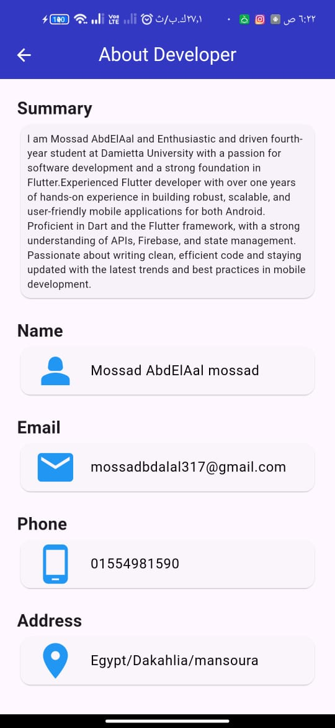

Slide 7

Introducing My Shop app
App logo
Your Gateway to Efficient Product Marketing
Content :
App logo
Tagline : "Discover, Shop, and Stay Updated!"
Visual of products or a mobile shopping experience

Slide 8
About My Shop app
App logo
My shop app is a cutting-edge mobile application designed to showcase marketing products seamlessly. With a user-friendly interface and real-time product updates via API integration, users can explore a variety of products across different categories."

Slide 9
Why My Shop app
App logo
Features:
API-Driven Product Display
"Products are updated in real-time from the server, ensuring users always see the latest inventory."
Dynamic Categories
"Browse through diverse product categories to find exactly what you need with ease."

Slide 10
Why My Shop app
App logo
Features:
Personal Profile Management
"Users can personalize their shopping experience by managing their profile, viewing order history, and saving favorites."
Developer Info Page
"Get to know the developer behind the app and explore the vision and motivation behind its creation."

Slide 11
Introducing My Shop app
App logo
Your Gateway to Efficient Product Marketing
Content :
App logo
Tagline : "Discover, Shop, and Stay Updated!"
Visual of products or a mobile shopping experience

Slide 12
Real-Time Product Updates
App logo
Brief overview of how the API works:
Step 1: App connects to the product database via API.
Step 2: Products are fetched and displayed in real-time.
Step 3: Users receive the latest product details instantly.
Benefits of API integration:
Always up-to-date product listings
Improved user experience through real-time updates
Scalable and flexible

Slide 13
How My Shop app Simplifies Shopping
App logo
Step 1: Download the app
Step 2: Browse the welcome page
Step 3: Explore products and categories using the real-time API
Step 4: Save favorite products and manage your profile
Step 5: Get to know the developer .

Slide 14
Thank You for Your Time
Name :
Mossad AbdElAal mossad
Email :
mossadbdalal317@gmail.com
linkedin :
www.linkedin.com/in/mossad-abdelaal-8109a1236

