Slide 1
Service Account in GCP
Identity and Access Management (IAM)
IAM lets administrators authorize who can take action on specific resources, giving you full control and visibility to manage Google Cloud resources centrally.
Service Account
A service account is a special kind of account typically used by an application or compute workload, such as a Compute Engine instance, rather than a person.
It’s an identity that an instance or an application can use to run API request on your behalf.
In compariso to user accounts, a service account also has an assigned e-mail. However, instead of a password for access, it can only be authenticated using a private-public RSA key pair. Additionally, a service account can’t be logged in via a browser.
Service accounts tipically represent virtual machines and applications. While user accounts should never be shared, with service accounts, multiple users can be granted access to everything that the service account is also able to access.
Service accounts are granted IAM roles to perform certain actions and access certain resources in the project.

Slide 2
Setup Service Account in GCP
GCP → Dashboard → IAM & Admin → Service Accounts
Create Service account and add roles: Storage Admin, BigQuery Admin, Compute Admin
  Roles can be created/destroyed after the creation of the service account by going to IAM and clicking on the edit button from the Serv.Accnt.
Add SA key: IAM&Admin → Service Accounts → Actions from specific SA → Manage Keys
  The Service Account key grants access to all the rights from the SA, this can be very dangerous because very expensive processes can be started on GCP,so: KEEP THIS KEY SAFE !!!

Slide 3
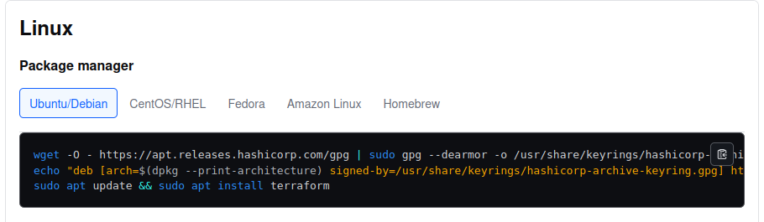
Terraform
Terraform is an infrastructure-as-code software tool created by HashiCorp.
Users define and provide data center infrastructure using a declarative configuration language known as HashiCorp Configuration Language (HCL), or optionally JSON.
Install Terraform

Slide 4
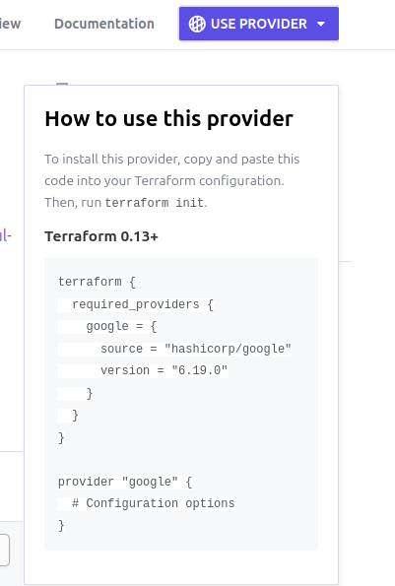
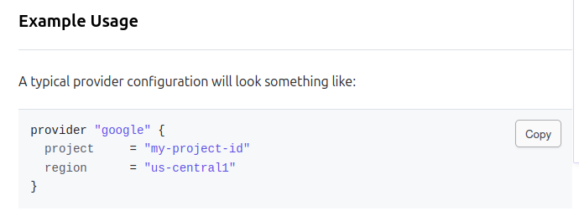
Terraform
Create main.tf file
Google terraform gcp provider and copy the code shown for the provider and configuration
The command terraform fmt main.tf formats the file

Slide 5
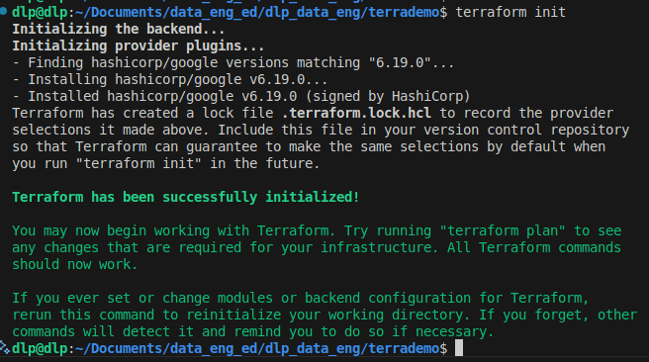
Terraform
Setting up credentials and providers
Define path to credentials using and environmental variable
export GOOGLE_CREDENTIALS="/home/dlp/Documents/data_eng_ed/dlp_data_eng/terrademo/keys/my-creds.json"
The ‘export’ command is one of the essential built-in commands in the Bash shell, allowing users to manage environment variables effectively. It is defined in POSIX standards, which state that the shell will assign the export attribute to specified variables, causing them to be included in the environment of subsequently executed commands. Simply put, the export command makes environment variables available to child processes, enabling changes to be reflected immediately in the current shell session without needing to start a new session.
Initialize the provider
In the directory containing the main.tf file, run the command: terraform init

Slide 6
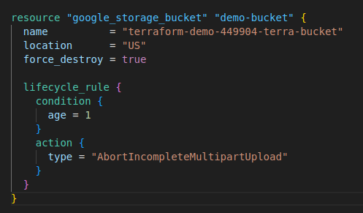
Terraform
Cretae a gcp storage bucket with the terraform script
Google examples on how to do it according to hashicorp
GCP name of resource
Local name of resource
Global name of resource, must be unique across all GCP. BY taking the project name (which is globally unqiue), the resource is guaranteed global uniqueness
Age in days
Age in days

Slide 7
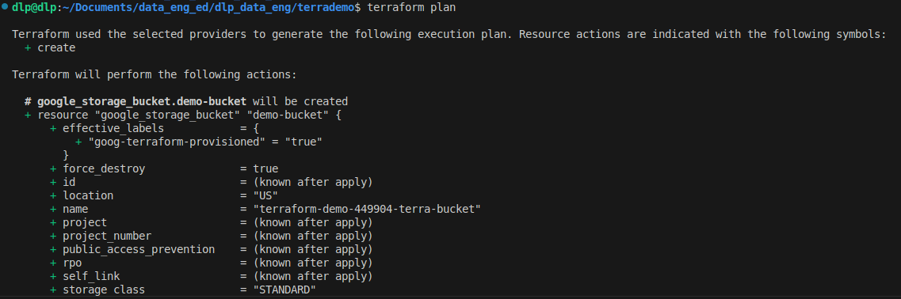
Terraform
Cretae a gcp storage bucket with the terraform script
Once the resource is specified in the main.tf file, this command generates a terraform plan: terraform plan
This command creates the specified resources: terraform apply
                or
          terraform init, terraform apply -auto-approve, terraform destroy
This command deletes the created resources: terraform destroy

