Slide 1
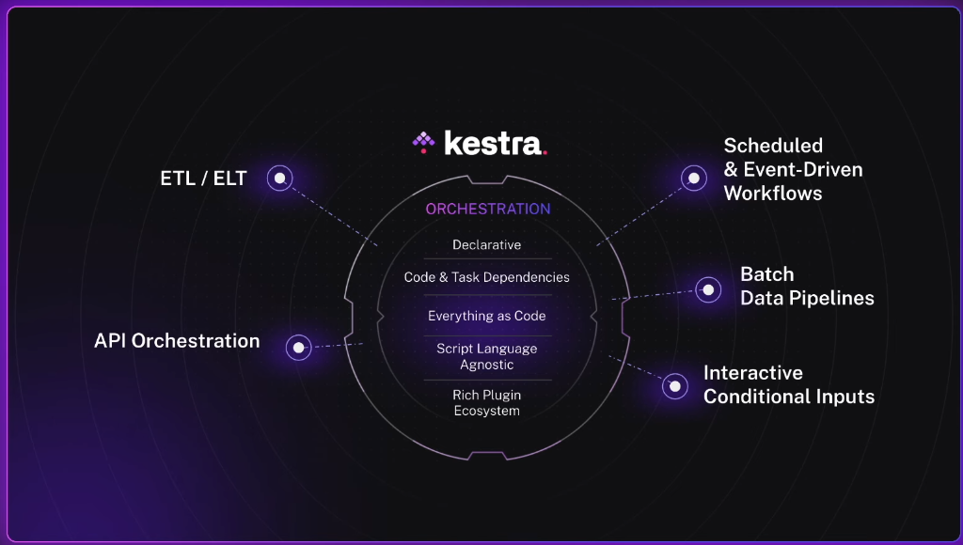
Workflow Orchestration

Slide 2
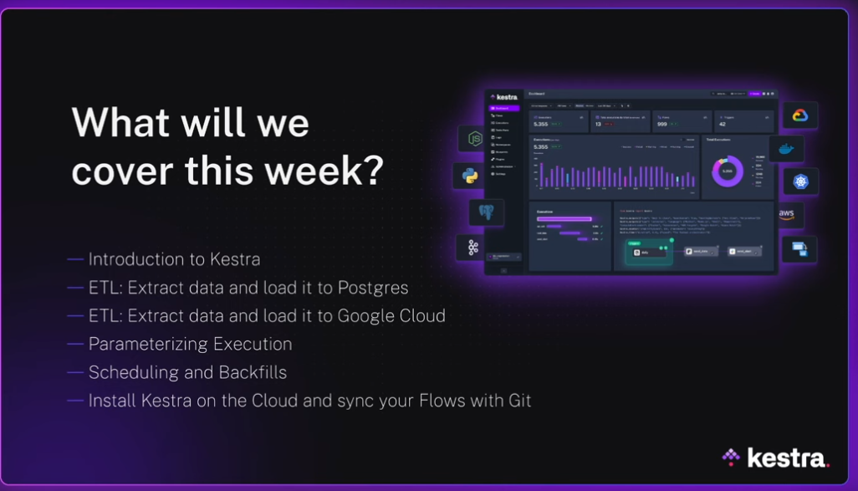

Slide 3
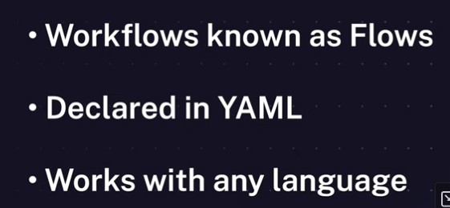
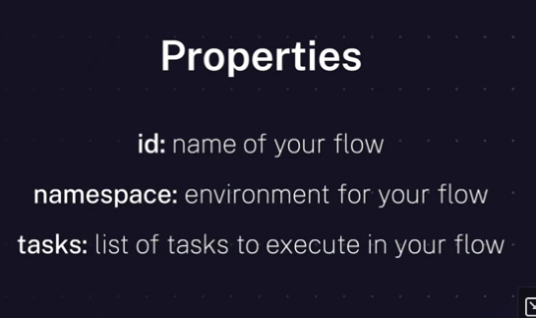
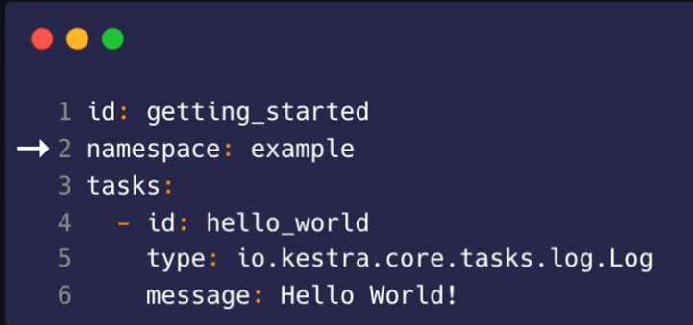

Slide 4
Install Kestra with Docker Compose
This yaml file configures the Docker Compose images needed so that Kestra has persistency (through a spinned Postgres database)
curl -o docker-compose.yml \
https://raw.githubusercontent.com/kestra-io/kestra/develop/docker-compose.yml

Slide 5
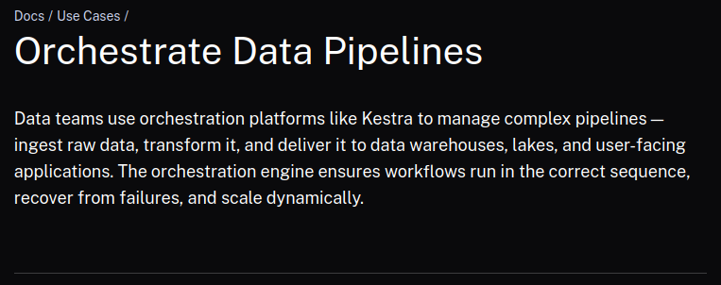
What is an orchestrator
https://kestra.io/docs/use-cases/data-pipelines

Slide 6
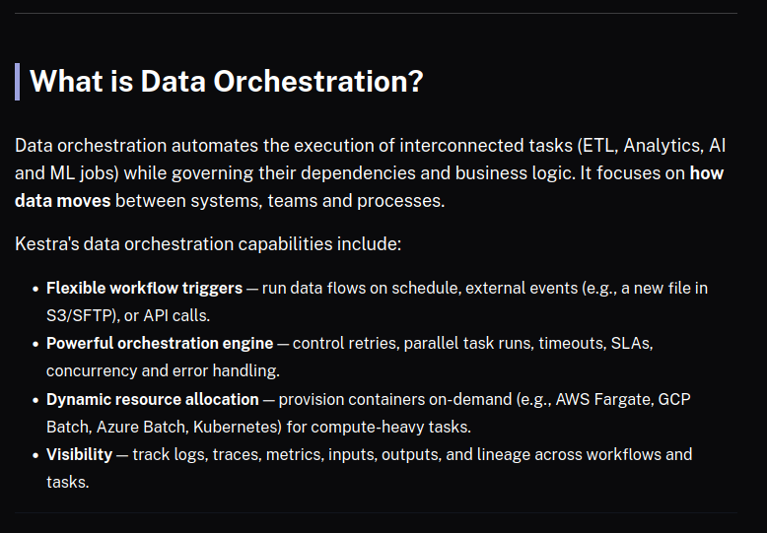

Slide 7
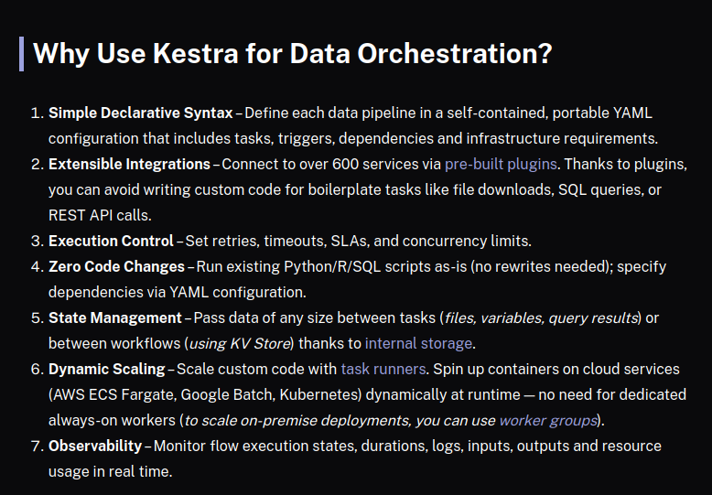

Slide 8
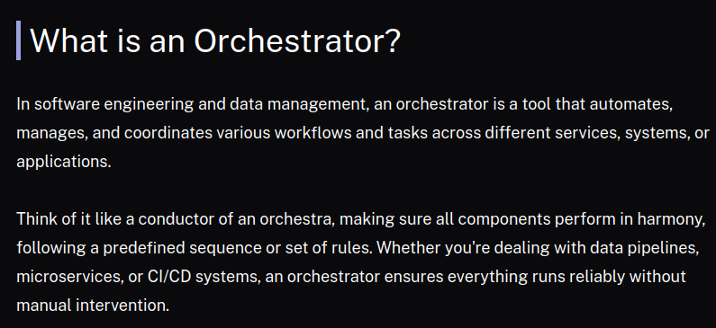
What is an orchestrator
https://kestra.io/blogs/2024-09-18-what-is-an-orchestrator

Slide 9
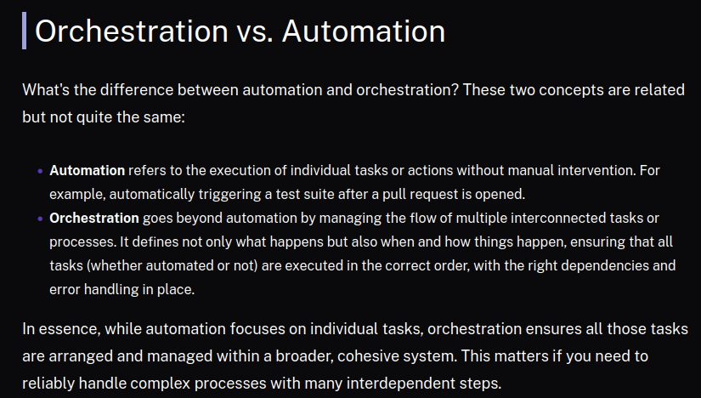

Slide 10
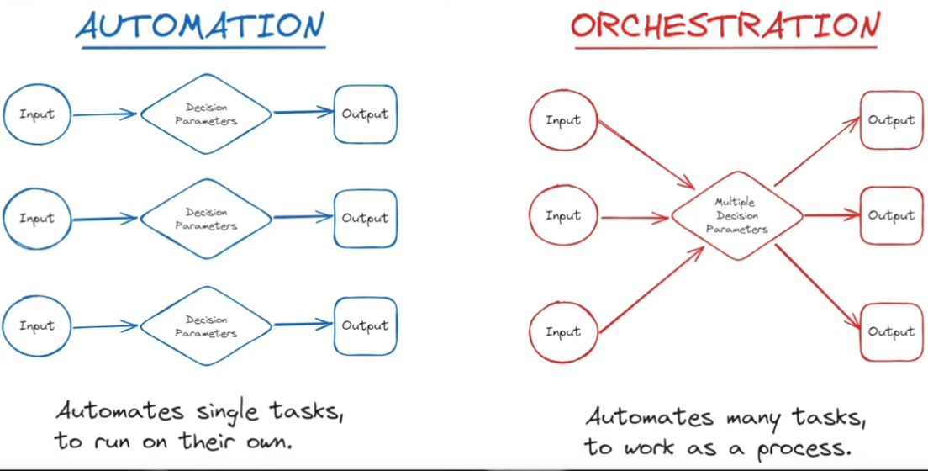
Automation is about executing individual tasks. Each one in isolation.
Orchestration is about synchronizing a group of tasks (pipeline)

Slide 11
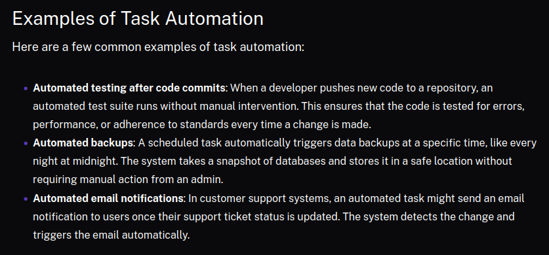

Slide 12
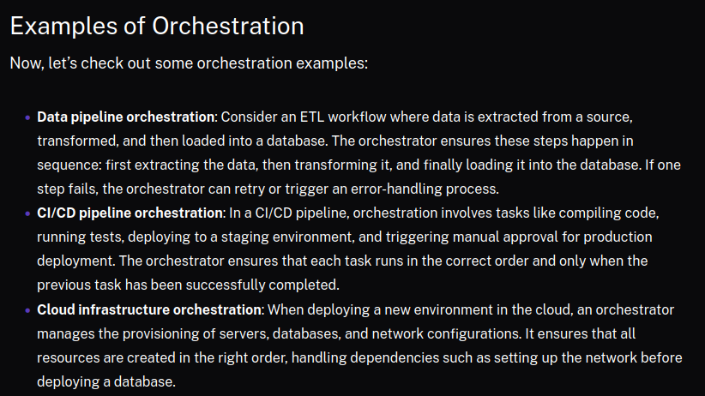

Slide 13
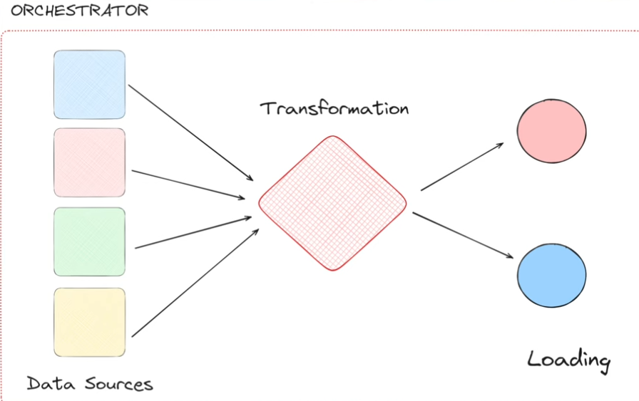
Example: data driven environment

Slide 14
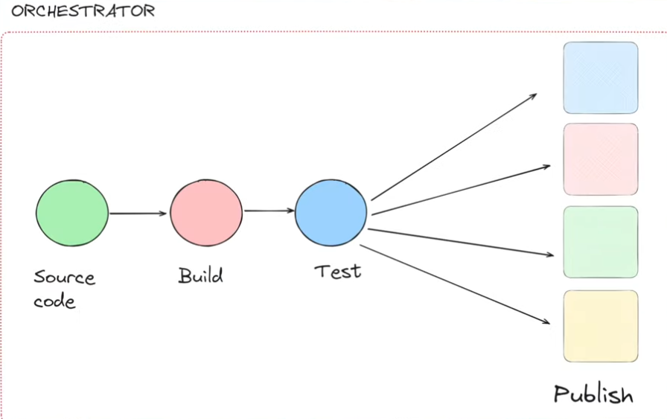
Example: CI/CD Pipelines

Slide 15
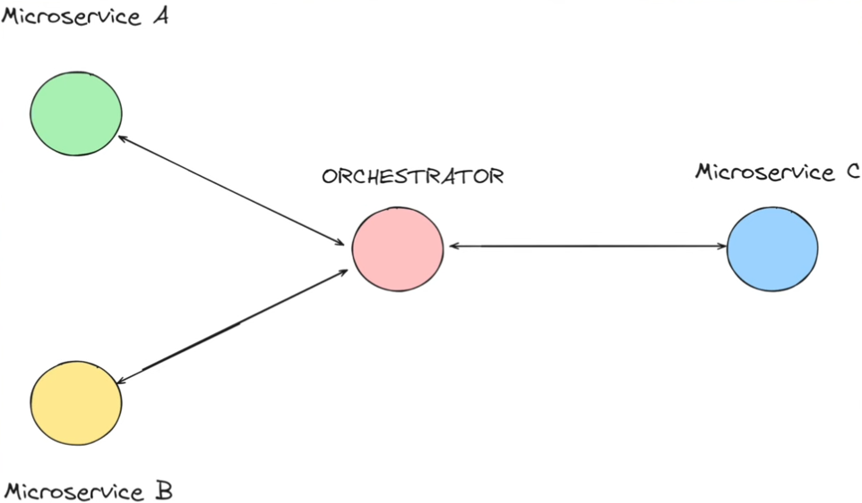
Example: Distributed Systems

Slide 16
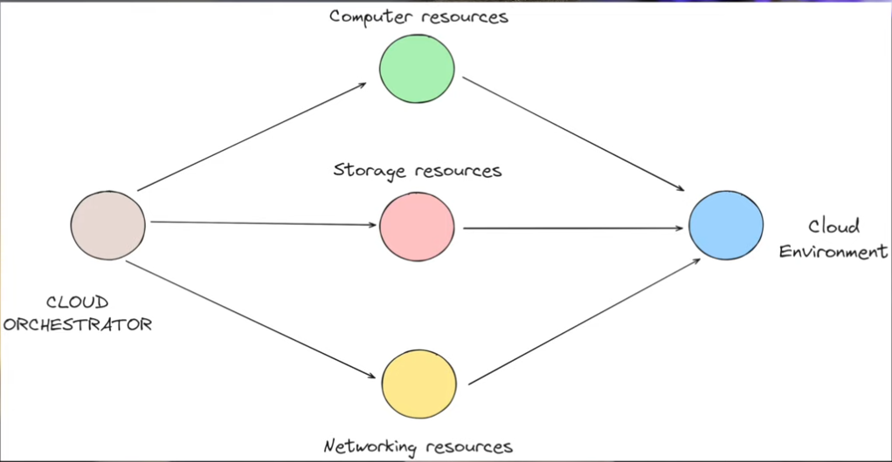
Example: Provision Resources

Slide 17
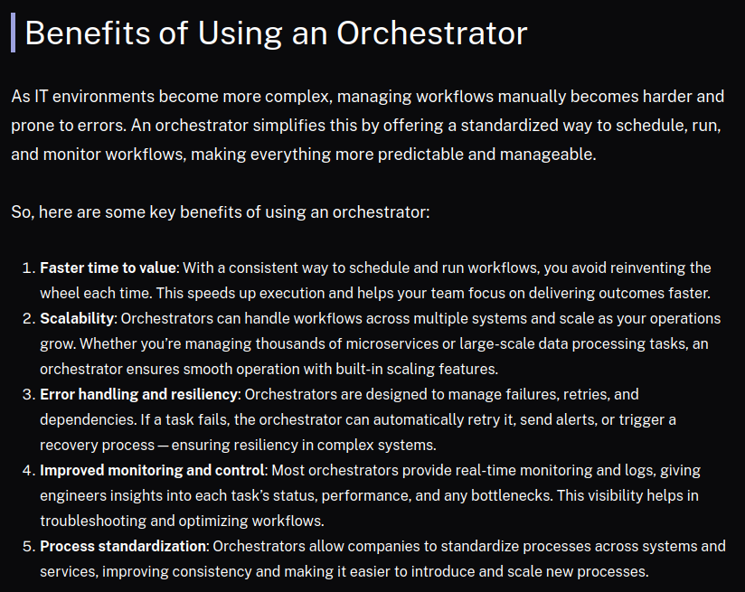

Slide 18
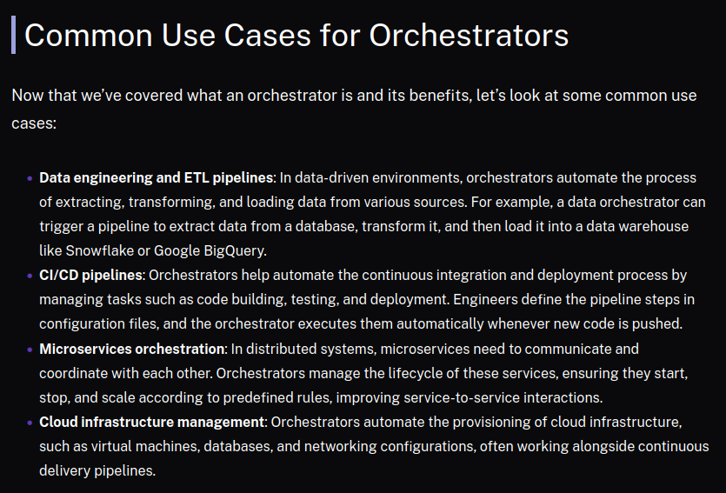

Slide 19
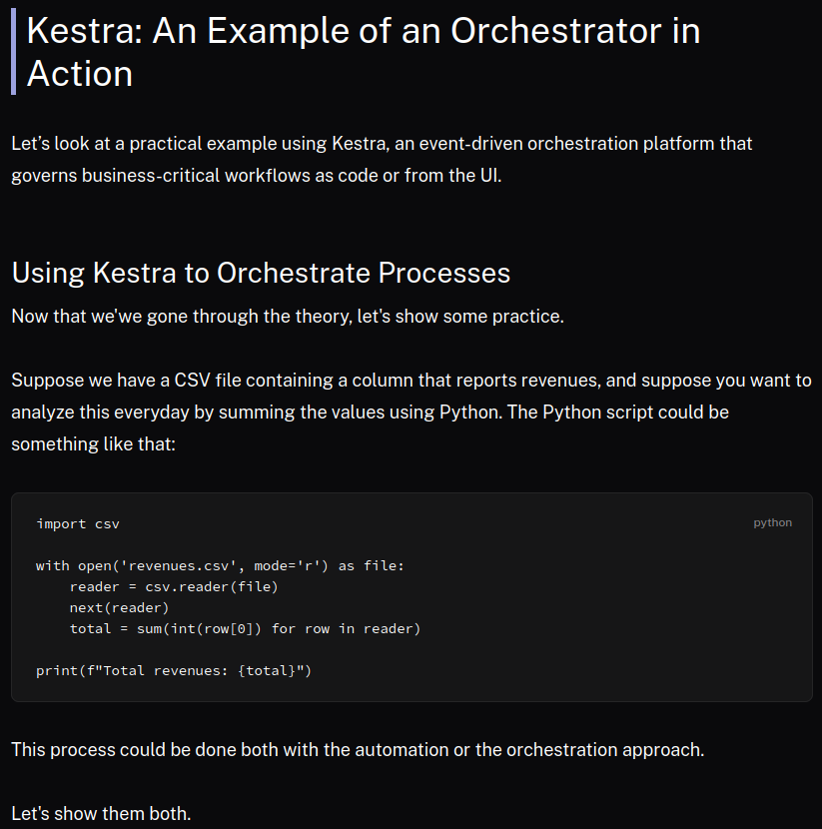

Slide 20
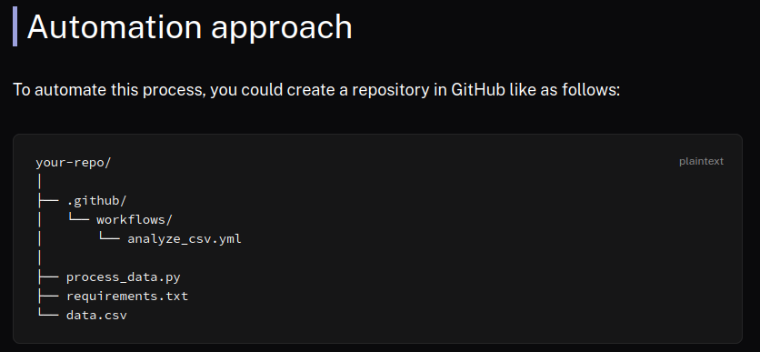

Slide 21
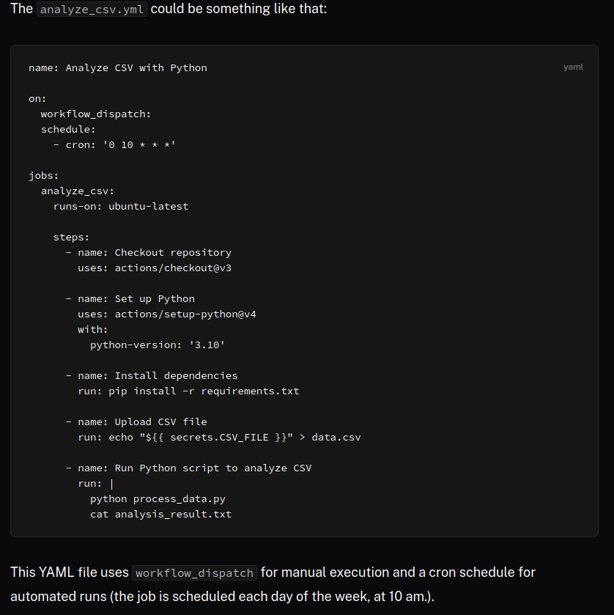
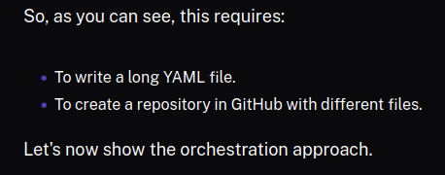

Slide 22
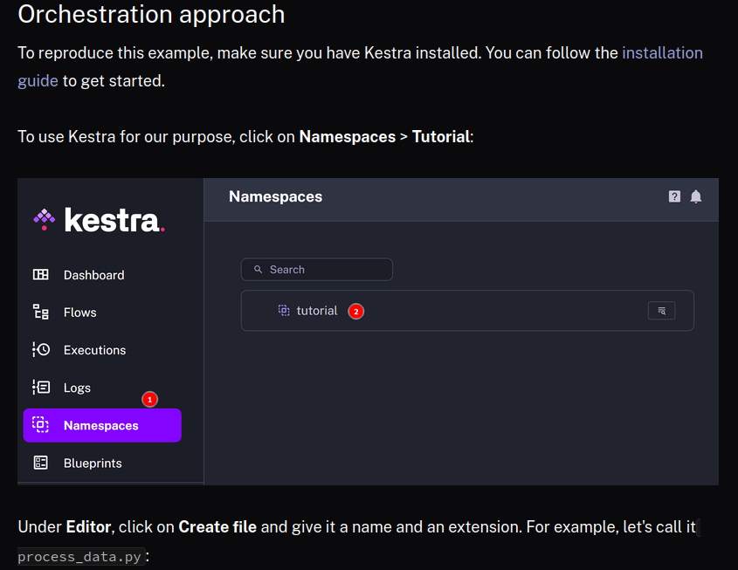

Slide 23
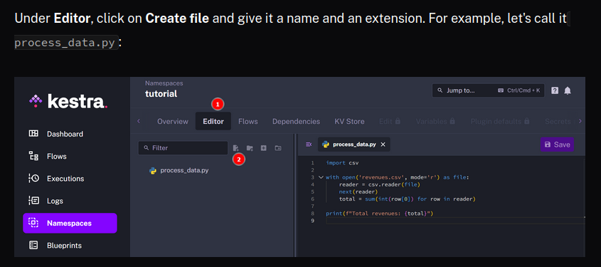

Slide 24
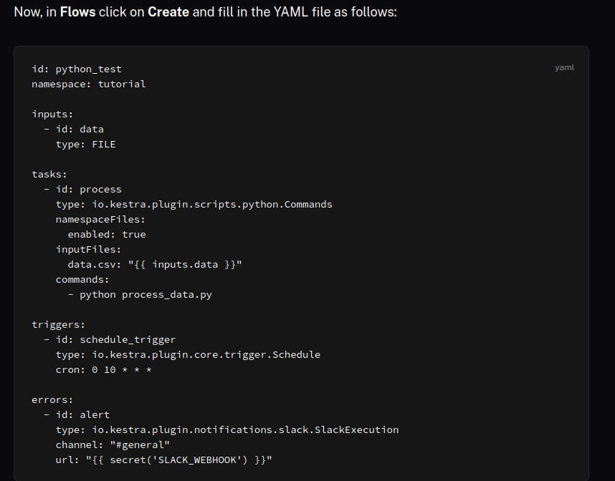

Slide 25
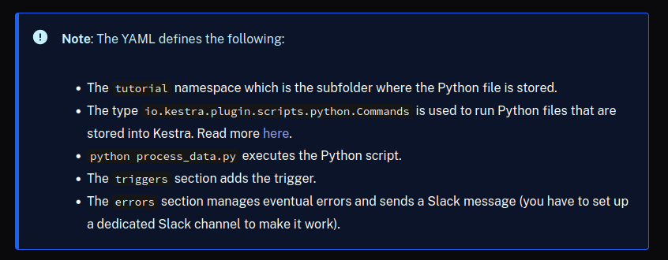

Slide 26
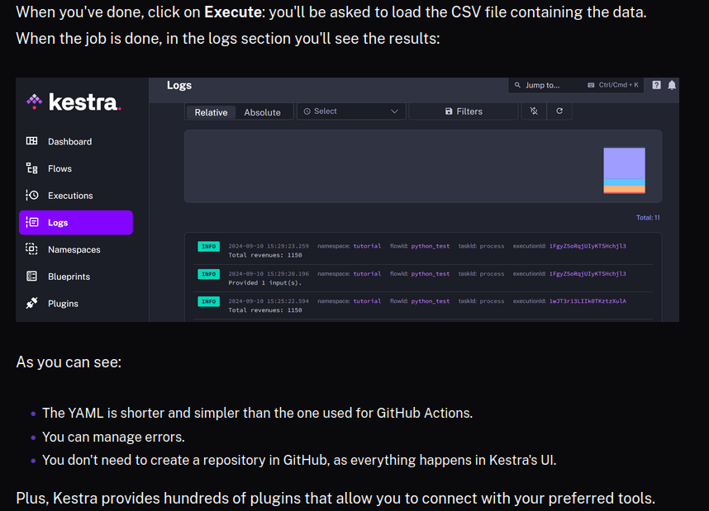

Slide 27
