Slide 1
Workflow Orchestration
Extraction, Transformation, Loading

Slide 2
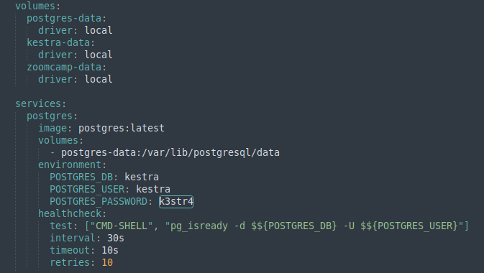
Kestra, Postgres and pgAdmin are run using a single yaml file
docker-compose-ensemble.yaml
Docker Compose
docker compose up
# Specifiy which yml file to use
sudo docker compose -f docker-compose_ensemble.yml up
sudo docker compose -f docker-compose_ensemble.yml down
# Force pulling a new image and not an outdated cached image
docker compose up --pull always
# Remove images and volumes
sudo docker compose -f docker-compose-ensemble.yaml down -v
Run docker compose command (always pull image to avoid errors with older cached images)
sudo docker compose -f docker-compose-ensemble.yaml up --pull always

Slide 3
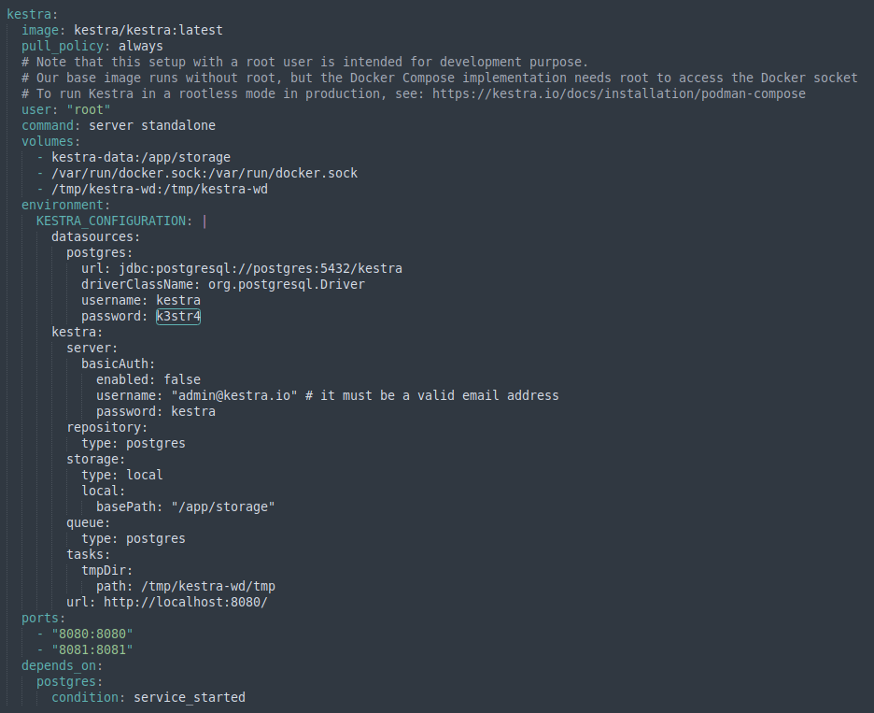
Kestra, Postgres and pgAdmin are run using a single yaml file
docker-compose-ensemble.yaml

Slide 4
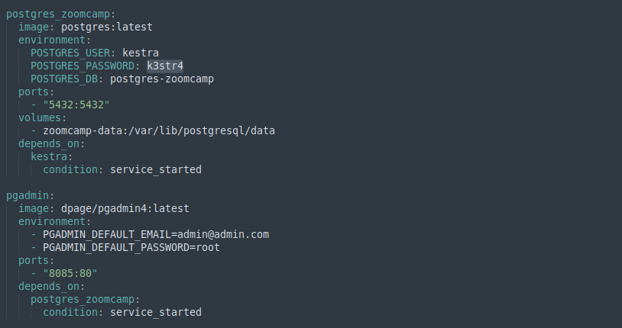
Kestra, Postgres and pgAdmin are run using a single yaml file
docker-compose-ensemble.yaml

Slide 5
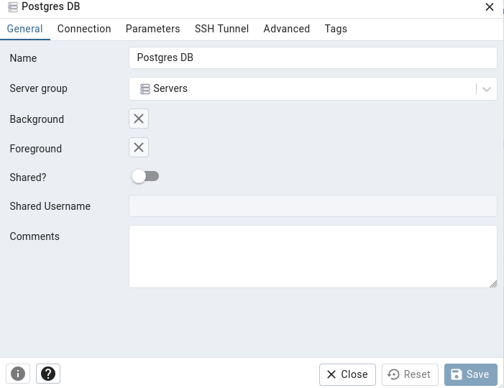
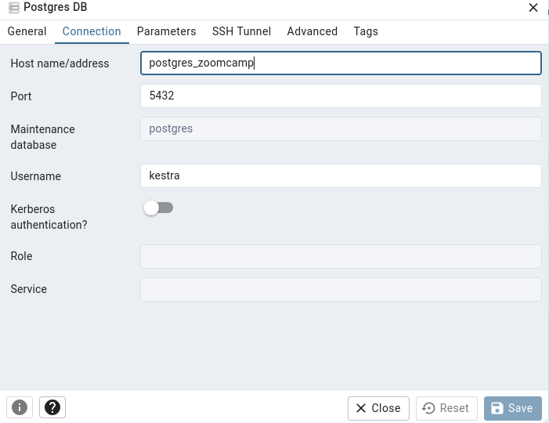
Once all images are running, we can create the Server in pgAdmin

Slide 6
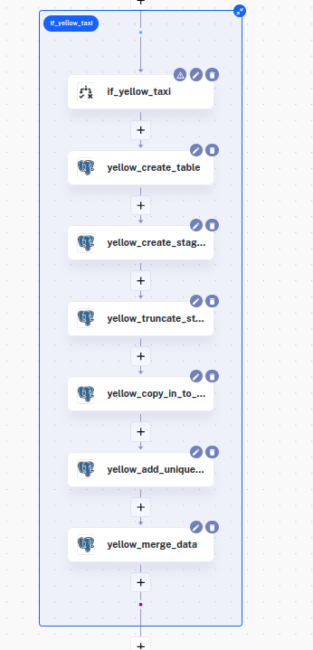
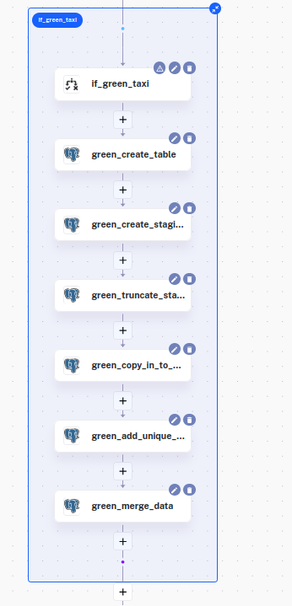
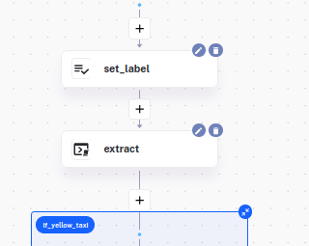
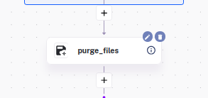
Define Kestra Flow

Slide 7
Workflow Orchestration
Manage Scheduling and Backfills using Postgres in Kestra

Slide 8
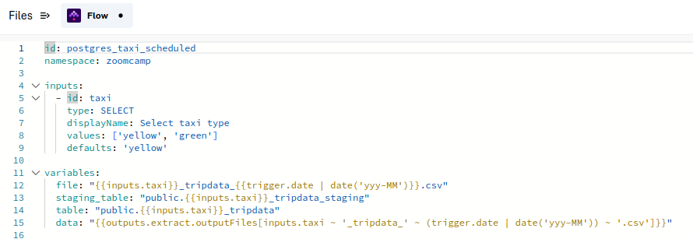
Manage Scheduling and Backfills using Postgres in Kestra
The inputs will consist only of taxi type
Inputs for Year and month will be removed because this information will be provided by triggers
Modify variables accordingly

Slide 9
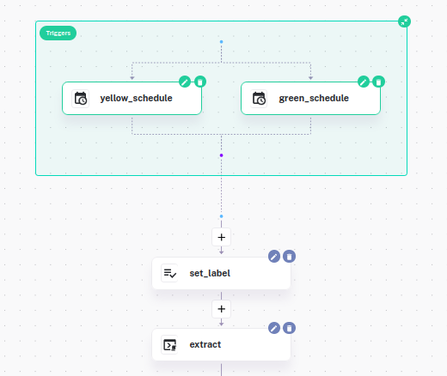
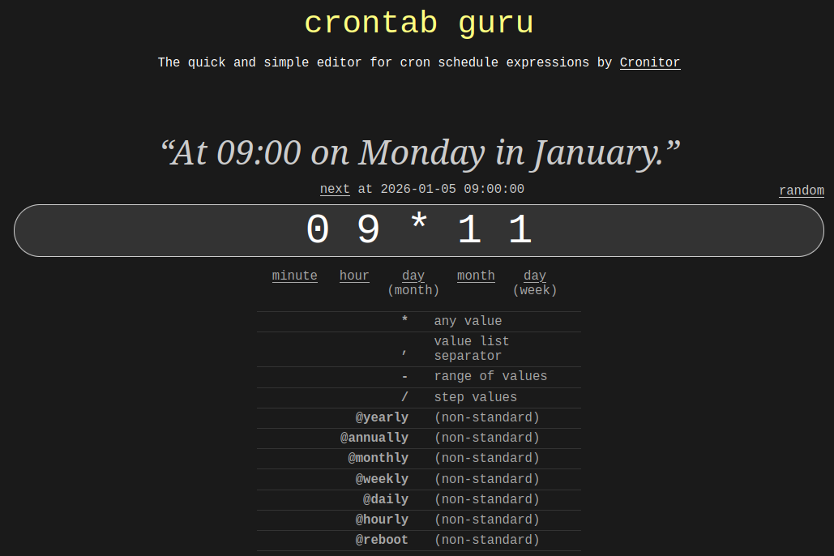
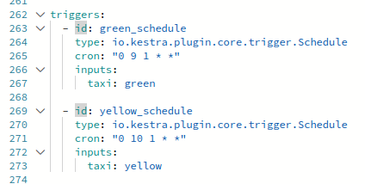
Manage Scheduling and Backfills using Postgres in Kestra
Add triggers
Use https://crontab.guru to know how to set up the cronometer:

Slide 10
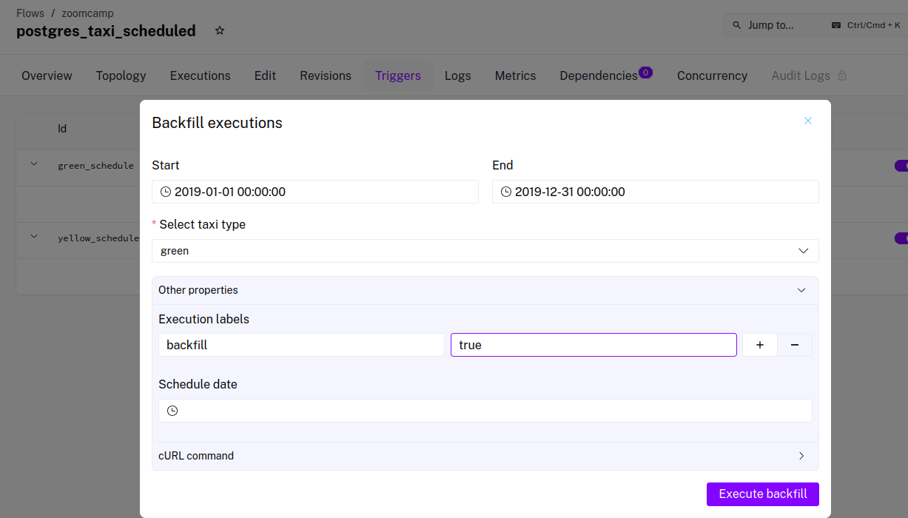
Manage Scheduling and Backfills using Postgres in Kestra
Because the taxi data is from the past, we need backfills, to fill the data that is from the past and has not been added yet.
The label allows to recognize which execution is backfill.

Slide 11
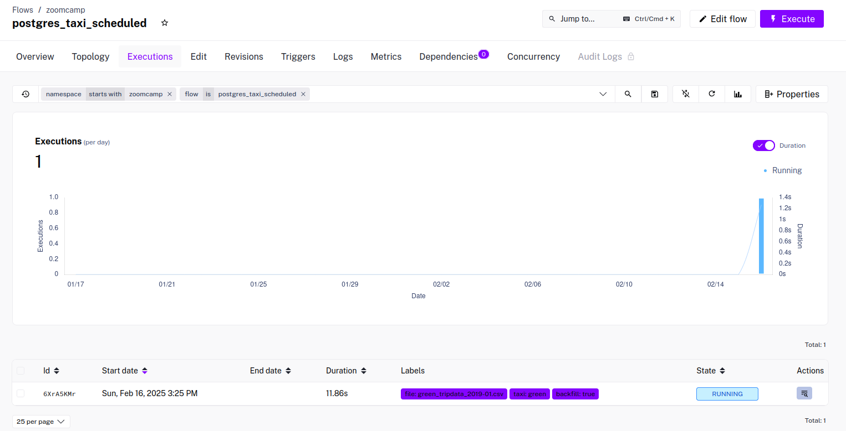
After executing the backfill, the progress of these backfill executions can be monitored in the Executions panel:

Slide 12
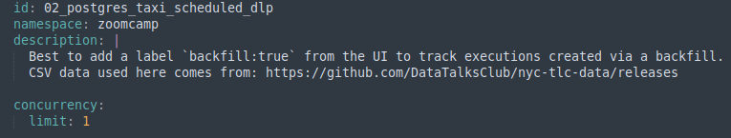
The flow defines concurrency as 1, this is because the staging_table name is the same for every execution, so to avoid unexpected overwriting and truncating when running concurrent executions.
We could also change the name of the staging_table so that it is specific to each month, however, this stores a staging_table for each month, consuming a lot of memory.

