Slide 1
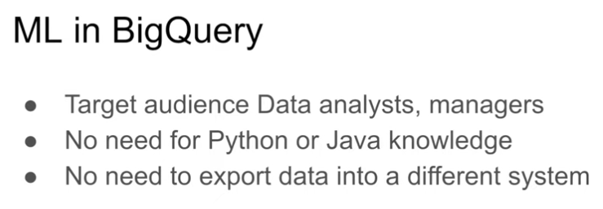
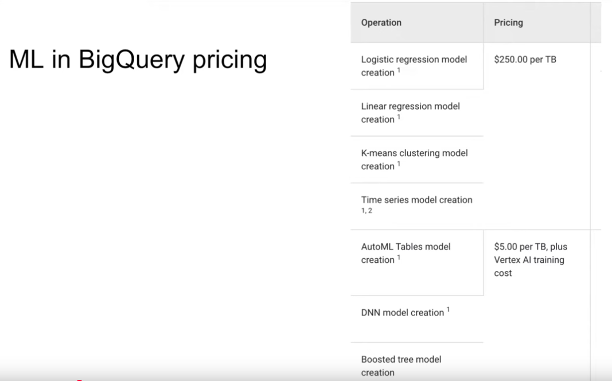
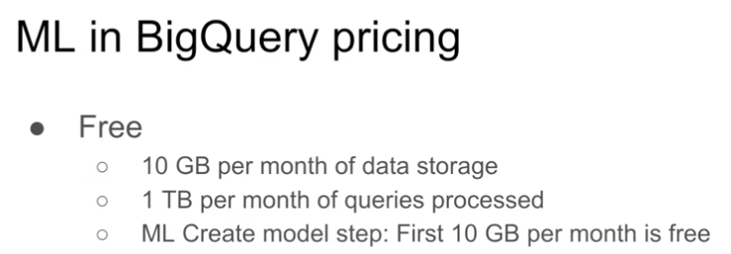
ML in BigQuery

Slide 2
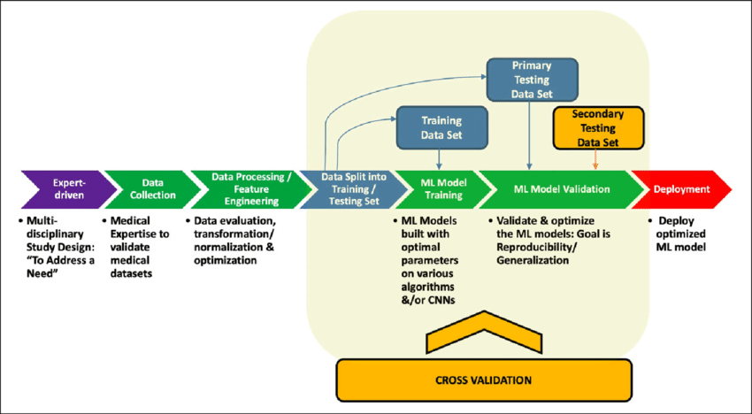
ML in BigQuery

Slide 3
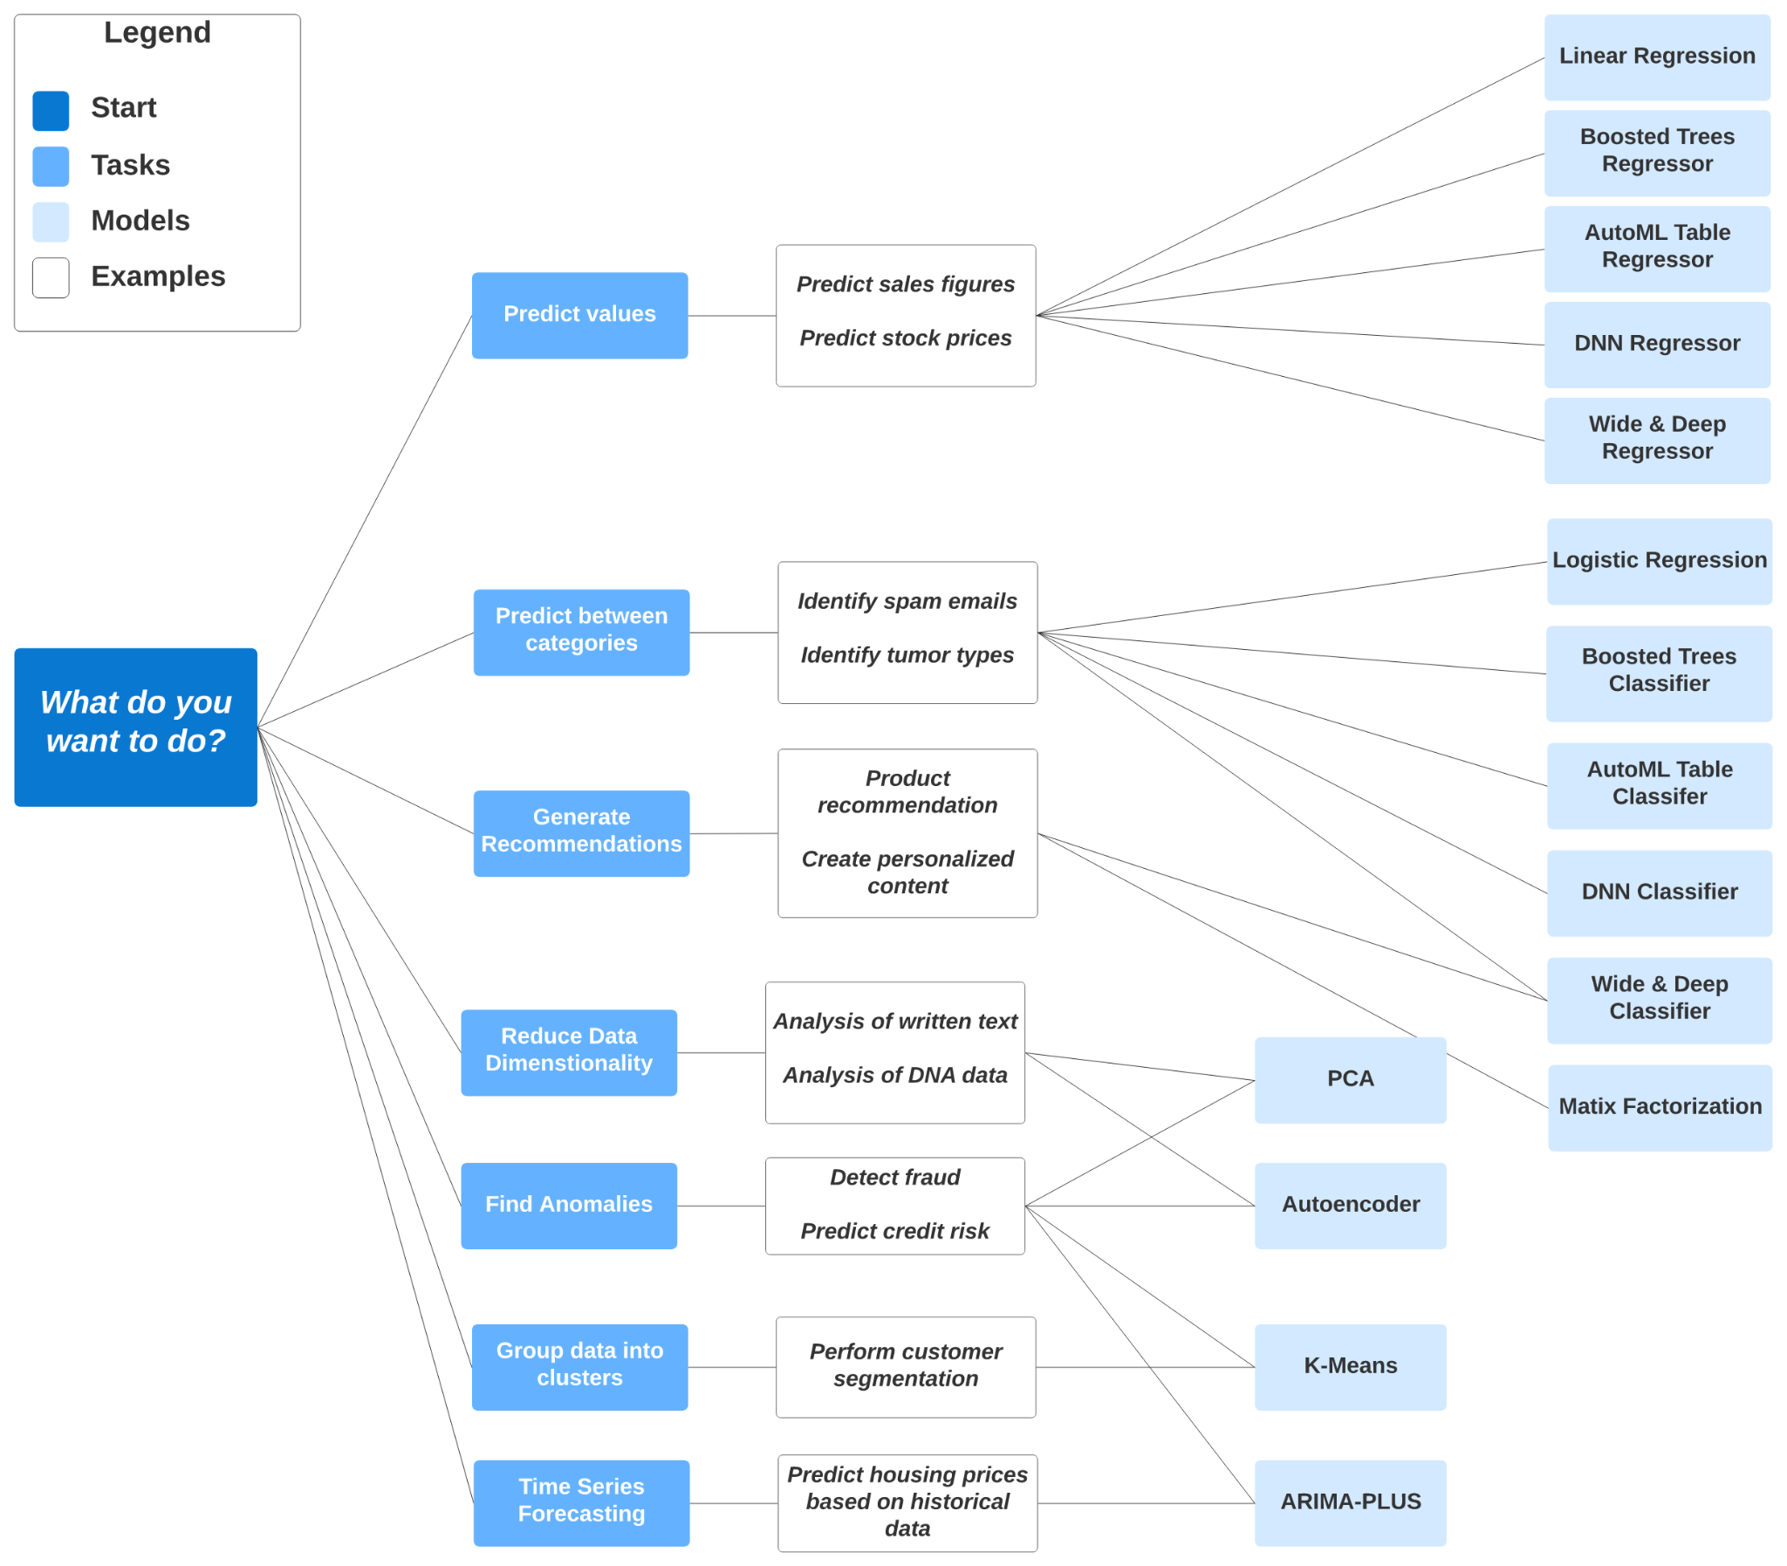
ML in BigQuery

Slide 4
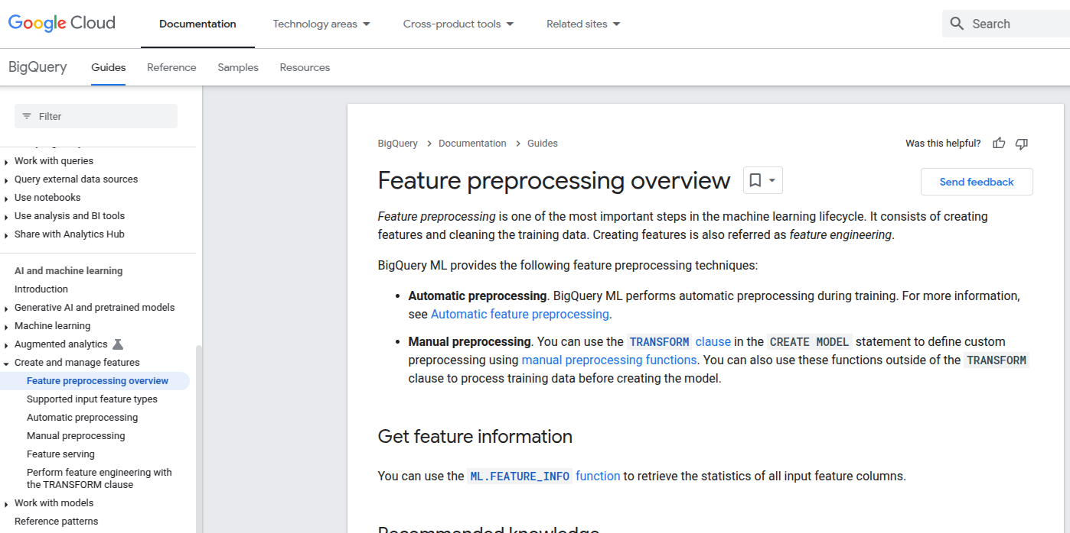
https://cloud.google.com/bigquery/docs/preprocess-overview

Slide 5
Feature preprocessing overview https://cloud.google.com/bigquery/docs/preprocess-overview
In order to do manual or automatic preprocessing of features, each column must have the correct datatype.
# CREATE A ML TABLE WITH APPROPRIATE TYPE
CREATE OR REPLACE TABLE `kestra-dlp-sandbox.de_zoomcamp.yellow_tripdata_ml` (
`passenger_count` INTEGER,
`trip_distance` FLOAT64,
`PULocationID` STRING,
`DOLocationID` STRING,
`payment_type` STRING,
`fare_amount` FLOAT64,
`tolls_amount` FLOAT64,
`tip_amount` FLOAT64
) AS (
SELECT passenger_count, trip_distance, cast(PULocationID AS STRING), CAST(DOLocationID AS STRING),
CAST(payment_type AS STRING), fare_amount, tolls_amount, tip_amount
FROM `kestra-dlp-sandbox.de_zoomcamp.yellow_tripdata_partitioned` WHERE fare_amount != 0
);

