Slide 1
Batch Processing

Slide 2
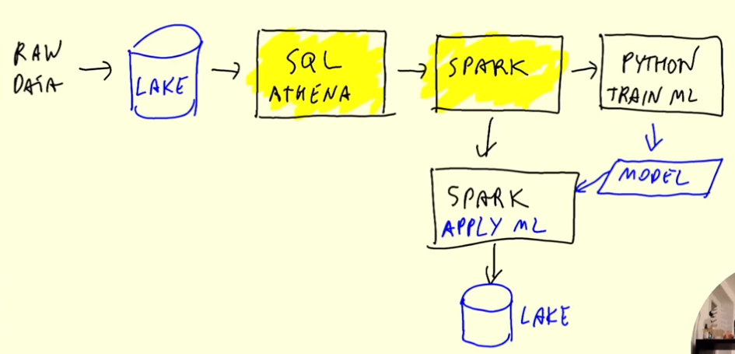
Apache Spark
Data Processing Engine
Can be used for Batch and Streaming
Used when data is in a data lake
Usual Workflow:
Pre-Processing

Slide 3
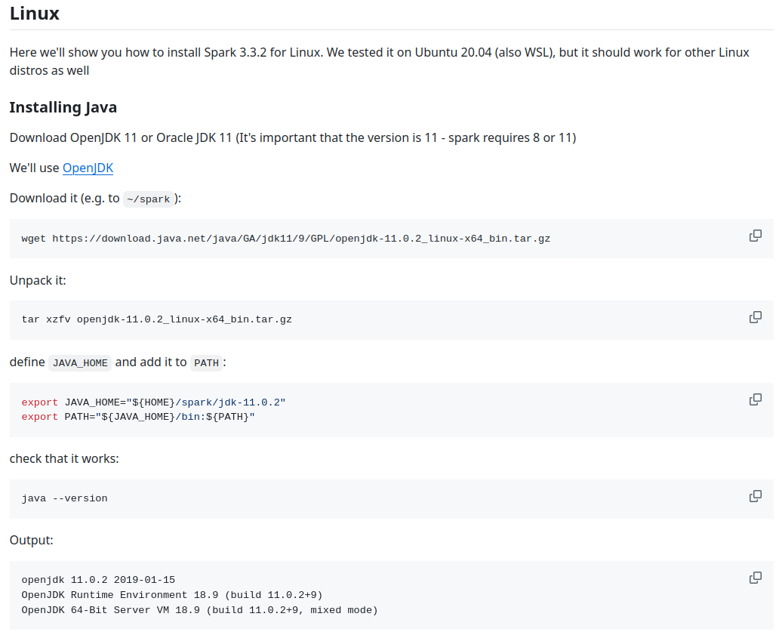
Setup Spark

Slide 4
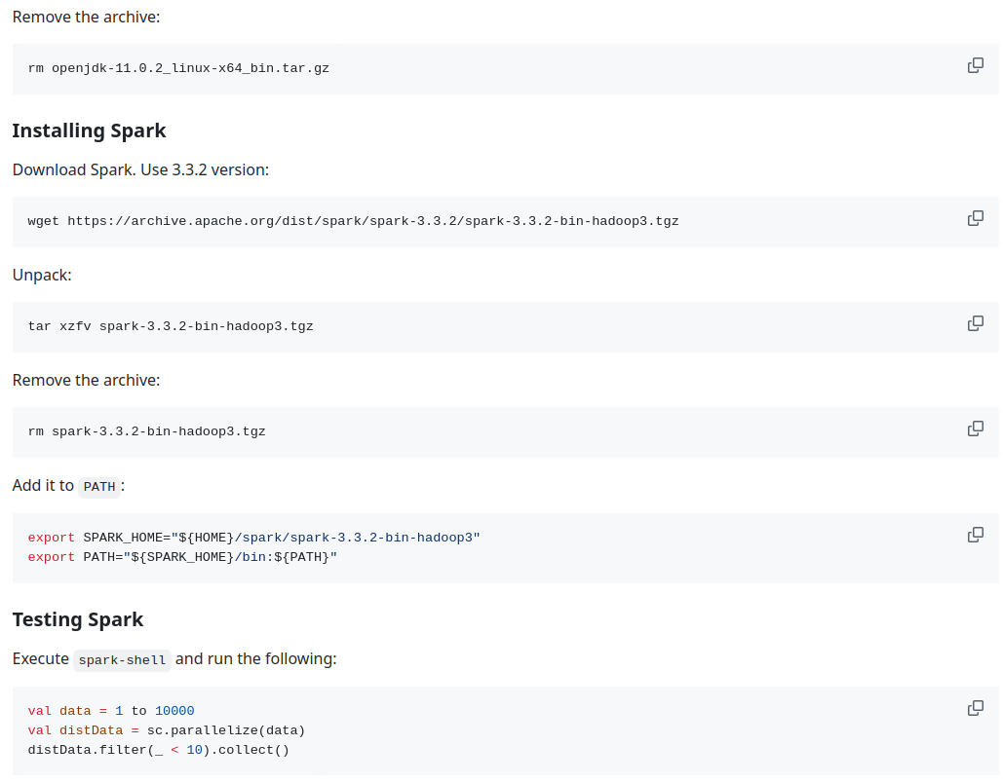
Setup Spark

Slide 5
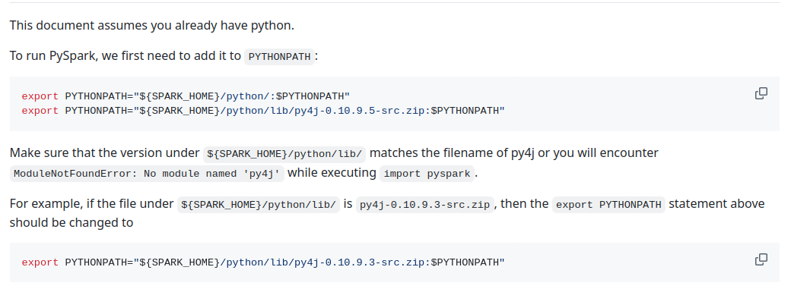
Setup PySpark

Slide 6
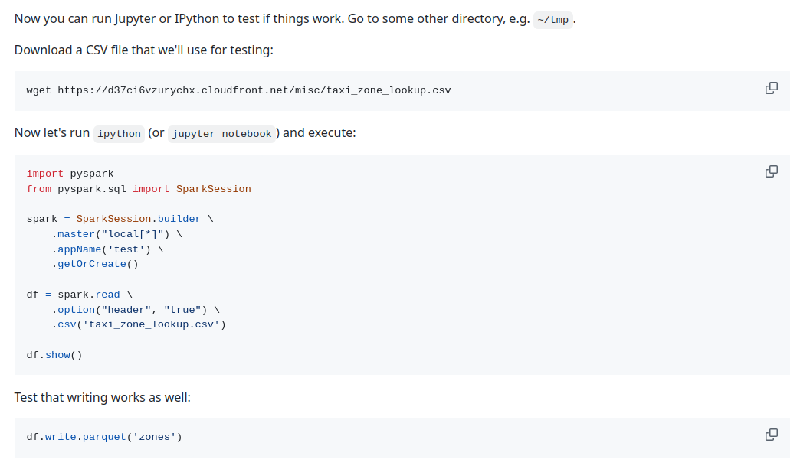
Setup PySpark

Slide 7
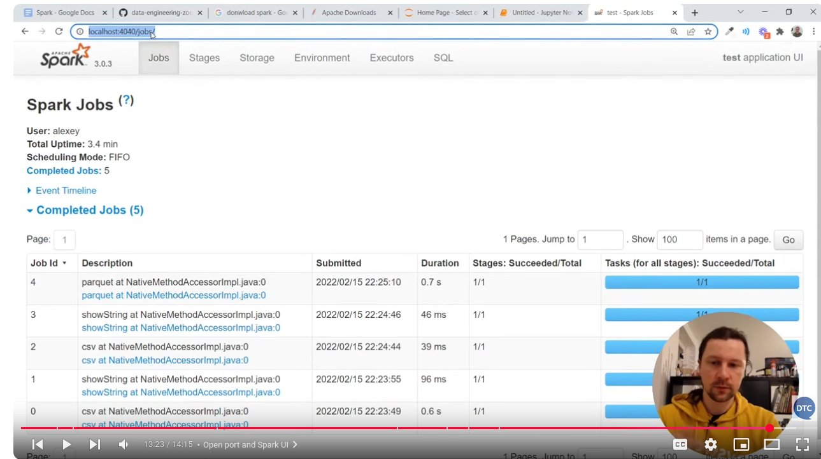
Access Spark jobs
http://localhost:4040/jobs/

Slide 8
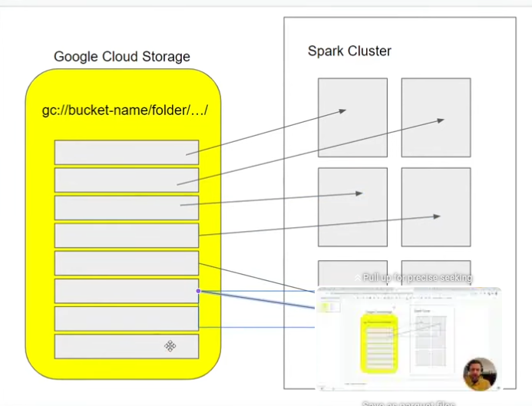
Spark Clusters
Spark can create a cluster of executors
To take advantage of this, the data should be partitioned in several files (instead of just one huge file which can only be processed by one executor)

Slide 9
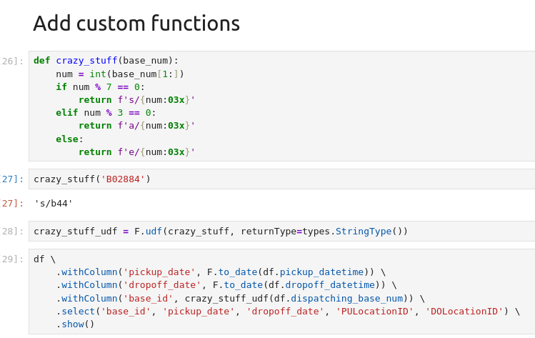
Spark differentiates between actions and transformations
Transformations are not executed immediately (lazy), Spark creates a sequence of transformations.
Actions are executed immediately (eager), they trigger the execution of transformations in the pipeline.
Why use Spark instead of SQL to transform data?
Spark can be written as python code, thus making the code testable
Spark provides user defined functions, which can modularized certain transformations
Spark also offers some built-in functions

Slide 10
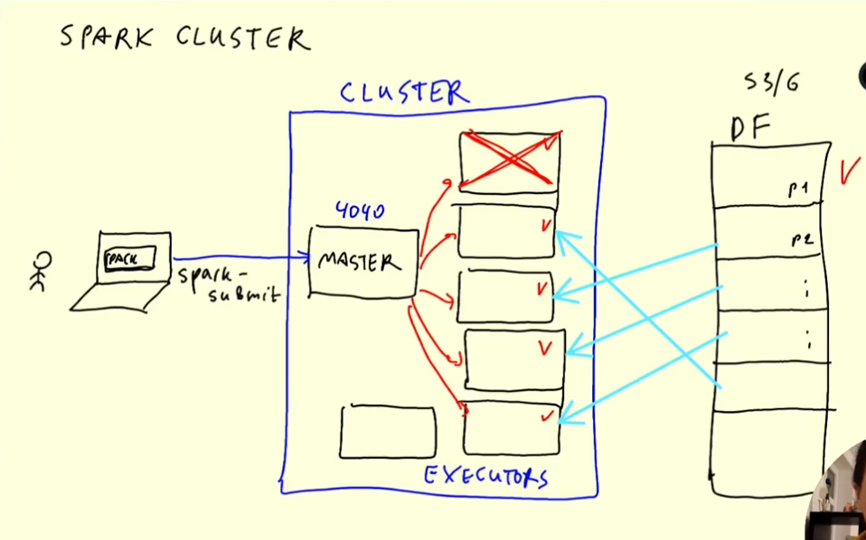
Anatomy of a Spark Cluster

Slide 11
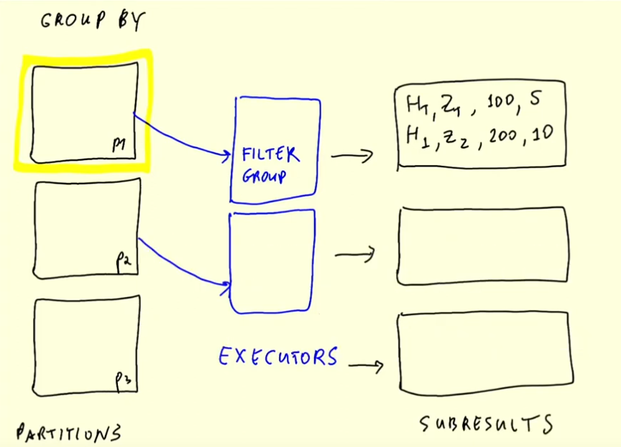
Spark GroupBy

Slide 12
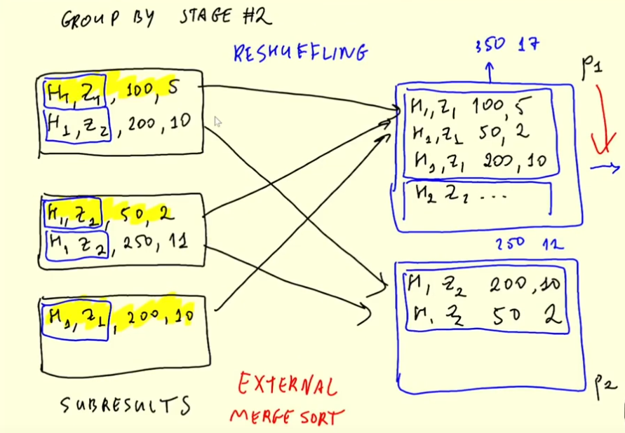
Spark GroupBy

Slide 13
Spark Joins

Slide 14
Spark in GCP
Use all available cores
Recursive (because it contains subfolders)
First, the data must be uploaded to a bucket.
Create a bucket and use this command:
gsutil -m cp -r pq/ gs://dlp_2025_dateng_week_05/pq
If the access is denied, try this:
Stop VM
goto --> VM instance details.
in "Cloud API access scopes" select "Allow full access to all Cloud APIs" then Click "save".
restart VM and Delete ~/.gsutil .

Slide 15
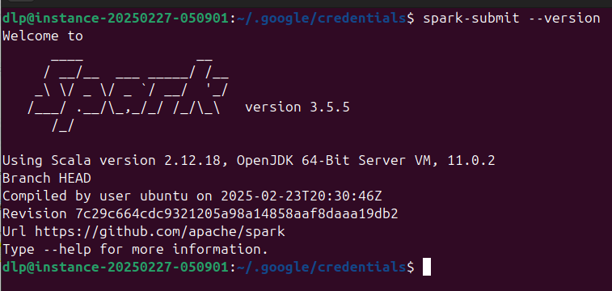
Spark in GCP
We also need a hadoop connector to GCS, so that Spark can connect to the GCS bucket.
The connector has to be compatible with the installed Spark version:
gsutil cp gs://hadoop-lib/gcs/gcs-connector-hadoop3-2.2.5.jar ~/lib/

Slide 16
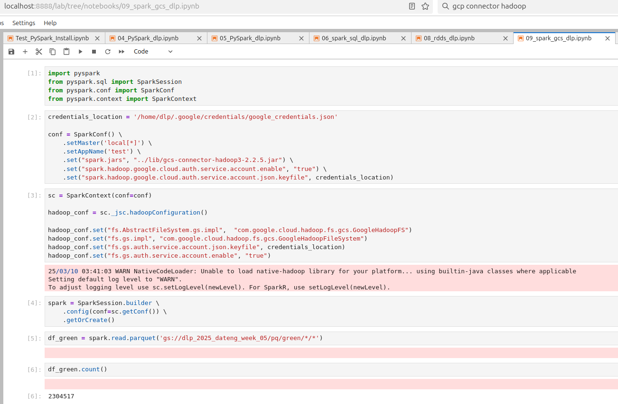
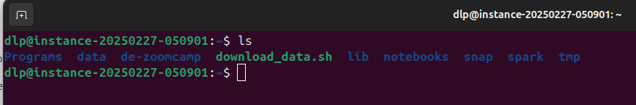
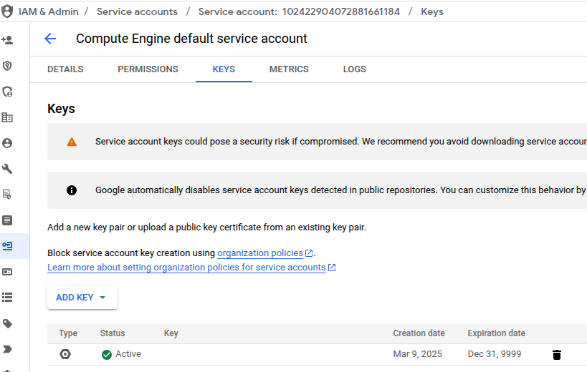
Spark in GCP
Distribution of directories in VM
This credentials is the .json key for the VM instance service account

Slide 17

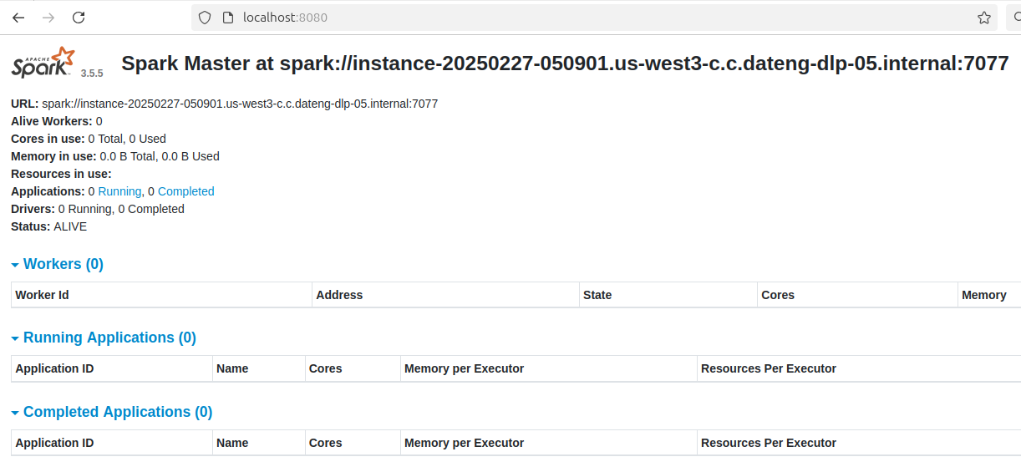
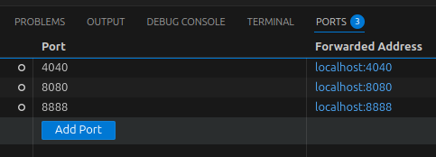
Creating a Local Spark Cluster
https://spark.apache.org/docs/latest/spark-standalone.html#installing-spark-standalone-to-a-cluster
./sbin/start-master.sh
Go to the directory saved as SPARK_HOME
./sbin/start-master.sh
This local cluster can be accessed on Port 8080, so map this port (VM Instance → local host) and check the UI in a browser

Slide 18
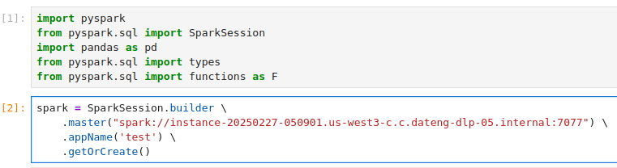
Creating a Local Spark Cluster
Now change the master from local to the created cluster

Slide 19
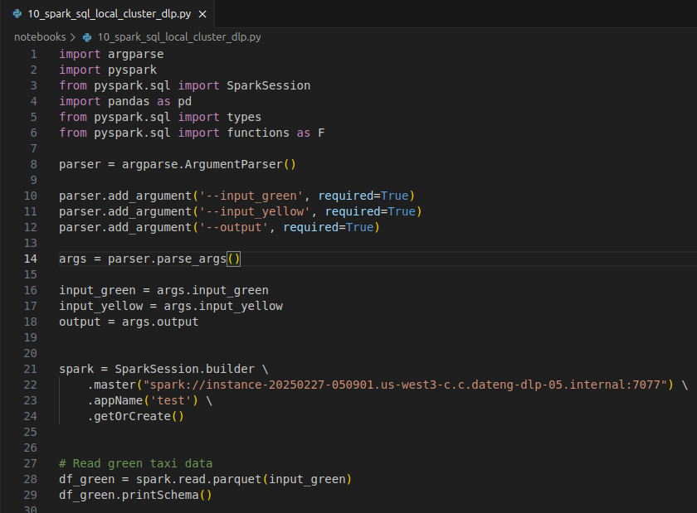
Creating a Local Spark Cluster
A Spark session can now be created but we need to manually create workers in order for the cluster to be able to do anything.
Now the script to obtain the revenue can be run (with input parameters)
./sbin/start-worker.sh <master-spark-URL>

Slide 20
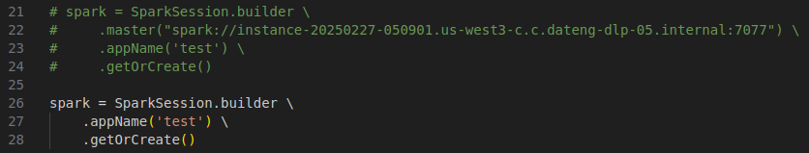
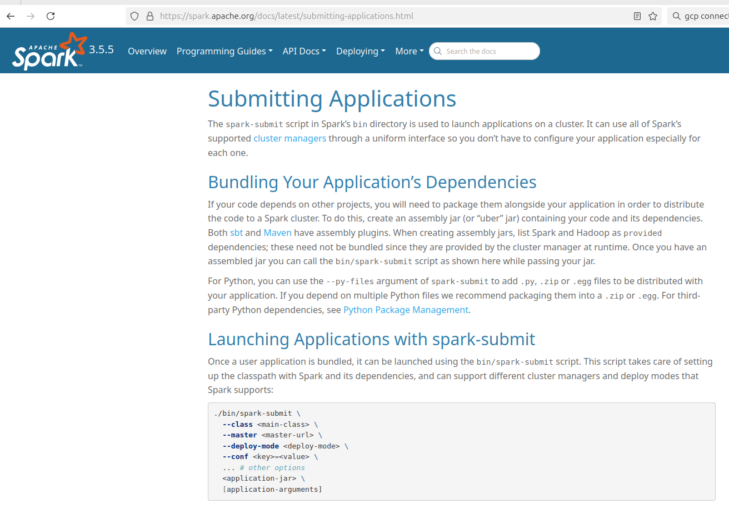
Creating a Local Spark Cluster
However, we don’t want to hard code the Spark master, we want to be able to define the number of executors and other settings.
We use Spark Submit for this!
https://spark.apache.org/docs/latest/submitting-applications.html

Slide 21
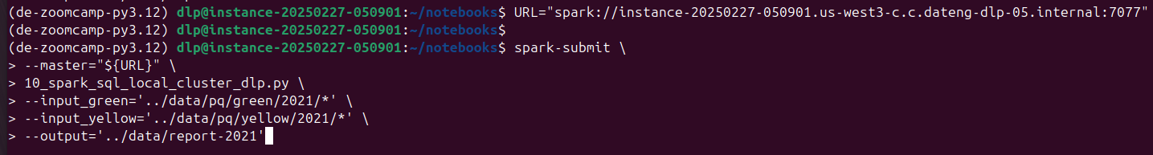
Submitting jobs with spark-submit
URL="spark://instance-20250227-050901.us-west3-c.c.dateng-dlp-05.internal:7077"
spark-submit \
--master="${URL}" \
10_spark_sql_local_cluster_dlp.py \
--input_green='../data/pq/green/2021/*' \
--input_yellow='../data/pq/yellow/2021/*' \
--output='../data/report-2021'

Slide 22
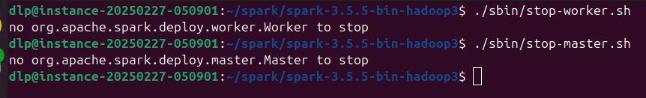
Shutting down the Spark Cluster
Once the Spark job is done, both the workers/executors and the master/cluster must be closed.
Navigate to the folder where Spark was installed

Slide 23
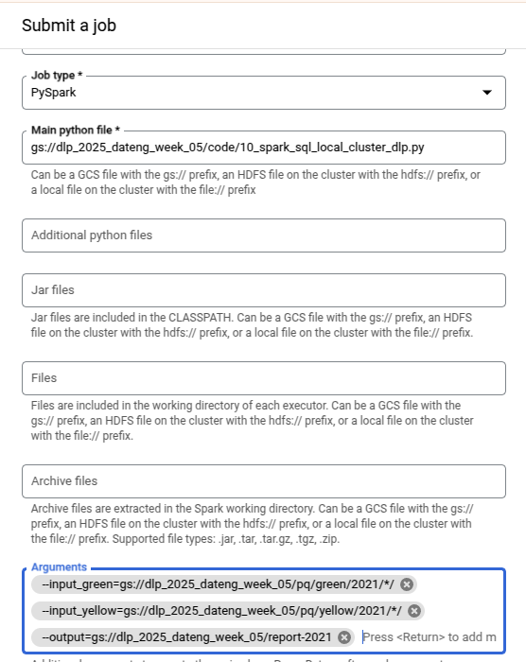
Create Dataproc cluster
Enable API
Add Dataproc Admin role
Create Cluster
Submit Job manually:
  Select Job Type
  Save a python script to a bucket and use this as the main python file:
gsutil cp notebooks/10_spark_sql_local_cluster_dlp.py gs://dlp_2025_dateng_week_05/code/10_spark_sql_local_cluster_dlp.py
  Specify arguments
Copy commands to do it programatically:
  Job→Configuration→Equivalent REST->Copy

Slide 24
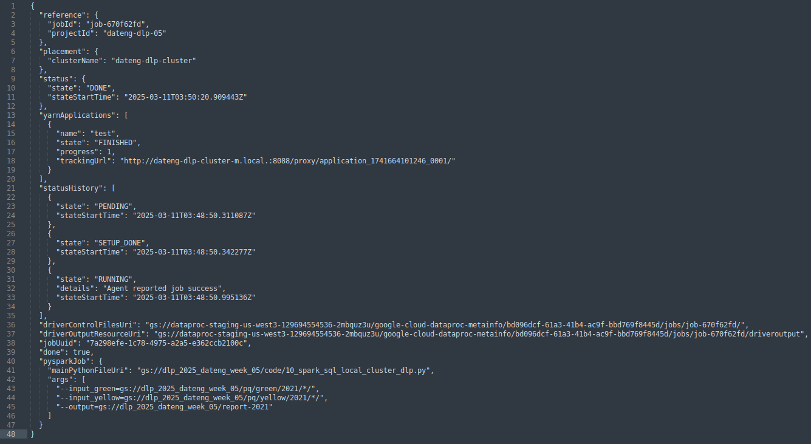
Submitting job to Dataproc cluster
Extract important info from REST API:

Slide 25
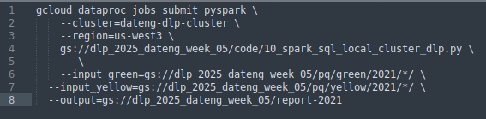
Submitting job to Dataproc cluster
Use Google Cloud SDK to submit Dataproc job
https://cloud.google.com/dataproc/docs/guides/submit-job#dataproc-submit-job-gcloud
Anything after this -- is considered parameters for the script
gcloud dataproc jobs submit pyspark \
--cluster=dateng-dlp-cluster \
--region=us-west3 \
gs://dlp_2025_dateng_week_05/code/10_spark_sql_local_cluster_dlp.py \
-- \
--input_green=gs://dlp_2025_dateng_week_05/pq/green/2021/*/ \
--input_yellow=gs://dlp_2025_dateng_week_05/pq/yellow/2021/*/ \
--output=gs://dlp_2025_dateng_week_05/report-2021

Slide 26
Connecting Spark to Big Query
Create a dataset (same region as bucket and Dataproc cluster)
Submit job:
gcloud dataproc jobs submit pyspark \
--cluster=dateng-dlp-cluster \
--region=us-west3 \
--jars=file:///usr/lib/spark/examples/jars/spark-examples.jar \
gs://dlp_2025_dateng_week_05/code/10_spark_sql_big_query_dlp.py \
-- \
--input_green=gs://dlp_2025_dateng_week_05/pq/green/2020/*/ \
--input_yellow=gs://dlp_2025_dateng_week_05/pq/yellow/2020/*/ \
--output=trips_data_all.reports-2020

