Slide 1
Spark in GCP
Use all available cores
Recursive (because it contains subfolders)
First, the data must be uploaded to a bucket.
Create a bucket and use this command:
gsutil -m cp -r pq/ gs://dlp_2025_dateng_week_05/pq
If the access is denied, try this:
Stop VM
goto --> VM instance details.
in "Cloud API access scopes" select "Allow full access to all Cloud APIs" then Click "save".
restart VM and Delete ~/.gsutil .

Slide 2
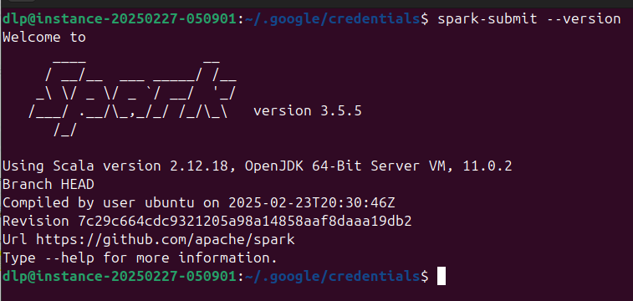
Spark in GCP
We also need a hadoop connector to GCS, so that Spark can connect to the GCS bucket.
The connector has to be compatible with the installed Spark version:
gsutil cp gs://hadoop-lib/gcs/gcs-connector-hadoop3-2.2.5.jar ~/lib/

Slide 3
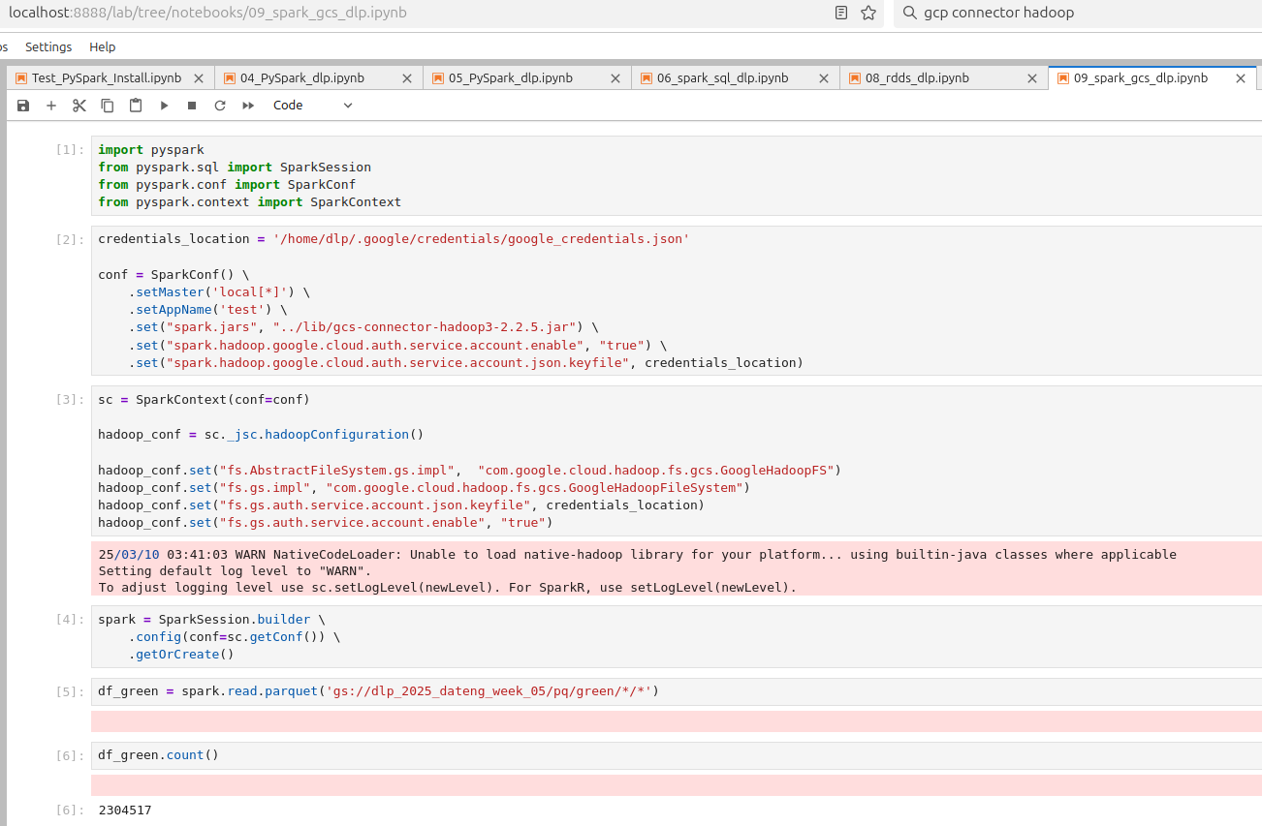
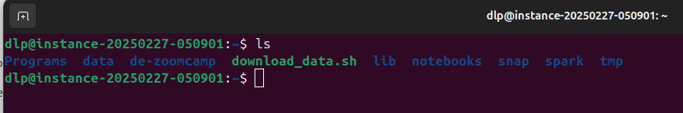
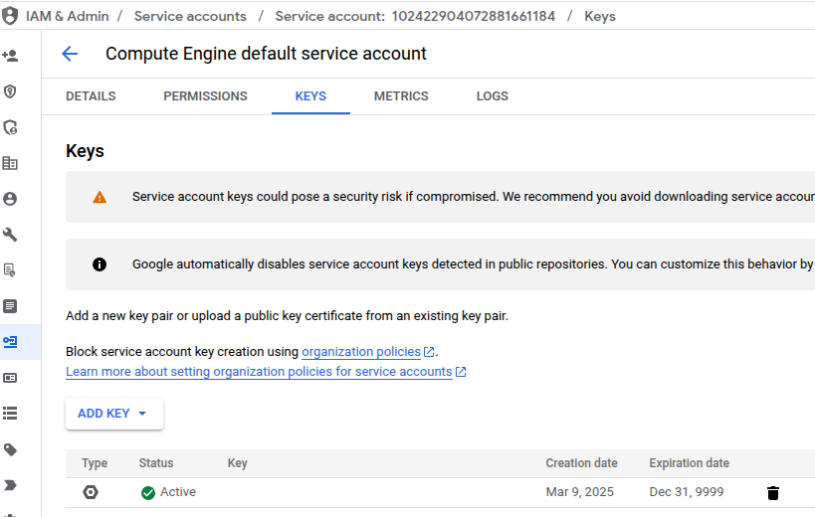
Spark in GCP
Distribution of directories in VM
This credentials is the .json key for the VM instance service account

Slide 4

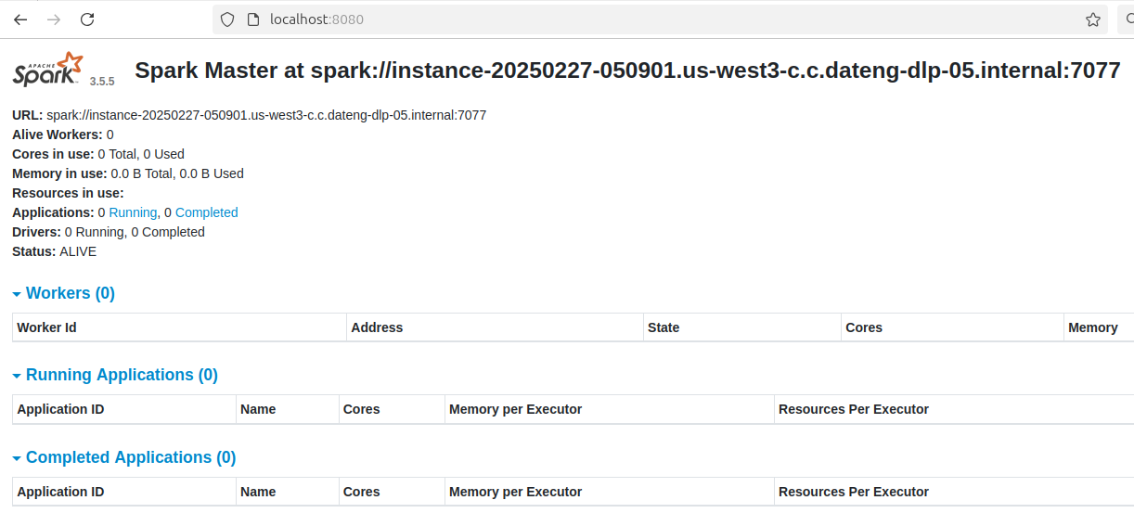
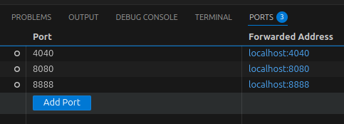
Creating a Local Spark Cluster
https://spark.apache.org/docs/latest/spark-standalone.html#installing-spark-standalone-to-a-cluster
./sbin/start-master.sh
Go to the directory saved as SPARK_HOME
./sbin/start-master.sh
This local cluster can be accessed on Port 8080, so map this port (VM Instance → local host) and check the UI in a browser

Slide 5
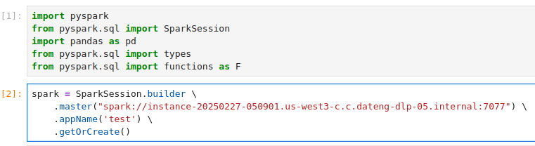
Creating a Local Spark Cluster
Now change the master from local to the created cluster

Slide 6
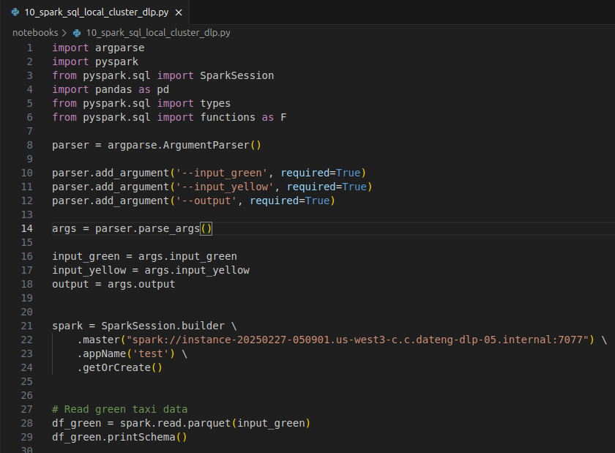
Creating a Local Spark Cluster
A Spark session can now be created but we need to manually create workers in order for the cluster to be able to do anything.
Now the script to obtain the revenue can be run (with input parameters)
./sbin/start-worker.sh <master-spark-URL>

Slide 7
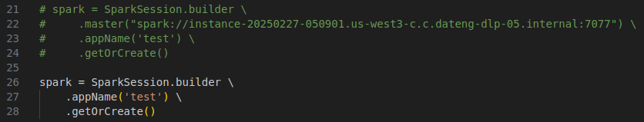
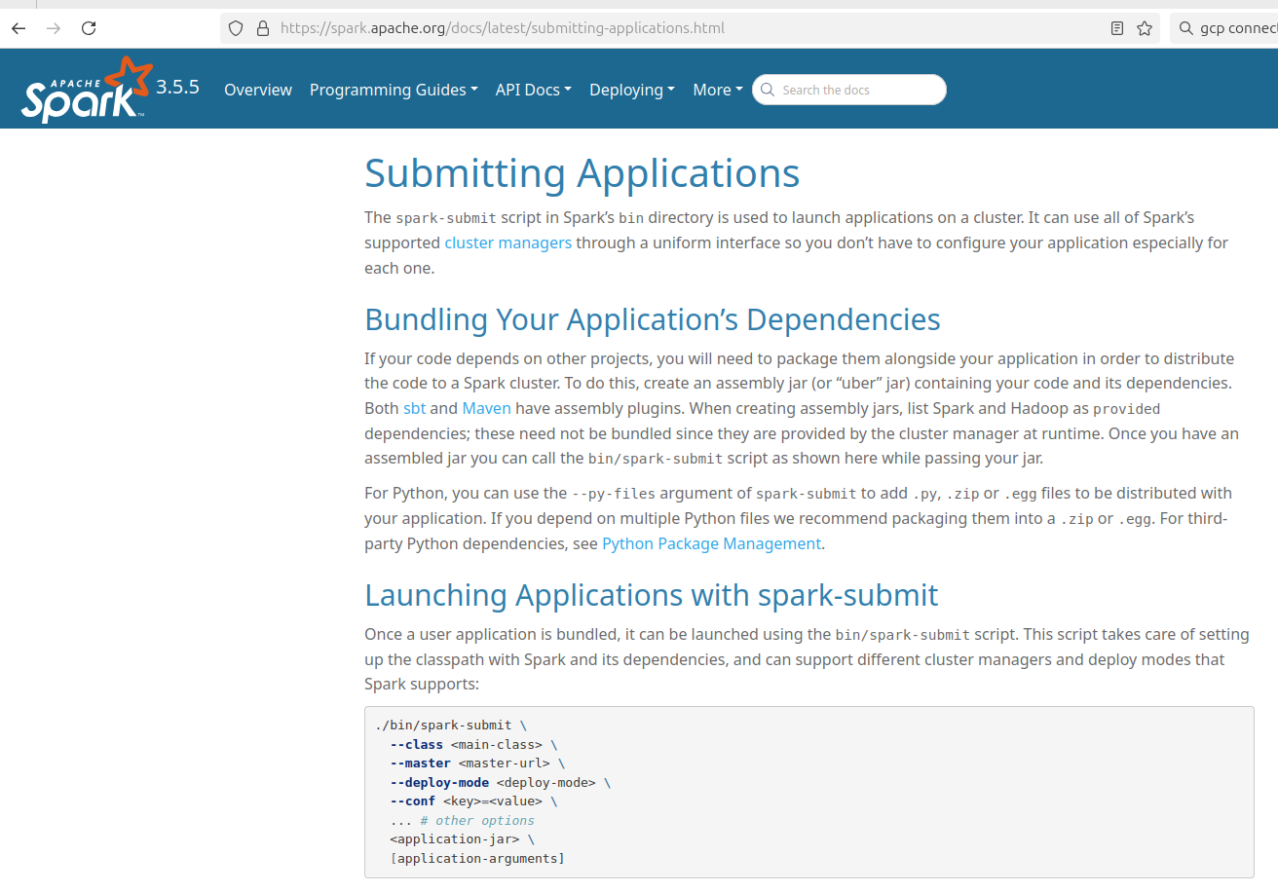
Creating a Local Spark Cluster
However, we don’t want to hard code the Spark master, we want to be able to define the number of executors and other settings.
We use Spark Submit for this!
https://spark.apache.org/docs/latest/submitting-applications.html

Slide 8
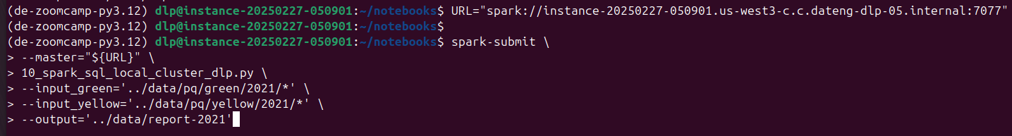
Submitting jobs with spark-submit
URL="spark://instance-20250227-050901.us-west3-c.c.dateng-dlp-05.internal:7077"
spark-submit \
--master="${URL}" \
10_spark_sql_local_cluster_dlp.py \
--input_green='../data/pq/green/2021/*' \
--input_yellow='../data/pq/yellow/2021/*' \
--output='../data/report-2021'

Slide 9
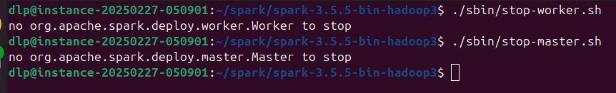
Shutting down the Spark Cluster
Once the Spark job is done, both the workers/executors and the master/cluster must be closed.
Navigate to the folder where Spark was installed

Slide 10
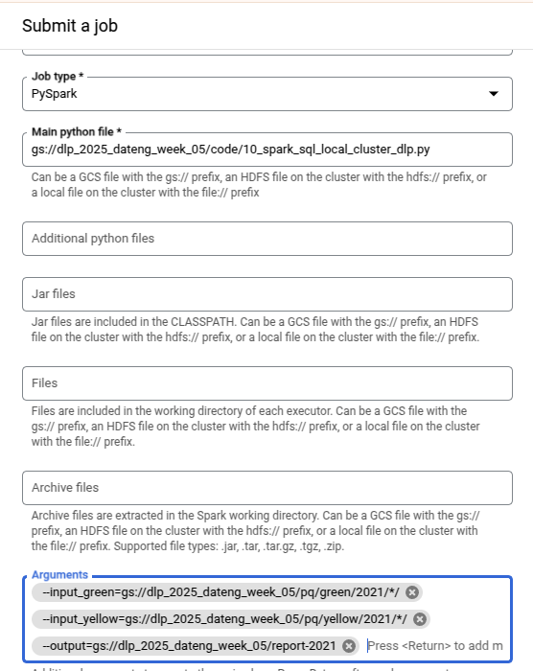
Create Dataproc cluster
Enable API
Add Dataproc Admin role
Create Cluster
Submit Job manually:
  Select Job Type
  Save a python script to a bucket and use this as the main python file:
gsutil cp notebooks/10_spark_sql_local_cluster_dlp.py gs://dlp_2025_dateng_week_05/code/10_spark_sql_local_cluster_dlp.py
  Specify arguments
Copy commands to do it programatically:
  Job→Configuration→Equivalent REST->Copy

Slide 11
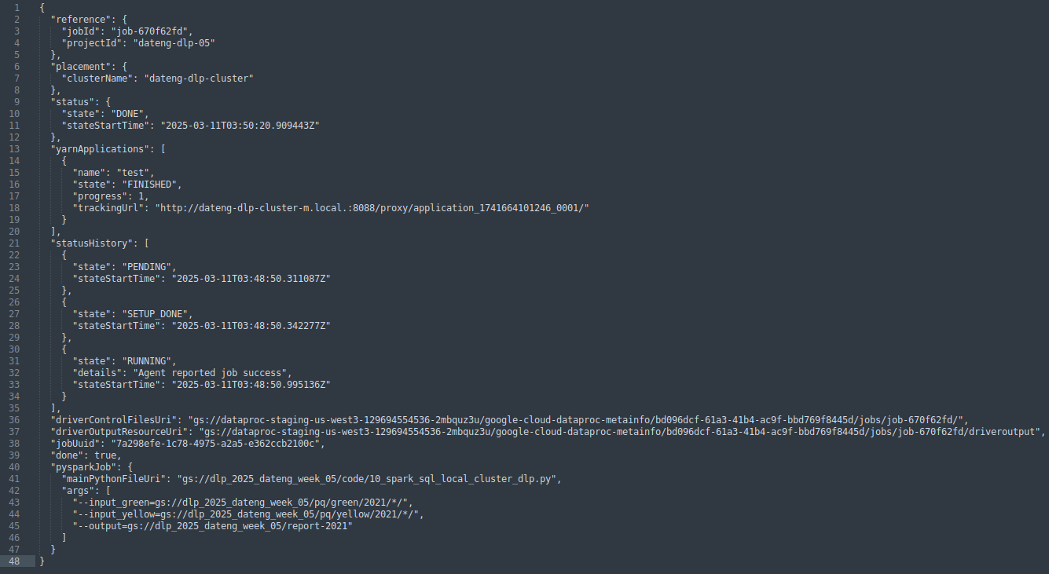
Submitting job to Dataproc cluster
Extract important info from REST API:

Slide 12
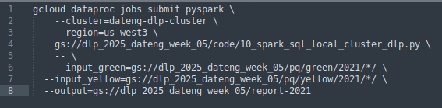
Submitting job to Dataproc cluster
Use Google Cloud SDK to submit Dataproc job
https://cloud.google.com/dataproc/docs/guides/submit-job#dataproc-submit-job-gcloud
Anything after this -- is considered parameters for the script
gcloud dataproc jobs submit pyspark \
--cluster=dateng-dlp-cluster \
--region=us-west3 \
gs://dlp_2025_dateng_week_05/code/10_spark_sql_local_cluster_dlp.py \
-- \
--input_green=gs://dlp_2025_dateng_week_05/pq/green/2021/*/ \
--input_yellow=gs://dlp_2025_dateng_week_05/pq/yellow/2021/*/ \
--output=gs://dlp_2025_dateng_week_05/report-2021

Slide 13
Connecting Spark to Big Query
Create a dataset (same region as bucket and Dataproc cluster)
Submit job:
gcloud dataproc jobs submit pyspark \
--cluster=dateng-dlp-cluster \
--region=us-west3 \
--jars=file:///usr/lib/spark/examples/jars/spark-examples.jar \
gs://dlp_2025_dateng_week_05/code/10_spark_sql_big_query_dlp.py \
-- \
--input_green=gs://dlp_2025_dateng_week_05/pq/green/2020/*/ \
--input_yellow=gs://dlp_2025_dateng_week_05/pq/yellow/2020/*/ \
--output=trips_data_all.reports-2020

