Slide 1
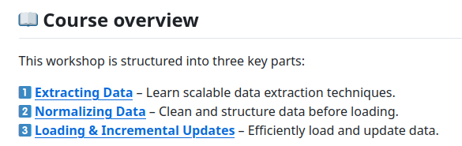
Data ingestion with dlt
Welcome to this hands-on workshop, where you'll learn to build efficient and scalable data ingestion pipelines.
What will you learn in this workshop?
In this workshop, you’ll learn the core skills required to build and manage data pipelines:
How to build robust, scalable, and self-maintaining pipelines.
Best practices, like built-in data governance, for ensuring clean and reliable data flows.
Incremental loading techniques to refresh data quickly and cost-effectively.
How to build a Data Lake with dlt.
By the end of this workshop, you'll be able to build data pipelines like a senior data engineer — quickly, concisely, and with best practices baked in.

Slide 2
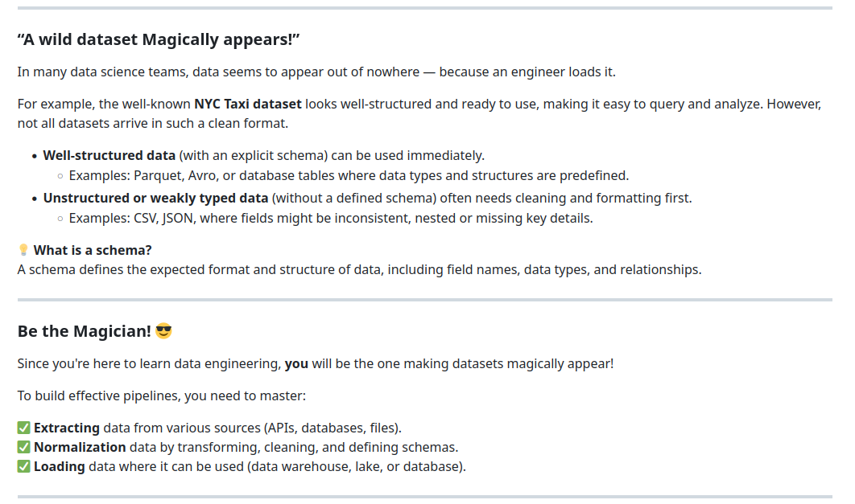

Slide 3
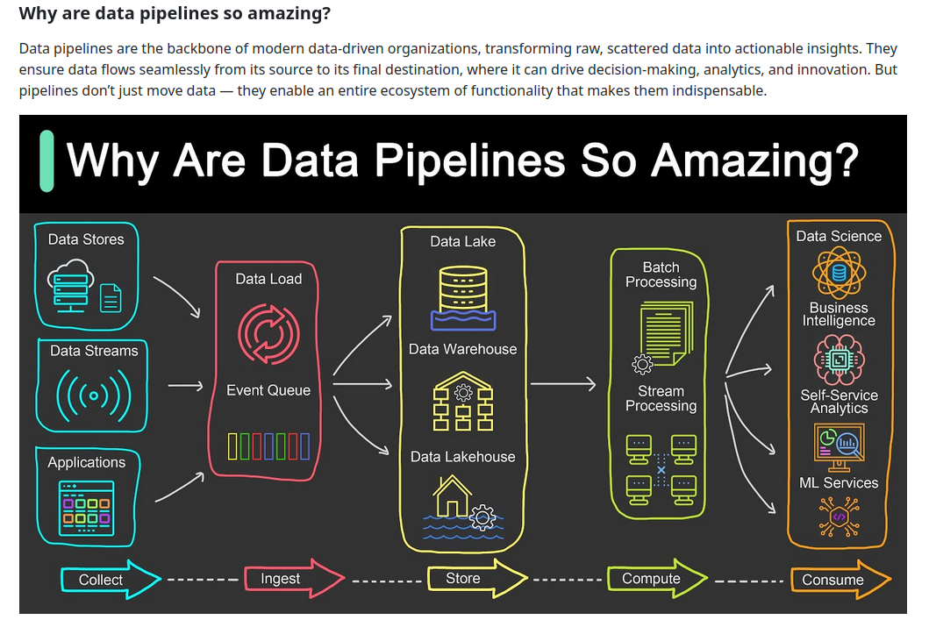

Slide 4
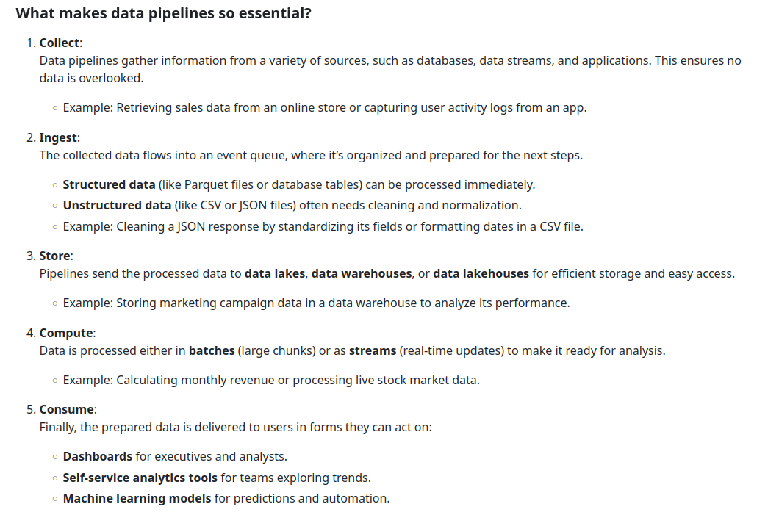

Slide 5
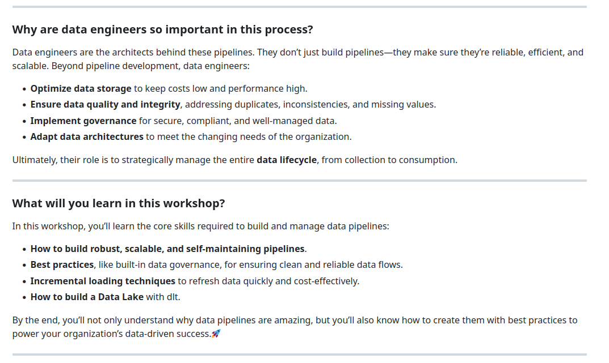

Slide 6
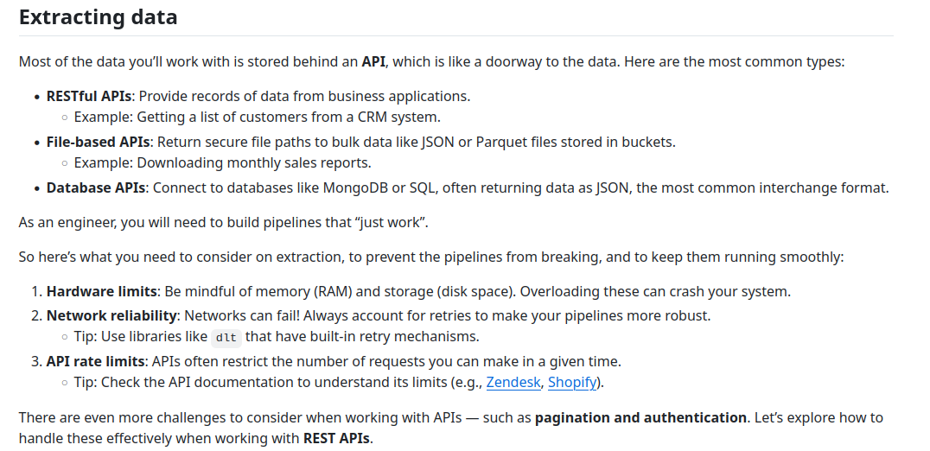
A customer relationship management (CRM) system helps manage customer data. It supports sales management, delivers actionable insights, integrates with social media, and facilitates team communication.

Slide 7
