Slide 1
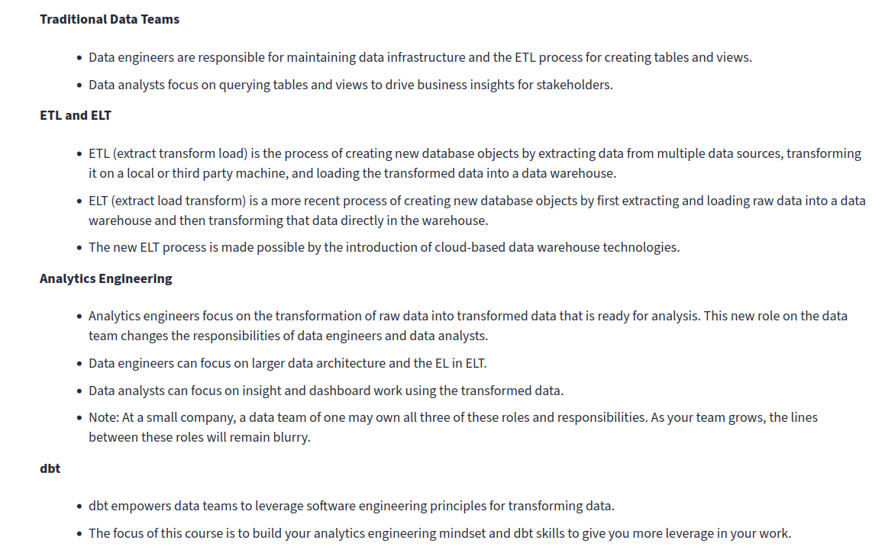
Analytics Engineering

Slide 2
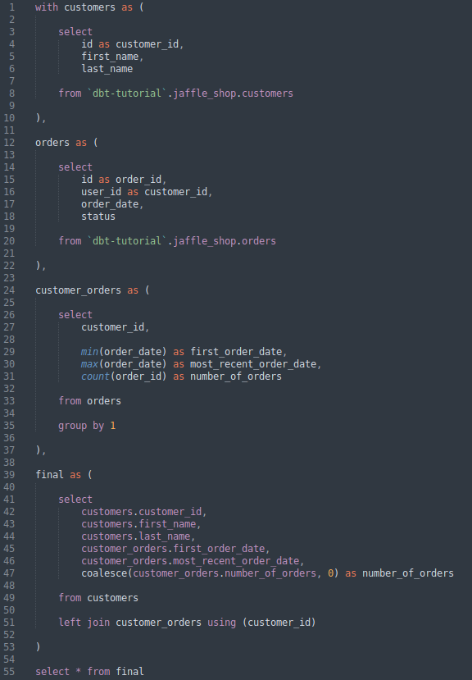
dbt Models
A model in dbt is a query. Queries can become complex and be inter-dependent, for example the one depicted to the right.
Here, we find CTEs. A Common Table Expression (CTE), is a temporary result set that can be used in a SQL query. You can use CTEs to break up complex queries into simpler blocks of code that can connect and build on each other. In a less formal, more human-sense, you can think of a CTE as a separate, smaller query within the larger query you’re building up. Creating a CTE is essentially like making a temporary view that you can access throughout the rest of the query you are writing.

Slide 3
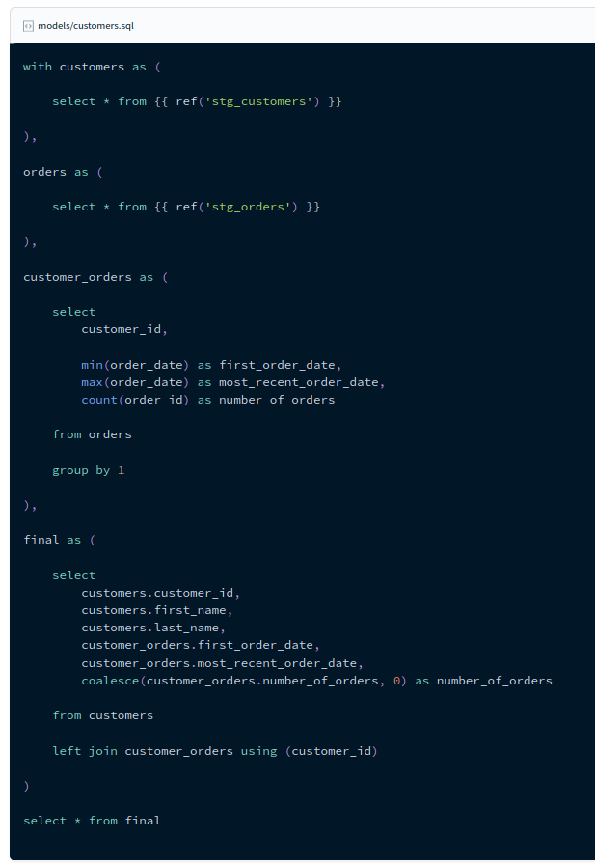
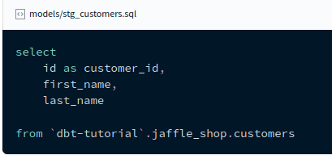
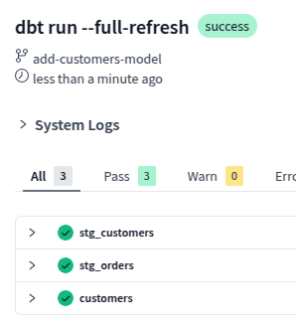
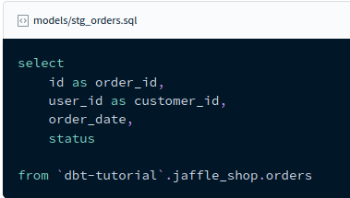
Modularity and the Ref Function
Instead of having one big model with several CTEs, we break the Query/Model down into several queries/models which can still be inter-dependent:

Slide 4
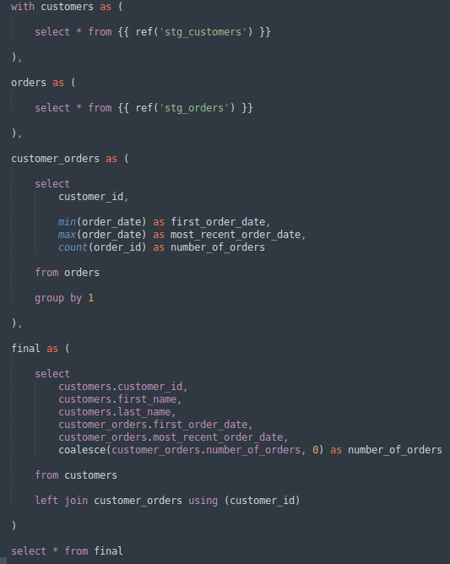
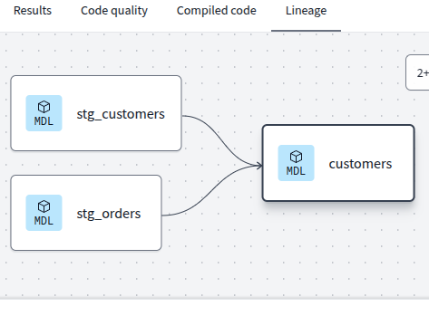
Modularity and the Ref Function
CTE
The model putting everything together (customers.sql) uses the ref function from dbt to create the CTEs
The ref function allows to pull information from a model that has already been materialized in our Warehouse (BigQuery)
CTE
CTE
CTE

Slide 5
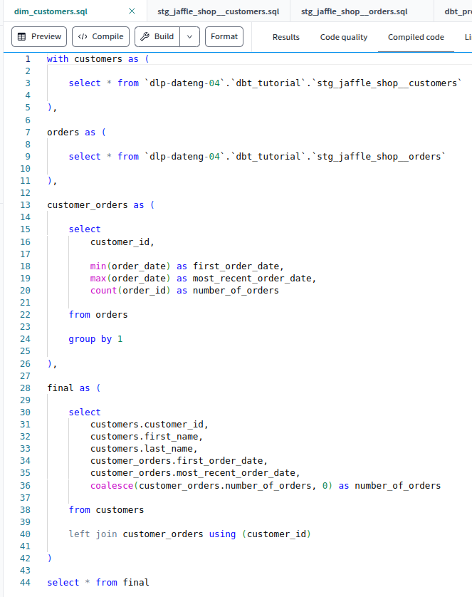
Modularity and the Ref Function
The advantage of using the ref function instead of raw SQL code, is that it constructs the queries based on the environmental variables from each user, so sharing the dbt Models with other users becomes easier.
It can be thought of as working with relative file paths instead of absolute filepaths.
To see what the ref function actually translates to in SQL, we can use the compile button in the cloud IDE:
This paths are constructed by the ref function based on the dbt user’s environmental variables, hence making the code easily shareable between users.
In summary: the path to the source data is absolute but the path to the models needed for a given analysis are relative to the user’s environment.

