Slide 1
ETL Pipelines in Kestra: Google Cloud Platform
Now that you've learned how to build ETL pipelines locally using Postgres, we are ready to move to the cloud. In this section, we'll load the same Yellow and Green Taxi data to Google Cloud Platform (GCP) using:
Google Cloud Storage (GCS) as a data lake
BigQuery as a data warehouse.

Slide 2
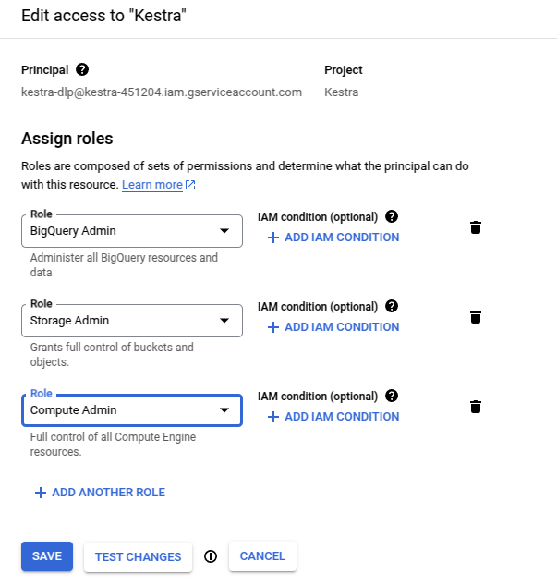
ETL Pipelines in Kestra: Google Cloud Platform
Create GCS service account

Slide 3
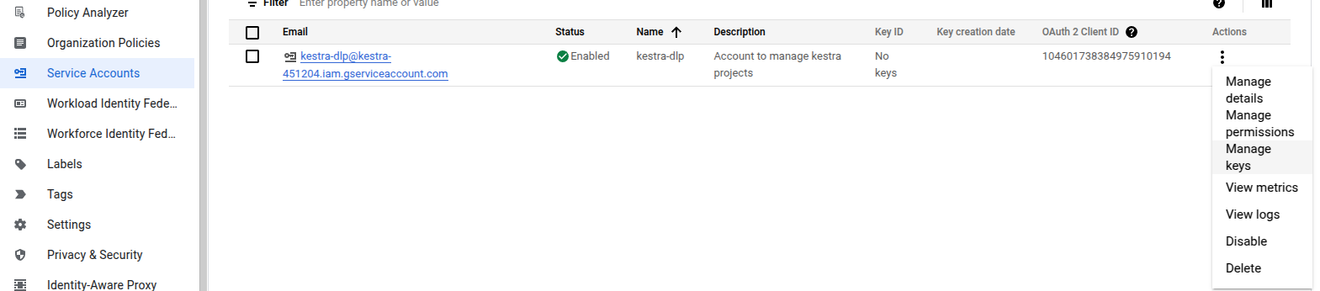
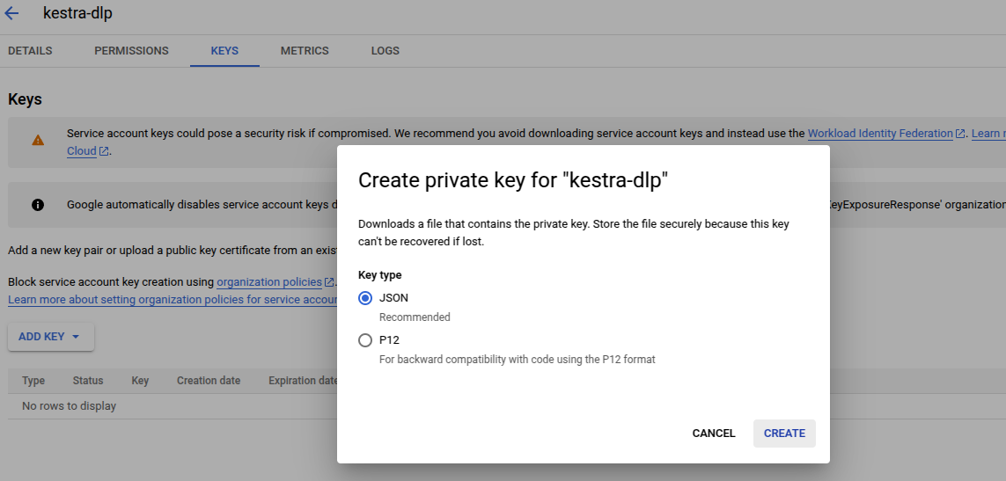
ETL Pipelines in Kestra: Google Cloud Platform
Generate Service Account Key

Slide 4
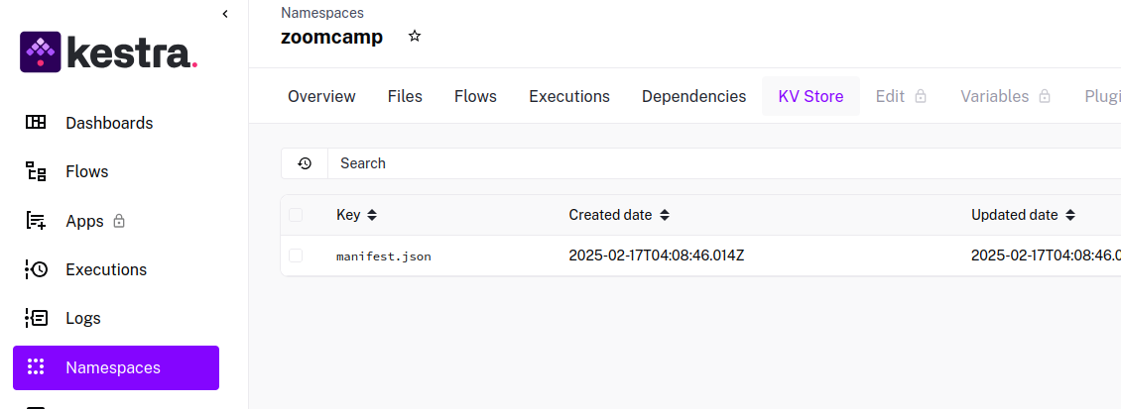
ETL Pipelines in Kestra: Google Cloud Platform
Setup GCP infrastructure with kestra flow
Create Project and service account on GCP
Generate JSON key
Use Key-Value store from Kestra (similar to python Dictionary), it sets environment variables for the flows.
Copy the JSON key to KV Store

Slide 5
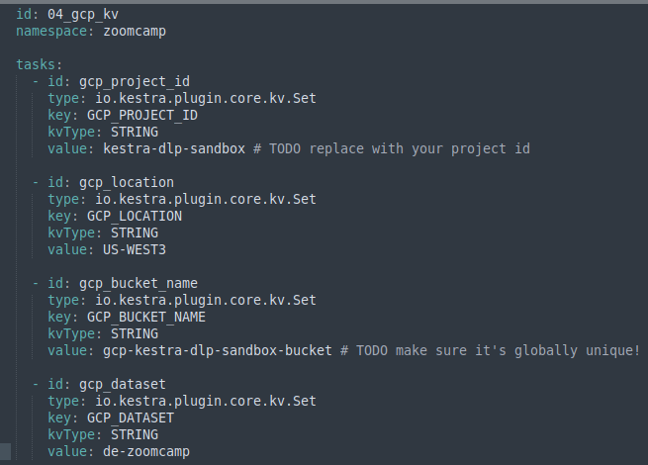
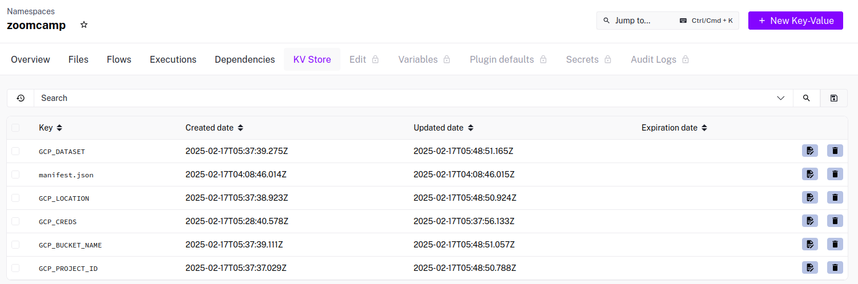
ETL Pipelines in Kestra: Google Cloud Platform
Add additional key:values to the KV Store using the following flow:

Slide 6
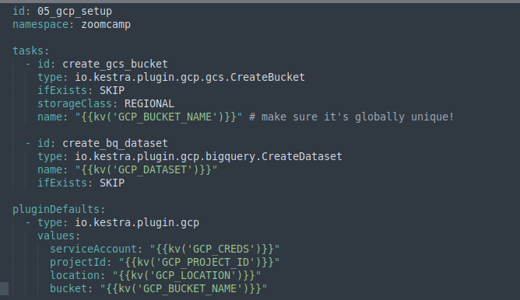
ETL Pipelines in Kestra: Google Cloud Platform
Create the resources in GCS with this flow:

Slide 7
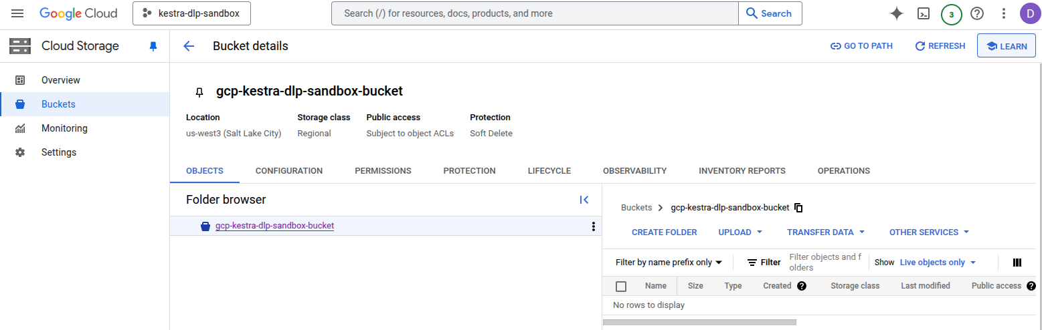
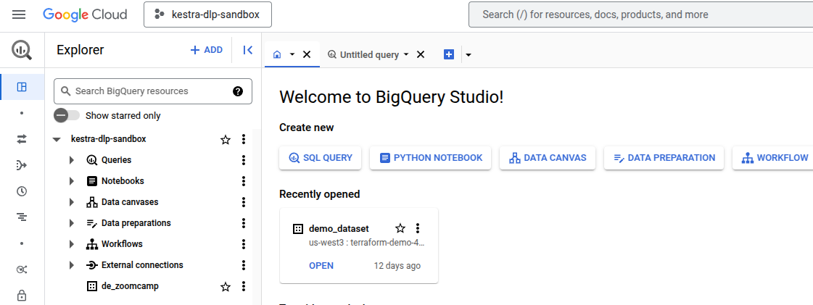
ETL Pipelines in Kestra: Google Cloud Platform
Verify that the bucket and database have been created:

Slide 8
ETL Pipelines in Kestra: Google Cloud Platform
Google Cloud Storage is normally used to store objects (unstructured data like pdfs, images, etc.)
BigQuery is a Data Warehouse (i.e. structured data)
So the idea is to use a data lake (GCS Bucket) to store an object (the original source data, i.e. the csv file), and then we’ll pass that data to the DataWarehouse(BigQuery) to process the data.
The Kestra Flows Topology is presented in the following slides

Slide 9
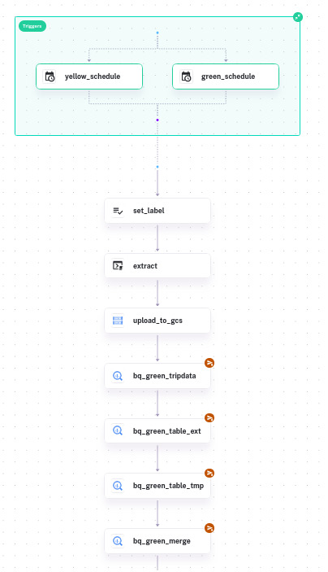
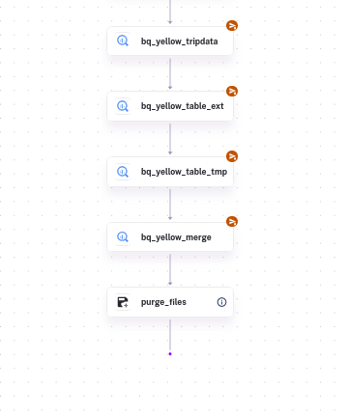

Slide 10
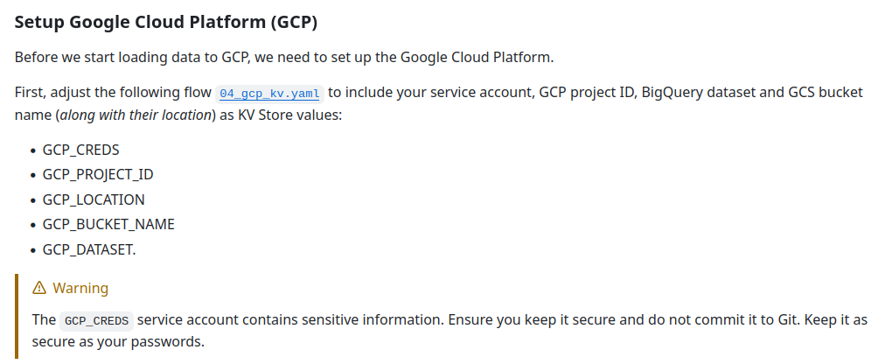

Slide 11
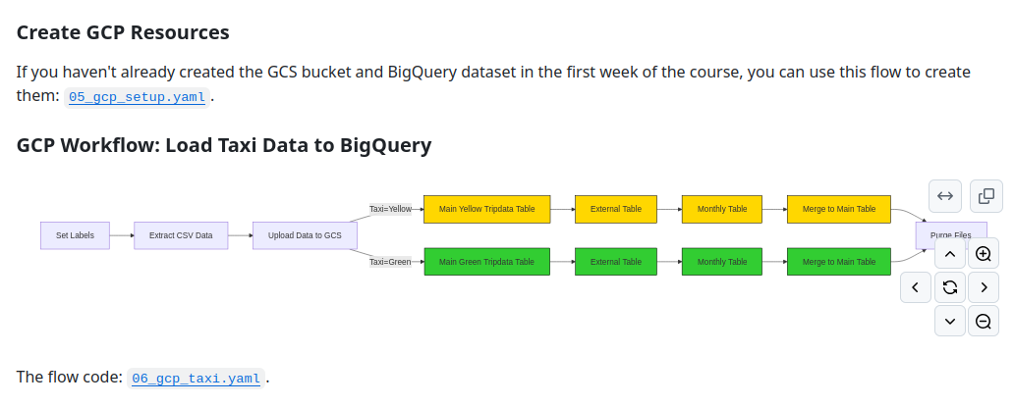

Slide 12
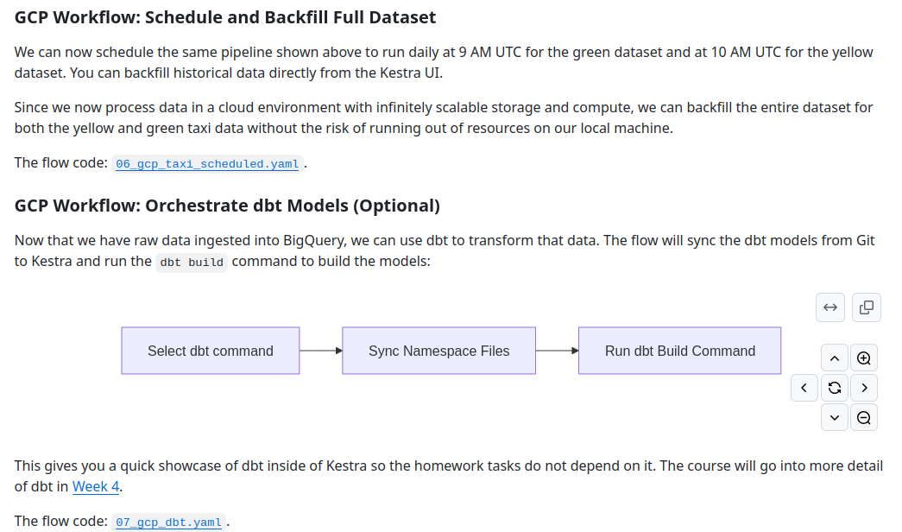

Slide 13
