Slide 1
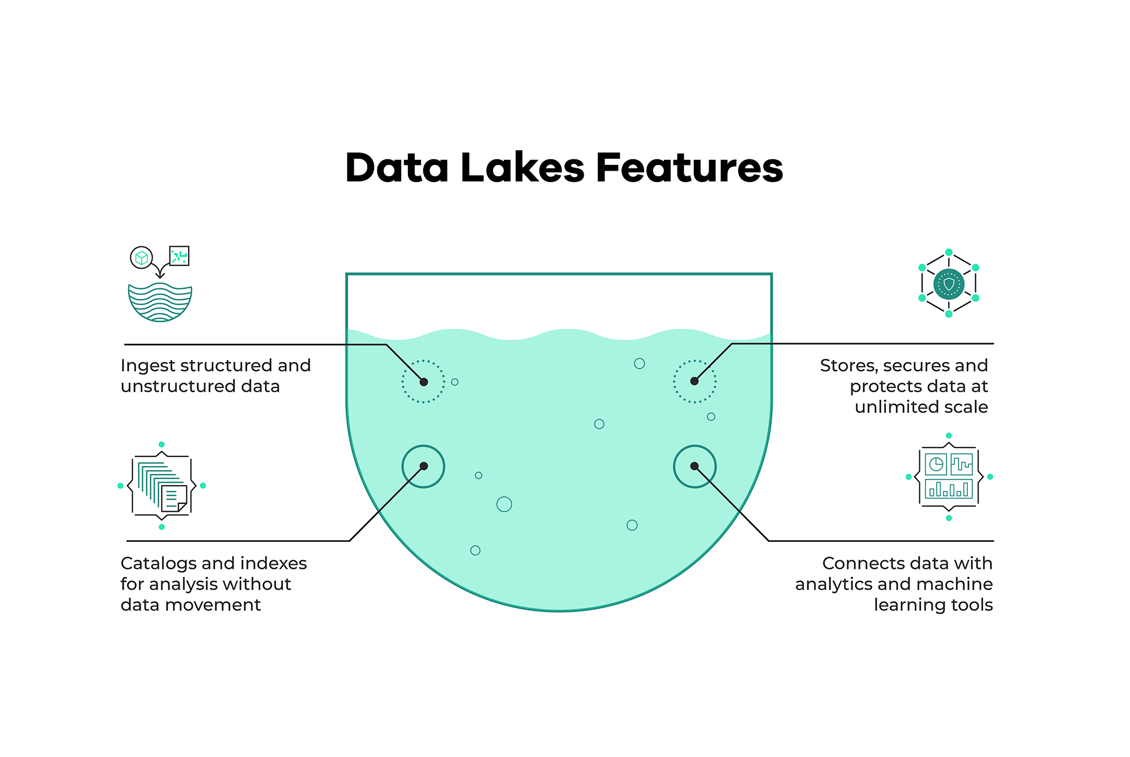
Data Lake
What is a Data Lake?
Data Lake vs Data warehouse
Gotcha of Data Lake
ETL vs ELT
Cloud provider Data Lake

Slide 2
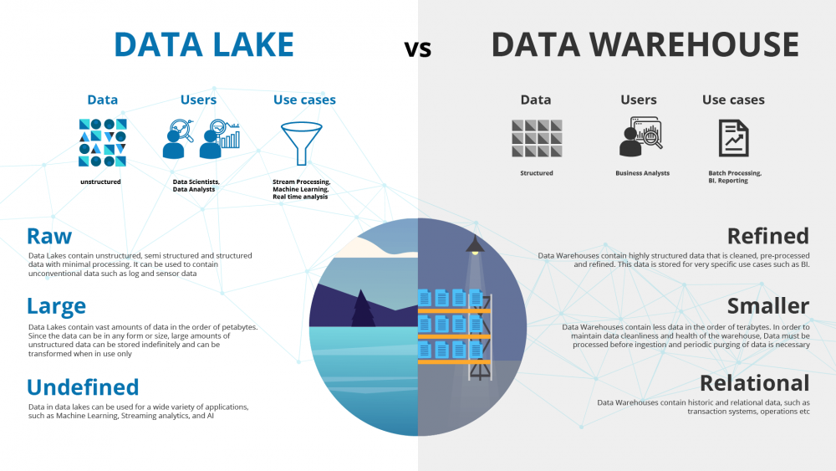

Slide 3
How did it start?
Companies realized the value of data
Store and access data quickly
Cannot always define structure of data
Usefulness of data being realized later in the project lifecycle
Increase in data scientists
R&D on data products
Need for Cheap storage of Big data

Slide 4
ETL vs ELT
ETL(Extract Transform and Load):
Mainly used for Data Warehouses, where data is structured, smaller in size and the users are usually data analysts and data scientists
ELT (Extract Load and Transform)
Mainly used for Data Lakes, where data is structured or unstructured and larger in size
ELT provides data lake support (Schema on read)
Disadvantages of Data Lakes
Could turn into a Data Swamp because of the
Lack of versioning
Incompatible schemas for same data (e.g. data in CSV, avro or parquet)
No metadata associated
Joins are not possible

Slide 5
Cloud provider solutions for data lake
GCP – Google Cloud Storage (Buckets)
AWS - S3
AZURE - AZURE BLOB

Slide 6
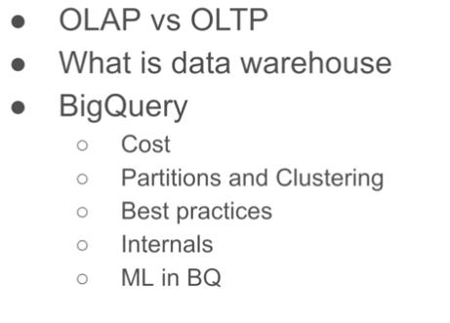
Data Warehouse

Slide 7
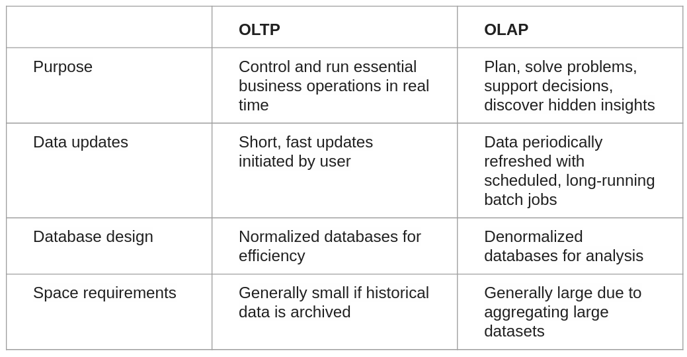
Data Warehouse
OLTP: Online Transaction Processing
OLTP is used for backend databases, where we want to group SQL queries together.
OLAP: Online Analytical Processing
OLAP is used for putting a lot of data in and discovering insights in the data(used by data analysts or data scientists).

Slide 8
 | OLTP | OLAP
Backup and recovery | Regular backups required to ensure business continuity and meet legal and governance requirements | Lost data can be reloaded from OLTP database as needed in lieu of regular backups
Productivity | Increases productivity of end users | Increases productivity of business managers, data analysts, and executives
Data view | Lists day-to-day business transactions | Multi-dimensional view of enterprise data
User examples | Customer-facing personnel, clerks, online shoppers | Knowledge workers such as data analysts, business analysts, and executives

Slide 9
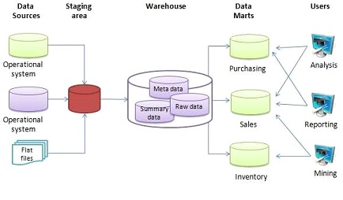
What is a data warehouse
OLAP solution
Used for reporting and data analysis

Slide 10
Data Partitioning and Clustering
Data can be partitioned (e.g. by date) to decrease the size of the processed data for each query
Clustering the data (e.g. by VendorID) reduces even more the amount of processed data needed for each query.
This is important because BigQuery charges by the amount of data processed:
On demand pricing
  1 TB of data processed is $5
Flat rate pricing
  Based on number of pre requested slots
  100 slots → $2,000/month = 400 TB data processed on demand pricing

Slide 11
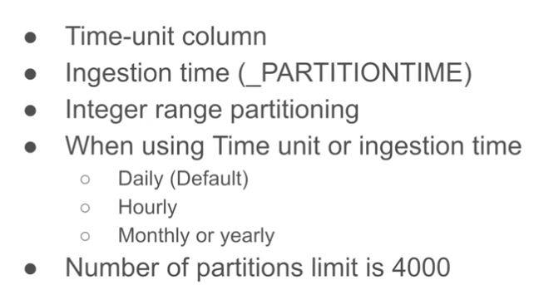
Partitioning Data
How to partition data?
  Partitions should be of equivalent size
  Good suggested partitioning criteria:

Slide 12
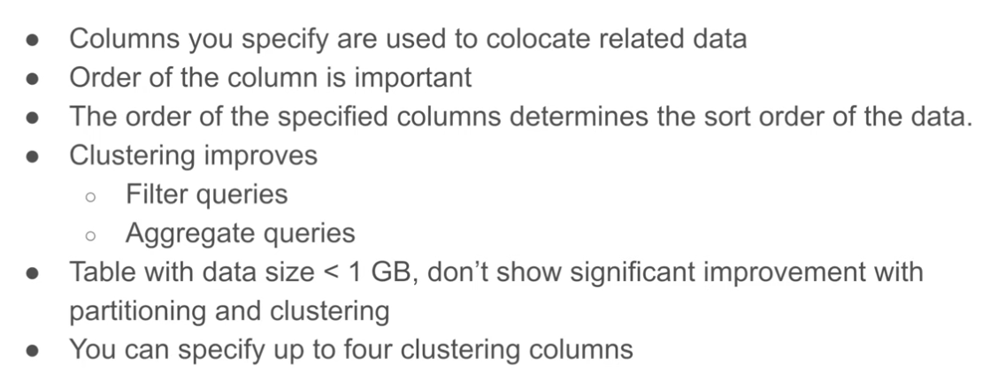
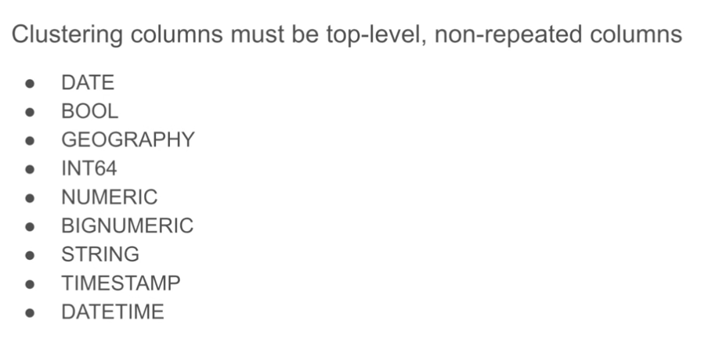
Clustering Data
How to cluster data?
  Max of four(4) columns

Slide 13
Partitioning vs Clustering
Clustering | Partitoning
Cost benefit unknown | Cost known upfront
You need more granularity than partitioning alone allows | You need partition-level management.
Your queries commonly use filters or aggregation against multiple particular columns | Filter or aggregate on single column
The cardinality of the number of values in a column or group of columns is large

Slide 14
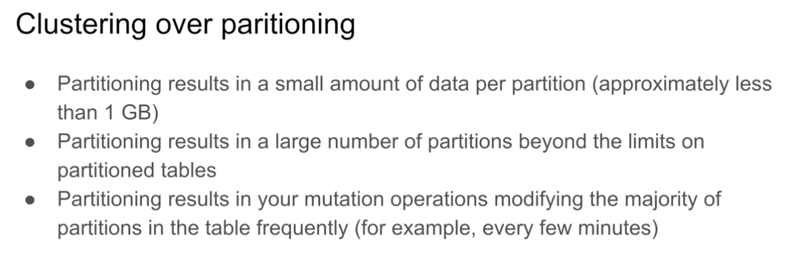
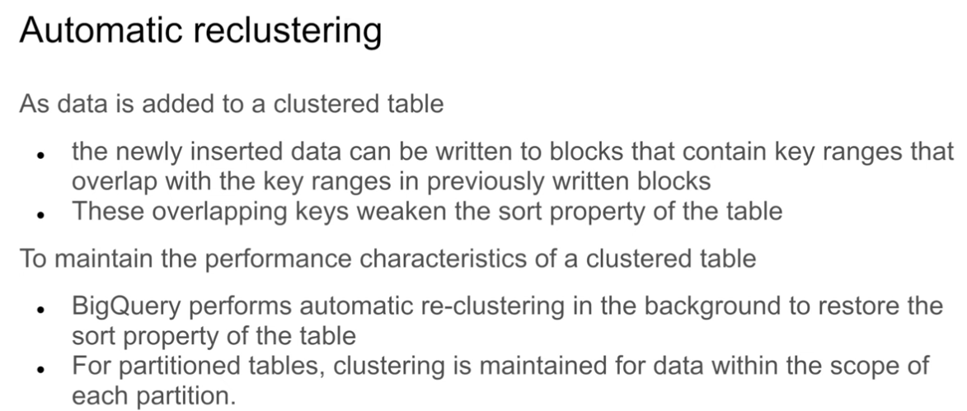

Slide 15
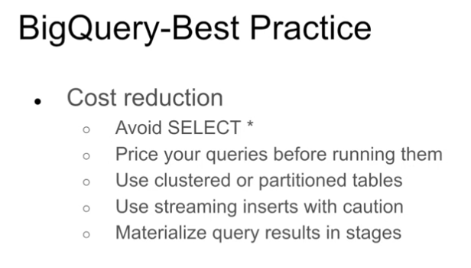
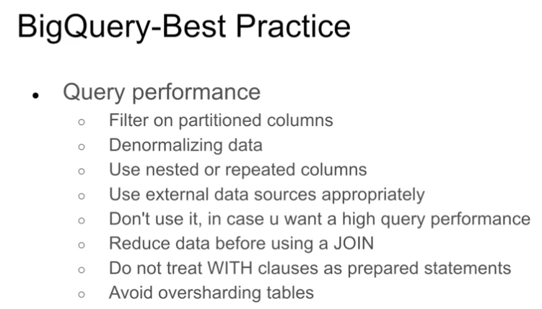
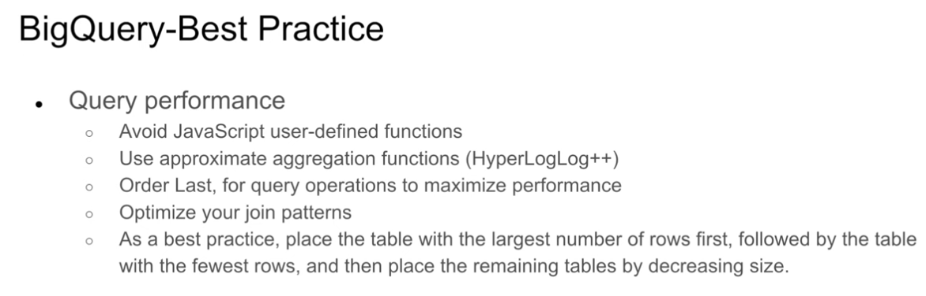

Slide 16
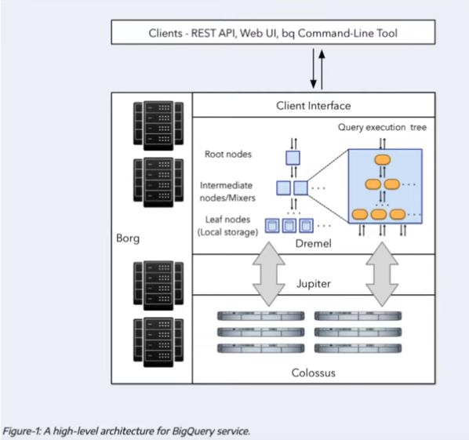
Internals of Big Query
Big Query separates the Storage (Colossus) from the Compute resources, which reduces the cost(e.g. adding more data only incurs in additional costs for Colossus and not Compute).
However, having Storage and Compute in different Hardware means that the communication between them can have a lag.
This lag is resolved by BigQuery using the Jupyter network, which can transmit/receive 1TB per second.
Dremel is the query execution engine, which divides queries into a tree structure so that each node can execute an indivudual subset of the query.

Slide 17
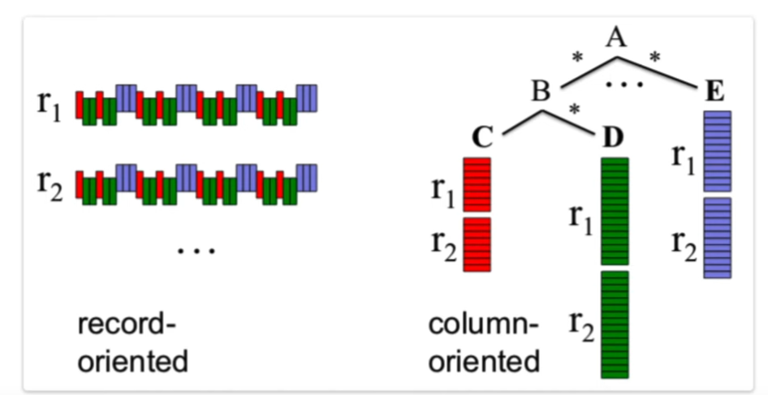
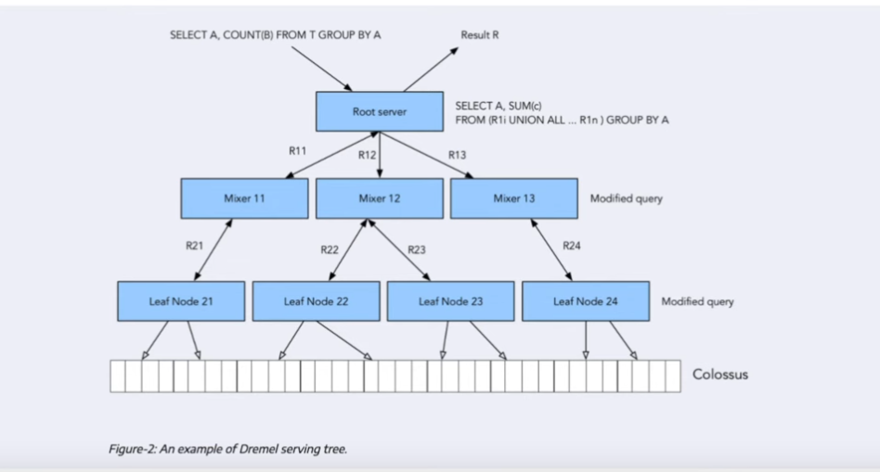
Column and Record oriented storage
Record Oriented (e.g. CSV)
Column Oriented
  Used by BigQuery
  Helps with aggregation of columns

