Slide 1






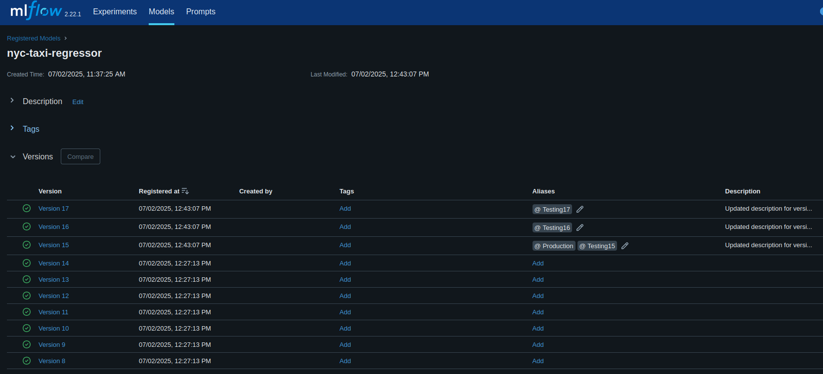


Tracking Server
Artifact Storage
NYC -TAXI-DATA
Data Partitioning
Train-set: Jan-2021
Validation-set: Feb-2021
Test-set: March-2021
Data Transformation
One-hot encoding
Standard Scaler
mlflow database
Experiment Tracking
Setup mlflow backend-store / tracking server
Log parameters
Log models
Train Regressors
Predict trip duration
1. Model Registry
Search runs in an experiment and show each run's performance
Register a model
Change a registered model's Tags and description
2. Retrieve a model and other artifacts
3. Test retrieved models
Compare each registered model's size, training time, run time and performance on the test-set
4. Elevate a model to Production status (i.e. set Production Tags)

Slide 3



Fetch artifacts and model from mlflow registry
Ride
details
Web Service
User
Data Pre-Processing
Tracking Server
Taxi ride duration prediction
Duration
Prediction
Artifact Storage
mlflow database
Port 9696
Port 9696

