Slide 1
Array: Types and Applications

Slide 2
What is AN Array ?
SO far you already know
An array is a group of elements with same name and data type.
Simple variable is a single memory location with unique name and a type. But an Array is collection of different adjacent memory locations.
The memory locations in the array are known as elements of array. The total number of elements in the array is called length.
The elements of array is referred to its position in array, that is call index or subscript.

Slide 3
Advantages / Uses of Arrays
Easy Access: Arrays can store a large number of value with single name.
Fast Access: Arrays are used to process many value easily and quickly.
Quick Processing:
The values stored in an array can be sorted easily.
The search process can be applied on arrays easily.

Slide 4
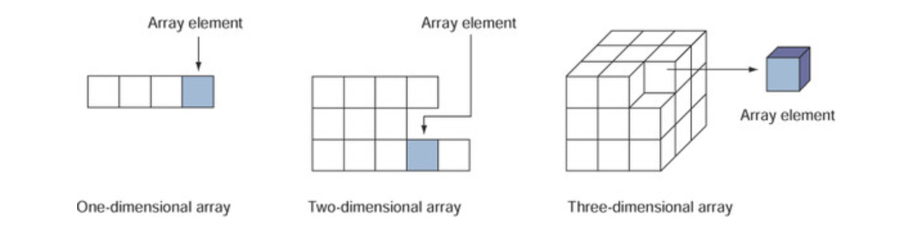
Types of Arrays:
One-Dimensional Array (1-D Array)
Two-Dimensional Array (2-D Array)
Multi-Dimensional Array (Multi-D Array)

Slide 5
One-D Array
A type of array in which all elements are arranged in the form of a list is known as 1-D array or single dimensional array or linear list.
It has a single row or column of variable.
It can be used to represent list of data items e.g. Vector.
Generally X[i] is used to refer to its ith element of the array.
e.g: int marks[5];

Slide 6
One-D array Intialization
The process of assigning values to array elements at the time of array declaration is called array initialization.
Syntax:
data_type identifier[length]={ List of values };
Individual Element:
Array_name[index];
Using Loop:
int marks[10];
for(int i=0;i<=9;i++) marks[i]=i;
Data _type:
Identifier:
Length:
Data type of values.
Name of the array.
Number of elements
o List of values: Values to initialize the array.

Slide 7
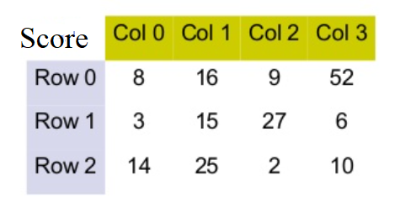
Two-D Arrays
Two-D array has two columns of values can be described as rows and columns.
Each element in 2-D array is refered with the help of two indexes.
Can be referred as matrix or table
Declaring 2-D Array:
Data _type:
Identifier:
Rows :
Column :
Data type of values
Name of the array.
# of Rows in the table of array.
# of Columns in the table of array

Slide 8
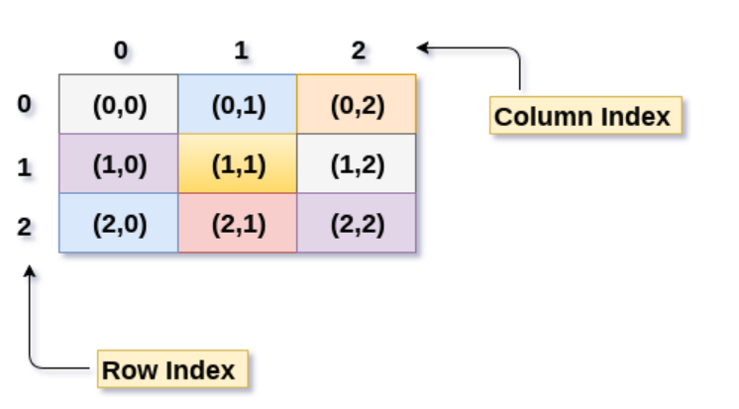
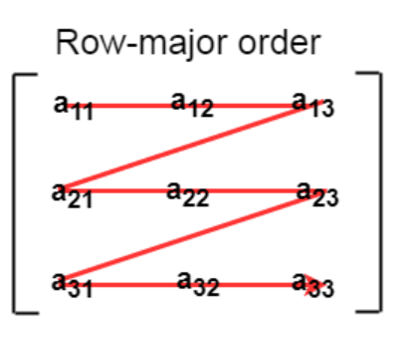
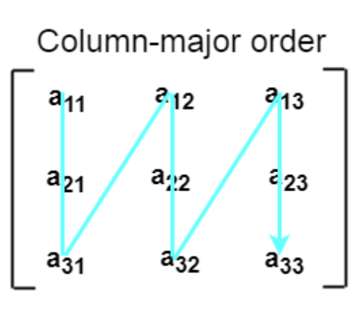
Mapping of array elements
Row Major Ordering
Column Major Ordering

Slide 9
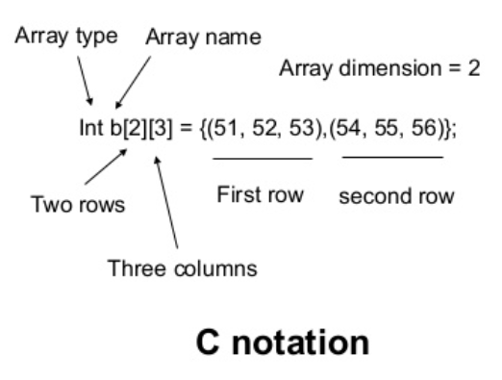
Two-D array Intialization
The elements of each row are enclosed within braces and seperated by comma.
All rows are enclosed within braces.
For number arrays, if all elements are not specified , the un specified elements are initialized by zero.

Slide 10
Two-D array Intialization
Syntax:
data_type identifier[row][column]={ List of values };
Row indexes
Total no. of elements
Row X column
0
1
2
Column
0
12 | 5 | 22
95 |  | 41
77 | 6 | 53
84 | 59 | 62
If int a[2][3] = {1,2,3,4}; the values are assigned from the left end to a[0][0], a[0][1], a[0][2], a[1][0] according to the order of storage representation. All other elements are initialised to 0.
1
2
3
Syntax:
int arr[3][3] = { {12,5,22}, {95,3,41}, {77,6,53}}

Slide 11
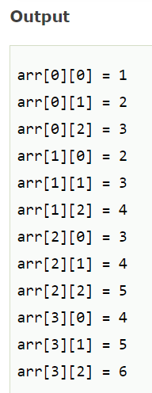
implementation
#include<stdio.h>
int main(){
int i=0,j=0;
int arr[4][3]={{1,2,3},{2,3,4},{3,4,5},{4,5,6}};
//traversing 2d array
for(i=0;i<4;i++){
for(j=0;j<3;j++){
printf("arr[%d] [%d] = %d \n",i,j,arr[i][j]);
}//end of j
}//end of i
return 0;
}

Slide 12
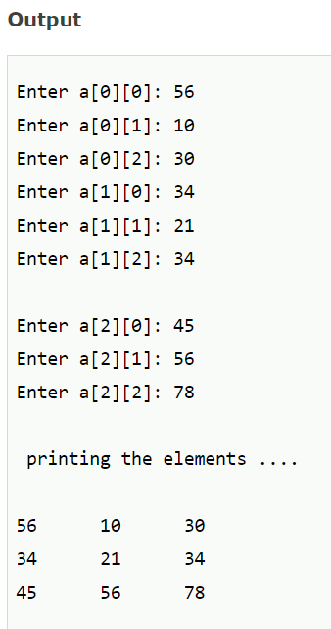
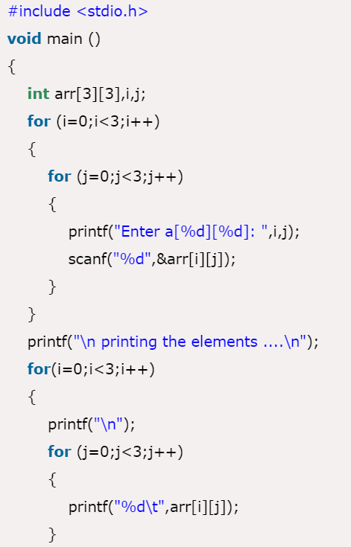

Slide 13
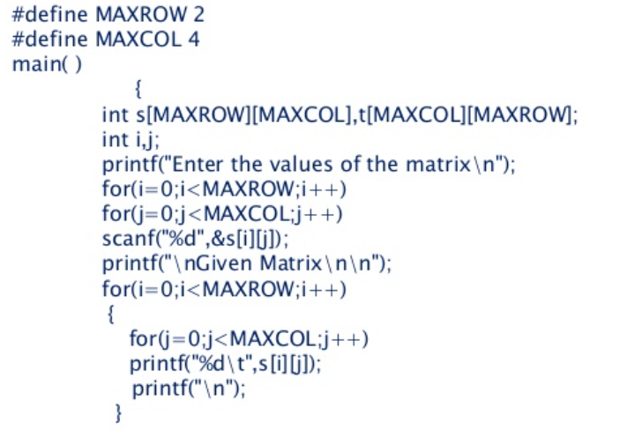
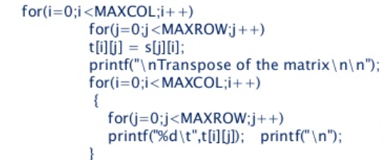
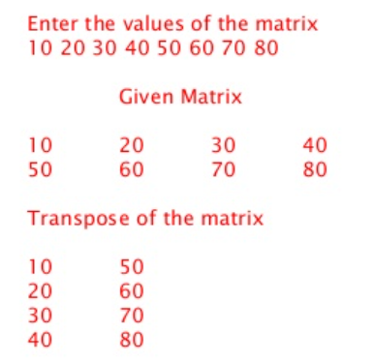
What will be the output?

Slide 14
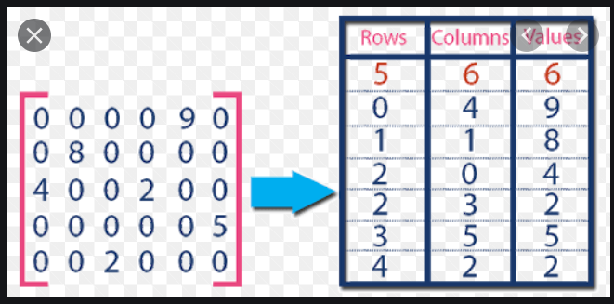
Sparse matrix
Sparse matrix is a matrix which contains very few non-zero elements. When a sparse matrix is represented with a 2-dimensional array, we waste a lot of space to represent that matrix. For example, consider a matrix of size 100 X 100 containing only 10 non-zero elements.

Slide 15
Sparse matrix
Why to use Sparse Matrix instead of simple matrix ?
Storage: There are lesser non-zero elements than zeros and thus lesser memory can be used to store only those elements.
Computing time: Computing time can be saved by logically designing a data structure traversing only non-zero elements..

Slide 16
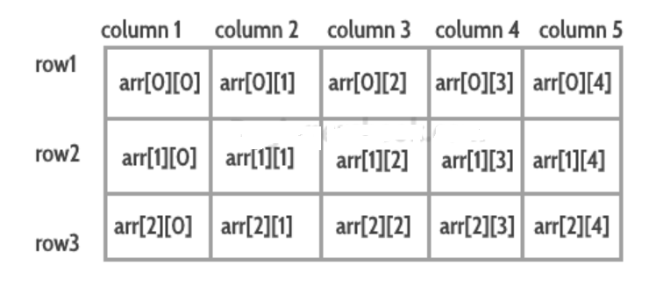
MULTI-D Arrays
Multidimensional arrays are also known as array of arrays. The data in multidimensional array is stored in a tabular form as shown in the diagram below:

Slide 17
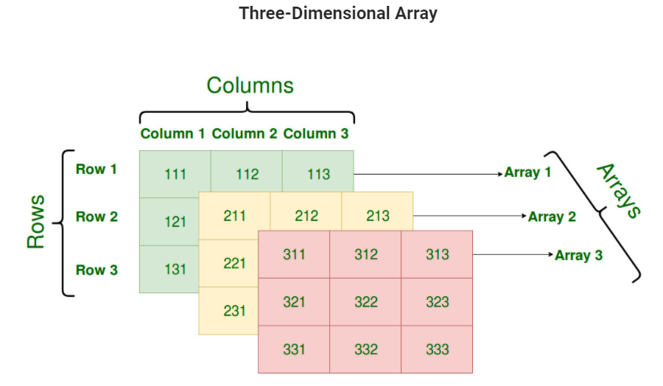

Slide 18
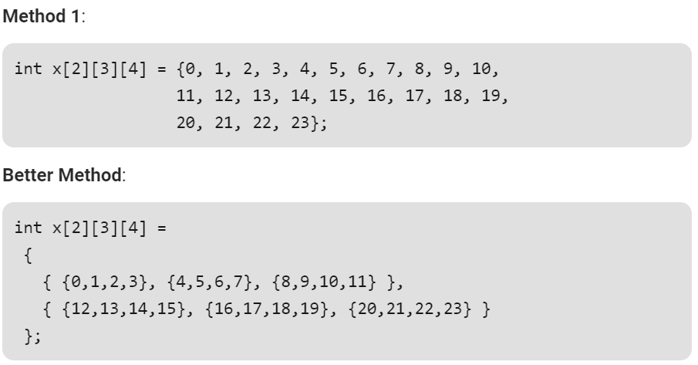

Slide 19
