Slide 1
Tree

Slide 2
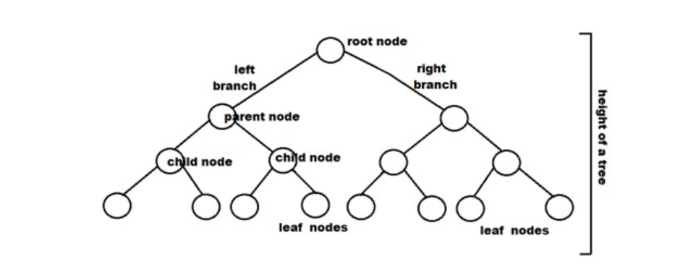
A binary tree is a tree-type non-linear data structure with a maximum of two children for each parent. Every node in a binary tree has a left and right reference along with the data element. The node at the top of the hierarchy of a tree is called the root node. The nodes that hold other sub-nodes are the parent nodes.

Slide 3
Types of Binary Trees
1. Full Binary Tree
2. Complete Binary Tree
3. Perfect Binary Tree
4. Balanced Binary Tree
5. Degenerate Binary Tree

Slide 4
Types of Binary Trees
1. Full Binary Tree
2. Complete Binary Tree
3. Perfect Binary Tree
4. Balanced Binary Tree
5. Degenerate Binary Tree

Slide 5
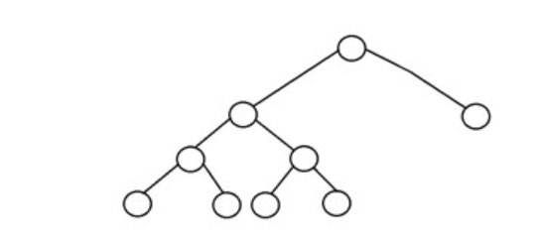
Types of Binary Trees
1. Full Binary Tree
2. Complete Binary Tree
3. Perfect Binary Tree
4. Balanced Binary Tree
5. Degenerate Binary Tree

Slide 6
Types of Binary Trees
1. Full Binary Tree
[Number of Leaf nodes = Number of Internal nodes + 1]
every node except the external node has two children

Slide 7
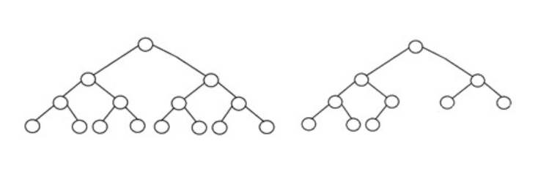
Types of Binary Trees
1. Full Binary Tree
2. Complete Binary Tree
all the tree levels are filled entirely with nodes, except the lowest level of the tree ( every node should possibly reside on the left side.)
[Binary Heap is an important use case of Complete Binary tree.]

Slide 8
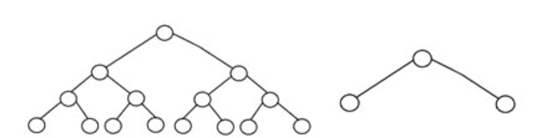
Types of Binary Trees
1. Full Binary Tree
2. Complete Binary Tree
3. Perfect Binary Tree
all the internal nodes have strictly two children, and every external or leaf node is at the same level or same depth within a tree.
[Total number of nodes in a Perfect Binary Tree with height H is 2^H — 1.]

Slide 9
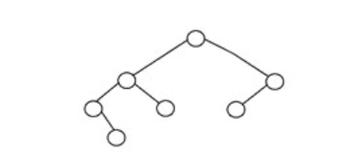
Types of Binary Trees
1. Full Binary Tree
2. Complete Binary Tree
3. Perfect Binary Tree
4. Balanced Binary Tree
In a balanced binary tree, the height of the left and the right subtrees of each node should vary by at most one.
[AVL Tree and Red-Black Tree are well-known data structure to generate/maintain Balanced Binary Search Tree. Search, insert and delete operations cost O(log n) time in that.]

Slide 10
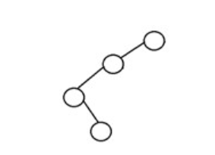
Types of Binary Trees
1. Full Binary Tree
2. Complete Binary Tree
3. Perfect Binary Tree
4. Balanced Binary Tree
5. Degenerate Binary Tree
A binary tree is said to be a degenerate binary tree or pathological binary tree if every internal node has only a single child.
[Height of a Degenerate Binary Tree is equal to Total number of nodes in that tree.]

Slide 11
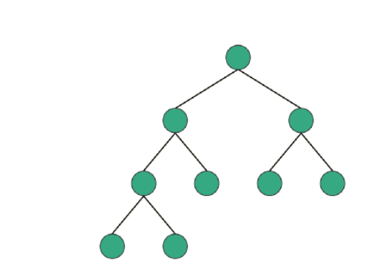
Types of Binary Trees
1. Full Binary Tree
2. Complete Binary Tree
3. Perfect Binary Tree
4. Balanced Binary Tree
5. Degenerate Binary Tree

Slide 12
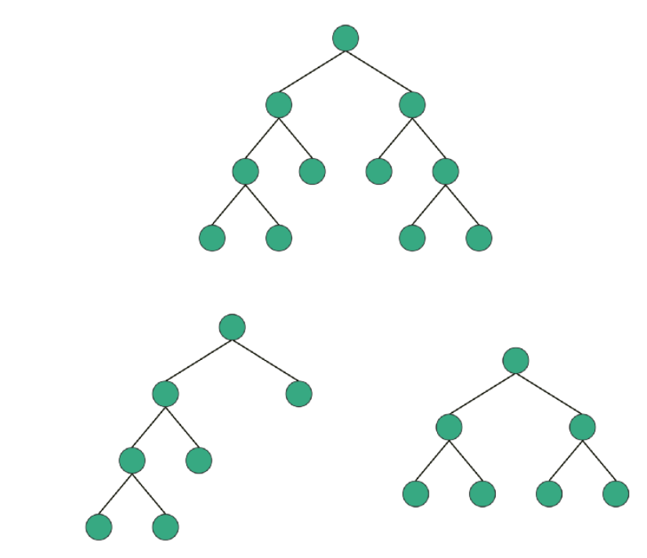
full

Slide 13
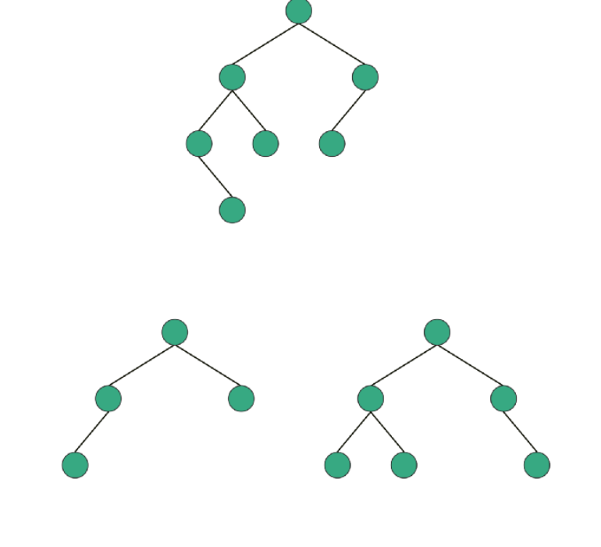
balanced

Slide 14
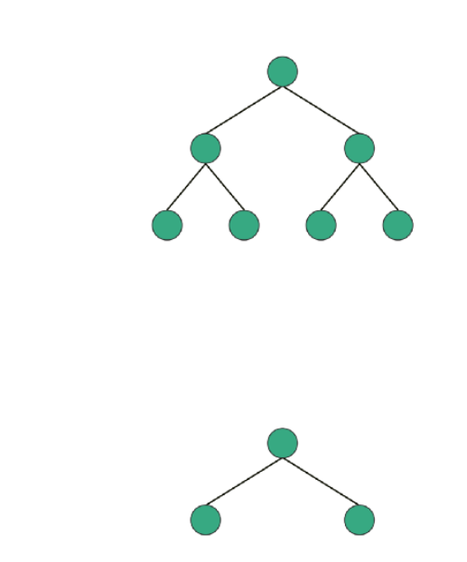
perfect

Slide 15
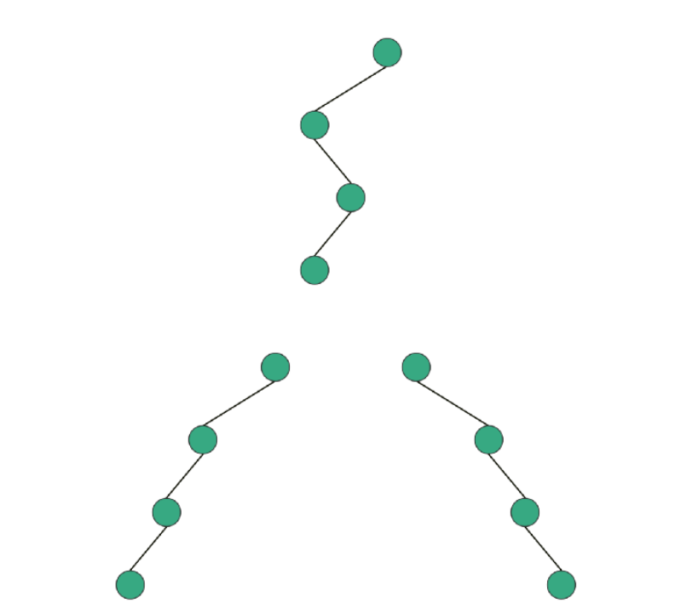
degenerate

Slide 16
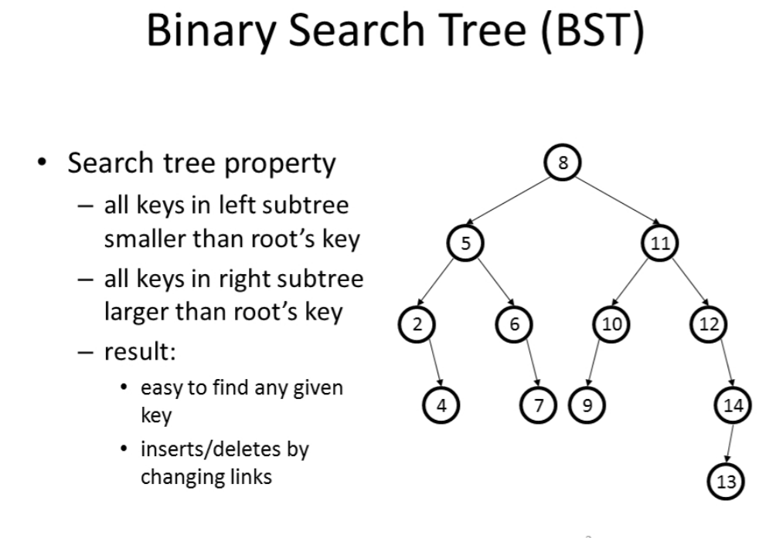

Slide 17
10
6
23

Slide 18
10, 12, 17
6
23

Slide 19
10, 13, 17
6,9
23,27
11,12
15,16

Slide 20
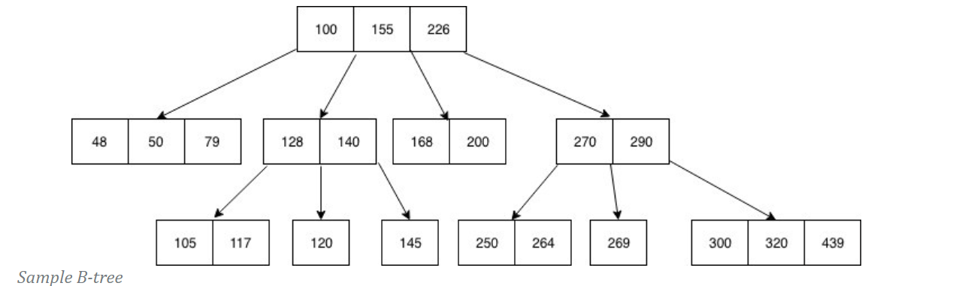
B Tree
The B-tree generalizes the binary search tree, allowing for nodes with more than two children.

Slide 21
A B-tree is an M-way search tree with two properties :
It is perfectly balanced: every leaf node is at the same depth
Every internal node other than the root, is at least half-full, i.e. M/2-1 ≤ #keys ≤ M-1
Every internal node with k keys has k+1 non-null children

Slide 22
Insert example
20 40 60 80
0 5 10 15
25 35
45 55
62 66 70 74 78
87 98
Insert 3:
20 40 60 80
0 3 5 10 15
25 35
45 55
62 66 70 74 78
87 98

Slide 23
20 40 60 80
0 3 5 10 15
25 35
45 55
62 66 70 74 78
87 98
Insert 61:
20 40 60 80
OVERFLOW
0 3 5 10 15
25 35
45 55
61 62 66 70 74 78
87 98
SPLIT IT
20 40 60 70 80
0 3 5 10 15
25 35
45 55
61 62 66
74 78
87 98

Slide 24
20 40 60 70 80
Insert 38:
0 3 5 10 15
25 35
45 55
61 62 66
74 78
87 98
20 40 60 70 80
0 3 5 10 15
25 35 38
45 55
61 62 66
74 78
87 98

Slide 25
Insert 4:
20 40 60 70 80
0 3 5 10 15
25 35 38
45 55
61 62 66
74 78
87 98
20 40 60 70 80
OVERFLOW
0 3 4 5 10 15
25 35 38
45 55
61 62 66
74 78
87 98
SPLIT IT
OVERFLOW
5 20 40 60 70 80
SPLIT IT
0 3 4
10 15
25 35 38
45 55
61 62 66
74 78
87 98

Slide 26
OVERFLOW
5 20 40 60 70 80
SPLIT IT
0 3 4
10 15
25 35 38
45 55
61 62 66
74 78
87 98
60
5 20 40
70 80
0 3 4
10 15
25 35 38
45 55
61 62 66
74 78
87 98

Slide 28
Constructing a B-tree
Suppose we start with an empty B-tree and keys arrive in the following order:1 12 8 2 25 5 14 28 17 7 52 16 48 68 3 26 29 53 55 45
We want to construct a B-tree of order 5
The first four items go into the root:
To put the fifth item in the root would violate condition 5
Therefore, when 25 arrives, pick the middle key to make a new root
1
2
8
12

Slide 29
Constructing a B-tree (contd.)
8
1
2
12
25
6, 14, 28 get added to the leaf nodes:
8
1
2
6
12
14
25
28

Slide 30
Constructing a B-tree (contd.)
Adding 17 to the right leaf node would over-fill it, so we take the middle key, promote it (to the root) and split the leaf
8
17
1
2
6
12
14
25
28
7, 52, 16, 48 get added to the leaf nodes
8
17
1
2
6
7
12
14
16
25
28
48
52

Slide 31
Constructing a B-tree (contd.)
Adding 68 causes us to split the right most leaf, promoting 48 to the root, and adding 3 causes us to split the left most leaf, promoting 3 to the root; 26, 29, 53, 55 then go into the leaves
3
8
17
48
1
2
6
7
12
14
16
25
26
28
29
52
53
55
68
Adding 45 causes a split of
25
26
28
29
and promoting 28 to the root then causes the root to split

Slide 32
Constructing a B-tree (contd.)
17
3
8
28
48
1
2
6
7
12
14
16
25
26
29
45
52
53
55
68

Slide 33
Inserting into a B-Tree
Attempt to insert the new key into a leaf
If this would result in that leaf becoming too big, split the leaf into two, promoting the middle key to the leaf’s parent
If this would result in the parent becoming too big, split the parent into two, promoting the middle key
This strategy might have to be repeated all the way to the top
If necessary, the root is split in two and the middle key is promoted to a new root, making the tree one level higher

Slide 34
Exercise in Inserting a B-Tree
Insert the following keys to a 5-way B-tree:
3, 7, 9, 23, 45, 1, 5, 14, 25, 24, 13, 11, 8, 19, 4, 31, 35, 56

Slide 35
Removal from a B-tree
During insertion, the key always goes into a leaf. For deletion we wish to remove from a leaf. There are three possible ways we can do this:
1 - If the key is already in a leaf node, and removing it doesn’t cause that leaf node to have too few keys, then simply remove the key to be deleted.
2 - If the key is not in a leaf then it is guaranteed (by the nature of a B-tree) that its predecessor or successor will be in a leaf -- in this case we can delete the key and promote the predecessor or successor key to the non-leaf deleted key’s position.

Slide 36
Removal from a B-tree (2)
If (1) or (2) lead to a leaf node containing less than the minimum number of keys then we have to look at the siblings immediately adjacent to the leaf in question:
3: if one of them has more than the min. number of keys then we can promote one of its keys to the parent and take the parent key into our lacking leaf
4: if neither of them has more than the min. number of keys then the lacking leaf and one of its neighbours can be combined with their shared parent (the opposite of promoting a key) and the new leaf will have the correct number of keys; if this step leave the parent with too few keys then we repeat the process up to the root itself, if required

Slide 37
Type #1: Simple leaf deletion
Assuming a 5-way
B-Tree, as before...
12
29
52
2
7
9
15
22
31
43
56
69
72
Delete 2: Since there are enough
keys in the node, just delete it
Note when printed: this slide is animated

Slide 38
Type #2: Simple non-leaf deletion
12
29
52
56
Delete 52
7
9
15
22
31
43
56
69
72
Borrow the predecessor
or (in this case) successor
Note when printed: this slide is animated

Slide 39
Type #4: Too few keys in node and its siblings
12
29
56
Join back together
7
9
15
22
31
43
69
72
Too few keys!
Delete 72
Note when printed: this slide is animated

Slide 40
Type #4: Too few keys in node and its siblings
12
29
7
9
15
22
31
43
56
69
Note when printed: this slide is animated

Slide 41
Type #3: Enough siblings
12
29
Demote root key and
promote leaf key
7
9
15
22
31
43
56
69
Delete 22
Note when printed: this slide is animated

Slide 42
Type #3: Enough siblings
12
31
7
9
15
29
43
56
69
Note when printed: this slide is animated

Slide 43
Exercise in Removal from a B-Tree
Given 5-way B-tree created by these data (last exercise):
3, 7, 9, 23, 45, 1, 5, 14, 25, 24, 13, 11, 8, 19, 4, 31, 35, 56
Add these further keys: 2, 6,12
Delete these keys: 4, 5, 7, 3, 14

Slide 44
Analysis of B-Trees
The maximum number of items in a B-tree of order m and height h:
root m – 1
level 1 m(m – 1)
level 2 m²(m – 1)
. . .
level h m^{h}(m – 1)
So, the total number of items is (1 + m + m² + m³ + … + m^{h})(m – 1) = [(m^{h+1} – 1)/ (m – 1)] (m – 1) = m^{h+1} – 1
When m = 5 and h = 2 this gives 5³ – 1 = 124

Slide 45
Reasons for using B-Trees
When searching tables held on disc, the cost of each disc transfer is high but doesn't depend much on the amount of data transferred, especially if consecutive items are transferred
If we use a B-tree of order 101, say, we can transfer each node in one disc read operation
A B-tree of order 101 and height 3 can hold 101⁴ – 1 items (approximately 100 million) and any item can be accessed with 3 disc reads (assuming we hold the root in memory)
If we take m = 3, we get a 2-3 tree, in which non-leaf nodes have two or three children (i.e., one or two keys)
B-Trees are always balanced (since the leaves are all at the same level), so 2-3 trees make a good type of balanced tree

Slide 46
Comparing Trees
Binary trees
Can become unbalanced and lose their good time complexity (big O)
AVL trees are strict binary trees that overcome the balance problem
Heaps remain balanced but only prioritise (not order) the keys
Multi-way trees
B-Trees can be m-way, they can have any (odd) number of children
One B-Tree, the 2-3 (or 3-way) B-Tree, approximates a permanently balanced binary tree, exchanging the AVL tree’s balancing operations for insertion and (more complex) deletion operations

Slide 47
B+ Tree
The drawback of B-tree used for indexing, however is that it stores the data pointer (a pointer to the disk file block containing the key value), corresponding to a particular key value, along with that key value in the node of a B-tree. This technique, greatly reduces the number of entries that can be packed into a node of a B-tree, thereby contributing to the increase in the number of levels in the B-tree, hence increasing the search time of a record.
B+ tree eliminates the above drawback by storing data pointers only at the leaf nodes of the tree.

Slide 48
A variation of B trees in which
internal nodes contain only search keys (no data)
Leaf nodes contain pointers to data records
Data records are in sorted order by the search key
All leaves are at the same depth

Slide 49
B+ Tree Nodes
Internal node
Pointer (Key, NodePointer)*M-1 in each node
First i keys are currently in use
k₀
k₁
…
k_{i-1}
__
…
__
0
1
i-1
M - 2
Leaf
(Key, DataPointer)* L in each node
first j Keys currently in use
k₀
k₁
…
k_{j-1}
__
…
__
0
1
L-1
Data for k₀
Data for k₂
Data for k_{j-1}
Notes:
FIX M-I to M-I-1!!
Alright, before we look at any examples, let’s look at what the node structure looks like.
Internal nodes are arrays of pointers to children interspersed with search keys.
Why must they be arrays rather than linked lists?
Because we want contiguous memory!
If the node has just I+1 children, it has I search keys, and M-I empty entries.
A leaf looks similar (I’ll use green for leaves), and has similar properties.
Why are these different?
Because internal nodes need subtrees-1 keys.

Slide 50
Example
B+ Tree with M = 4
Often, leaf nodes linked together
10
40
3
15
20
30
50
1
2
10
11
12
20
25
26
40
42
3
5
6
9
15
17
30
32
33
36
50
60
70
Notes:
This is just an example B-tree. Notice that it has 24 entries with a depth of only 2.
A BST would be 4 deep.
Notice also that the leaves are at the same level in the tree. I’ll use integers as both key and data, but we all know that that could as well be different data at the bottom, right?

Slide 51
Advantages of B+ tree usage for databases
keeps keys in sorted order for sequential traversing
uses a hierarchical index to minimize the number of disk reads
uses partially full blocks to speed insertions and deletions
keeps the index balanced with a recursive algorithm
In addition, a B+ tree minimizes waste by making sure the interior nodes are at least half full. A B+ tree can handle an arbitrary number of insertions and deletions.

Slide 52
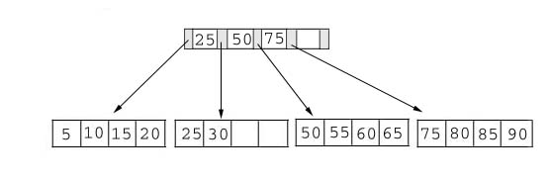
Searching
Just compare the key value with the data in the tree, then return the result.
For example: find the value 45, and 15 in below tree.

Slide 53
Searching
Result:
1. For the value of 45, not found.
2. For the value of 15, return the position where the pointer located.

Slide 54
Insertion
inserting a value into a B+ tree may unbalance the tree, so rearrange the tree if needed.
Example #1: insert 28 into the below tree.
25 28 30
Fits inside the leaf

Slide 55
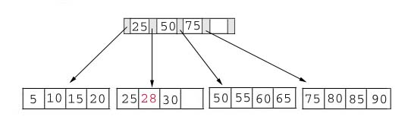
Insertion
Result:

Slide 56
Insertion
Example #2: insert 70 into below tree

Slide 57
Insertion
Process: split the leaf and propagate middle key up the tree
50 55 60 65 70
Does not fit inside the leaf
50 55
60 65 70

Slide 58
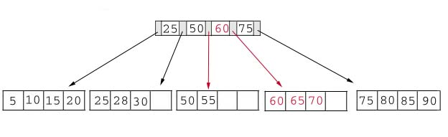
Insertion
Result: chose the middle key 60, and place it in the index page between 50 and 75.

Slide 59
Insertion
The insert algorithm for B+ Tree
Leaf Node Full | Index Node Full | Action
NO | NO | Place the record in sorted position in the appropriate leaf page
YES | NO | Split the leaf node Place Middle Key in the index node in sorted order. Left leaf node contains records with keys below the middle key. Right leaf node contains records with keys equal to or greater than the middle key.
YES | YES | Split the leaf node. Records with keys < middle key go to the left leaf node. Records with keys >= middle key go to the right leaf node. Split the index node. Keys < middle key go to the left index node. Keys > middle key go to the right index node. The middle key goes to the next (higher level) index node. IF the next level index node is full, continue splitting the index nodes.

Slide 60
Insertion
Exercise: add a key value 95 to the below tree.
75 80 85 90 95
Leaf node full, split the leaf.
75 80
85 90 95
25 50 60 75 85
Notes:
Add 95 to 75, 80, 85, 90; node full. Split into: 75, 80 and 85, 90 95. Propagate middle value (85) to parent.
Parent is full with 25, 50, 60, 75. Split into 25, 50 and 60, 75, 85. Propagate middle value (60) up the tree.

Slide 61
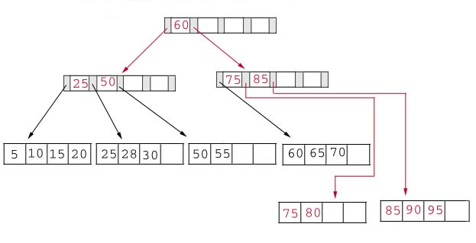
Insertion
Result: again put the middle key 60 to the index page and rearrange the tree.
Notes:
B+ Trees grow UP from the bottom

Slide 62
Deletion
Same as insertion, the tree has to be rebuild if the deletion result violate the rule of B+ tree.
Example #1: delete 70 from the tree
OK. Node >=50% full
60 65

Slide 63
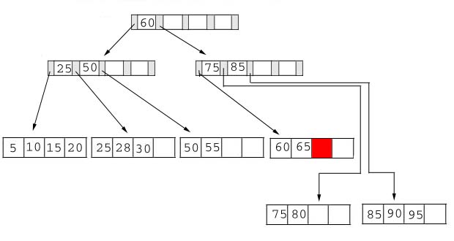
Deletion
Result:
Notes:
Locate it in the leaf node. Delete it. Node is still >= 50% full, all done.

Slide 64
Deletion
Example #2: delete 25 from below tree, but 25 appears in the index page.
But…
28 30
This is OK.
Notes:
Locate 25 in leaf. Delete it. Node still >= 50% full so okay.
BUT, 25 was used in index node….
Propagate smallest value in leaf node (28) up the tree to replace it.

Slide 65
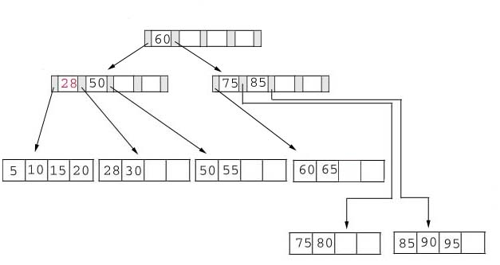
Deletion
Result: replace 28 in the index page.
Add 28

Slide 66
Deletion
Example #3: delete 60 from the below tree
65
Less than 50% full
50 55 65
Notes:
Locate 60 in leaf node Delete it. Leaf now < 50% full.
Neighbor at most 50% full, so merge with neighbor to the right. Guaranteed to fit.

Slide 67
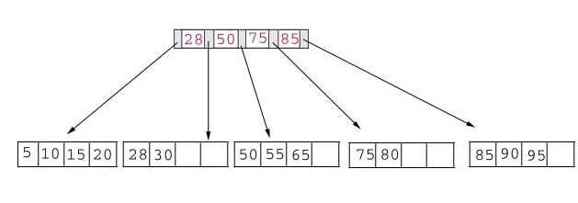
Deletion
Result: delete 60 from the index page and combine the rest of index pages.

Slide 68
Deletion
Delete algorithm for B+ trees
Data Page Below Fill Factor | Index Page Below Fill Factor | Action
NO | NO | Delete the record from the leaf page. Arrange keys in ascending order to fill void. If the key of the deleted record appears in the index page, use the next key to replace it.
YES | NO | Combine the leaf page and its sibling. Change the index page to reflect the change.
YES | YES | Combine the leaf page and its sibling. Adjust the index page to reflect the change. Combine the index page with its sibling. Continue combining index pages until you reach a page with the correct fill factor or you reach the root page.

Slide 69
Conclusion
For a B+ Tree:
It is “easy” to maintain its balance
Insert/Deletion complexity O(log_{M/2})
The searching time is shorter than most of other types of trees because branching factor is high

