Slide 1
GRAPHS
All the programs in this file are selected from
Ellis Horowitz, Sartaj Sahni, and Susan Anderson-Freed
“Fundamentals of Data Structures in C”,
Computer Science Press, 1992.
CHAPTER 6

Slide 2
Graphs
Definition of Graphs and Related Concepts
Representation of Graphs
The Graph Class
Graph Traversal
Graph Applications
CS 103

Slide 3
Examples of Graphs
V={0,1,2,3,4}
E={(0,1), (1,2), (0,3), (3,0), (2,2), (4,3)}
1
When (x,y) is an edge,
we say that x is adjacent to y, and y is adjacent from x.
0 is adjacent to 1.
1 is not adjacent to 0.
2 is adjacent from 1.
0
2
4
3
CS 103

Slide 4
A “Real-life” Example of a Graph
V=set of 6 people: John, Mary, Joe, Helen, Tom, and Paul, of ages 12, 15, 12, 15, 13, and 13, respectively.
E ={(x,y) | if x is younger than y}
Mary
Helen
John
Joe
Tom
Paul
CS 103

Slide 5
Definition
A graph G consists of two sets
  a finite, nonempty set of vertices V(G)
  a finite, possible empty set of edges E(G)
  G(V,E) represents a graph
An undirected graph is one in which the pair of vertices in a edge is unordered, (v0, v1) = (v1,v0)
A directed graph is one in which each edge is a directed pair of vertices, <v0, v1> != <v1,v0>
tail
head
CHAPTER 6

Slide 6
Examples for Graph
0
0
0
1
2
1
2
1
3
3
4
5
6
G1
2
G2
complete graph
incomplete graph
G3
V(G1)={0,1,2,3} E(G1)={(0,1),(0,2),(0,3),(1,2),(1,3),(2,3)}
V(G2)={0,1,2,3,4,5,6} E(G2)={(0,1),(0,2),(1,3),(1,4),(2,5),(2,6)}
V(G3)={0,1,2} E(G3)={<0,1>,<1,0>,<1,2>}
complete undirected graph: n(n-1)/2 edges
complete directed graph: n(n-1) edges
CHAPTER 6

Slide 7
Complete Graph
A complete graph is a graph that has the
maximum number of edges
  for undirected graph with n vertices, the maximum number of edges is n(n-1)/2
  for directed graph with n vertices, the maximum
  number of edges is n(n-1)
  example: G1 is a complete graph
CHAPTER 6

Slide 8
Adjacent and Incident
If (v0, v1) is an edge in an undirected graph,
  v0 and v1 are adjacent
  The edge (v0, v1) is incident on vertices v0 and v1
If <v0, v1> is an edge in a directed graph
  v0 is adjacent to v1, and v1 is adjacent from v0
  The edge <v0, v1> is incident on v0 and v1
CHAPTER 6

Slide 9
Figure 6.3
*Figure 6.3:Example of a graph with feedback loops and a
multigraph (p.260)
0
0
2
1
3
1
2
self edge
multigraph:
multiple occurrences
of the same edge
(a)
(b)
CHAPTER 6

Slide 10
Subgraph and Path
A subgraph of G is a graph G’ such that V(G’)
is a subset of V(G) and E(G’) is a subset of E(G)
A path from vertex vp to vertex vq in a graph G,
is a sequence of vertices, vp, vi1, vi2, ..., vin, vq,
such that (vp, vi1), (vi1, vi2), ..., (vin, vq) are edges
in an undirected graph
The length of a path is the number of edges on it
CHAPTER 6

Slide 11
Figure 6.4: subgraphs of G₁ and G₃ (p.261)
0
0
0
1
2
0
1
2
1
2
3
1
2
3
3
G1
(i) (ii) (iii) (iv)
(a) Some of the subgraph of G₁
0
0
0
0
0
單一
1
1
1
1
分開
2
2
(i) (ii) (iii) (iv)
(b) Some of the subgraph of G₃
2
CHAPTER 6
G3

Slide 12
Simple Path and Style
A simple path is a path in which all vertices,
except possibly the first and the last, are distinct
A cycle is a simple path in which the first and
the last vertices are the same
In an undirected graph G, two vertices, v0 and v1, are connected if there is a path in G from v0 to v1
An undirected graph is connected if, for every
pair of distinct vertices vi, vj, there is a path
from vi to vj
CHAPTER 6

Slide 13
connected
0
0
1
2
1
2
3
3
4
5
6
G1
G2
tree (acyclic graph)
CHAPTER 6

Slide 14
Connected Component
A connected component of an undirected graph
is a maximal connected subgraph.
A tree is a graph that is connected and acyclic.
A directed graph is strongly connected if there
is a directed path from vi to vj and also
from vj to vi.
A strongly connected component is a maximal subgraph that is strongly connected.
CHAPTER 6

Slide 15
*Figure 6.5: A graph with two connected components (p.262)
connected component (maximal connected subgraph)
H₁
0
H₂
4
2
1
5
3
6
7
G₄ (not connected)
CHAPTER 6

Slide 16
*Figure 6.6: Strongly connected components of G₃ (p.262)
strongly connected component
(maximal strongly connected subgraph)
not strongly connected
0
0
2
1
1
2
G3
CHAPTER 6

Slide 17
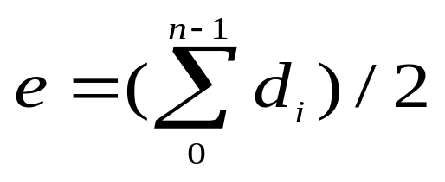
Degree
The degree of a vertex is the number of edges incident to that vertex
For directed graph,
  the in-degree of a vertex v is the number of edges
  that have v as the head
  the out-degree of a vertex v is the number of edges
  that have v as the tail
  if di is the degree of a vertex i in a graph G with n vertices and e edges, the number of edges is
CHAPTER 6

Slide 18
undirected graph
degree
3
0
0
2
1
2
3
1
2
3
3
3
3
4
5
6
3
3
1
G1
1
G2
1
1
0
in:1, out: 1
directed graph
in-degree
out-degree
1
in: 1, out: 2
2
in: 1, out: 0
CHAPTER 6
G3

Slide 19
ADT for Graph
structure Graph is
objects: a nonempty set of vertices and a set of undirected edges, where each
edge is a pair of vertices
functions: for all graph ∈ Graph, v, v₁ and v₂ ∈ Vertices
Graph Create()::=return an empty graph
Graph InsertVertex(graph, v)::= return a graph with v inserted. v has no
incident edge.
Graph InsertEdge(graph, v1,v2)::= return a graph with new edge
between v1 and v2
Graph DeleteVertex(graph, v)::= return a graph in which v and all edges
incident to it are removed
Graph DeleteEdge(graph, v1, v2)::=return a graph in which the edge (v1, v2)
is removed
Boolean IsEmpty(graph)::= if (graph==empty graph) return TRUE
else return FALSE
List Adjacent(graph,v)::= return a list of all vertices that are adjacent to v
CHAPTER 6

Slide 20
Graph Representations
Adjacency Matrix
Adjacency Lists
Adjacency Multilists
CHAPTER 6

Slide 21
Adjacency Matrix
Let G=(V,E) be a graph with n vertices.
The adjacency matrix of G is a two-dimensional
n by n array, say adj_mat
If the edge (vi, vj) is in E(G), adj_mat[i][j]=1
If there is no such edge in E(G), adj_mat[i][j]=0
The adjacency matrix for an undirected graph is symmetric; the adjacency matrix for a digraph
need not be symmetric
CHAPTER 6

Slide 22
Example of Adjacency Matrix
1
0
0 1 0 1 0
0 0 1 0 0
0 0 1 0 0
1 0 0 0 0
0 0 0 4 0
A =
2
4
3
CS 103

Slide 23
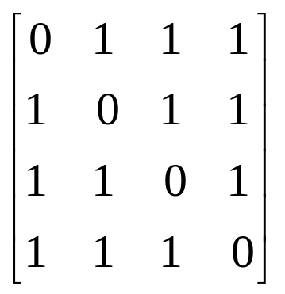
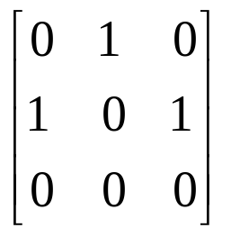
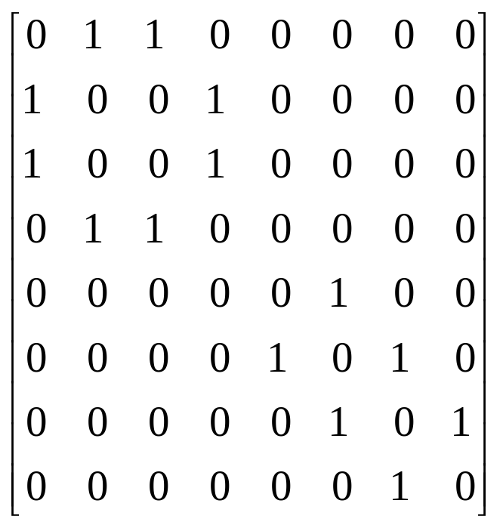
Examples for Adjacency Matrix
0
0
4
0
2
1
5
1
2
3
6
3
1
7
2
G2
G1
symmetric
undirected: n²/2
directed: n²
CHAPTER 6
G4

Slide 24
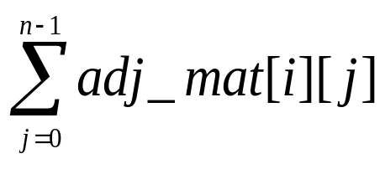
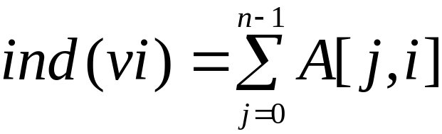
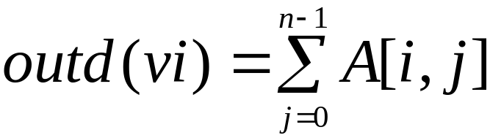
Merits of Adjacency Matrix
From the adjacency matrix, to determine the connection of vertices is easy
The degree of a vertex is
For a digraph, the row sum is the out_degree, while the column sum is the in_degree
CHAPTER 6

Slide 25
Data Structures for Adjacency Lists
Each row in adjacency matrix is represented as an adjacency list.
#define MAX_VERTICES 50
typedef struct node *node_pointer;
typedef struct node {
int vertex;
struct node *link;
};
node_pointer graph[MAX_VERTICES];
int n=0; /* vertices currently in use */
CHAPTER 6

Slide 26
0
0
4
2
1
5
1
2
3
6
3
7
0
1
2
3
1
2
3
0
1
2
3
4
5
6
7
1
2
0
2
3
0
3
0
1
3
0
3
0
1
2
1
2
G1
0
5
4
6
0
1
2
1
5
7
0
2
1
6
G3
G4
2
CHAPTER 6
An undirected graph with n vertices and e edges ==> n head nodes and 2e list nodes

Slide 27
Interesting Operations
degree of a vertex in an undirected graph
  # of nodes in adjacency list
# of edges in a graph
  determined in O(n+e)
out-degree of a vertex in a directed graph
  # of nodes in its adjacency list
in-degree of a vertex in a directed graph
  traverse the whole data structure
CHAPTER 6

Slide 28
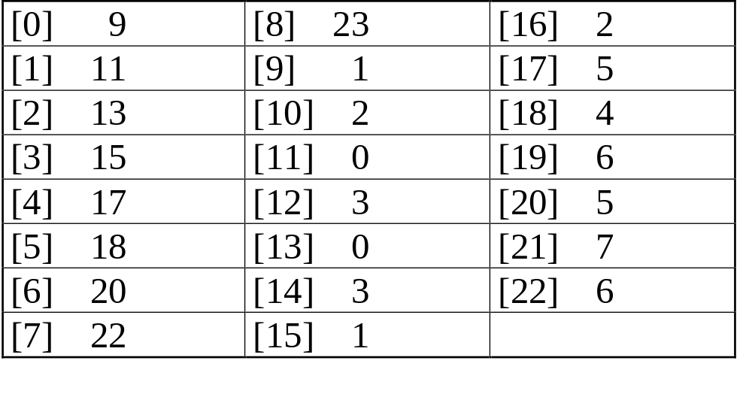
Compact Representation
0
4
node[0] … node[n-1]: starting point for vertices
node[n]: n+2e+1
node[n+1] … node[n+2e]: head node of edge
2
1
5
3
6
7
0
4
5
1
6
2
7
3
CHAPTER 6

Slide 29
Figure 6.10: Inverse adjacency list for G₃
0
0
1
2
•
•
•
1 NULL
1
0 NULL
1 NULL
2
Determine in-degree of a vertex in a fast way.
CHAPTER 6

Slide 30
Figure 6.11: Alternate node structure for adjacency lists (p.267)
tail head column link for head row link for tail
CHAPTER 6

Slide 31
Figure 6.12: Orthogonal representation for graph G₃(p.268)
0
1
2
0
0 1 NULL NULL
1
1 0 NULL
1 2 NULL NULL
0
2 NULL
1
CHAPTER 6
2

Slide 32
Figure 6.13:Alternate order adjacency list for G₁ (p.268)
Order is of no significance.
headnodes vertax link
0
•
3 •
1 •
2 NULL
1
•
2 •
0 •
3 NULL
2
•
3 •
0 •
1 NULL
3
•
2 •
1 •
0 NULL
0
1
2
CHAPTER 6
3

Slide 33
Adjacency Multilists
An edge in an undirected graph is represented by two nodes in adjacency list representation.
Adjacency Multilists
  lists in which nodes may be shared among several lists.
  (an edge is shared by two different paths)
marked vertex1 vertex2 path1 path2
CHAPTER 6

Slide 34
Example for Adjacency Multlists
Lists: vertex 0: M1->M2->M3, vertex 1: M1->M4->M5
vertex 2: M2->M4->M6, vertex 3: M3->M5->M6
(1,0)
0
1
2
3
N1
N2
N3
N4
N5
N6
0 1 N2 N4
edge (0,1)
edge (0,2)
edge (0,3)
edge (1,2)
edge (1,3)
edge (2,3)
(2,0)
0 2 N3 N4
(3,0)
0 3 N5
(2,1)
1 2 N5 N6
0
(3,1)
1 3 N6
1
2
(3,2)
2 3
3
six edges
CHAPTER 6

Slide 35
Graph Traversal Techniques
The previous connectivity problem, as well as many other graph problems, can be solved using graph traversal techniques
There are two standard graph traversal techniques:
  Depth-First Search (DFS)
  Breadth-First Search (BFS)
CS 103

Slide 36
Graph Traversal (Contd.)
In both DFS and BFS, the nodes of the undirected graph are visited in a systematic manner so that every node is visited exactly one.
Both BFS and DFS give rise to a tree:
  When a node x is visited, it is labeled as visited, and it is added to the tree
  If the traversal got to node x from node y, y is viewed as the parent of x, and x a child of y
CS 103

Slide 37
Depth-First Search
DFS follows the following rules:
  Select an unvisited node x, visit it, and treat as the current node
  Find an unvisited neighbor of the current node, visit it, and make it the new current node;
  If the current node has no unvisited neighbors, backtrack to the its parent, and make that parent the new current node;
  Repeat steps 3 and 4 until no more nodes can be visited.
  If there are still unvisited nodes, repeat from step 1.
CS 103

Slide 38
Illustration of DFS
0
1
0
2
1
4
4
9
10
5
7
2
11
8
5
9
6
7
11
6
Graph G
8
10
DFS Tree
CS 103

Slide 39
Implementation of DFS
Observations:
  the last node visited is the first node from which to proceed.
  Also, the backtracking proceeds on the basis of "last visited, first to backtrack too".
  This suggests that a stack is the proper data structure to remember the current node and how to backtrack.
CS 103

Slide 40
DFS (Pseudo Code)
DFS(input: Graph G) {
Stack S; Integer x, t;
while (G has an unvisited node x){
visit(x); push(x,S);
while (S is not empty){
t := peek(S);
if (t has an unvisited neighbor y){ visit(y); push(y,S); }
else
pop(S);
}
}
}
CS 103

Slide 41
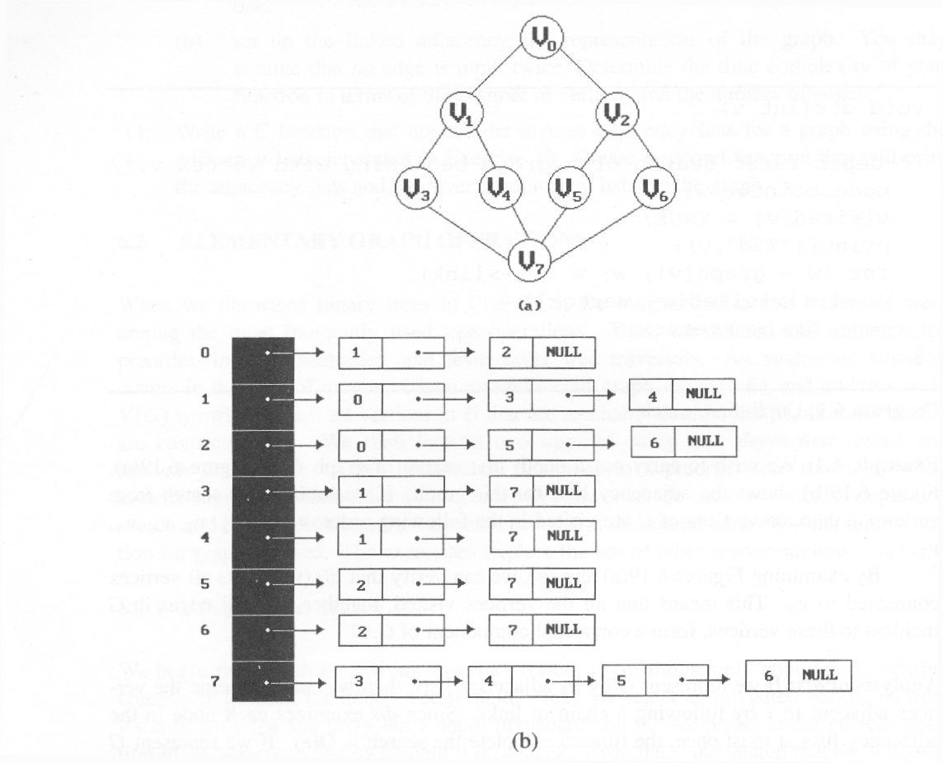
*Figure 6.19:Graph G and its adjacency lists (p.274)
depth first search: v0, v1, v3, v7, v4, v5, v2, v6
breadth first search: v0, v1, v2, v3, v4, v5, v6, v7
CHAPTER 6

Slide 42
Depth First Search
#define FALSE 0
#define TRUE 1
short int visited[MAX_VERTICES];
void dfs(int v)
{
node_pointer w;
visited[v]= TRUE;
printf(“%5d”, v);
for (w=graph[v]; w; w=w->link)
if (!visited[w->vertex])
dfs(w->vertex);
}
Data structure
adjacency list: O(e)
adjacency matrix: O(n²)
CHAPTER 6

Slide 43
Breadth-First Search
BFS follows the following rules:
  Select an unvisited node x, visit it, have it be the root in a BFS tree being formed. Its level is called the current level.
  From each node z in the current level, in the order in which the level nodes were visited, visit all the unvisited neighbors of z. The newly visited nodes from this level form a new level that becomes the next current level.
  Repeat step 2 until no more nodes can be visited.
  If there are still unvisited nodes, repeat from Step 1.
CS 103

Slide 44
Breadth First Search
typedef struct queue *queue_pointer;
typedef struct queue {
int vertex;
queue_pointer link;
};
void addq(queue_pointer *,
queue_pointer *, int);
int deleteq(queue_pointer *);
CHAPTER 6

Slide 45
Breadth First Search (Continued)
void bfs(int v)
{
node_pointer w;
queue_pointer front, rear;
front = rear = NULL;
printf(“%5d”, v);
visited[v] = TRUE;
addq(&front, &rear, v);
adjacency list: O(e)
adjacency matrix: O(n²)
CHAPTER 6

Slide 46
while (front) {
v= deleteq(&front);
for (w=graph[v]; w; w=w->link)
if (!visited[w->vertex]) {
printf(“%5d”, w->vertex);
addq(&front, &rear, w->vertex);
visited[w->vertex] = TRUE;
}
}
}
CHAPTER 6

Slide 47
Connected Components
void connected(void)
{
for (i=0; i<n; i++) {
if (!visited[i]) {
dfs(i);
printf(“\n”);
}
}
}
adjacency list: O(n+e)
adjacency matrix: O(n²)
CHAPTER 6

Slide 48
Spanning Trees
When graph G is connected, a depth first or
breadth first search starting at any vertex will
visit all vertices in G
A spanning tree is any tree that consists solely
of edges in G and that includes all the vertices
E(G): T (tree edges) + N (nontree edges)
where T: set of edges used during search
N: set of remaining edges
CHAPTER 6

Slide 49
Examples of Spanning Tree
0
0
0
0
1
2
1
2
1
2
1
2
3
3
3
3
G1
Possible spanning trees
CHAPTER 6

Slide 50
Spanning Trees
Either dfs or bfs can be used to create a
spanning tree
  When dfs is used, the resulting spanning tree is
  known as a depth first spanning tree
  When bfs is used, the resulting spanning tree is
  known as a breadth first spanning tree
While adding a nontree edge into any spanning
tree, this will create a cycle
CHAPTER 6

Slide 51
DFS VS BFS Spanning Tree
0
0
0
1
2
1
2
1
2
3
4
5
6
3
4
5
6
3
4
5
6
7
7
nontree edge
cycle
7
DFS Spanning
BFS Spanning
CHAPTER 6

Slide 52
A spanning tree is a minimal subgraph, G’, of G
such that V(G’)=V(G) and G’ is connected.
Any connected graph with n vertices must have
at least n-1 edges.
A biconnected graph is a connected graph that has
no articulation points.
0
1
2
biconnected graph
3
4
5
6
7
CHAPTER 6

Slide 53
0
8 9
2
7
1
3
5
connected graph
4
6
two connected components
one connected graph
8 9
0
8 9
0
2
7
2
7
1
1
3
5
3
5
CHAPTER 6
4
6
4
6

Slide 54
biconnected component: a maximal connected subgraph H
(no subgraph that is both biconnected and properly contains H)
0
8
9
0
8 9
1
7
7
2
7
1
2
7
1
3
5
3
3
5
5
4
6
4
6
biconnected components
CHAPTER 6

Slide 55
Find biconnected component of a connected undirected graph
by depth first spanning tree
nontree
edge
(back edge)
0
3
4 0
9 8 9 8
1 5
nontree
edge
(back edge)
4
5
7 7
3
1
0 5
3 5
2
4
2
6
7
6
2 2
3
1
7
dfn
depth
first
number
8 9
4 6
1 6
0
9
8
Why is cross edge impossible?
(a) depth first spanning tree (b)
If u is an ancestor of v then dfn(u) < dfn(v).
CHAPTER 6

Slide 56
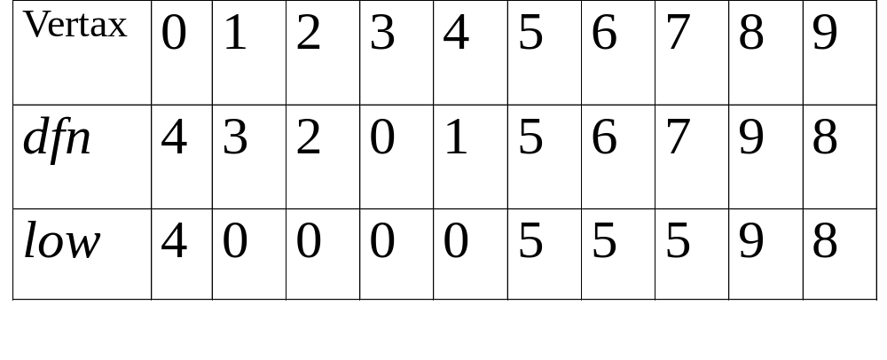
*Figure 6.24: dfn and low values for dfs spanning tree with root =3(p.281)
CHAPTER 6

Slide 57
0
3
*The root of a depth first spanning
tree is an articulation point iff
it has at least two children.
1 5
4
5
2
4
2
6
7
6
*Any other vertex u is an articulation
point iff it has at least one child w
such that we cannot reach an ancestor
of u using a path that consists of
(1) only w (2) descendants of w (3)
single back edge.
3
1
7
8 9
0
9
8
low(u)=min{dfn(u),
min{low(w)|w is a child of u},
min{dfn(w)|(u,w) is a back edge}
u: articulation point
low(child) ≥ dfn(u)
CHAPTER 6

Slide 58
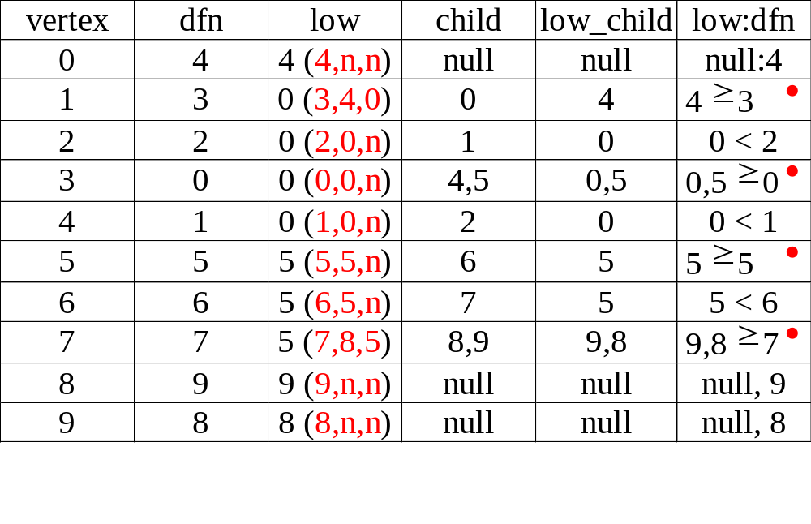
3
1 5
4
5
2
4
2
6
7
6
3
1
7
8 9
CHAPTER 6
0
9
8

Slide 59
*Program 6.5: Initializaiton of dfn and low (p.282)
void init(void)
{
int i;
for (i = 0; i < n; i++) {
visited[i] = FALSE;
dfn[i] = low[i] = -1;
}
num = 0;
}
CHAPTER 6

Slide 60
*Program 6.4: Determining dfn and low (p.282)
void dfnlow(int u, int v)
{
/* compute dfn and low while performing a dfs search
beginning at vertex u, v is the parent of u (if any) */
node_pointer ptr;
int w;
dfn[u] = low[u] = num++;
for (ptr = graph[u]; ptr; ptr = ptr ->link) {
w = ptr ->vertex;
if (dfn[w] < 0) { /*w is an unvisited vertex */
dfnlow(w, u);
low[u] = MIN2(low[u], low[w]);
}
else if (w != v)
low[u] =MIN2(low[u], dfn[w] );
}
}
Initial call: dfn(x,-1)
low[u]=min{dfn(u), …}
v
u
w
v
u
low[u]=min{…, min{low(w)|w is a child of u}, …}
dfn[w]≠0 非第一次，表示藉back edge
X
O
CHAPTER 6
low[u]=min{…,…,min{dfn(w)|(u,w) is a back edge}

Slide 61
*Program 6.6: Biconnected components of a graph (p.283)
void bicon(int u, int v)
{
/* compute dfn and low, and output the edges of G by their
biconnected components , v is the parent ( if any) of the u
(if any) in the resulting spanning tree. It is assumed that all
entries of dfn[ ] have been initialized to -1, num has been
initialized to 0, and the stack has been set to empty */
node_pointer ptr;
int w, x, y;
dfn[u] = low[u] = num ++;
for (ptr = graph[u]; ptr; ptr = ptr->link) {
w = ptr ->vertex;
if ( v != w && dfn[w] < dfn[u] )
add(&top, u, w); /* add edge to stack */
low[u]=min{dfn(u), …}
(1) dfn[w]=-1 第一次
(2) dfn[w]!=-1非第一次，藉back
edge
CHAPTER 6

Slide 62
if(dfn[w] < 0) {/* w has not been visited */ bicon(w, u); low[u] = MIN2(low[u], low[w]); if (low[w] >= dfn[u] ){ articulation point printf(“New biconnected component: “); do { /* delete edge from stack */ delete(&top, &x, &y); printf(“ <%d, %d>” , x, y);
} while (!(( x = = u) && (y = = w))); printf(“\n”);
}
} else if (w != v) low[u] = MIN2(low[u], dfn[w]);
}
}
low[u]=min{…, min{low(w)|w is a child of u}, …}
low[u]=min{…, …, min{dfn(w)|(u,w) is a back edge}}
CHAPTER 6

Slide 63
Minimum Cost Spanning Tree
The cost of a spanning tree of a weighted undirected graph is the sum of the costs of the edges in the spanning tree
A minimum cost spanning tree is a spanning
tree of least cost
Three different algorithms can be used
  Kruskal
  Prim
  Sollin
Select n-1 edges from a weighted graph
of n vertices with minimum cost.
CHAPTER 6

Slide 64
Greedy Strategy
An optimal solution is constructed in stages
At each stage, the best decision is made at this
time
Since this decision cannot be changed later,
we make sure that the decision will result in a feasible solution
Typically, the selection of an item at each
stage is based on a least cost or a highest profit criterion
CHAPTER 6

Slide 65
Kruskal’s Idea
Build a minimum cost spanning tree T by
adding edges to T one at a time
Select the edges for inclusion in T in
nondecreasing order of the cost
An edge is added to T if it does not form a
cycle
Since G is connected and has n > 0 vertices,
exactly n-1 edges will be selected
CHAPTER 6

Slide 66
Examples for Kruskal’s Algorithm
10
0 5
2 3
1 6
1 2
3 6
3 4
4 6
4 5
0 1
12
14
0
0
0
28
16
1
1
10
1
10
14
16
18
6
2
5
6
2
5
6
2
5
24
22
25
18
12
4
4
4
22
3
3
3
24
25
6/9
CHAPTER 6
28

Slide 67
0 5
2 3
1 6
1 2
3 6
3 4
4 6
4 5
0 1
10
12
14
16
0
0
0
10
1
10
1
10
1
18
14
14
16
22
5
6
2
5
6
2
5
6
2
12
12
12
24
4
4
4
3
3
3
25
28
+
3 6
CHAPTER 6
cycle

Slide 68
0 5
2 3
1 6
1 2
3 6
3 4
4 6
4 5
0 1
10
12
14
0
0
16
10
1
10
1
18
14
16
14
16
5
6
2
5
6
2
22
25
12
12
4
4
24
22
+
4 6
22
3
3
25
cycle
cost = 10 +25+22+12+16+14
28
CHAPTER 6

Slide 69
Kruskal’s Algorithm
目標：取出n-1條edges
T= {};
while (T contains less than n-1 edges
&& E is not empty) {
choose a least cost edge (v,w) from E;
delete (v,w) from E;
if ((v,w) does not create a cycle in T)
add (v,w) to T
else discard (v,w);
}
if (T contains fewer than n-1 edges)
printf(“No spanning tree\n”);
min heap construction time O(e)
choose and delete O(log e)
find find & union O(log e)
{0,5}, {1,2,3,6}, {4} + edge(3,6) X + edge(3,4) --> {0,5},{1,2,3,4,6}
CHAPTER 6
O(e log e)

Slide 70


Prim’s Algorithm
(tree all the time vs. forest)
T={};
TV={0};
while (T contains fewer than n-1 edges)
{
let (u,v) be a least cost edge such
that and
if (there is no such edge ) break;
add v to TV;
add (u,v) to T;
}
if (T contains fewer than n-1 edges)
printf(“No spanning tree\n”);
CHAPTER 6

Slide 71
Examples for Prim’s Algorithm
0
28
10
1
14
16
5
6
2
24
25
0
18
12
0
0
4
10
1
22
3
1
10
1
10
5
6
2
5
6
2
5
6
2
25
25
4
4
4
3
3
22
3
CHAPTER 6

Slide 72
0
28
10
1
14
16
5
6
2
24
25
18
12
4
22
3
0
0
0
10
1
10
1
10
1
16
14
16
5
6
2
5
6
2
5
6
2
25
25
25
4
12
4
12
4
12
22
3
22
3
22
3
CHAPTER 6

