Slide 1
Data Structure & Algorithms

Slide 2
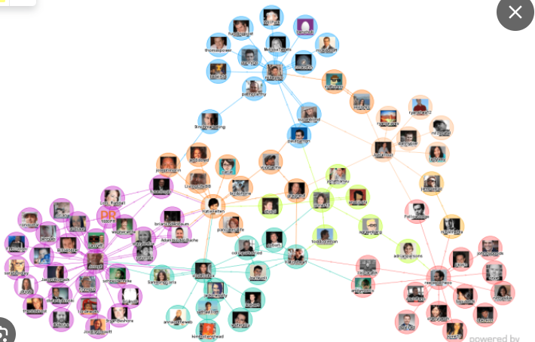
Social Media
Ref: https://www.devcript.com/introduction-to-graph-data-structure/

Slide 3
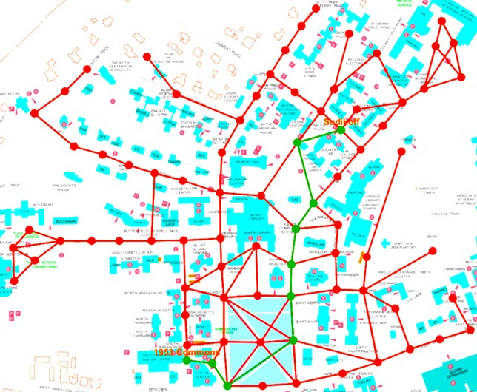

Map Navigation
Ref: https://www.linkedin.com/pulse/overview-google-maps-algorithms-shanmugapriya-thangavel/
https://adrianmejia.com/data-structures-for-beginners-graphs-time-complexity-tutorial/

Slide 4
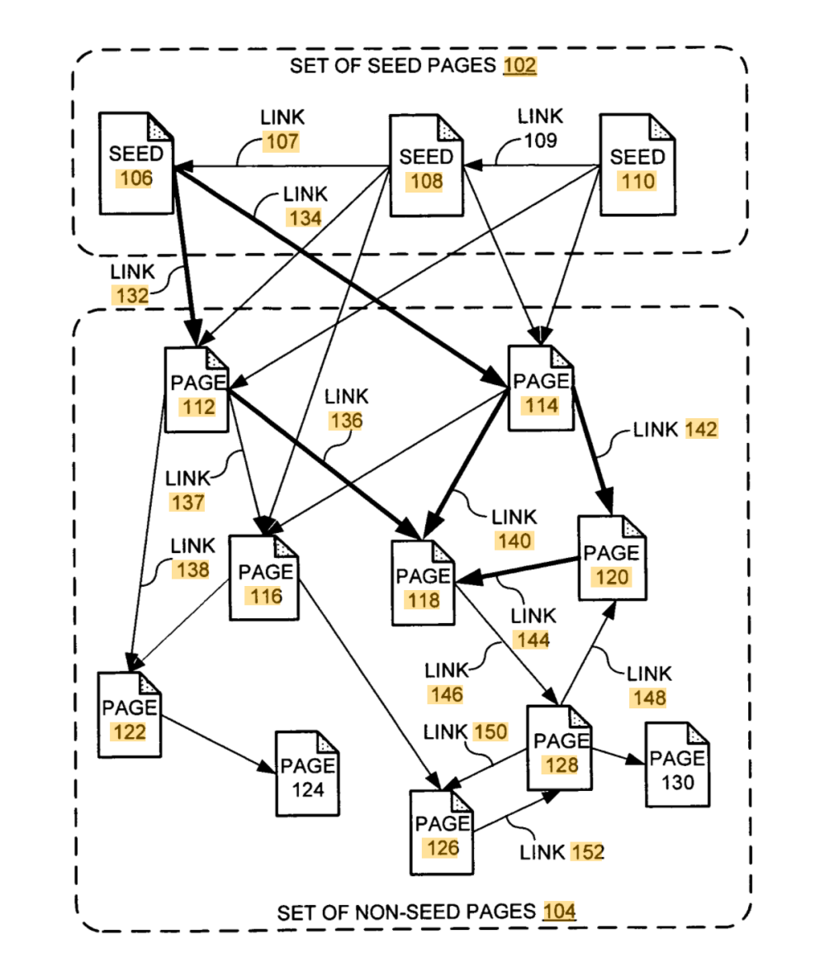
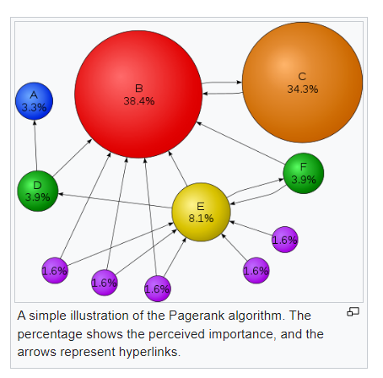
Page Rank
[PR is an algorithm used by Google Search to rank web pages in their search engine results. It is named after both the term "web page" and co-founder Larry Page. PageRank is a way of measuring the importance of website pages. According to Google:]
Ref: https://www.semrush.com/blog/pagerank/ & wikipedia

Slide 5
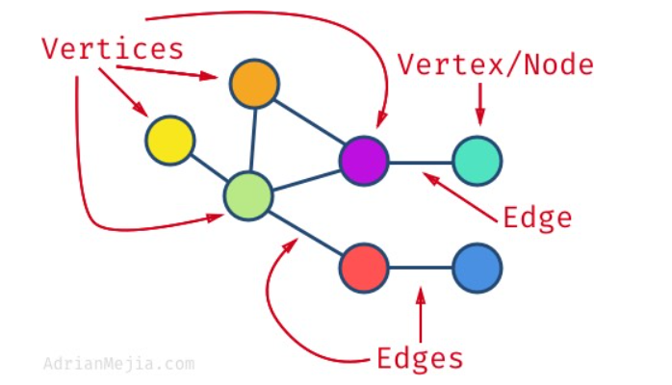
In Computer science graphs are used to represent the flow of computation.

Slide 6
The applications of graph split broadly into three categories:
First, analysis to determine structural properties of a network, such as the distribution of vertex degrees and the diameter of the graph. A vast number of graph measures exist.
b) Second, analysis to find a measurable quantity within the network, for example, for a transportation network, the level of vehicular flow within any portion of it.
c) Third, analysis of dynamic properties of network. Map of a country can be represented using a graph. Road network, Air network or rail network can be represented using a graph. Connection among routers in a communication network can be represented using a graph. Routing of a packet between two communicating nodes can be done through the shortest path.
Ref: https://www.geeksforgeeks.org/applications-of-graph-data-structure/

Slide 7

Different applications

Slide 8
Graph- Definitions
A graph G is represented by a tuple (V,E), where V is a set of vertices V=(v₁,v₂,v₃…) and E is a set of edges E=(e₁,e₂,e₃…..).
An element of E, say e_{i} is a pair of vertices (v_{m}, v_{n}).
If e_{i} = (v_{m}, v_{n}) is an ordered pair, then the graph is a directed one; v_{m} is the start vertex and v_{n} is the end vertex. We class such graphs as directed graphs.
Sparse graphs-those for which |E| is much less than |V|².
The graph is dense-|E| is close to |V|²

Slide 9
Types of Graph
Ref: https://www.simplilearn.com/tutorials/data-structure-tutorial/graphs-in-data-structure
Representation: How is a graph represented? (Adjacency list and adjacency matrix) #datastructures #graphtheory (youtube.com)

Slide 10
Adjacency-list Representation
The adjacency-list representation of a graph G = (V, E) consists of an array Adj of |V| lists, one for each vertex in V .
For each u ∈ V, the adjacency list Adj[u] contains all the vertices v such that there is an edge (u, v) ∈ E.
That is, Adj[u] consists of all the vertices adjacent to u in G.

Slide 11
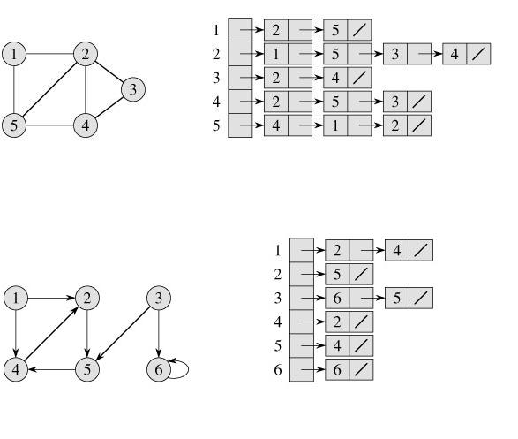
Adjacency-list Representation

Slide 12
Adjacency-list Representation
If G is a directed graph,
  the sum of the lengths of all the adjacency lists is |E|,
  an edge of the form (u, v) is represented by having v appear in Adj[u].
If G is an undirected graph,
  the sum of the lengths of all the adjacency lists is
  2 |E|,
  if (u, v) is an undirected edge, then u appears in v's adjacency list and vice versa.

Slide 13

Adjacency-matrix representation
For the adjacency-matrix representation of a graph G = (V, E), we assume that the vertices are numbered 1, 2,..., |V| in some arbitrary manner.
Then the adjacency-matrix representation of a graph G consists of a |V| × |V| matrix A = (a_{ij}) such that

Slide 14
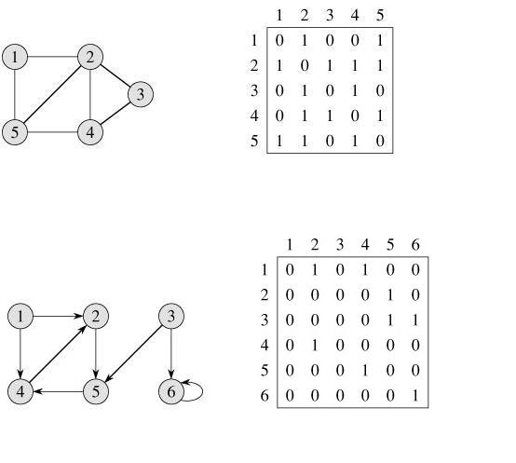
Adjacency-matrix representation

Slide 15
Traversal
Depth First Search [DFS]
Breadth First Search [BFS]

Slide 16
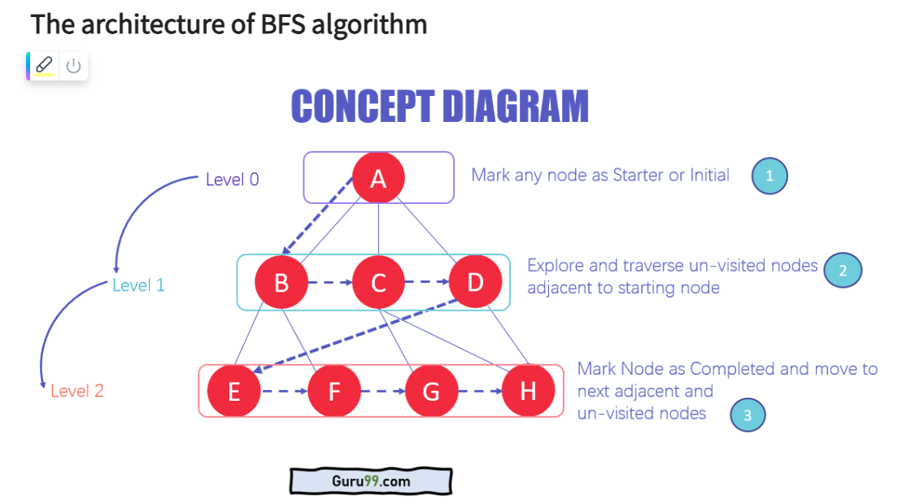
BFS [https://www.youtube.com/shorts/umHJzlKFGlU]

Slide 17
Breadth-first search
Given a graph G = (V, E) and a distinguished source vertex s, breadth-first search systematically explores the edges of G to "discover" every vertex that is reachable from s.
It computes the distance (smallest number of edges) from s to each reachable vertex.
It also produces a "breadth-first tree" with root s that contains all reachable vertices.
The algorithm works on both directed and undirected graphs.

Slide 18
Breadth-first search
To keep track of progress, breadth-first search colors each vertex white, gray, or black.
All vertices start out white and may later become gray and then black.
A vertex is discovered the first time it is encountered during the search, at which time it becomes nonwhite.
Gray and black vertices, therefore, have been discovered, but breadth-first search distinguishes between them to ensure that the search proceeds in a breadth-first manner.

Slide 19
Breadth-first search
If (u, v) ∈ E and vertex u is black, then vertex v is either gray or black; that is, all vertices adjacent to black vertices have been discovered.
Gray vertices may have some adjacent white vertices; they represent the frontier between discovered and undiscovered vertices.
Whenever a white vertex v is discovered in the course of scanning the adjacency list of an already discovered vertex u, the vertex v and the edge (u, v) are added to the tree. We say that u is the predecessor or parent of v in the breadth-first tree.

Slide 20
Breadth-first search
BFS(G, s)
1 for each vertex u ∈ V [G] - {s}
2 do color[u] ← WHITE
3 d[u] ← ∞
4 π[u] ← NIL
5 color[s] ← GRAY
6 d[s] ← 0
7 π[s] ← NIL
8 Q ← Ø
9 ENQUEUE(Q, s)

Slide 21
Breadth-first search
BFS(G, s)
10 while Q ≠ Ø
11 do u ← DEQUEUE(Q)
12 for each v ∈ Adj[u]
13 do if color[v] = WHITE
14 then color[v] ← GRAY
15 d[v] ← d[u] + 1
16 π[v] ← u
17 ENQUEUE(Q, v)
18 color[u] ← BLACK

Slide 22
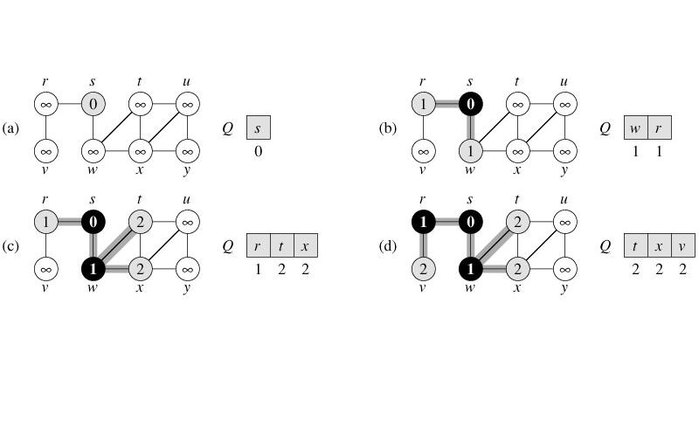
Breadth-first search

Slide 23
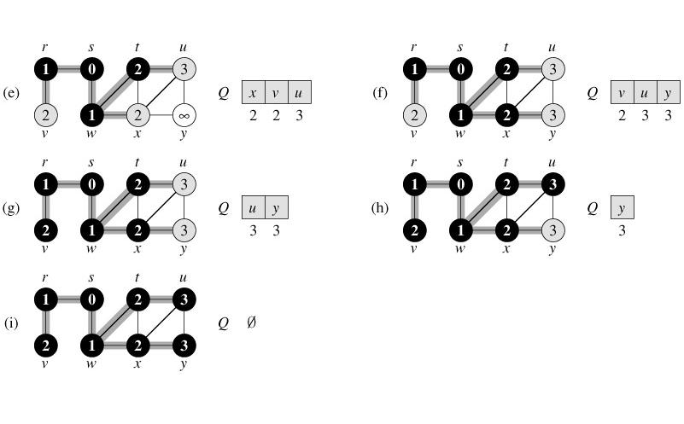
Breadth-first search

Slide 24
Analysis
The operations of enqueuing and dequeuing take O(1) time, so the total time devoted to queue operations is O(V).
the sum of the lengths of all the adjacency lists is Θ(E), the total time spent in scanning adjacency lists is O(E).
The overhead for initialization is O(V),
The total running time of BFS is O(V + E).
Thus, breadth-first search runs in time linear in the size of the adjacency-list representation of G.

Slide 25
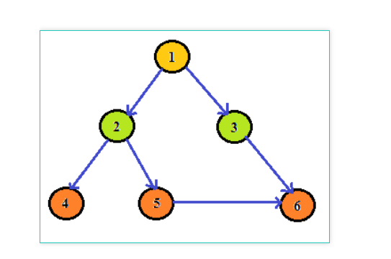

Slide 26
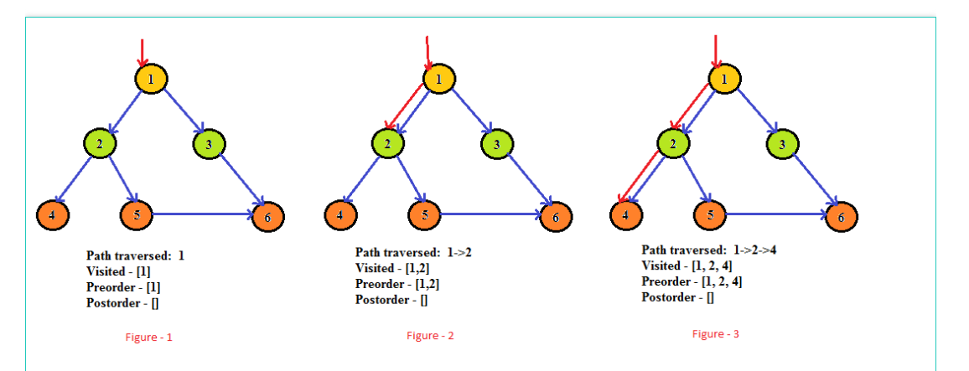

Slide 27
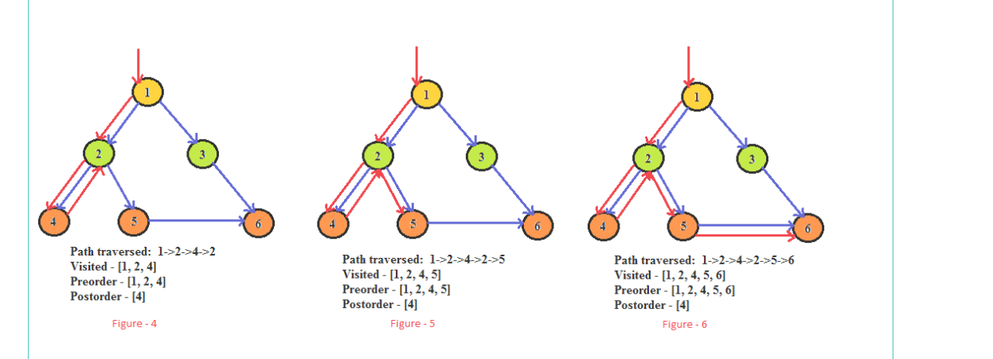

Slide 28
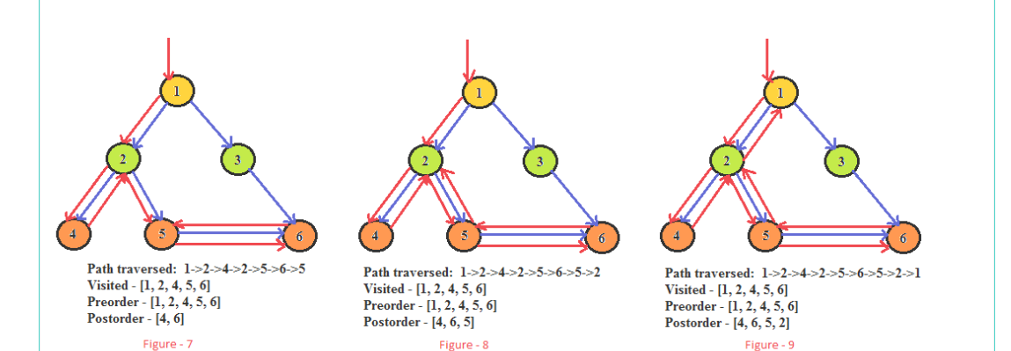

Slide 29
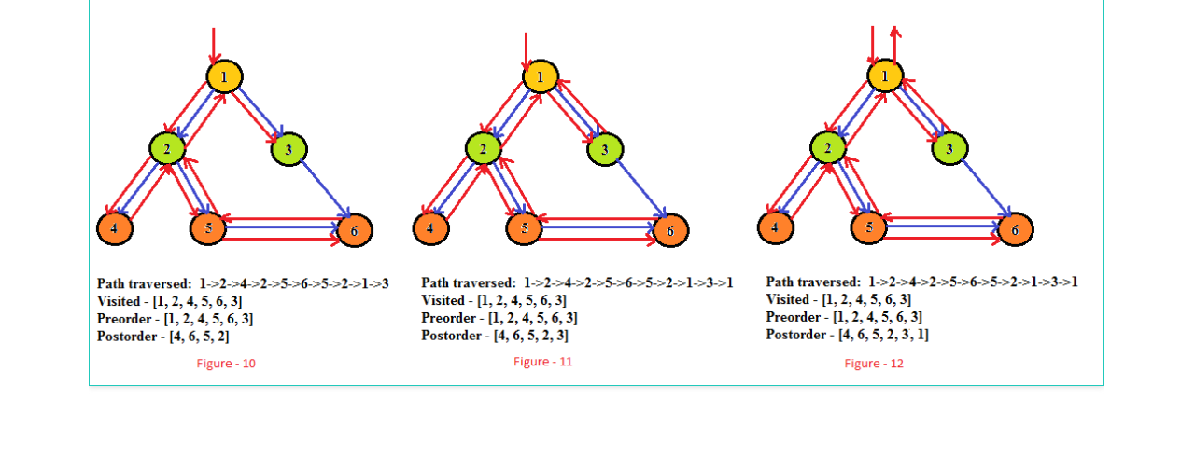

Slide 30
Depth-first search
In depth-first search, edges are explored out of the most recently discovered vertex v that still has unexplored edges leaving it.
When all of v's edges have been explored, the search "backtracks" to explore edges leaving the vertex from which v was discovered.
This process continues until we have discovered all the vertices that are reachable from the original source vertex.
If any undiscovered vertices remain, then one of them is selected as a new source and the search is repeated from that source.
This entire process is repeated until all vertices are discovered.

Slide 31
Depth-first search
DFS(G)
1 for each vertex u ∈ V [G]
2 do color[u] ← WHITE
3 π[u] ← NIL
4 time ← 0
5 for each vertex u ∈ V [G]
6 do if color[u] = WHITE
7 then DFS-VISIT(u)

Slide 32
Depth-first search
DFS-VISIT(u)
1 color[u] ← GRAY ▹White vertex u has just been discovered.
2 time ← time +1
3 d[u] time
4 for each v ∈ Adj[u] ▹Explore edge(u, v).
5 do if color[v] = WHITE
6 then π[v] ← u
7 DFS-VISIT(v)
8 color[u] BLACK ▹ Blacken u; it is finished.
9 f [u] ▹ time ← time +1

Slide 33
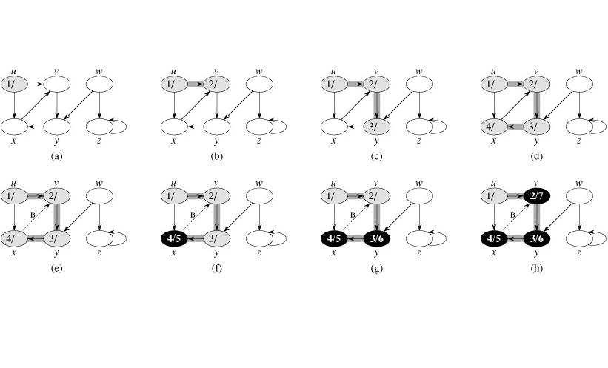
Depth-first search

Slide 34
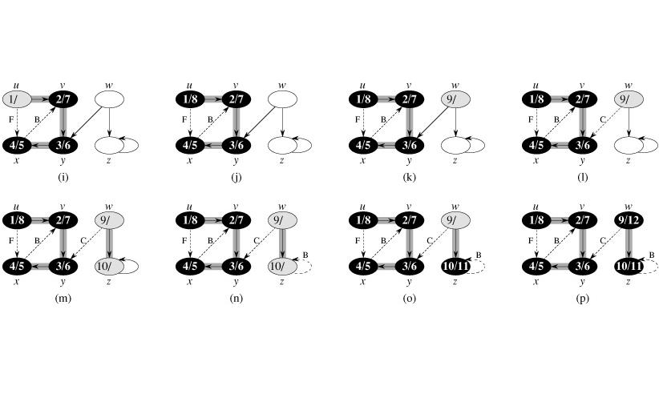
Depth-first search

Slide 35
Minimum Spanning Tree

Slide 36
Minimum Spanning Tree
Given a connected, undirected graph, a spanning tree of that graph is a sub graph which is a tree and connects all the vertices together.
A single graph can have many different spanning trees.
A minimum spanning tree or minimum weight spanning tree is then a spanning tree with weight less than or equal to the weight of every other spanning tree.

Slide 37
Growing a minimum spanning tree
Assume that we have a connected, undirected graph G = (V, E) with a weight function w : E → R, and we wish to find a minimum spanning tree for G.
At each step, we determine an edge (u, v) that can be added to A without violating this invariant, in the sense that A U {(u, v)} is also a subset of a minimum spanning tree.
We call such an edge a safe edge for A, since it can be safely added to A while maintaining the invariant.

Slide 38
Growing a minimum spanning tree
GENERIC-MST(G, w)
  1 A ← Ø
  2 while A does not form a spanning tree
  3 do find an edge (u, v) that is safe for A
  4 A ← A U {(u, v)}
  5 return A

Slide 39
Growing a minimum spanning tree
We use the loop invariant as follows:
  Initialization: After line 1, the set A trivially satisfies the loop invariant.
  Maintenance: The loop in lines 2-4 maintains the invariant by adding only safe edges.
  Termination: All edges added to A are in a minimum spanning tree, and so the set A is returned in line 5 must be a minimum spanning tree.

Slide 40
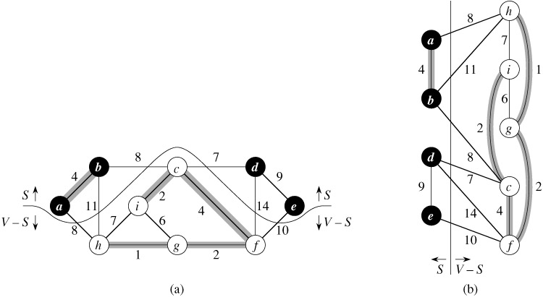

Slide 41
A cut (S, V - S) of an undirected graph G = (V, E) is a partition of V.
An edge (u, v) ∈ E crosses the cut (S, V - S) if one of its endpoints is in S and the other is in V - S.
A cut respects a set A of edges if no edge in A crosses the cut.
An edge is a light edge crossing a cut if its weight is the minimum of any edge crossing the cut.
There can be more than one light edge crossing a cut in the case of ties.
An edge is a light edge satisfying a given property if its weight is the minimum of any edge satisfying the property.

Slide 42
Kruskal's algorithm
MST-KRUSKAL(G, w)
1 A ← Ø
2 for each vertex v ∈ V[G]
3 do MAKE-SET(v)
4 sort the edges of E into non-decreasing order by weight w
5 for each edge (u, v) ∈ E, taken in non-decreasing order by weight
6 do if FIND-SET(u) ≠ FIND-SET(v)

Slide 43
Kruskal's algorithm
MST-KRUSKAL(G, w)
7 then A ← A ∪ {(u, v)}
8 UNION(u, v)
9 return A
We can state the running time of Kruskal's algorithm as O(E lg V).

Slide 44
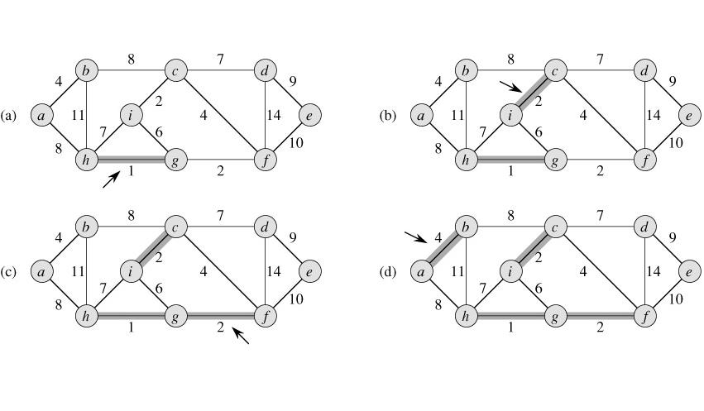
Kruskal's algorithm

Slide 45
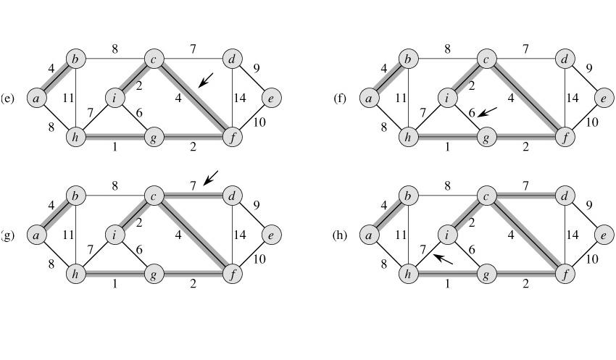
Kruskal's algorithm

Slide 46
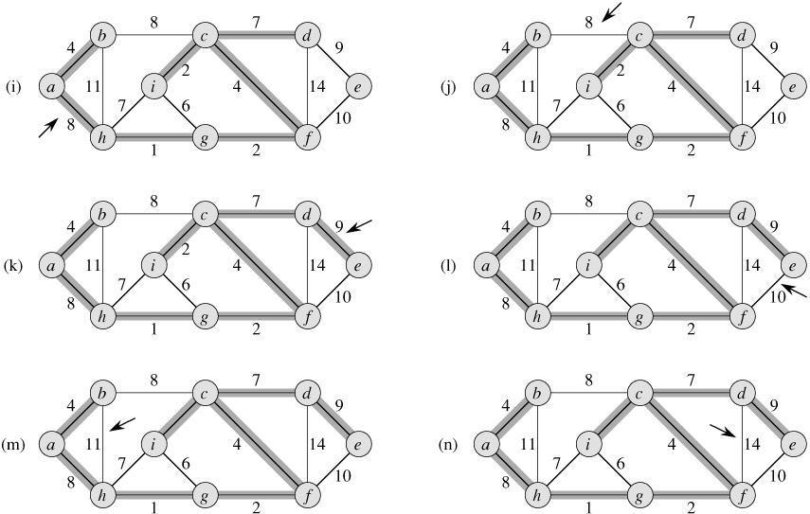
Kruskal's algorithm

Slide 47
Prim's algorithm
MST-PRIM(G, w, r)
1 for each u ∈ V [G]
2 do key[u] ← ∞
3 π[u] ← NIL
4 key[r] ← 0
5 Q ← V [G]
6 while Q ≠ Ø
7 do u ← EXTRACT-MIN(Q)
8 for each v ∈ Adj[u]
9 do if v ∈ Q and w(u, v) < key[v]

Slide 48
Prim's algorithm
MST-PRIM(G, w, r)
10 then π[v] ← u
11 key[v] ← w(u, v)
The total time for Prim's algorithm:
O(V lg V + E lg V) = O(E lg V)

Slide 49
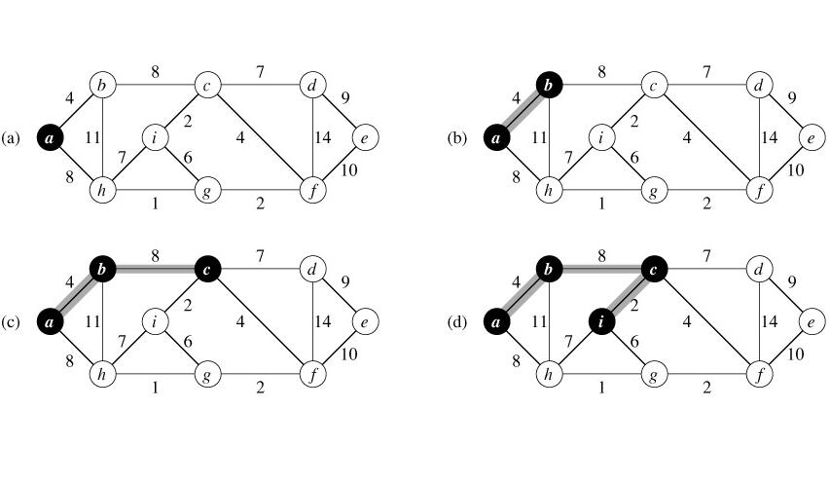
Prim's algorithm

Slide 50
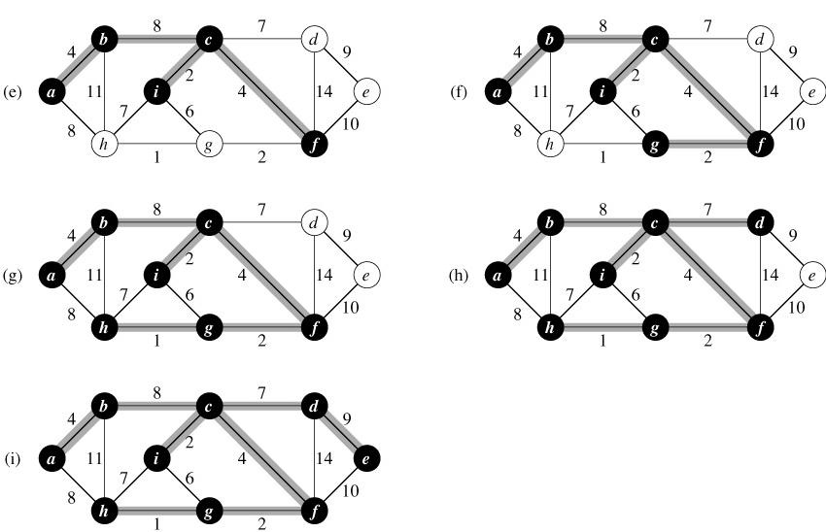
Prim's algorithm

Slide 51
Single-Source Shortest Paths

Slide 52

Single-Source Shortest Paths
We are given a weighted, directed graph G = (V, E), with weight function w : E → R mapping edges to real-valued-weights.
The weight of path p = {v₀, v₁, ..., v_{k} } is the sum of the weights of its constituent edges:
We define the shortest-path weight from u to v by
A shortest path from vertex u to vertex v is then defined as any path p with weight w(p) = δ(u, v).

Slide 53
Variants
Single-destination shortest-paths problem: Find a shortest path to a given destination vertex t from each vertex v.
Single-pair shortest-path problem: Find a shortest path from u to v for given vertices u and v. If we solve the single-source problem with source vertex u, we solve this problem also.
All-pairs shortest-paths problem: Find a shortest path from u to v for every pair of vertices u and v.

Slide 54
Negative-weight edges
There may be edges whose weights are negative.
If the graph G = (V, E) contains no negative-weight cycles reachable from the source s, then for all v ∈ V , the shortest-path weight δ(s, v) remains well defined, even if it has a negative value.
If there is a negative-weight cycle reachable from s, however, shortest-path weights are not well defined.
If there is a negative-weight cycle on some path from s to v, we define δ(s, v) = -∞.

Slide 55
Relaxation
d[v] (shortest-path estimate): an upper bound on the weight of a shortest path from source s to v.
INITIALIZE-SINGLE-SOURCE(G, s)
  1 for each vertex v ∈ V[G]
  2 do d[v] ← ∞
  3 π[v] ← NIL
  4 d[s] 0
After initialization, π[v] = NIL for all v ∈ V, d[s] = 0, and d[v] = ∞ for v ∈ V - {s}.

Slide 56
Relaxation
The process of relaxing an edge (u, v) consists of testing whether we can improve the shortest path to v found so far by going through u and, if so, updating d[v] and π[v].
A relaxation step may decrease the value of the shortest-path estimate d[v] and update v's predecessor field π[v].
RELAX(u, v, w)
  1 if d[v] > d[u] + w(u, v)
  2 then d[v] ← d[u] + w(u, v)
  3 π[v] ← u

Slide 57
The Bellman-Ford algorithm
It solves the problem in the general case in which edge weights may be negative.
Given a weighted, directed graph G = (V, E) with source s and weight function w : E → R, the algorithm returns a Boolean value indicating whether or not there is a negative-weight cycle that is reachable from the source.
If there is such a cycle, the algorithm indicates that no solution exists.
If there is no such cycle, the algorithm produces the shortest paths and their weights.

Slide 58
The Bellman-Ford algorithm
BELLMAN-FORD(G, w, s)
  1 INITIALIZE-SINGLE-SOURCE(G, s)
  2 for i ← 1 to |V[G]| - 1
  3 do for each edge (u, v) ∈ E[G]
  4 do RELAX(u, v, w)
  5 for each edge (u, v) ∈ E[G]
  6 do if d[v] > d[u] + w(u, v)
  7 then return FALSE
  8 return TRUE

Slide 59
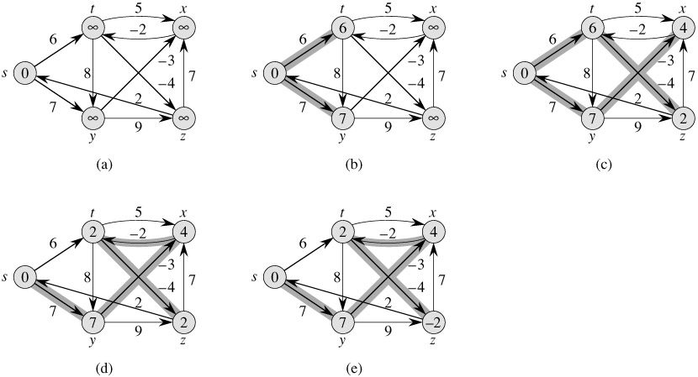
The Bellman-Ford algorithm
The Bellman-Ford algorithm runs in time O(V E)

Slide 60
Dijkstra's algorithm
Dijkstra's algorithm solves the problem on a weighted, directed graph G = (V, E) for the case in which all edge weights are nonnegative.
we assume that w(u, v) ≥ 0 for each edge (u, v) ∈ E.

Slide 61
Dijkstra's algorithm
DIJKSTRA(G, w, s)
  1 INITIALIZE-SINGLE-SOURCE(G, s)
  2 S ← Ø
  3 Q ← V[G]
  4 while Q ≠ Ø
  5 do u ← EXTRACT-MIN(Q)
  6 S ← S ∪{u}
  7 for each vertex v ∈ Adj[u]
  8 do RELAX(u, v, w)

Slide 62
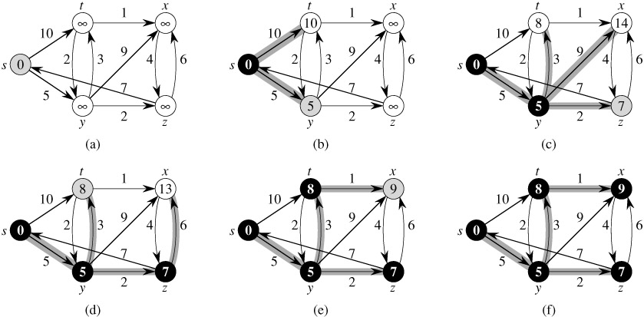
Dijkstra's algorithm

Slide 63
All-Pairs Shortest Paths

Slide 64

All-Pairs Shortest Paths
We assume that the vertices are numbered 1, 2, …., |V|, so that the input is an n X n matrix.
W representing the edge weights of an n-vertex directed graph G= (V, E).That is, W=(w_{ij}), where
We need to compute also a predecessor matrix П = (π_{ij} ), where π_{ij} is NIL if either i =j or there is no path from i to j, and otherwise π_{ij} is the predecessor of j on some shortest path from i.

Slide 65
All-Pairs Shortest Paths
PRINT-ALL-PAIRS-SHORTEST-PATH(Π, i, j)
1 if i = j
2 then print i
3 else if πij = NIL
4 then print "no path from" i "to" j "exists"
5 else PRINT-ALL-PAIRS-SHORTEST-PATH(Π, i, πij)
6 print j

Slide 66
The Floyd-Warshall algorithm
The structure of a shortest path :
An intermediate vertex of a simple path p = {v₁, v₂,..., v_{l}} is any vertex of p other than v₁ or v_{l}, that is, any vertex in the set {v₂, v₃,..., v_{l-1}}.
The relationship depends on whether or not k is an intermediate vertex of path p.
  If k is not an intermediate vertex of path p, then all intermediate vertices of path p are in the set {1, 2,..., k - 1}.
  If k is an intermediate vertex of path p, then we break p down into, i~>k~>j

Slide 67
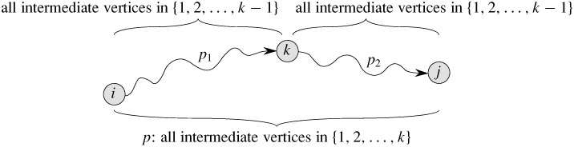
The structure of a shortest path
  p₁ is a shortest path from i to k with all intermediate vertices
  in the set {1, 2,..., k}. Because vertex k is not an
  intermediate vertex of path p₁, we see that p₁ is a shortest
  path from i to k with all intermediate vertices in the set {1,
  2,..., k - 1}.
  Similarly, p₂ is a shortest path from vertex k to vertex j with
  all intermediate vertices in the set {1, 2,..., k – 1}.

Slide 68

A recursive solution
Let be the weight of a shortest path from vertex i to vertex j for which all intermediate vertices are in the set {1, 2,..., k}.
A recursive definition is given by

Slide 69
Computing the shortest-path weights bottom up
FLOYD-WARSHALL(W)
1 n ← rows[W]
2 D(0) ← W
3 for k ← 1 to n
4 do for i ← 1 to n
5 do for j ← 1 to n
6 do
7 return D(n)

Slide 70
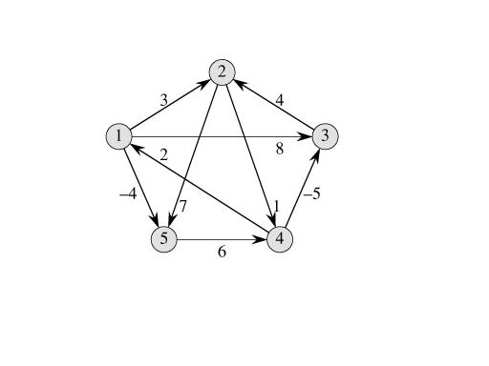
The Floyd-Warshall algorithm

Slide 71
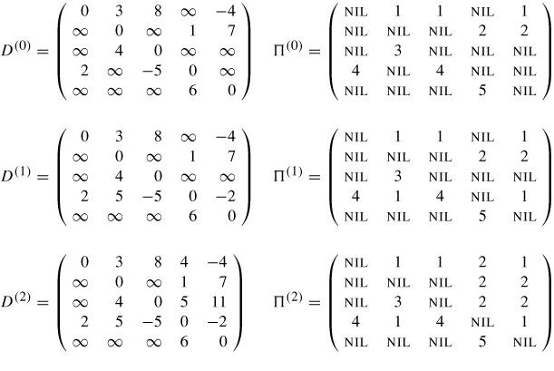
The Floyd-Warshall algorithm

Slide 72
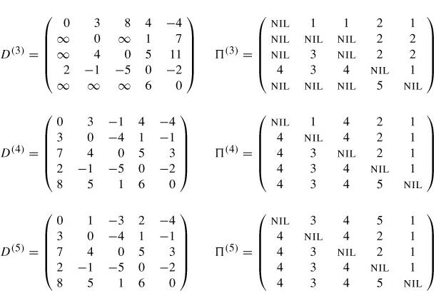
The Floyd-Warshall algorithm

Slide 73


Constructing a shortest path
We can give a recursive formulation of π_{ij} ^{(k)} .
When k = 0,
For k ≥ 1, if we take the path i~k~>j , where k ≠ j, then

