Slide 1
Speaking for the Trees
A New (Old) Approach to Languages and Syntax
Moss Prescott

Slide 2
Preamble
syntax is important
current approaches are limited…
  in what they can express
  or they’re hard to extend
try something new
Notes:
apologize to “syntax doesn’t matter” crowd
“syntax” == “concrete syntax”
1) I’ll talk about why
2) I’ll show you what I mean
3) a new combination of old ideas

Slide 3
This Talk
background and motivation
a new approach
demo

Slide 4
Approaches to Syntax
C, Haskell, …
y = x + 2
(let ((y (+ x 2)))
...)
Lisp
<xsl:variable
name="y"
select="$x + 2"/>
XSL-T, …
Notes:
free-form text
- whitespace sig. or not
- pro: looks sort of familiar
- con: a hard problem -> not usually flexible
s-expressions (Common Lisp)
- pro: parsing a non-issue
- con: you have to ask?
markup
- *** they gave up at $x + 2
- pro: similar to s-expr.
- con: even worse readability!

Slide 5
What's hard for text?
1 + 2 * 3
7 or 9?
foo *ptr;
a * y;
Declaration or expression?
"She said \"hello.\""
"She said ""hello."""
/She said "hello."/
She said "hello."
Notes:
Problems with the parsing approach:
1) depends on your language
You have to know the rules when you’re writing.
2) (In C)
we can guess pretty well; compiler has to know about previous defs
A problem for compiler writers, mostly.
3)

Slide 6
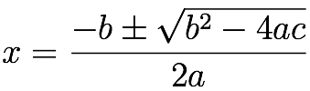
What’s not possible?
x1 = (-b + sqrt(b^2 -
4*a*c))
/(2*a)
new Color(255, 127, 0)
NORTH_NORTH_WEST
degrees(360-22.5)
Notes:
TODO: build
1) notice I dropped the +/-, because what would you do with that?
2)
3) ideas:
road signs, washing directions
compass vs. “NNE”
thermometer vs. “32 < temp < 100”

Slide 7
If not text, what?
obvious alternative: abstract syntax tree
syntax extension becomes easy
how will editing work?
Notes:
ASCII text a good idea, in 1957
inside the compiler, it’s all trees, all the time
easier to un-parse than to parse

Slide 8
Basic Idea
source is an AST
reduce new nodes to target language
presentation is a target language
Notes:
The basic idea

Slide 9


Related Work
structure editors
language workbenches

Slide 10
What’s Different
use a kernel meta-language
everything’s a tree
reductions

Slide 11

Lorax
“I am the Lorax.
I speak for the trees.”
- Dr. Suess
Notes:
_Don’t_ get into it.

Slide 12
Node
an immutable record with three parts
label: globally unique
type: a name, unrestricted
value: primitive, sequence, map, or reference
n0: plus { left ↦ 1, right ↦ 2 }

Slide 13
Sequence Node
contains children indexed from 0 to n – 1
represents any kind of ordered collection
Notes:
sequence of statements

Slide 14
Map Node
contains named children
children not ordered
represents any node with defined structure
Notes:
if, then, else

Slide 15
Reference Node
refers to another node
otherwise opaque
uses label internally
Notes:
anything in a program that refers to something defined elsewhere
variables, declarations

Slide 16
Well-formed Trees
The nodes of a well-formed tree satisfy certain constraints:
labels are unique
each node appears only once
referenced nodes appear in tree
Notes:
2) i.e. the tree is in fact tree-shaped
3) sometimes violated - like a free variable
A persistent data structure.
Modification by building new trees.
System mostly enforces well-formedness.

Slide 17
Specifications
A node is valid with respect to a certain specification iff every node satisfies a set of constraints.
...on types, values, and their arrangement
local vs. non-local constraints
Notes:
Borrowing terminology of XML/DTD
Trees/programs may be invalid.
System reports violations as errors.
local constraints easier to define and check

Slide 18
Reductions
from source to target language
top-down, structural recursion
constructs new tree from existing nodes

Slide 19
[Comparison]
with XML
with s-expressions

Slide 20

Languages
“…Truffula Trees are
what everyone needs.”
- Dr. Suess
Notes:
so your program is a tree, now what?

Slide 21
Defining a Language
specification
source ⟶ valid?
abstract syntax
reduction
source ⟶ kernel
semantics
reduction
source ⟶ view
concrete syntax
Notes:
2) _dynamic_ semantics
3) view or “presentation”

Slide 22

grammar
language for defining languages
declaration of expected children
node types: abstract and sub-types
Notes:
1) a language in the same system
2) a local constraint

Slide 23
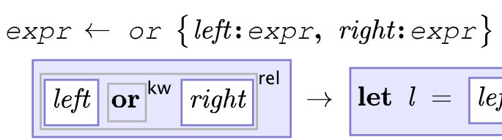
“Display” Reduction
defines concrete syntax for a type of node
a fragment of code returning a node
typically quasi-quoted
Notes:
blue b/g is “quote”
white b/g is “unquote”
border shows “inner” level

Slide 24
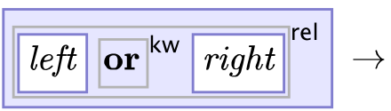
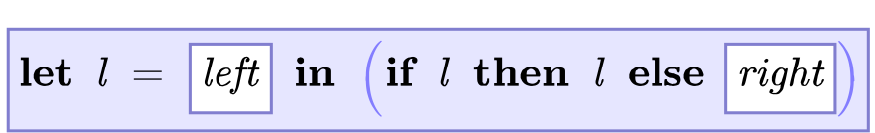
“Expand” Reduction
defines semantics for a type of node
exactly like a “display” reduction, except…
result is a node in target language
Notes:
short-circuiting ‘or’ returning first ‘true’ value, as in Python or JavaScript

Slide 25
Kernel Language
what “expand” reductions produce
the language you are extending
any language could be a kernel language

Slide 26
Host Kernel Language
Is...
the language reductions are written in
the most obvious target language
a test case for the system

Slide 27
Host Kernel Language
Designed to be...
functional
meta
minimal
easy to implement
Notes:
1) makes working with trees natural
2) nodes/programs are a first-class data type
3&4) go hand-in hand

Slide 28
Clojure
a relatively new language on the JVM
a Lisp
compiled at runtime to Java bytecode
easy access to Java APIs
Notes:
jumping ahead...
Other interesting things about Clojure:
- concurrency
- everything is immutable by default
1) (and CLR, to some extent)
2) functional, not statically typed
3) some overhead but no “interpreter” penalty; can infer some types (to use unboxed primitives)
4) needed for editor, etc.

Slide 29

Lorax Kernel Language
a subset of the “special forms” of Clojure
LC + primitives + efficiency
meta-compile ⟶ s-expressions
eval ⟶ Clojure/Java value
Notes:
2) e.g. let and recur
3) a fairly trivial transformation, except for quotations

Slide 30
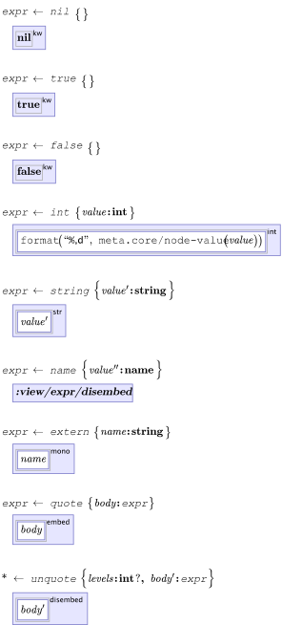
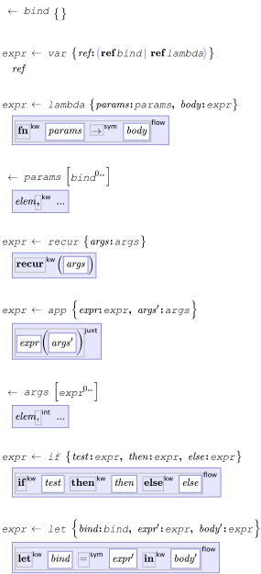
Notes:
primitives:
nil, booleans, int, string, name
lambda and app
let and if
extern
quote and unquote

Slide 31
Lorax Core Language
built on (reduces to) the kernel language
implemented as several grammars
subset of the Clojure Core API
plus syntax for working with nodes
Notes:
in principle, a general-purpose language
only partially implemented
“in the large” stuff isn’t doable at the moment
does more with syntax and less with definitions

Slide 32
Presentation Languages
what “display” reductions produce
meant to be generic across source languages
different languages for different needs
Notes:
2) grammar and kernel language use same presentation language
so could any “expression”-oriented language
3) that is, different _kinds_ of source languages

Slide 33
Lorax Pres. Lang. (LPL)
presentation language for typical languages
common syntactical elements
plus additional signs and symbols
as good as publishable pseudocode or
a typical algebra textbook
Notes:
1) that is, languages that are composed of expressions (and statements, with caveats)
handles the common needs

Slide 34
LPL Concepts
inspired by TEX’s math mode
each node occupies a rectangular region
parents surround children
atoms, sequences, groups, and few more

Slide 35
Atoms
type | examples
keyword | if then else
var | x g fib
num | 1 2.0 3,000
string | abc Hello,␣world
symbol | ⟶ ∈ ∑
Notes:
about 8 or 10 defined in all
different font, weight, etc.
string: note special treatment of whitespace
symbol: currently using TeX fonts, but UNICODE probably a better option

Slide 36

Sequences
arrange child nodes:
  in a horizontal line
  aligned to a common baseline
  separated by spaces (4 widths)

Slide 37
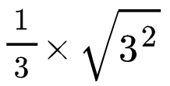

Others
√, fractions, superscripts
( ) [ ] { } ⌊ ⌋ ⌈ ⌉ 〈 〉 |

Slide 38
expr Embedding
visual cue of meta-levels
background color + border
up to 6 or so levels
[[example]]

Slide 39
Editor
UI for viewing/editing Lorax programs
implemented in Clojure, runs on JVM
uses “display” reductions from grammars
can also evaluate expressions
basic editing, but not yet an integrated tool

Slide 40

Demo
Notes:
1) (1+2)*3
2) (1 + 2^2)^2
3) rationals

Slide 41
Rationals
Functional Pearl: Enumerating the Rationals (Jeremy Gibbons, et al., JFP, 2006:16)
write a generator for the infinite series of all positive rational numbers

Slide 42
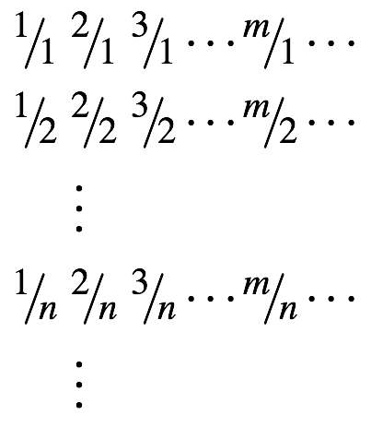
Matrix Traversal

Slide 43
Matrix Traversal

Slide 44
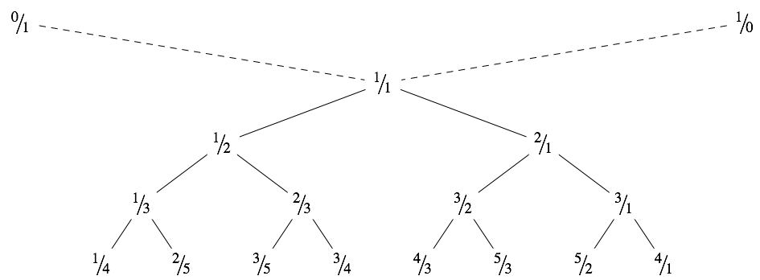



Stern-Brocot Tree

Slide 45

A Formula
start with x = 1
generates the ratios in the tree, row-by-row
  1, ½, 2, ⅓, …
int. part, fraction part, add, negate, reciprocal
not cheap: ⌊x⌋ involves division

Slide 46
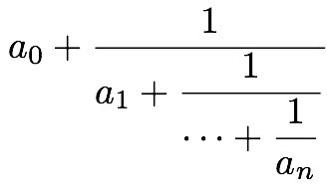
Continued Fraction
a unique repr. for each rational (a regular c.f.)
5 operations with no division, multiplication
O(1) additions/subtractions
Notes:
a_i positive, except a_0
a_n > 1 (except 1)

Slide 47

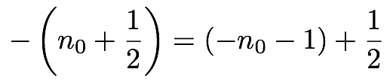
Cont. Fractions: Haskell
need a new kind of runtime value
use a list of integers (the coefficients)
write operations as functions on lists
ex.:

Slide 48
Cont. Fractions: Lorax
need a new kind of runtime value
can do that with the “expand” reduction
then implement each operation as syntax

Slide 49
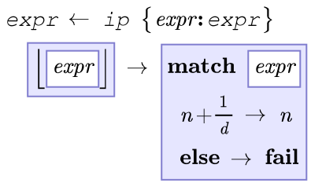
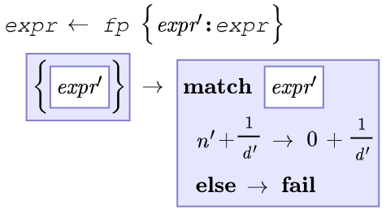
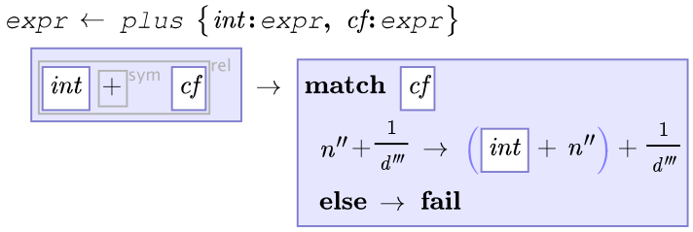
Operations

Slide 50
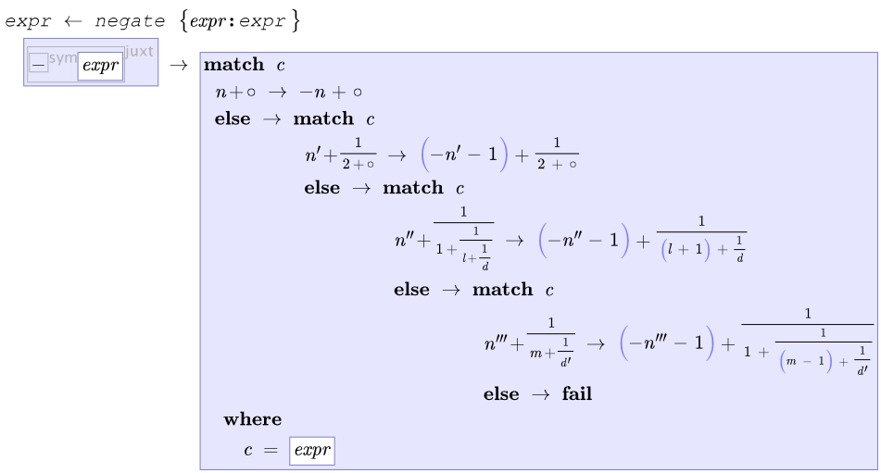
Operations

Slide 51
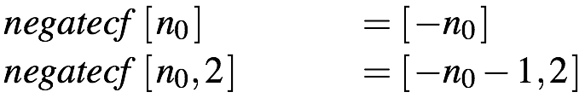
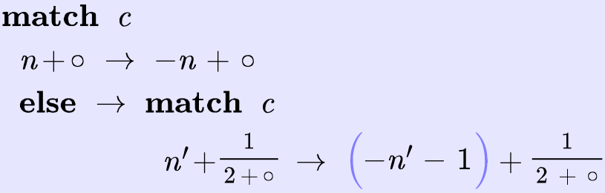
Haskell vs. Lorax

Slide 52
Conclusion
editor supports extended syntax equally
lower barrier for language creation
syntax freed from limitations of text

Slide 53
Questions?

